Slide 1

2026 ENGINEERING INSTITUTION OF ZAMBIA SYMPOSIUM
TECHNICAL PREREQUISITES FOR
HIGH-PENETRATION SOLAR PV
INTEGRATION IN ZAMBIA
Lessons from Germany and South Africa on Power Quality and Grid Stability
PRESENTER: Eng. Nyakamenji Kaponda FEIZ, R.Eng | Director, Slon Champion Initiatives
DATE: Friday 17th April 2026 | Avani Victoria Falls Resort, Livingstone, Zambia
EngRB No. SMENG220502130021634 | +260 976 206 536 | nyakamenjikaponda@gmail.com

Slide 2
COVERAGE: This paper answers 11 questions
1
Why does this paper exist?
7
The current power quality reports from ERB
2
What is hydro-solar hybrid system?
8
What should the grid code contain to make hydro-solar system possible?
3
Why is the Hydro-Solar Hybrid not working yet?
9
Why it can't be a loss to have BESS mandatory?
4
What is Zambia's real-world solar performance data showing?
10
Why the FDT?
5
What does a plant with BESS do that one without cannot?
11
Conclusion
6
What went wrong in Germany and South Africa and is Zambia heading the same way?

Slide 3
PURPOSE OF THIS PAPER: Why This Paper Exists
1
THE OPPORTUNITY
Zambia has a natural advantage: hydro and solar can work together. 80% of Zambia's electricity comes from hydropower. Every MWh of reliable daytime solar generation conserves 1,683 m³ of reservoir water, water that stays in the dam for evening generation. Solar does not compete with hydro. It completes it.
2
THE GAP
Solar only delivers that benefit if it stays connected. Right now, it does not. Grid-following inverters, the technology across Zambia's entire 307 MW solar fleet, stop generating whenever ZESCO's grid quality deteriorates. No battery. No independent reference. No ride-through. The result: stranded energy, unrealised water conservation, and cascade risk as the fleet doubles.
3
THE CONTRIBUTION
This paper proposes eight technical prerequisites that close that gap. Four months of Zambian field data. A live BESS vs no-BESS comparison. Germany and South Africa case studies. ERB grid compliance data. Together: the engineering standards that must be codified before the Hydro-Solar Hybrid moves from theory to operation.

Slide 4
THE FRAMEWORK: The Hydro-Solar Hybrid System:
How It Works and Why BESS Is Not Optional
1
2
3
4
Solar generates
during the day
ZESCO reduces
hydro dispatch
Water stays in
the reservoir
Hydro generates
reliably at night
Daytime solar covers demand that would otherwise be met by releasing water through turbines.
▶
Solar covers demand so ZESCO throttles back turbine output. Less water leaves the reservoir.
▶
Conserved water, 1,683 m³ per MWh of solar, becomes the evening peak generation reserve.
▶
Fuller reservoir. Hydro dispatches into the evening peak. Load-shedding is reduced.
CRITICAL CONDITION
Step 2 only happens if ZESCO trusts solar to stay on. A grid-following inverter without BESS trips on every voltage dip, so ZESCO must keep hydro running at full capacity as backup. BESS makes each plant grid-forming and trustworthy. Without it, Steps 2, 3 and 4 never happen. The water conservation benefit of the entire 307 MW solar fleet depends on this one technical condition.

Slide 5
THE BARRIERS: Why the Hydro-Solar Hybrid system Is Not Working Yet
BARRIER 1
Zambia's combined generation capacity barely meets demand and the country is already importing.
Kariba, Kafue and Itezhi-Tezhi are all operating below capacity due to drought. No generation headroom, ZESCO cannot reduce hydro unless solar reliably replaces every megawatt. Every unnecessary turbine rotation costs water Zambia cannot afford to lose.
BARRIER 2
All 307 MW of Zambia's existing solar is grid-tied and grid-following, and the grid is not stable.
All 307 MW uses grid-following inverters, entirely dependent on ZESCO's voltage signal. 40% of ZESCO monitored sites failed the voltage dip standard in 2023. Field data in this paper: 16 zero-generation days over 4 months at a 300 kW Lusaka plant. All caused by the grid. None by weather.

Slide 6
RESULTS: The Cost of Not Having BESS: Water and Money
1,683 m³
2,188 m³
336M m³
per MWh of solar
(cascade-weighted avg.)
conserved per day
(NHPP2 December rate)
per 5-month season
(307 MW fleet)
KARIBA RESERVOIR: 14-DAY SNAPSHOT (Source: Zambezi River Authority)
METRIC
16 MAR 2026
30 MAR 2026
14-DAY CHANGE
2019 GOOD YEAR
Lake Level (masl)
478.01 m ↑
479.10 m ↑
+ 1.09 m
480.98 m
Usable Storage Volume
11.32 BCM ↑
16.38 BCM ↑
+ 5.06 BCM (+44.7%)
25.38 BCM
Usable Storage (Power Gen)
17.47% ↑
25.28% ↑
+ 7.81 pp
39.17%

Slide 7
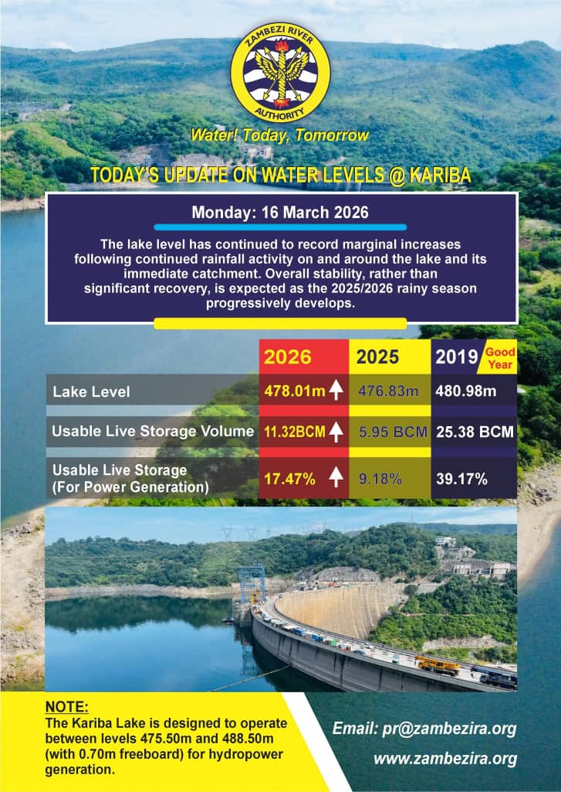

THE CONTEXT: Kariba Reservoir Status: The Thesis Confirmed
KEY FINDING
+5.06 BCM in 14 days while turbines kept generating.
Kariba surface area ~5,000 km². A 1.09 m rise = ~5.45 BCM net inflow. Turbines draw 1,200–1,500 m³/s. Peak Zambezi inflow: 5,000–7,000 m³/s. The reservoir fills on the 3–4x surplus.
16 March 2026: 478.01m | 17.47% usable storage
30 March 2026: 479.10m | 25.28% usable storage
THE THESIS CONFIRMED
The 2019–2024 Kariba crisis was fundamentally about annual drawdown management, not insufficient rainfall. A reliable solar fleet displacing daytime hydro dispatch reduces turbine draw, reduces drawdown, and accelerates reservoir recovery. At 25.28% usable storage on 30 March 2026, the gap to the 2019 good-year reference of 39.17% is a dispatch management opportunity
that BESS-backed solar closes faster.
This is a dispatch management problem - not a rainfall problem.

Slide 8
METHODOLOGY: Five Research Streams
WHY: Four months of fault logs from two Sungrow SG150CX grid-following inverters at a 300 kW Lusaka installation. 16 zero-generation days, none caused by weather. December: full generation every day.
1
iSolarCloud data: NHPP2, Lusaka
(Nov 2025–Feb 2026)
WHY: BESS plant 8 km from NHPP2 on the same ZESCO network. During the same 7-day January gap that shut down NHPP2, the BESS plant generated every day. Same grid. Completely different outcome.
2
Deye Cloud data: 50 kW BESS plant,
Eureka off Kafue Road
WHY: Applied to Kariba, Kafue, Itezhi-Tezhi and Victoria Falls using ERB plant data. Result: 1,683 m³ of reservoir water conserved per MWh of reliable solar generation.
3
Hydraulic power formula:
Zambia's full hydro cascade
WHY: Germany: near-continental blackout from a 50.2 Hz hard-trip standard with no FRT. South Africa: R46.2M in deemed energy payments to 40 IPPs in H1 2024 alone. Both directly applicable to Zambia.
4
International case studies,
Germany and South Africa
WHY: 40% of monitored sites failed the voltage dip standard. Only 39 national frequency datasets exist. No LVRT, FRT or BESS requirement exists in any published Zambian grid code.
5
ERB grid code gap analysis,
ZESCO 2023 compliance data

Slide 9
RESULTS: Field Evidence: iSolarCloud / Sungrow SG150CX - NHPP2, Lusaka
⚠ NO BESS — GRID-FOLLOWING | 300 kW | 2 × Sungrow SG150CX | NHPP2, Lusaka | Nov 2025 – Feb 2026
342
16
0
ZMW 186M
grid-triggered events
in one month (Feb 2026)
zero-generation days
over 4 months
weather-caused
zero-gen days
stranded per year
(scaled to 307 MW fleet)
23,000 kWh stranded at NHPP2 over 4 months | Scaled to 307 MW fleet: ZMW 186 million stranded per year
The sun shone. The panels were capable. The inverter was functional. The grid was not. Every zero-generation day represents kilowatt-hours that were produced at the panel level and discarded, because the inverter had no stable reference to generate against. This is not equipment failure. This is the direct financial cost of operating a grid-following fleet on an unstable grid without BESS.

Slide 10
RESULTS: Fault Attribution: Proving the Cause Was the Grid, Not the Hardware
December 2025: CONTROL MONTH. No grid anomalies. Full generation every single day. Hardware performed perfectly.
All 16 zero-generation days occurred in months with documented grid instability. None were weather-caused.
February 2026: 10 dual-confirmed grid-side faults but no zero-gen days, most stable month of the study.
The inverter hardware performed perfectly throughout. The grid was the only failing variable in every recorded event.
Platform: iSolarCloud, Sungrow NHPP2, Lusaka. Data: Nov 2025–Feb 2026.

Slide 11
RESULTS: Deye Cloud: Grid-Forming Inverter With BESS - Eureka, Kafue Road
SYSTEM SPECS
Plant:
Eureka off Kafue Road, Lusaka
Capacity:
50 kW (Deye hybrid inverter)
Battery:
On-site BESS — grid-forming mode
Distance:
~8 km from NHPP2
Network:
Same ZESCO regional area
Platform:
Deye Cloud
965.4 kWh generated | 0 days of zero-generation | Minimum 95.6 kWh (weather, not grid)
BESS does not improve the grid. It makes the inverter independent of the grid. The plant generates using its own voltage reference, the battery, regardless of ZESCO's signal quality. Same grid. Same week. Completely different outcome. The only variable between the two plants is the battery.

Slide 12
Same Grid. Same Week. Two Completely Different Outcomes.
6–12 January 2026 | Same ZESCO regional distribution area | ~8 km apart
NHPP2 : NO BESS
EUREKA: WITH BESS
0
965.4
kWh total over 7 days
kWh every day for 7 straight days
Grid-forming inverter. Battery provides independent reference. Generates regardless of ZESCO signal. Every kWh metered and billed.
Grid-following inverter. No independent reference. Grid unstable. Inverter trips. Panels produce. Power is discarded.
0 days of zero-generation
Revenue: USD 0.00
Min: 95.6 kWh (weather, not grid)

Slide 13
INTERNATIONAL LESSONS: As Zambia's Solar Fleet Grows, Learning From Others Is Essential
Both countries deployed solar rapidly without the right standards. Both paid a heavy price. These are not hypothetical risks for Zambia, they are the exact conditions Zambia is heading into.
GERMANY: Frequency Cascade: The 50.2 Hz Near-Miss
SOUTH AFRICA: Two Issues, Both Applicable to Zambia
THE MISTAKE
ISSUE 1: DEEMED ENERGY
Germany's fleet grew rapidly with no Frequency Ride Through standard. Every inverter had a hard-trip at 50.2 Hz. A single routine frequency event could have tripped the ENTIRE fleet simultaneously, threatening a continental blackout across all synchronously-connected European grids.
R46.2M in deemed energy payments to 40 IPPs in H1 2024 alone. R320 billion transmission reinforcement bill. Grid connections were signed before feeder capacity was checked.
ISSUE 2: VOLTAGE BACKFLOW
Solar backflow on low-load feeders pushed voltage above the ±10% statutory band. Protection relays tripped the most productive inverters first. Deemed energy obligations still applied.
THE COST
Mandatory retrofit across 315,000 installations. Hundreds of millions of euros. A standard that should have been set before the first plant connected.
Zambia has no deemed energy clause in any PPA and no feeder hosting capacity survey before connection.

Slide 14
RESULTS: ZESCO Power Quality: Four Critical Gaps in the Current Regulatory Framework
GAP 1: VOLTAGE DIP NON-COMPLIANCE
1
40% of ZESCO monitored sites failed the voltage dip standard in 2023. NHPP2 field data: 16 zero-generation days over
4 months, all grid-caused. December control month: full generation every day. The inverter was never the variable.
2
GAP 2: NO LVRT OR FRT STANDARDS IN ANY PUBLISHED GRID CODE
307 MW fleet-wide trip risk. No Low Voltage Ride Through or Frequency Ride Through standard exists. A single frequency event could trip the entire grid-tied fleet simultaneously, Germany's 50.2 Hz cascade scenario, at higher risk in Zambia's isolated grid.
3
GAP 3: NO PUBLISHED ERB GRID CODE
BESS sizing, LVRT threshold, FRT range, feeder survey, and engineer sign-off are absent or negotiated per PPA. There is no floor and no enforcement. Each new IPP connection resets the baseline to zero. ERB cannot adjudicate without a published standard.
4
GAP 4: NO DEEMED ENERGY CLAUSE IN ANY ZAMBIAN PPA
When ZESCO's grid trips an IPP's inverter, the IPP loses revenue with zero legal recourse. South Africa paid R46.2M in H1 2024 because their framework requires it. Zambia has no such protection. Every grid-caused trip is a silent transfer of revenue from the IPP to the grid, unrecoverable.

Slide 15
GRID CODE COMPARISON: Proposed Zambia Parameters vs Germany and South Africa
Parameter
Germany (pre-retrofit)
South Africa (NERSA)
Proposed Zambia
LVRT
Not required (pre-2012)
0.15 pu / 150 ms
0.15 pu / 625 ms
FRT
50.2 Hz hard-trip (no FRT)
47.5–52.0 Hz proportional
47.5–51.5 Hz proportional — no hard-trip
Mandatory BESS
Not required
Project-specific
Min. 2 MWh/MW for all grid-tied plants
Published Grid Code
Published (BNetzA)
Published (NERSA GCR)
Not published — ERB must publish
PQ Survey (Class A)
Required
Required (REIPPPP)
Not required — no published standard
Feeder/Hosting Survey
Not required (pre-2012)
Required (REIPPPP v5+)
Not required — no published standard
EIZ Engineer Sign-off
Licensed engineer required
Registered engineer required
Not required — no published standard
Deemed Energy Clause
Yes
Yes — R46.2M paid H1 2024
No — zero protection in any Zambian PPA

Slide 16
RECOMMENDATIONS: Eight Technical Prerequisites for High-Penetration Solar PV in Zambia
Prerequisites 1 and 8 are addressed in dedicated slides. The six prerequisites between them are explained on the following slide.
1
2
3
4
Mandatory BESS
LVRT
FRT
Published ERB Grid Code
Min 2 MWh/MW. Stranded energy capture reduces payback from 16–18 to 14–16 years.
Low Voltage Ride Through: 0.15 pu for 625 ms. Ramp to full output within 10 seconds.
Frequency Ride Through: 47.5–51.5 Hz. Proportional active power reduction, no hard-trip.
Legally enforceable. Removes all parameters from individual PPA negotiation.
5
6
7
8
Power Quality Survey
Feeder Survey
EIZ Engineer Sign-off
Feeder Digital Twins
Class-A PCC measurement before any grid connection. Establishes baseline on record.
Hosting capacity study before PPA execution. Prevents South Africa Scenario 1.
Registered Zambian engineer signs every pre-connection survey and grid licence.
Real-time monitoring + predictive analytics. Shifts ZESCO from reactive to predictive.

Slide 17
PREREQUISITE 1
Mandatory BESS: Minimum 2 MWh/MW for All Grid-Tied Plants
What BESS does
The stranded energy argument
The payback argument
Converts a grid-following inverter into a grid-forming inverter. The inverter uses the battery as its voltage reference, not the grid. ZESCO's signal quality becomes irrelevant.
Solar keeps generating through voltage dips, frequency events, and brief outages. Every kWh the panels produce is captured, stored if needed, and metered.
At NHPP2:
Without stranded energy capture:
16 - 18 years
23,000 kWh stranded over 4 months
~69,000 kWh/year currently unmetered
With stranded energy captured:
14–16 years
USD 4,830/year in revenue that already exists, currently being thrown away
Both within a 25-year PPA horizon.
Revenue flows from day one.
BESS is not a cost.
It is a revenue recovery instrument.
Payback clock started the day the plant connected without BESS. Every day of delay is irrecoverable loss.

Slide 18
PREREQUISITE 8
Feeder Digital Twins: From Reactive Fault Response to Predictive Grid Management
Layer 1
Class A Online Data Loggers
Layer 2
Digital Twin Engines
Layer 3
Fault Signature Library
IEC 61000-4-30 Class A certified. One per power source. GSM/WiFi streaming. Legally defensible before ERB and ZESCO.
One twin per source, OpenDSS and Python. Each carries a unique source ID. Models voltage, power flow, hosting capacity, impedance, and protection settings in real time.
Every threshold breach stores the 60 seconds preceding the event, the fault's fingerprint. Library grows with every event. After 90 days: reliable prediction baseline established.
▶
▶
Layer 4
Predictive Engine
Layer 5
Three-Tier Alert Dispatch
Layer 6
Monitors live data against stored fault signatures. At 70% match: alert fires before the fault happens, identifying which source is responsible. Horizon: 10 seconds to 15 minutes.
Tier 1: Automated, inverter settings adjusted in seconds. Tier 2: SMS to technician with exact engineering instruction. Tier 3: Escalation to senior engineer and funder dashboard.
All twins visible on one dashboard from any device. Fault log with source attribution. ERB submission view: exportable certified data reports for regulatory compliance.
▶
▶
Architecture principle: one Digital Twin per source of power. The number of twins equals the number of sources on the feeder. Each twin carries a unique source ID — enabling precise fault attribution.

Slide 19
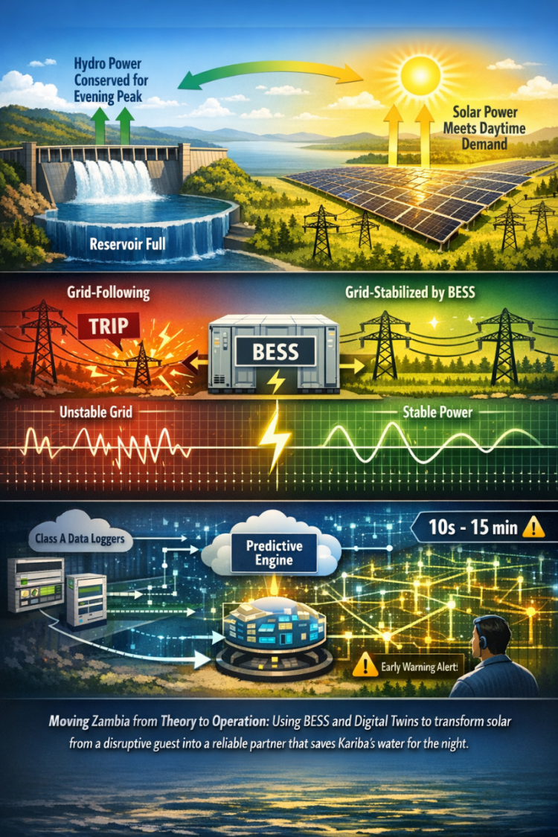
THANK YOU
FOR YOUR
ATTENTION.

