Slide 1
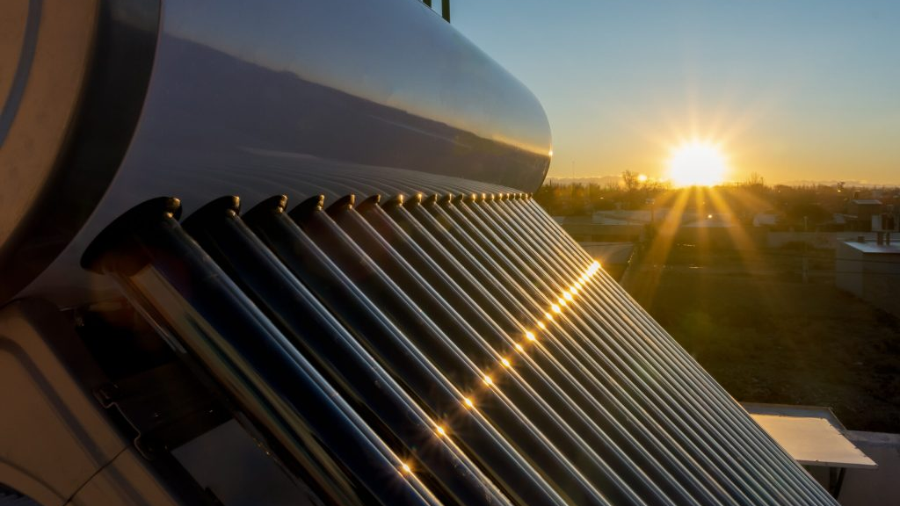

2025 ENGINEERING INSTITUTION OF ZAMBIA SYMPOSIUM
OPTIMISING COLLECTOR AZIMUTH AND TILT FOR EVENING HOT WATER DEMAND IN HYBRID SOLAR GEYSERS
PRESENTER : Amos Banda
DATE : Friday 17th April 2026
Avani Victoria Falls Resort, Livingstone, Zambia

Slide 2
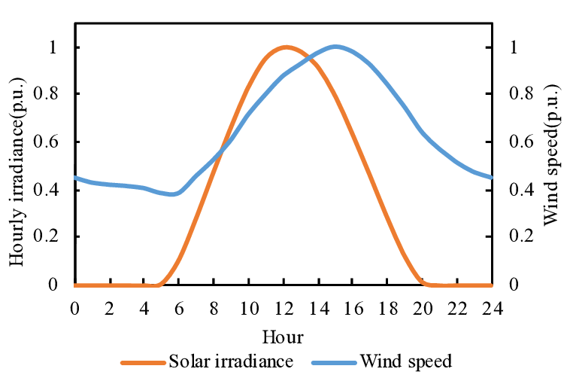
The Problem Statement
  The "North" Orthodoxy: Standard practice dictates a 0° Azimuth (True North) to maximize annual yield.
  The Mismatch: Maximum production occurs at solar noon, while peak demand occurs in the morning and evening.
  The Consequence: Reliance on 4,000W electric auxiliary heaters during peak grid hours (25% - 40% of household consumption).
Typical Distribution Curves of Solar Radiation and Wind Speed through out a Day (Source: X. Liu & Z. Bie)

Slide 3
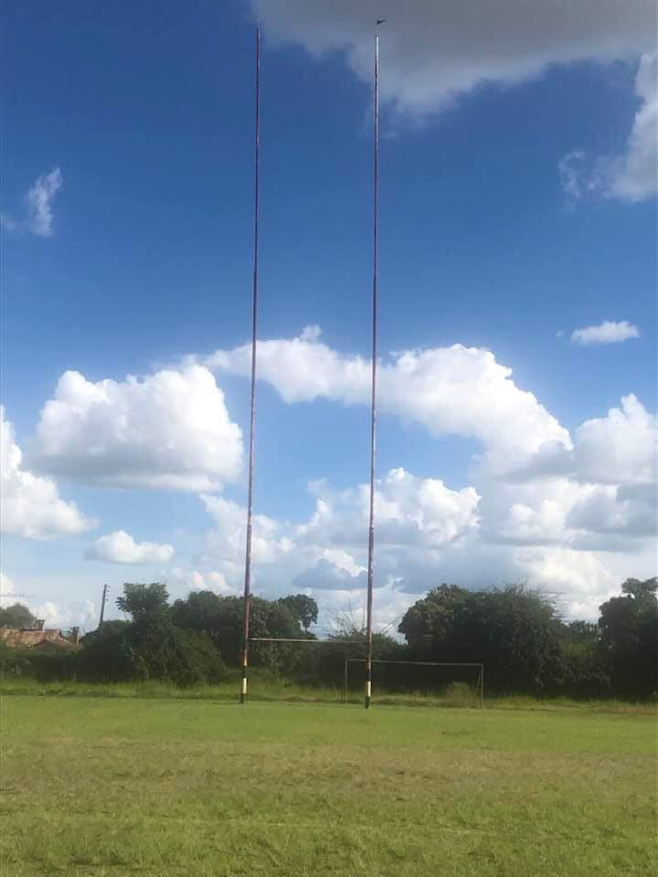
Research Objective
Primary Goal: Identify the optimal North-West collector orientation that maximizes thermal energy retention.
Target: Minimize reliance on auxiliary electric heating during late-afternoon and evening periods.

Slide 4

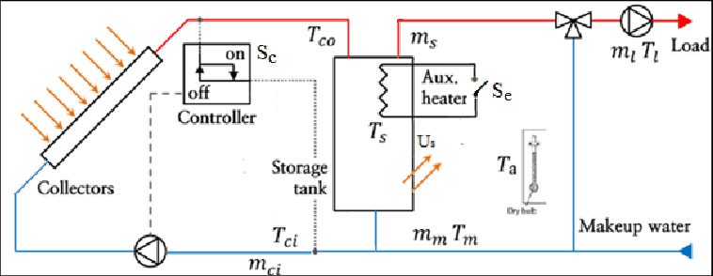
Methodology – The Model
Single-Node Thermal Model: Used to simplify transient energy balance while maintaining accuracy.
Energy Balance Equation:
Schematic Diagram of a Hybrid Solar Water Heater
Data Source: Meteosat Prime Meridian Africa (4km resolution) for Global Horizontal Irradiance (GHI) and Direct Normal Irradiance (DNI).

Slide 5
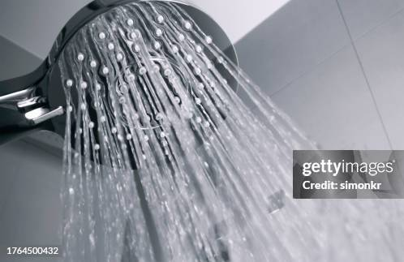
Hot Water Draw Profile
Consumption Event: One large draw representing four adult showers.
Total Draw Volume (Vdraw): 200 Liters (four showers at 50 Liters each of hot water).
Time of Draw Variation: To assess the impact of demand-side management and load-shifting strategies, the simulation will be executed across three distinct time slots for the 200 Litre draw i.e morning, afternoon and evening.

Slide 6
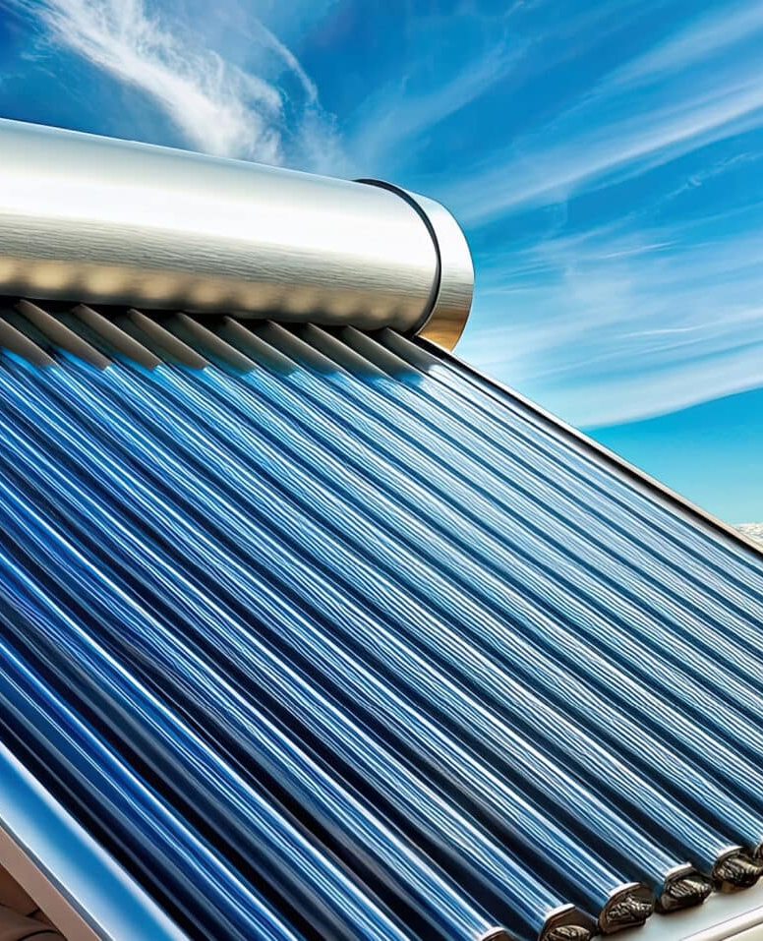
System Specifications
Collector Type: Evacuated Tube (High-efficiency).
Collector Area: 3.0 m² (Sized for a 200L system).
Auxiliary Power: 4,000 W (Standard element rating).

Slide 7
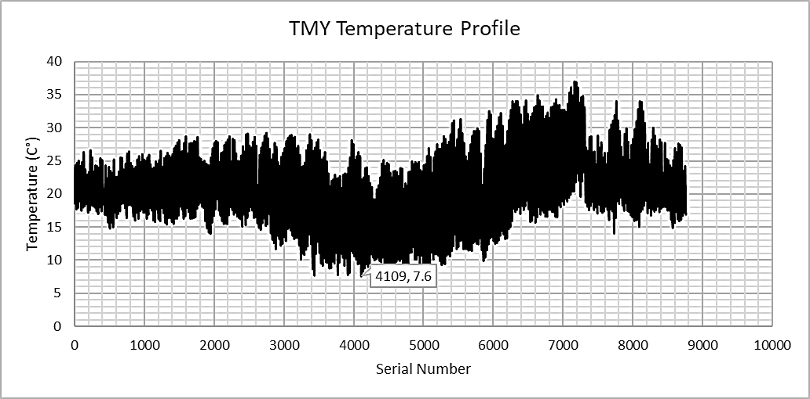
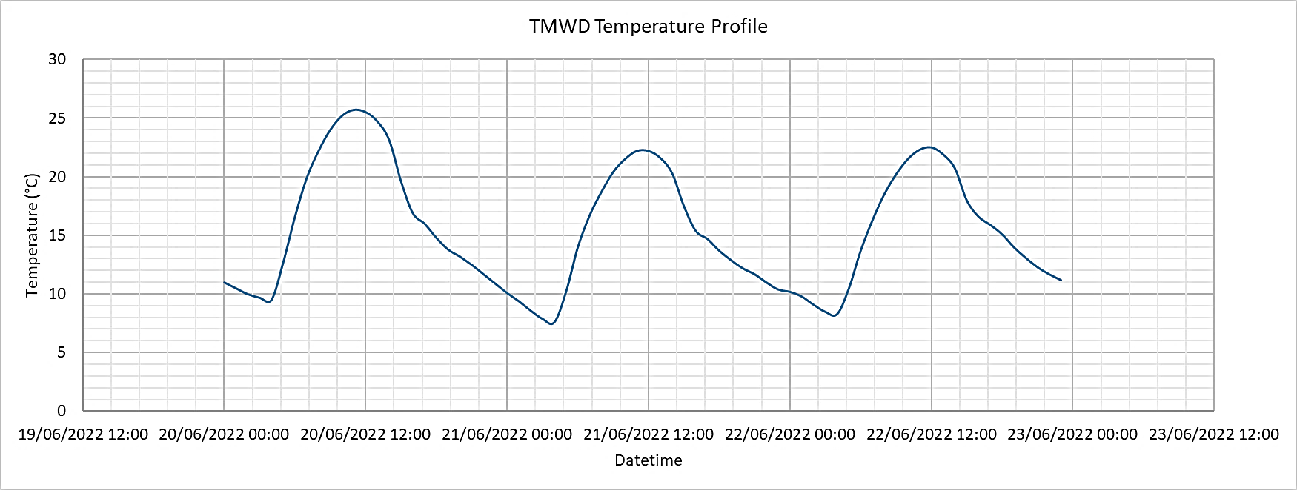
Selecting the "Worst-Case" Scenario
Typical Meteorological Year (TMY): Analysis focused on the coldest winter day (Winter Solstice, June 21st).
The "Stress Test": Ambient temperature low of 7.6 °C.

Slide 8
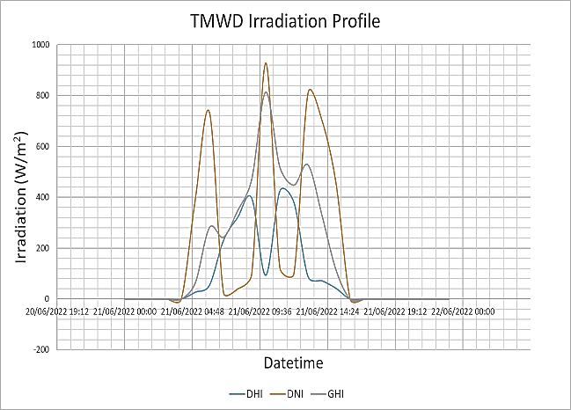
Solar Radiation Profiles

Slide 9
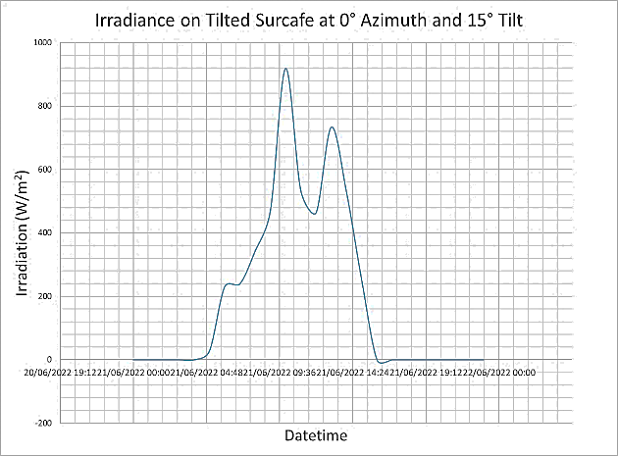
Solar Radiation Profiles
Baseline (0° Azimuth):
Maximum irradiance occurs early, around 10:00 hrs.

Slide 10
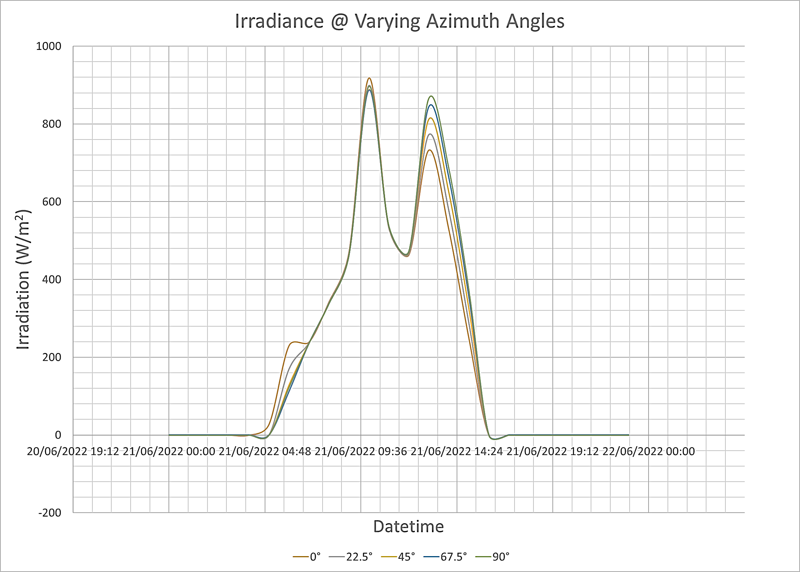
Solar Radiation Profiles
The Shift:
As the azimuth increases towards the West, afternoon radiation improves significantly.

Slide 11
Solar Radiation Profiles
Tilt Optimisation:
The 5° tilt angle had the best morning radiation, while the 55° had the best afternoon radiation.

Slide 12
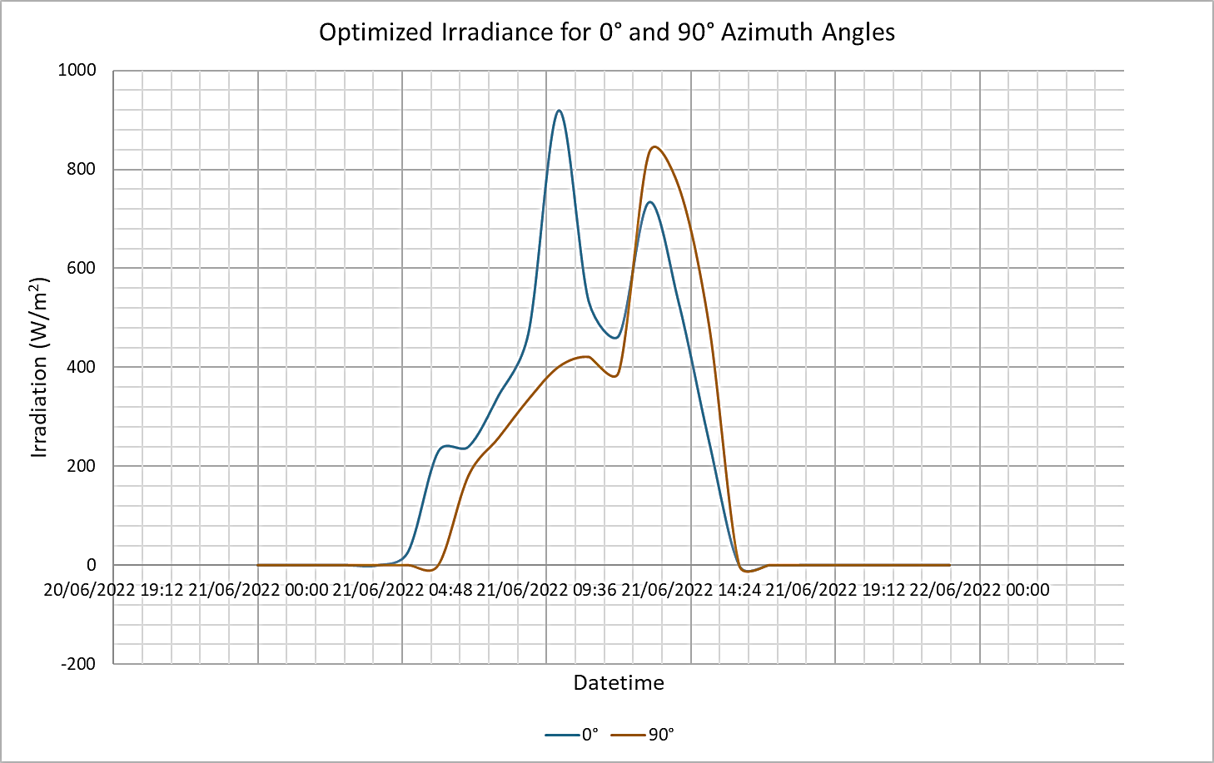
Solar Radiation Profiles
An inclined surface facing west receives more radiation in the afternoon hours compared to the one facing north.
A west-facing solar receptor surface is better optimised for receiving afternoon radiation.

Slide 13
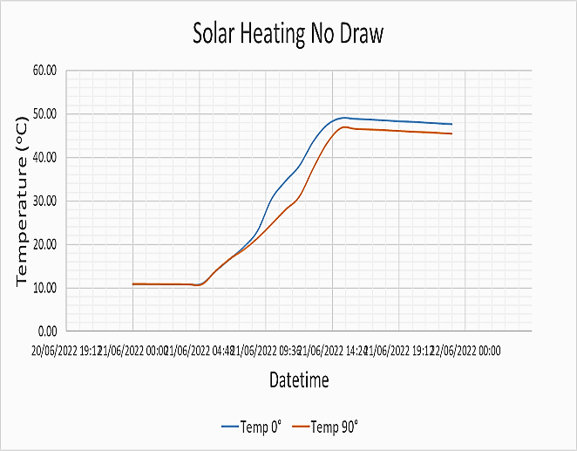
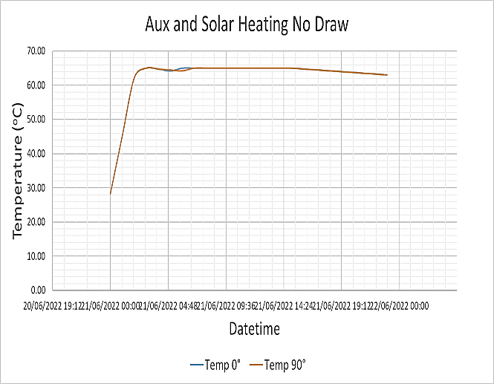
Tank Temperature Profiles
No Draw Heating Scenarios
The geyser facing north was able to achieve a temperature of 49°C against 47°C for the west-facing geyser.
If the same no-draw scenario above is applied but this time with auxiliary heating in the early hours, the two geysers perform basically the same and will keep the temperature around 63°C by midnight.

Slide 14
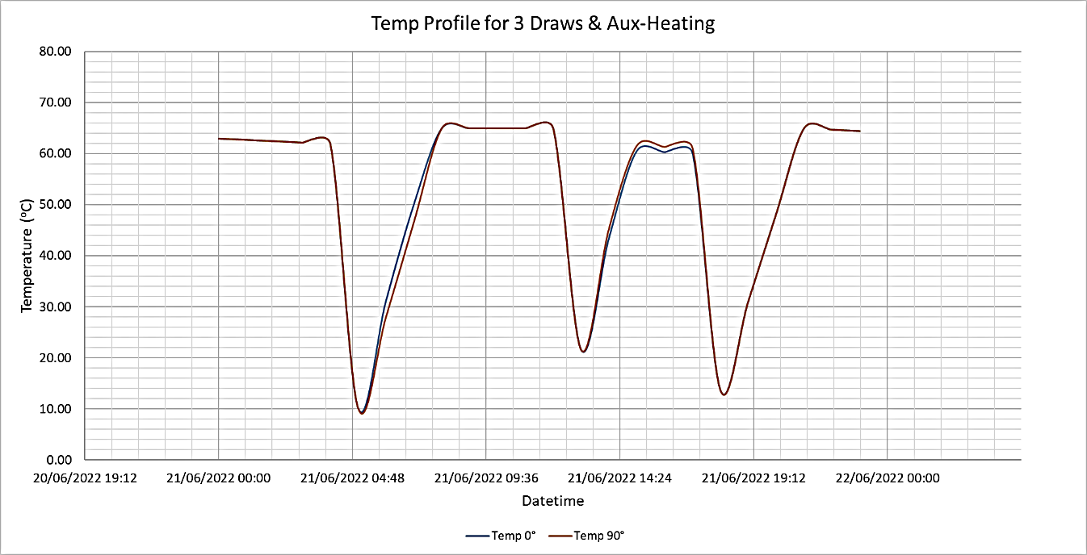
Tank Temperature Profiles
The "Three Draw" Scenario
Testing Real Use: Morning, Afternoon, and Evening draws of 200L total.
Morning Draw Performance: North is slightly more efficient (10.9 kWh vs. 11.9 kWh for West).
Afternoon Draw Performance: West consumes 6.8 kWh vs. North's 7.7 kWh.
The Result: A 10% reduction in electrical energy consumption for afternoon/evening demand.

Slide 15
Conclusion & Recommendations
Conclusion:
A geyser facing the true west (90°) and tilted at an angle of 55° will receive more radiation in the afternoon than a geyser facing true north (0°) and tilted at 15°.
The rate of solar heating during the afternoon hours is higher for a west-facing geyser.
The west-facing geyser required 10% less electrical energy to reheat the water compared to the north-facing geyser.
Orienting a solar geyser at a 90° azimuth angle and a 55° tilt angle optimizes the performance of a hybrid geyser for afternoon hot water consumption.

Slide 16
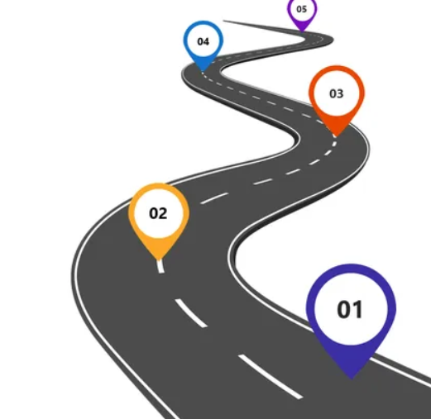
Conclusion & Recommendations
Future Work:
A high-fidelity thermal analysis employing the multi-node model be conducted.
An integrated dynamic flow control should be investigated with the aim of retaining the hot temperature for the top layer during draws.

Slide 17

Thank You

