Slide 1



ASSESSING THE SUSTAINABILITY PERFORMANCE OF THE CIRCULAR ECONOMY IN ZAMBIA THROUGH THE BIOGAS VALUE CHAIN
A Case Study of a Commercial Farm
2026 ENGINEERING INSTITUTION OF ZAMBIA SYMPOSIUM
PRESENTERS : Eng. Oziah KALINDA
: Eng. Dr. Mwansa KAOMA
DATE : Friday 17th April 2026
Avani Victoria Falls Resort, Livingstone, Zambia

Slide 2
PRESENTATION OUTLINE
1.0 INTRODUCTION
2.0 METHODOLOGY
Background, Objectives
3.0 RESULTS/DISCUSSION
4.0 CONCLUSION
Frame work, Environmental, Economic, Social
Biogas Potential, Environmental, Economic, Social
Environmental, Economic, Social

Slide 3
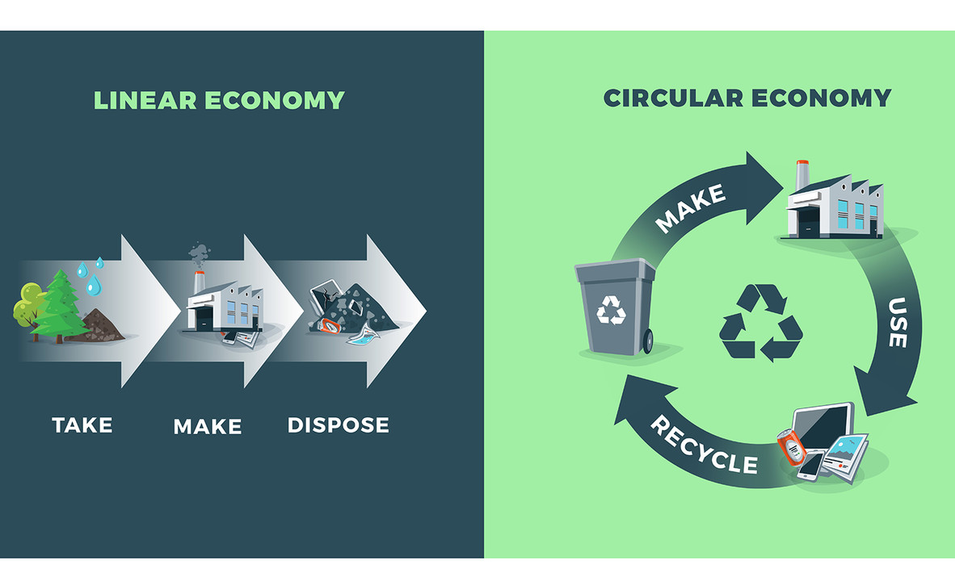
1.1 BACKGROUND
The global emphasis on Sustainable Development (SD) has intensified.
Circular Economy (CE) promotes SD through resource efficiency & waste recovery/Reuse.
Linear Economy (LE) doesn’t promote (SD) → Climate change, environmental degradation, energy poverty & Natural Resources depletion.
LE dominates Zambia’s waste & energy systems hence has led to;
  Waste mismanagement - 5M+ tonnes/year of untreated organic waste (MOFNP, 2022)
  Energy Poverty - only 53.3% electricity access (Kannan et al., 2024; WHO, 2025),
  Heavy reliance on imported fossil fuels
Notes:
CE – Resource Extracted – emphasises product & material re-use, re-manufacturing, refurbishment, repair or recycle
LE – Resourced Extracted – Product Made & Used – Waste Disposed
In response to these challenges, GRZ through the 8th National development plan has Identified CE as a Transition priority by coming up with 10 ten key CE opportunities.

Slide 4
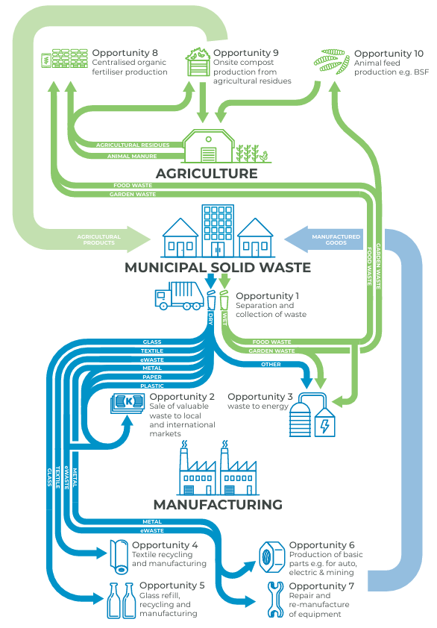
Background…Con’d
Evidently, waste to Energy is one of the ways in which CE can be applied in the energy sector.
  Separation and collection waste
  Sale of valuable waste to local and international markets
  Waste to energy (Biogas)
  Textile recycling and manufacturing
  Glass refill, recycling and manufacturing
  Production of basic parts e.g. for auto, electric and mining
  Repair and re-manufacture of equipment
  Centralised organic fertilizer production
  Onsite compost production from agricultural residue
  Animal feed production e.g. BSF
Zambia's 10 Key CE Opportunities
Source: AGS (2023)
Notes:
Among them is WtE through biogas.
BG is a RE source produced through the anaerobic digestion
This value chain can be broken down into several key stages: feedstock supply, anaerobic digestion, biogas upgrading, distribution, and end-use.

Slide 5
Background…Con’d
LE
Resource Inefficiency
Environmental Degradation
Waste Mismanagement
BUT?
Limited evidence on how CE implemented through biogas adoption affects sustainability outcomes.
Hence limits effective policy, investment and scaling of biogas solutions.

Slide 6
1.2 OBJECTIVES
1. To Evaluate Environmental Sustainability
3. To Assess Social Sustainability
2. To Investigate Economic Sustainability
Notes:
performance of biogas value chain centered around the circular economy.

Slide 7
2.0 METHODOLOGY
Waste Streams (4) & Energy Use
Feedstock Characterization –Lab. Analysis (TS/VS)
Biogas Potential Calculation
GBEP
Economic: Fuel Displacement & Fuel Saving
Social: Jobs in Bioenergy Sector
Environmental:
LC GHG emis.
Comparative Conclusion

Slide 8




2.1 Existing & Proposed Systems
Steam
Biogas as Boiler Fuel
Boiler
Livestock
Manure
Slaughter Hse
Pasture
Slaughter Hse Waste
Bedding
Plant Waste
Circular Economy
Processing Plant
To Market
Heat to farm
Electricity
Bio-methene
Crops
Landfill
Incineration
Stabilization Ponds
Compost site
Bio-Fertiliser
Biogas
Digester
Digestate
Notes:
Farm operates across a wide range of agribusiness activities but only focused on Waste (4 streams) and Energy for steam and/or Temperature regulation
Existing System – Boiler (Coal/Diesel) for steam and temp Regulation – Waste from 4 streams to ponds etc –
Proposed – Waste reused Through Bio Digester – Biogas (no need to upgrade only clean) and Digestate
Therefore closing the loop and making the sub system circular

Slide 9
3.0 RESULTS & DISCUSSION
3.1 Feedstock Characterization
3.2 Biogas Potential
Feedstock | Qty (Ton/yr) | Biogas (m³/yr) | Energy (GJ/yr)
Poultry | 52,696 | 6,697,772 | 163,426
Cattle | 32,850 | 3,929,870 | 95,889
Slaughter House | 639 | 105,900 | 2,584
Processing Plant | 1,095 | 41,391 | 1,009
Total |  |  | 280,148.3
Notes:
VS – Benchmark above 70% - Important to avoid under/over feeding lest the Digester becomes a septic tank. Designs have to be custom made according to the VS which can vary based on a lot of factors eg feed etc.
Biogas potential – importance of VS eg Slaughter house produced 639 tons but had more BG potential than Processing plant

Slide 10
3.3 Environmental – LC GHG Emissions
Major GHG Contributors
Coal mining & combustion
Diesel production & use
Biogenic CO₂ from biogas: Neutral cycle
Methane leakage (circular)→ Key mitigation area
System-Level Emissions (kg CO₂-eq)
Reference System : 18,287,289
Circular System: 4,172,423
Net Reduction: (77%)

Slide 11
3.4 Economic - Fuel Displacement & Savings
Fuel | Energy (GJ) | Cost (USD)
Coal | 77,024 | 514,000
Diesel | 14,370 | 522,000
Total | 91,394 | 1,036,000
GBEP Indicator 20.1a – Net Energy Balance
Fossil system: 91,394 GJ
Biogas system: 280,148 GJ
Surplus: 188,754 GJ
GBEP Indicator 20.1b – Foreign Exchange Savings
$1.04M/year saved from avoided fuel imports
Supports energy sovereignty & local reinvestment

Slide 12
4.5 Social – Job creation in Bioenergy Sector
Subsystem | Fossil Jobs | Biogas Jobs | Change
Fuel Supply | 14 | 25 | +11
Transport | 5 | 20 | +15
Conversion | 19 | 8 | -11
Waste Utilization | 12 | 25 | +13
Admin/Indirect | 6 | 12 | +6
Total | 56 | 90 | +34
Net Job Creation: +21 jobs
Notes:
Jobs along the value chain
Fossil 6.36 Jobs/MW
Biogas 10.23 Jobs/MW

Slide 13
4.0 CONCLUSION
Environmental Pillar:
  Achieved a 77% reduction in GHG emissions vs. linear model. Prevents ~14 million kg CO₂-eq annually, supporting Zambia's NDCs.
Economic Pillar:
  Ensures full thermal energy self-sufficiency + a large surplus (188,754 GJ/year).
  Saves ~$1.04 million/year in fossil fuel imports, boosting fiscal resilience.
Social Pillar:
  Generated a 39.3% net new jobs increase
  Therefore, integrating Circular Economy (CE) via biogas is a SUSTAINABLE and transformative solution for Zambia's waste, energy, and agricultural challenges.

Slide 14
References
AGS (2023) Zambia Circular Economy Study An overview of opportunities for SMEs in Zambia to make use of waste materials and products and develop a more circular economy in Zambia.
Bond, A.J. and Morrison-Saunders, A. (2009) ‘Sustainability appraisal: Jack of all trades, master of none?’, Impact Assessment and Project Appraisal, 27(4), pp. 321–329. Available at: https://doi.org/10.3152/146155109X479422.
EC (2019) ‘ “The European Green Deal”, COM/2019/640 final.’
Gamuchirai Mutezo (2021) ‘INTEGRATING ENERGY FROM WASTE IN RAPIDLY URBANISING AFRICAN CITIES: A CIRCULAR ECONOMY CASE FOR BIOGAS INITIATIVES’. Available at: https://doi.org/10.1007/978-3-030.
Geissdoerfer, M. et al. (2018) ‘Business models and supply chains for the circular economy’, Journal of Cleaner Production, 190, pp. 712–721. Available at: https://doi.org/10.1016/j.jclepro.2018.04.159.
Gibson, B., H.S. and T.J. (2013) ‘Sustainability assessment: criteria and processes. Routledge.’
GRID-Arendal (2021) CIRCULAR ECONOMY ON THE AFRICAN CONTINENT. Available at: www.footprintsafrica.co.
Kabeyi, M.J.B. and Olanrewaju, O.A. (2022) ‘Biogas Production and Applications in the Sustainable Energy Transition’, Journal of Energy, 2022, pp. 1–43. Available at: https://doi.org/10.1155/2022/8750221.
Korhonen, J., Honkasalo, A. and Seppälä, J. (2018) ‘Circular Economy: The Concept and its Limitations’, Ecological Economics, 143, pp. 37–46. Available at: https://doi.org/10.1016/j.ecolecon.2017.06.041.
Lubańska, A. and Kazak, J.K. (2023) ‘The Role of Biogas Production in Circular Economy Approach from the Perspective of Locality’, Energies, 16(9). Available at: https://doi.org/10.3390/en16093801.
Lyng, K.A. et al. (2020) ‘The implications of economic instruments on biogas value chains: a case study comparison between Norway and Denmark’, Environment, Development and Sustainability, 22(8), pp. 7125–7152. Available at: https://doi.org/10.1007/s10668-019-00463-9.

Slide 15
The End

Slide 16

END

