Slide 1

2026 ENGINEERING INSTITUTION OF ZAMBIA SYMPOSIUM
NAVIGATING/UNDERSTANDING INVESTMENT RISKS IN SOLAR & WIND ENERGY PROJECTS IN ZAMBIA TO FOSTER THEIR DEVELOPMENT
PRESENTER : Matemba Roy Chilengi
DATE : Friday 16th April 2025
Avani Victoria Falls Resort, Livingstone, Zambia

Slide 2
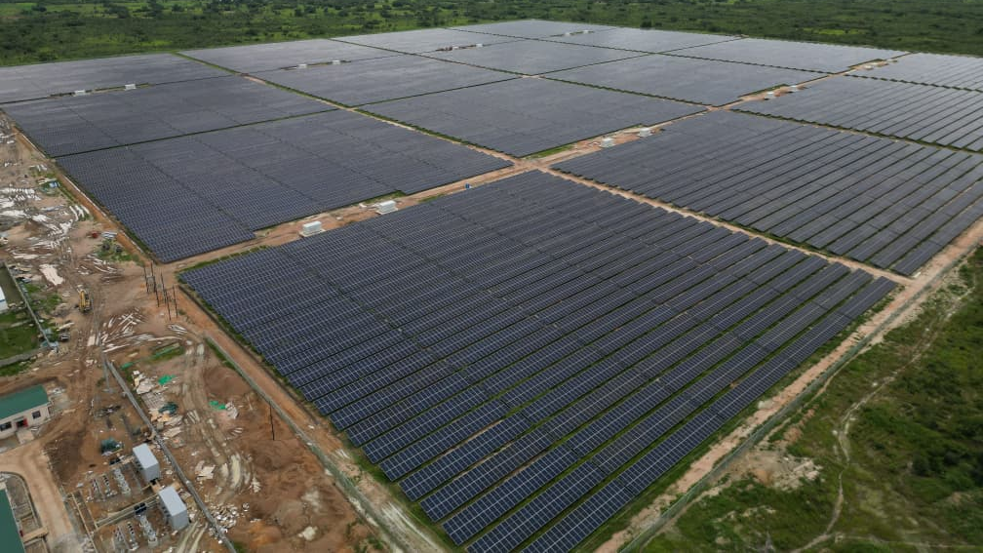

PRESENTATION OUTLINE
  Background and Context
  Link to Conference Theme
  Investment Opportunity in Zambia
  Key Investment Risks Overview
  Policy/Regulatory; Financial/Currency Risks
  Technical; Grid/Infrastructure Risks
  Environmental/Social Risks
  Risks Impact on Mining/Agriculture Sectors
  Mitigation Strategies – Policy/Financial/Technical
  Opportunities for Circular Economies
  Conclusion and Key Takeaways

Slide 3
BACKGROUND & CONTEXT
Zambia has been experiencing energy deficits mostly due to climate variability
-Increasing climate variability; Prolonged droughts &; Growing electricity demand have exposed structural vulnerabilities in the energy system.
-The imperative is, to diversify the energy mix towards other sources such as solar and wind now rather than later
Overdependence on hydropower (>80%)
-Zambia’s electricity sector is heavily hydropower. Installed capacity at 3,700 MW, hydropower represents roughly 87% of that mix. Solar only contributes about 2%

Slide 4
BACKGROUND & CONTEXT
Solar & Wind offer diversification opportunities
-Power deficits experienced in recent drought periods have underscored the urgent need for diversification of the energy mix through alternative renewable energy sources, particularly solar and wind energy.
-Solar & wind energy technologies offer Zambia an opportunity to enhance Energy Security; Reduce Greenhouse Gas Emissions; Attract private sector investment through IPP models.
Critical for Mining & Agriculture productivity as well as a great input into having a Circular Economy (2026 EIZ AGM & Symposium Theme)

Slide 5
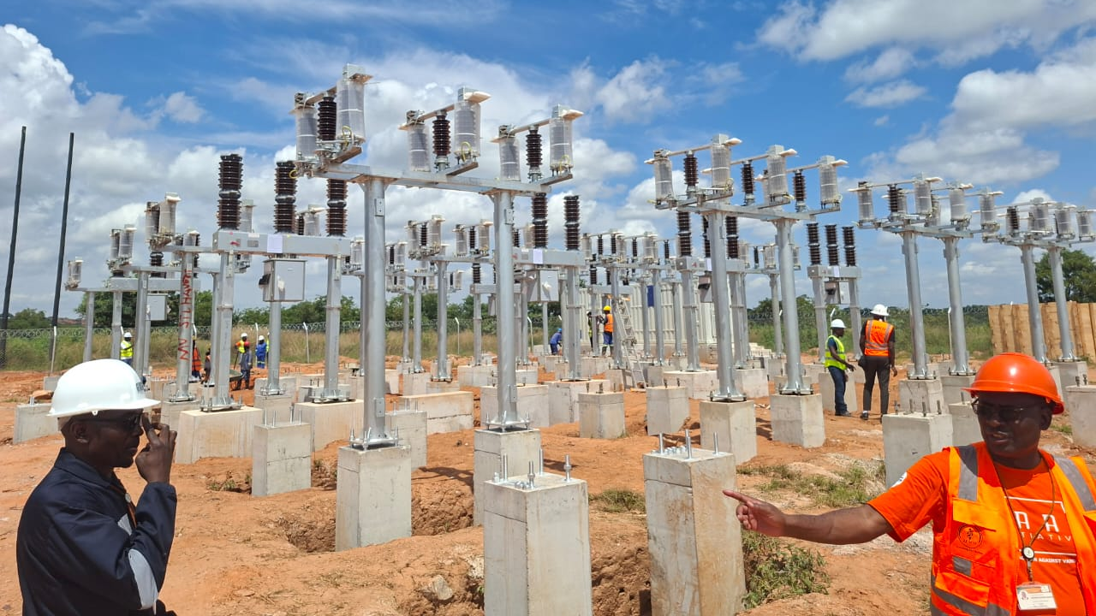
BACKGROUND:- Some Solar/Wind Examples
ZESCO/the country at large, has embarked on a number of Solar Projects and Initiatives:
ZESCO’s Chisamba 100MW; KGL 100MW; Siavonga 100MW; Mansa 50MW; Kasupe 7.5MW etc.
Others: CEC’s combined 94MW at Itimpi & Riverside recently commissioned etc.
ZESCO introduced Net-Metering schemes all in a quest encourage investment in alternative energy sources like solar
GRZ through MoE is stirring activities in Wind Energy; Installation of Wind Masts with wind sensors and measurement capabilities in 8 identified windy spots across the country to capture wind data has been done with Targets to bring on board 200MW by 2028

Slide 6

LINK TO CONFERENCE THEME
Energy: Backbone/strong supporter of Mining/Agriculture.
Smart mining operations rely on reliable, high quality and uninterrupted power supply (de-risks mining productivity)
In Agriculture, Solar/Wind provides energy for sustainable
irrigation & agro-processing & reduces diesel usage
Both solar/wind reduce dependence on climate-vulnerable hydropower (innovation in the energy sector)
Reduces carbon footprint → circular economy
Enhances energy resilience and resource efficiency
Enables automation, digital mining systems, and AI-driven operations
Reduces operational downtime caused by load shedding

Slide 7
INVESTMENT OPPORTUNITY IN ZAMBIA
High solar irradiance (5.5–6.5 kWh/m²/day)
Untapped wind corridors (e.g., Muchinga, Central Province)
Growing demand from domestic, mining & agriculture needs
Government’s push for 1000MW solar deployment
Supporting huge energy needs in Mining
Existing and new mines need bulk power
2) Supporting Regenerative Agriculture
Solar-powered irrigation systems/year-round farming & climate resilience
Supports Agro-processing/cold storage & value addition
Facilitates water-efficient/sustainable farming practices
3) Enabling Rural Electrification & Productive Use

Slide 8
KEY INVESTMENT RISKS OVERVIEW
Policy & Regulatory Risks
Policy inconsistency/slow approvals/Unclear or evolving frameworks for IPPs and open access/Tariff-setting uncertainty/lack of cost-reflective pricing/Bureaucratic delays increase project timelines+ costs
Financial & Currency Risks
High upfront CAPEX/Cost of capital/Currency mismatch/Inflation & interest rate volatility impacting project returns
Market/Off-taker Risks
Single buyer model (heavy reliance on ZESCO)/Payment delays affecting cash flow and debt servicing/Weak PPA bankability (limited guarantees, tariff uncertainty)/Low electricity tariffs vs cost-reflective pricing

Slide 9
KEY INVESTMENT RISKS OVERVIEW
Technical Risks
Intermittency of solar & wind/Grid instability and frequency control challenges/Limited local expertise for O&M of advanced systems /Technology performance risks (degradation, equipment failure)
Infrastructure Risks
Weak transmission network and congestion constraints /Delays in grid expansion (e.g., 330kV evacuation lines)/Curtailment risk due to limited grid absorption capacity/Poor rural grid connectivity limiting project siting options

Slide 10
POLICY & REGULATORY RISKS
Regulatory and policy risks arise from uncertainties in the legal and institutional framework governing renewable energy projects
Bottlenecks such as slow approval processes delay project development by months or even years, this increases investor risk and cost overruns. Examples are:
Inconsistent policy implementation
Delays in approvals and licensing
Uncertainty in tariffs and PPAs
Limited clarity on open access frameworks but this is better now, than in the past.
Changes in energy policy/tariff-setting mechanisms/tax incentives can significantly alter project economics

Slide 11
FINANCIAL & CURRENCY RISKS
Financial risks are among the most significant barriers to solar and wind energy investment in Zambia… Clogged by:
High upfront CAPEX (Solar: 0.8–1.2M/MW; Wind higher with logistics)
Exchange rate volatility (USD vs ZMW). Inflation and interest rate volatility impacting project returns
Currency mismatch: revenues often in ZMW vs financing in USD
Limited access to affordable financing
High cost of capital (limited long-term, low-interest local financing)
Off-taker creditworthiness concerns which is improving

Slide 12
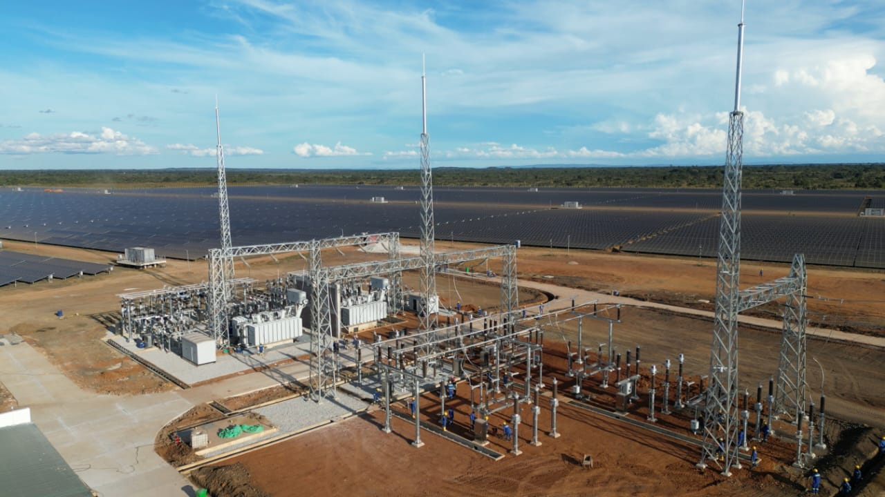
TECHNICAL RISKS
Technical risks in solar and wind projects include:
Variability of solar and wind resources
Technology performance and degradation
Grid integration challenges (Inverter Standards, Evacuation cost etc)
Limited local technical capacity
Dependence on imported equipment

Slide 13
GRID & INFRASTRUTURE RISKS
Transmission constraints and delays as a result of power evacuation and related challenges
Limited grid absorption capacity, in terms of Fault Levels (strength of the power system…)
Zambia’s transmission and distribution network requires modernization to accommodate variable renewables increasing grid integration and inherent capacity to accommodate these alternative energy sources
Risk of curtailment
Slow development of high-voltage evacuation lines

Slide 14
SOCIO-POLITICAL RISKS
Socio-political risks include:
Political instability/ Changes in Government or government priorities/ Public opposition to private sector participation in electricity generation etc. Although Zambia has generally maintained political stability, election cycles and fiscal pressures can influence energy sector decision-making.
Public perception of electricity tariffs
PP arrangements may also affect policy continuity. Investors closely monitor these factors, as adverse socio-political developments can disrupt contractual arrangements and revenue streams.

Slide 15
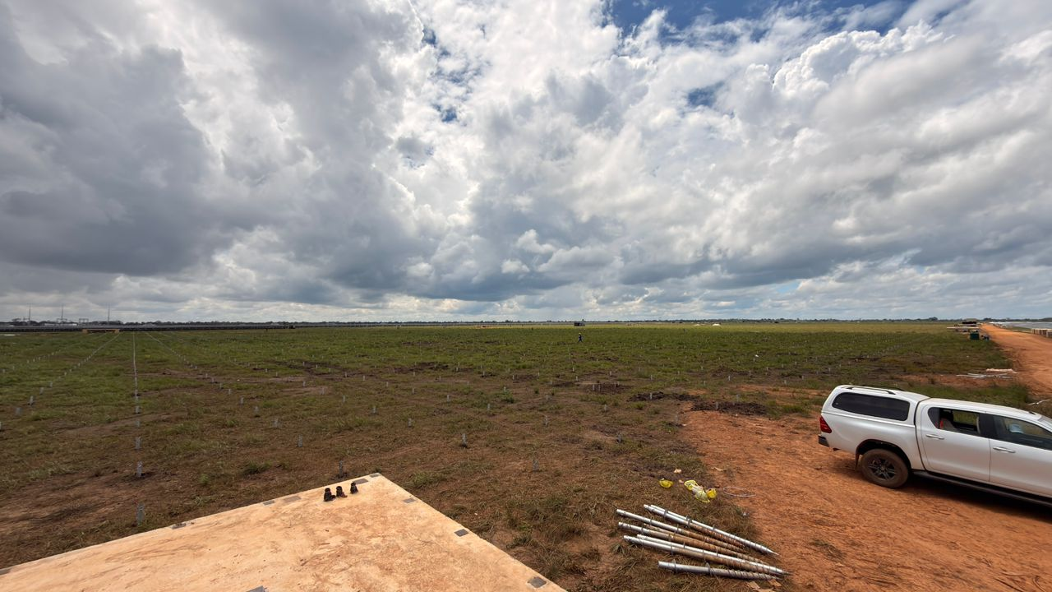
ENVIRONMENTAL & SOCIAL RISKS
Land & Site Acquisition
-Land tenure complexities (customary vs state land)
-Compensation disputes/Resettlement challenges
-Competing land use (agriculture, conservation, mining)
Environmental Compliance
-Stringent Environmental Impact Assessment (EIA) requirements
-Biodiversity concerns (especially for wind projects)
-Water use considerations for panel cleaning and construction

Slide 16
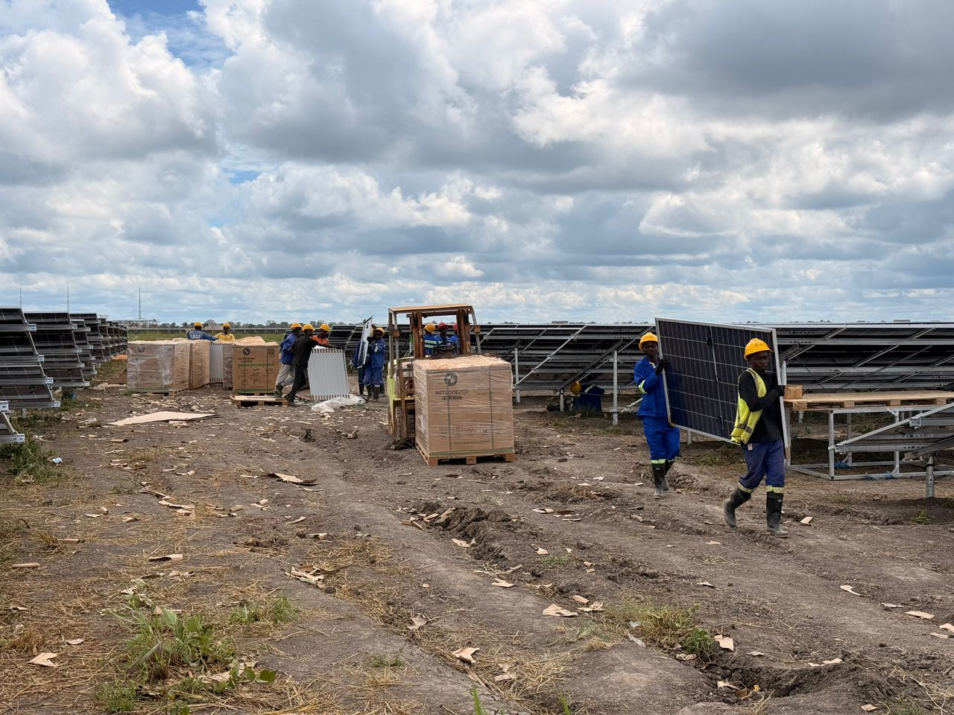
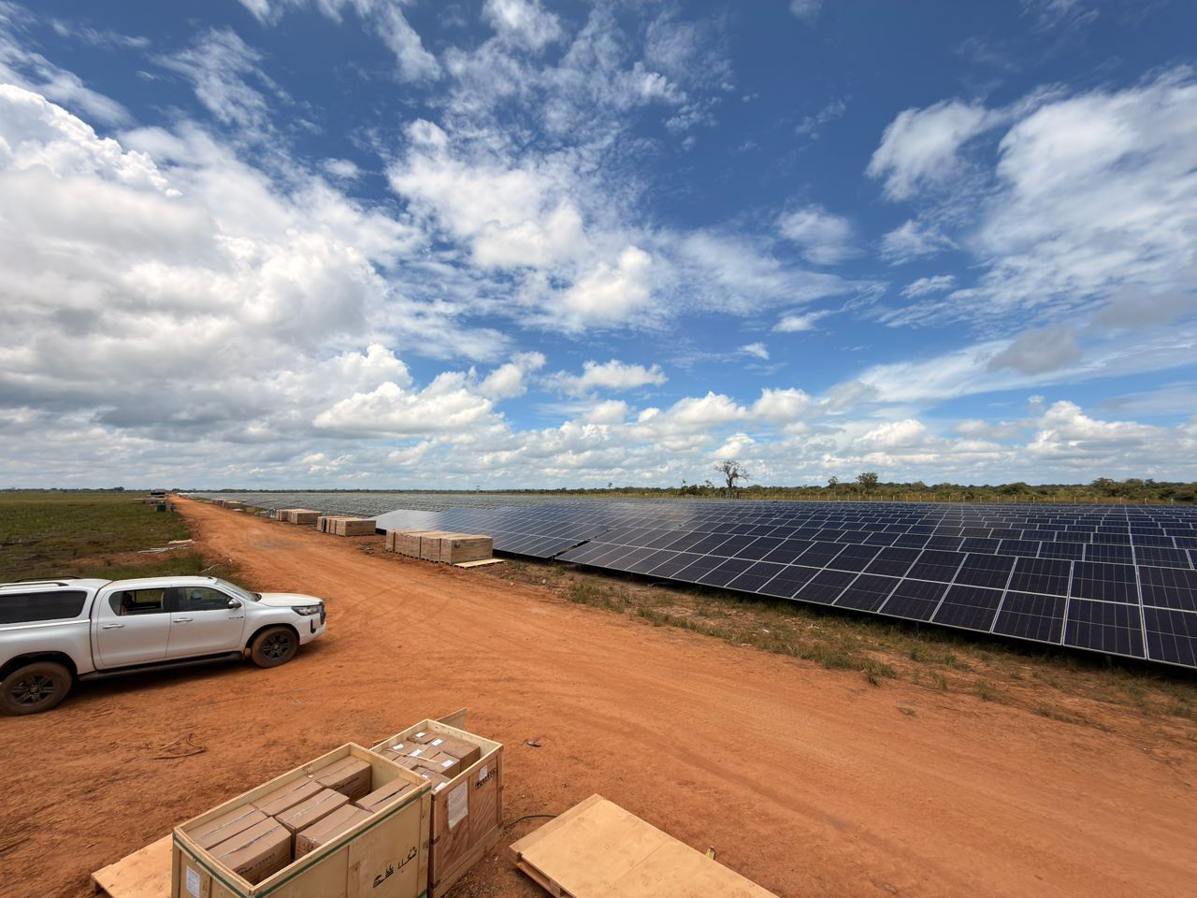
ENVIRONMENTAL & SOCIAL RISKS
Climate & Resource Variability
-Seasonal variation in solar irradiation and wind speeds
-Extreme weather events affecting infrastructure resilience
-Long-term climate uncertainty impacting generation forecast
Community & Social Acceptance
-Community resistance due to inadequate engagement
-Misaligned expectations on local benefits (jobs, electrification)
-Risk of social conflict affecting project timelines

Slide 17

RISK IMPACT ON MINING/ AGRICULTURE
Risk Impact on Mining
Power instability increases production costs
De-Risks Mining
Diesel reliance increases emissions and expenses
Renewable integration enhances sustainability
Manging Energy Risk = Managing Investment Risk
Improves ESG compliance for global markets
Risk Impact on Agriculture
Energy needed for irrigation & storage
Solar enables mechanization & value addition
Reduces post-harvest losses
Supports climate-smart agriculture
Energy access transforms agriculture into a resilient system

Slide 18
MITIGATION STRATGIES - POLICY
Strengthen regulatory consistency
Promote open access and IPP frameworks
Streamline Approval Processes/Fast Track Approvals: Reducing bureaucratic delays through digital processing and set timelines can improve investor confidence and reduce soft costs.
Implement clear renewable energy policies. Clear PPA Frameworks: Establishing stable, standardized PPA templates with predictable pricing for renewable generation will reduce contract negotiation risk.
Tariff Policy Reform: Work on having predictable tariff frameworks aligned with cost-reflective pricing to enhance revenue predictability, encouraging investment.

Slide 19
MITIGATION STRATEGIES - FINANCIAL
Risk Sharing and Guarantee: Introducing instruments such as partial risk guarantees, concessional funding, and blended finance vehicles can lower the cost of capital for investors (public-private partnerships)
Risk Guarantees from institutions such as AfDB, World Bank etc.
Local Financial Market Development: Building capacity within local banks and capital markets to underwrite renewable energy projects enhances access to affordable finance (develop local currency financing mechanisms
Incentives (tax breaks, duty exemptions) to encourage these VREs

Slide 20
MITIGATION STRATEGIES – TECHNICAL & GRID
Grid Modernization and Storage: Investments in grid infrastructure and energy storage systems will reduce curtailment risks and smooth renewable supply variability.
Early evacuation strategies (33kV/11kV integration) e.g. 50MW Mansa Solar; 100MW KNBE or Siavonga Solar PV Plant.
Resource Mapping for Wind: Comprehensive wind atlases and data investments enhance site selection and reduce exploration risk for wind projects. GRZ-MoE has embarked on this journey
Capacity Building: Sharpen and enhance skills for local engineers/technician and all
Hybrid systems (solar + storage) where possible…

Slide 21
OPPORTUNIIES FOR CIRCULAR ECONOMY
Solar/Wind fit so well in Circular Economy:
By definition, a way of designing and managing resources so that nothing is wasted and materials kept in use for as long as possible
Solar-powered mining operations.
Utilization of roofing spaces; Lake Surfaces for Floating Solar (FPVs) etc.
Introducing and inculcating Energy Efficiency practices, use of natural lighting etc.
Renewable energy for Agro-processing
Waste-to-energy integration ideas/ Resource efficiency and sustainability

Slide 22
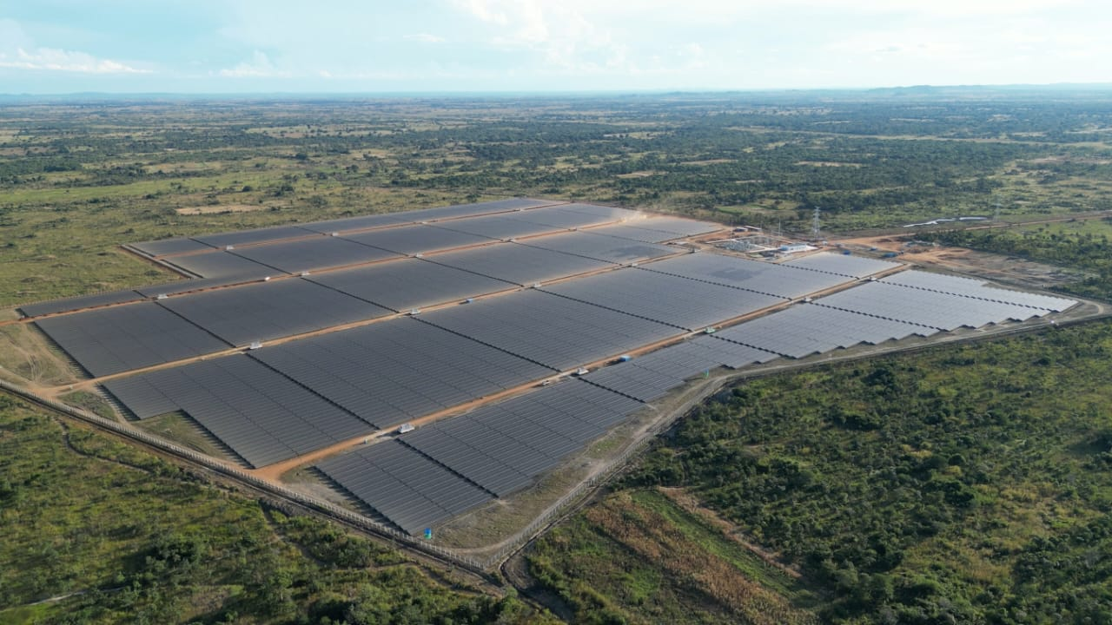
CONCLUSION AND KEY TAKEAWAYS
Solar & Wind Energy offer Zambia a viable pathway to help diversify its Electricity Mix to enhance Energy Security
Zambia has strong renewable potential that can contribute to stimulating Economic Growth
Risks present barriers but with the right frameworks Risks can be navigated and are manageable
Solar & wind are critical for sustainable mining & agriculture
Collaboration is key: Government + Private Sector + Financiers. With Policy reforms/Financial innovation/Technological investment &/Institutional Strengthening, Zambia can create a more enabling environment for investment in VREs
Urgent action needed & to continue to unlock investment

Slide 23
THANK YOU

