Slide 1

2026 ENGINEERING INSTITUTION OF ZAMBIA SYMPOSIUM
Unlocking Zambia’s Biogas Potential: Insights from the SF-BioVac Project (Focus on Biogas Production)
PRESENTER : CYNTHIA SÖDERBACKA
DATE : Friday 17th April 2026
Avani Victoria Falls Resort, Livingstone, Zambia

Slide 2
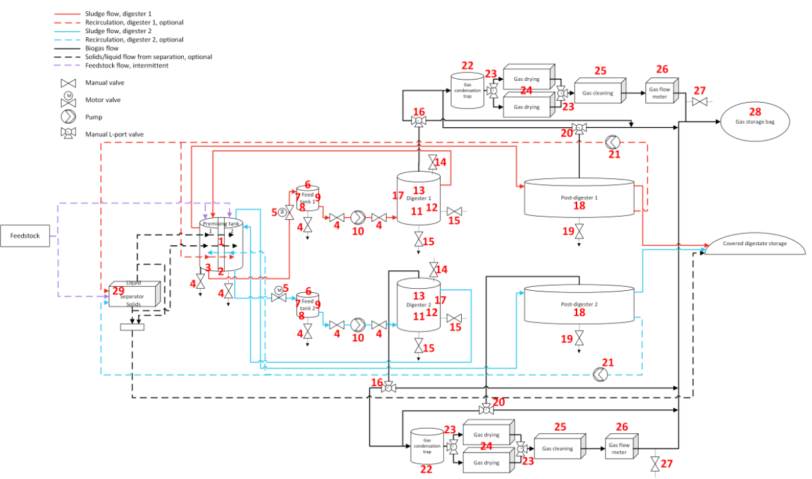
Overview
About the SF-BioVac Project
Background & Aim of study
About Biogas: Production & Applications
Methodology
  Mapping: Stakeholder Engagement
  Biogas Capacity Building
  BMP Tests on cassava
Results & Discussion
Conclusion
Recommendations
Acknowledgements

Slide 3

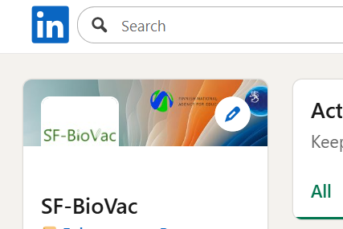
About the project
Project Name: Sustainable Futures: Biogas Value Chain for Circular Economy Competence Growth in Zambia (SF-BioVac)
Theme: Climate Change, Circular Economy & Energy Transition
Partner Countries: Finland & Zambia
Period: 1.1.2024-31.8.2026
Finland
Novia University of Applied Sciences (Faculty of Technology & Seafaring)
University of Oulu (Faculty of Technology)
Zambia
Copperbelt University (School of Engineering)
University of Zambia (School of Engineering)
Rural Electrification Authority (REA) as industrial partner
Total Budget: € 1 096 221,89
https://www.sf-biovac.com/

Slide 4
Funder for HEP Programme: Ministry for Foreign Affairs of Finland
Main: The Higher Education Partnership (HEP) Programme supports cooperation projects between higher education institutions in Finland and the developing world. The projects support the HEIs as they develop their subject-specific, methodological, educational and administrative capacity. The programme is funded by the Ministry for Foreign Affairs of Finland and administered by the Finnish National Agency for Education.
Project Partners ca 10%
Project Objective: Circular Economy competence, biogas value chain as an example

Slide 5
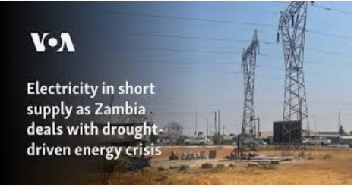
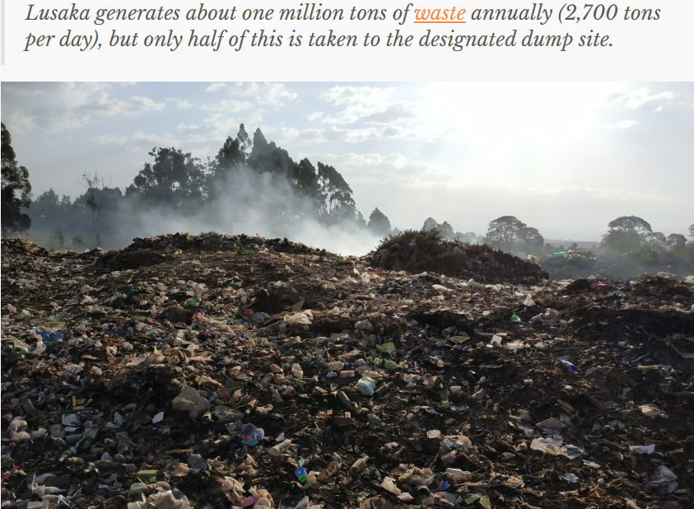
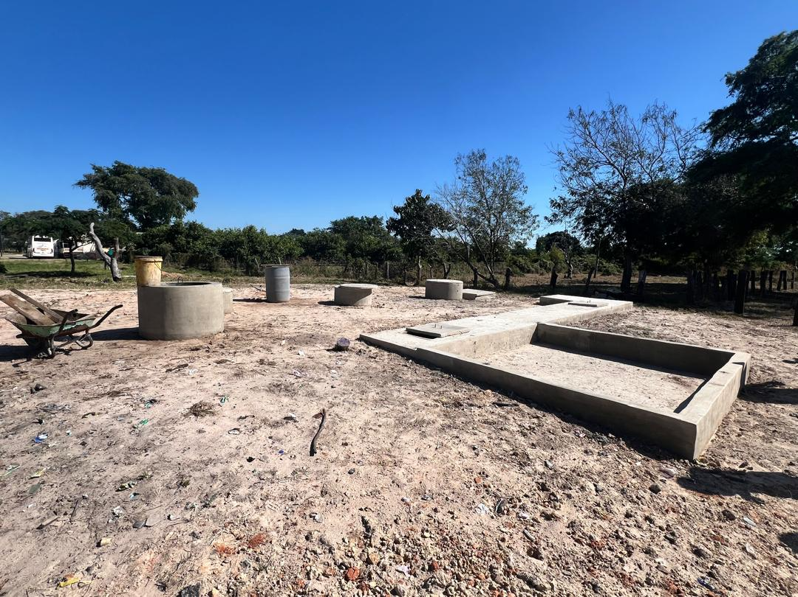
Background & Aim:
Alternative Energy Solutions for Zambia’s energy crisis
Waste Management Crisis
Waterborne diseases during rainy seasons
Knowledge Gaps
Potential of biogas as an alternative energy resource
Circular economy competence growth
Understanding of feedstock-process design & utilisation pathways
Photo: Woima Corporation, Finland
Photo: Rural Electrification Authority, Zambia

Slide 6
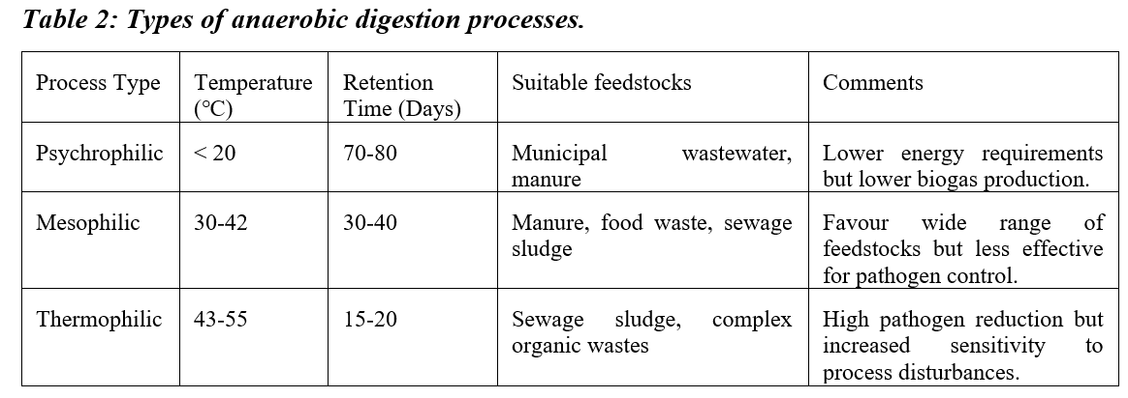
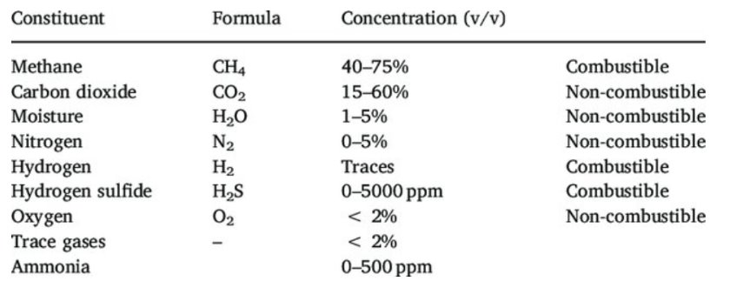
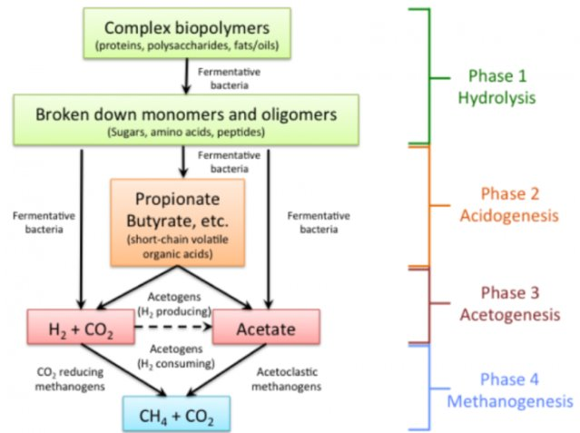
Introduction to Biogas:
What is biogas?
Pros
Waste as a resource/feedstock
Cons
Requires sustainable ecosystems
Stand-alone or grid-connected
Renewable fuel
Decomposition of organic matter in O2-free environments
Expensive (depending on technology)
Multidisciplinary ecosystems
Complexity of process: know-how
Source:https://www.researchgate.net/publication/324794647_Biogas_production_-_A_review_on_composition_fuel_properties_feed_stock_and_principles_of_anaerobic_digestion/figures?lo=1
Source: https://www.e-education.psu.edu/egee439/node/727

Slide 7
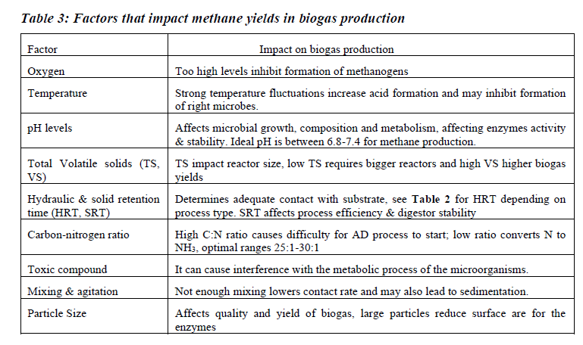
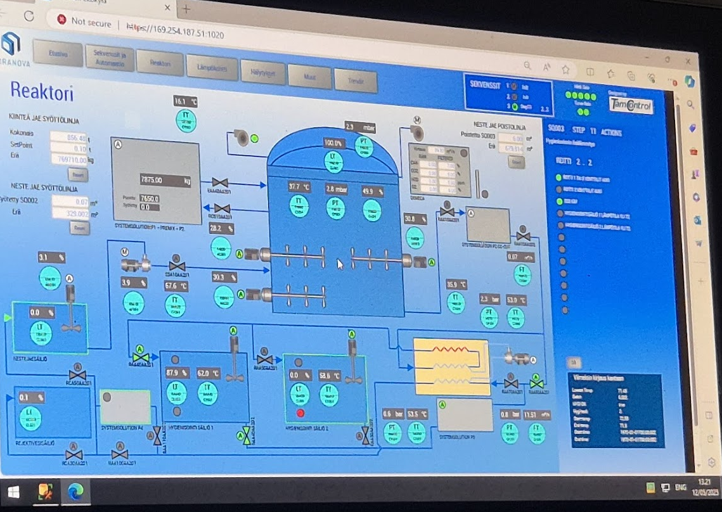
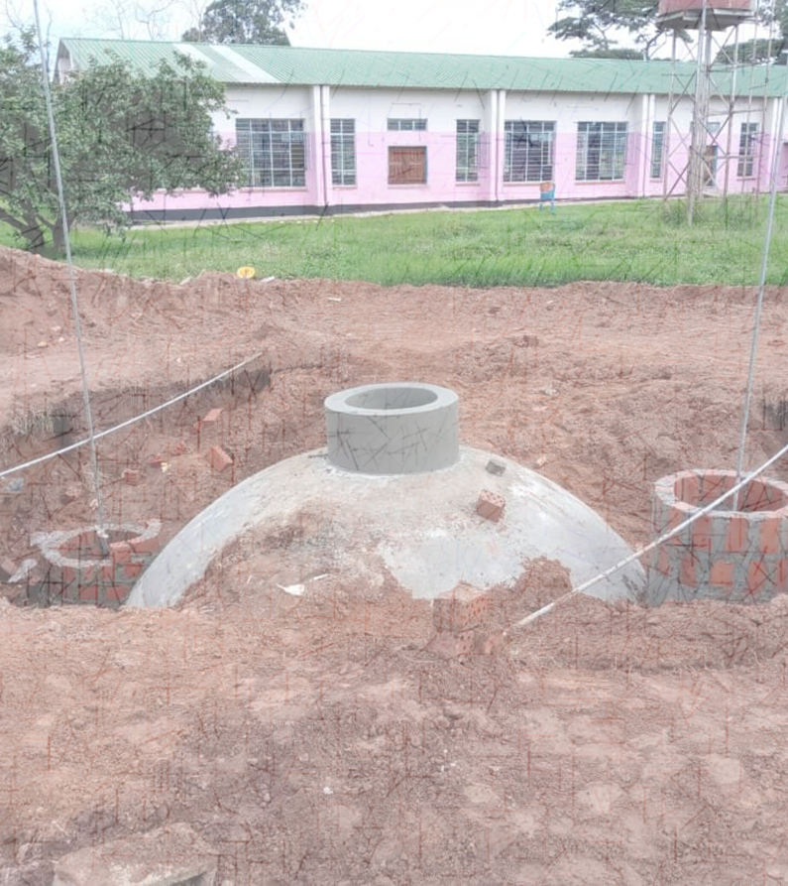
Biogas Production:
Biogas Yield Determinants
Feedstock characterisation
Biogas Production Technologies
Continous Stirred Tank Reactor (CSTR) vs Fixed Dome Reactor
How to get more & better-qulity biogas
What does my feedstock contain
Photo:Rural Electrification Authority, Zambia
Photo:Viskaali Eco-Village BP, Finland

Slide 8
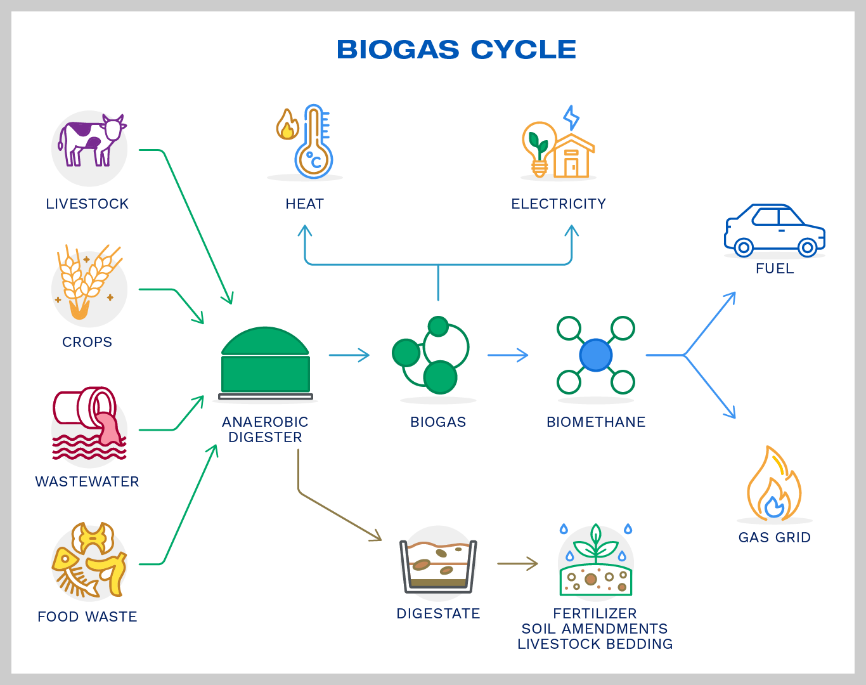
Applications:
Thermal & Electrical Energy Source
Upgraded Biogas (Biomethane ~99% CH4)
Use as fuel in transport (engine sensitivity & storage optimisation)
Digestate-Agricultural Usage
Bio-fertiliser most common, feedstock composition
Methane gas grids
May require further treatment/processing
No cleaning required to produce electricity
More efficent if CHP (70-90%) vs 20-60% electrical energy
Photo: Galileo Technologies

Slide 9
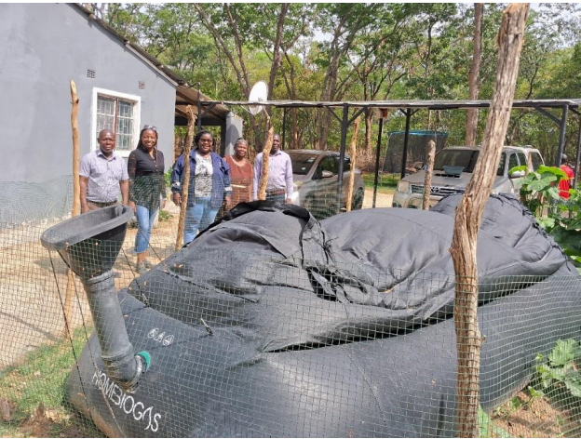
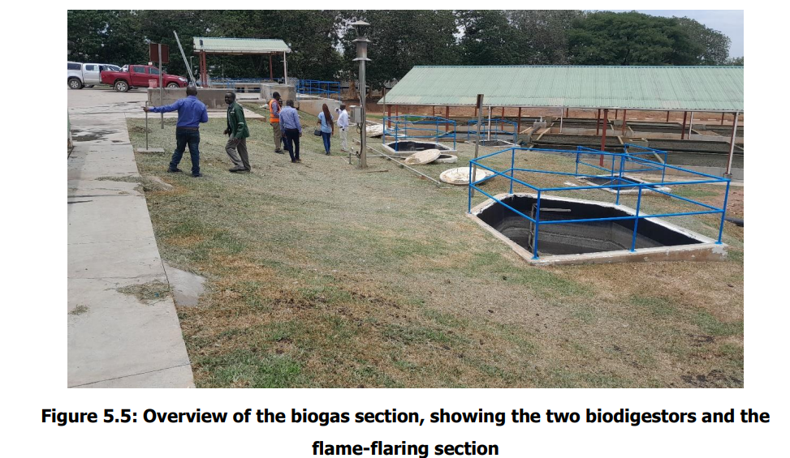
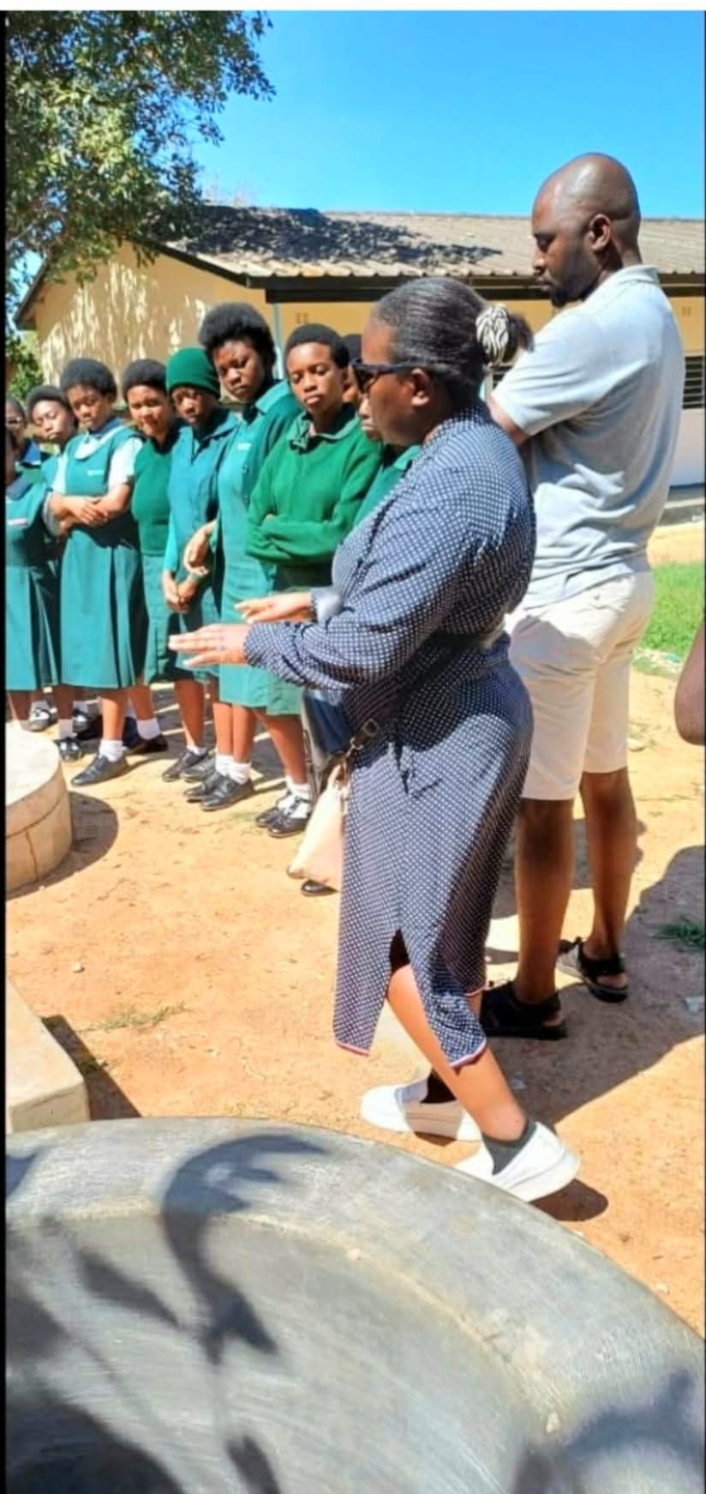
Methodology 1. Stakeholder Engagement
Lusaka Water & Sanitation Company
Njase GSS Biogas Plant, Choma-REA
Nkuyuma Farm, Ndola
Target Regions: Copperbelt, Lusaka & Southern Provinces
Target Stakeholders: Implementing biogas solution of some sort & potential to implement biogas solutions
Identification of knowledge gaps

Slide 10
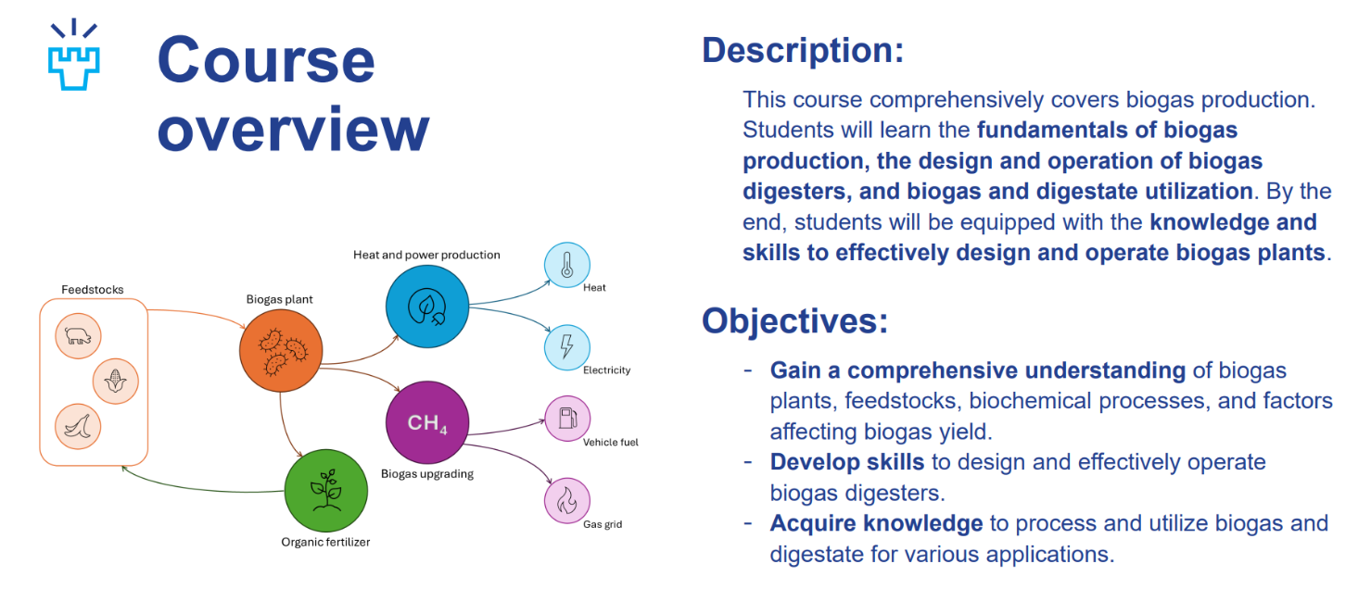
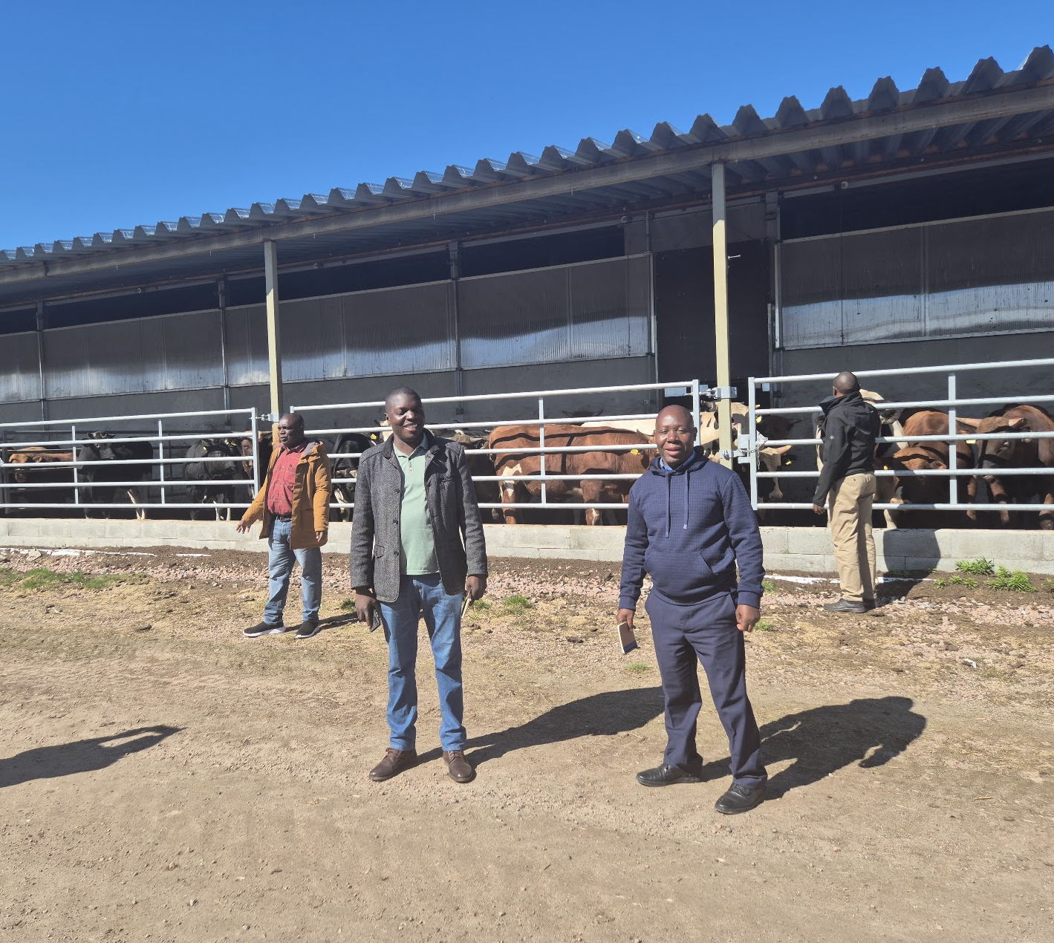
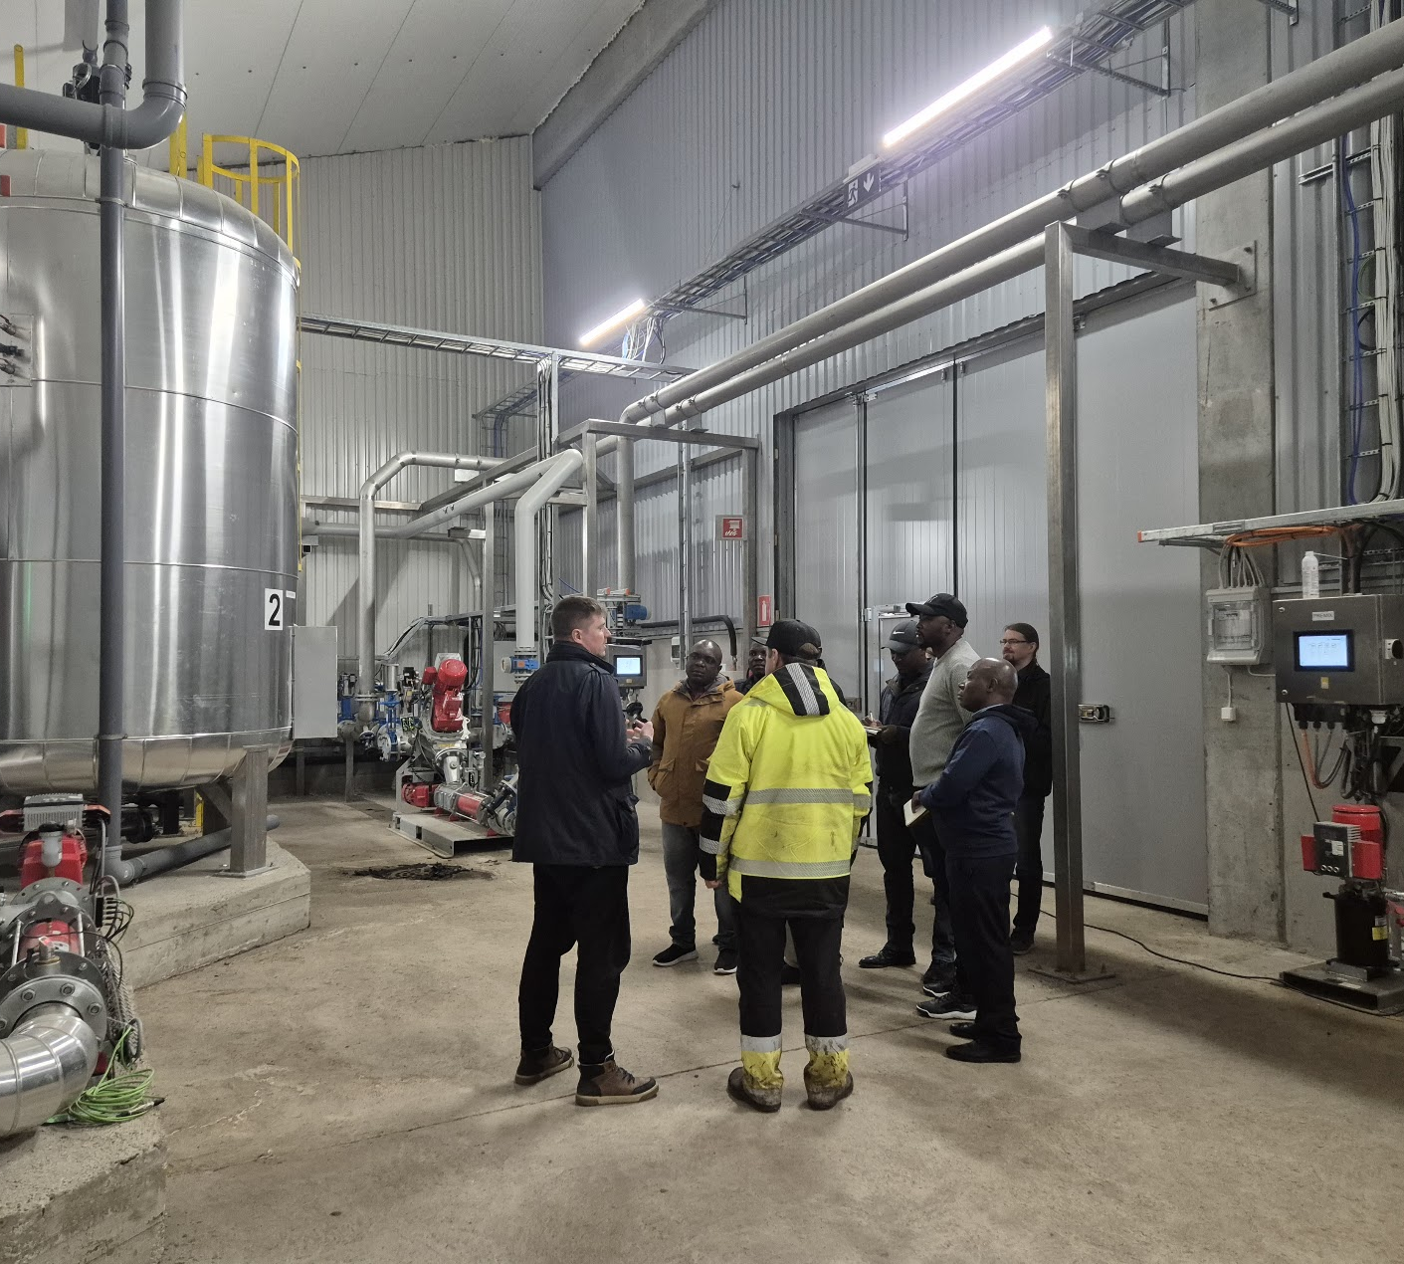
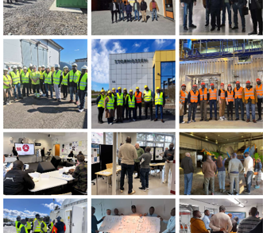
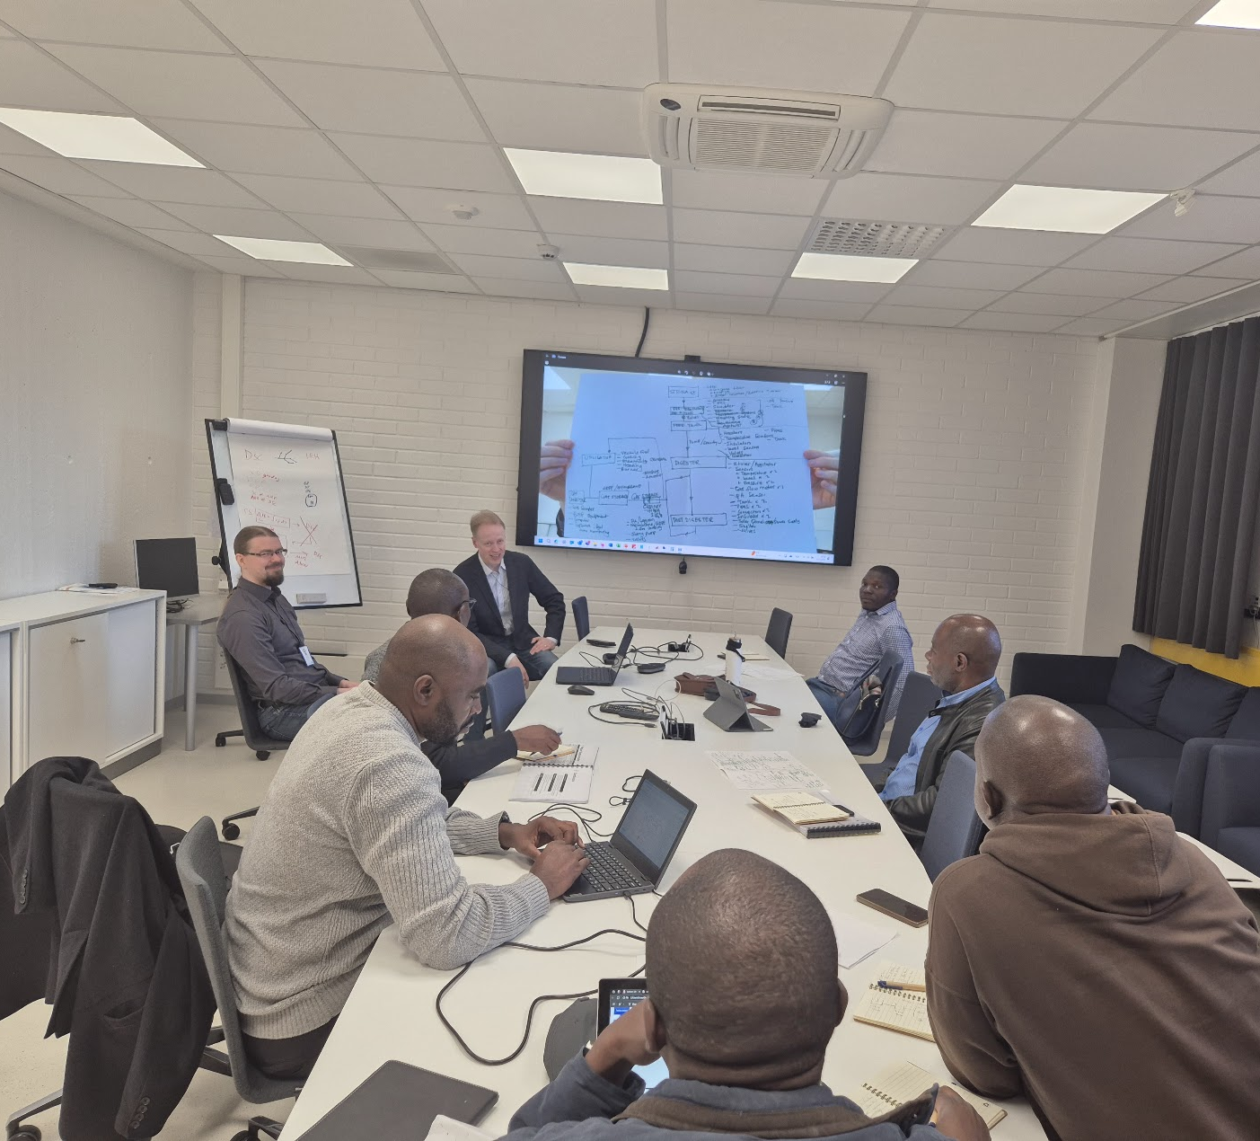
Methodology 2.
Capacity Building in Biogas Production & Process Design
A course; Biogas Production & Process Design (Oct-April)
  300 signed up, 67 completed
Company visits to biogas plants (different types & sizes) in Finland
Plant Design Workshops
Lab demonstrations

Slide 11
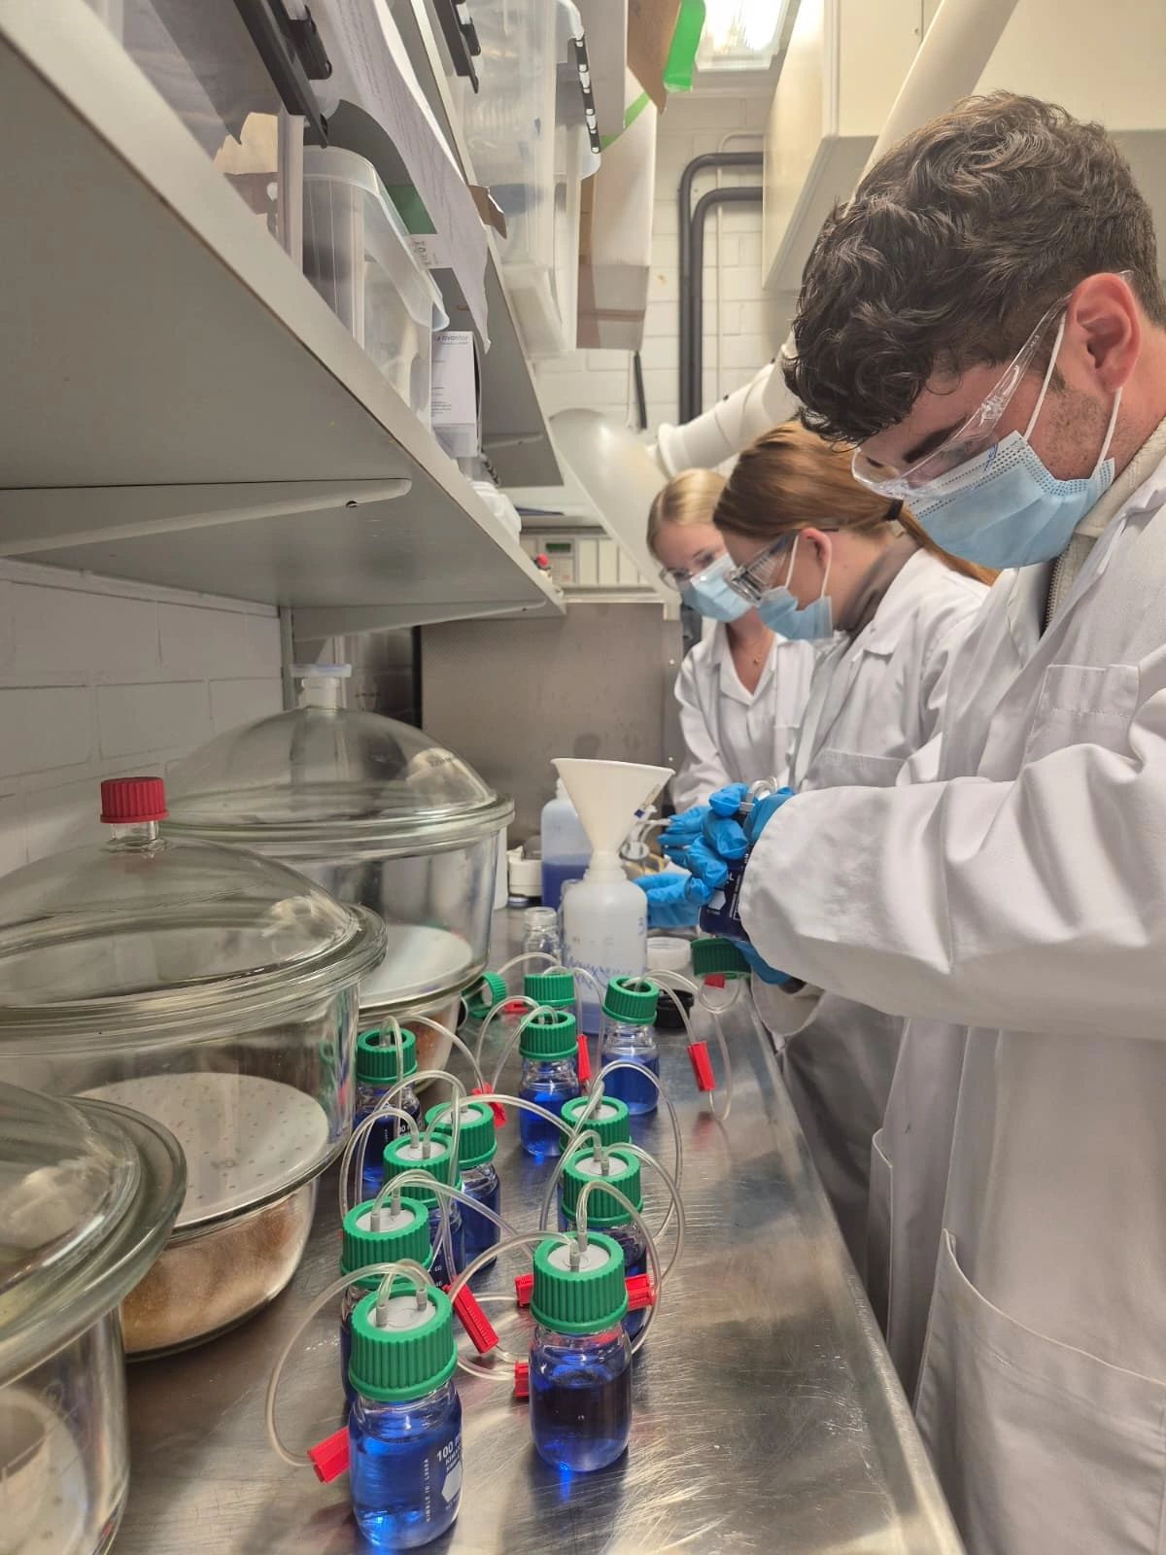
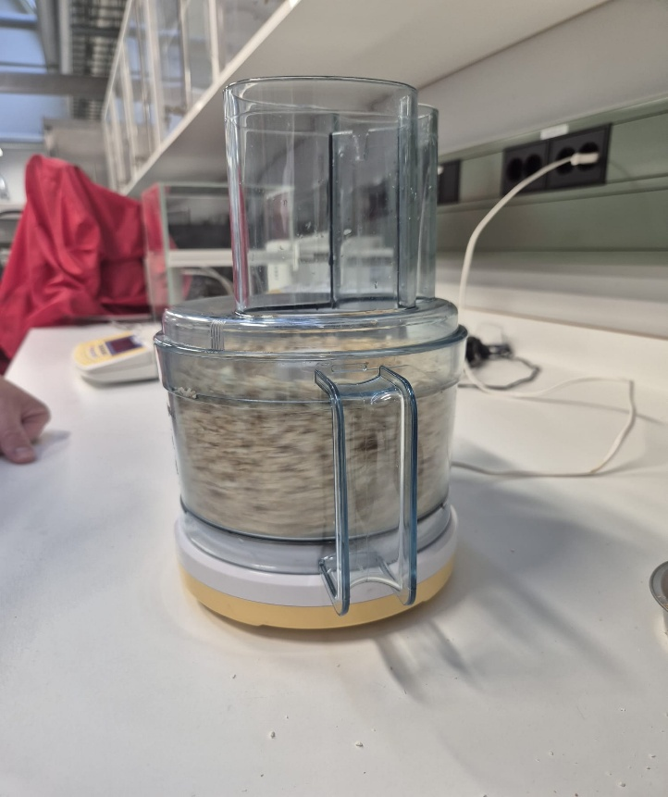
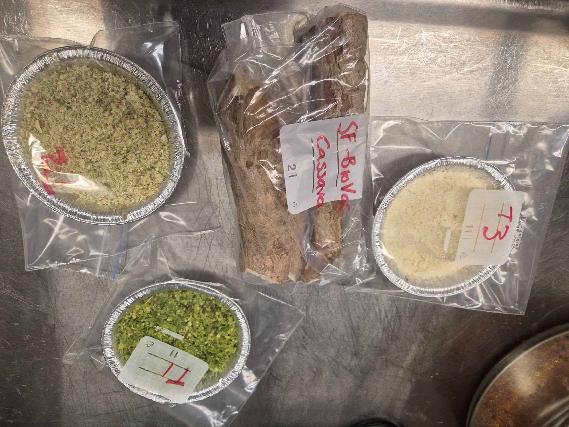
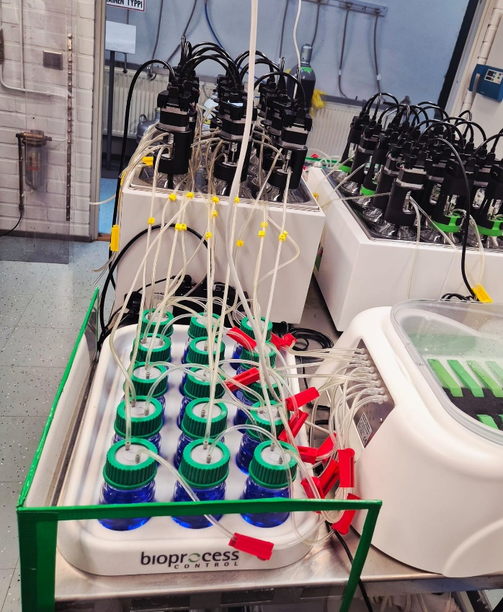
Methodology 3. Biochemical Methane Potential Tests (BMP test)
Test different parts of cassava; roots, peel, pulp, leaves, mixed crop (avoid competion with food)
Use innoculum from a functional industrial scale plant- biowaste stream 42°C
Use APMTS II machine for BMP tests
Tests prepared in triplicates & test ran for 39 days

Slide 12
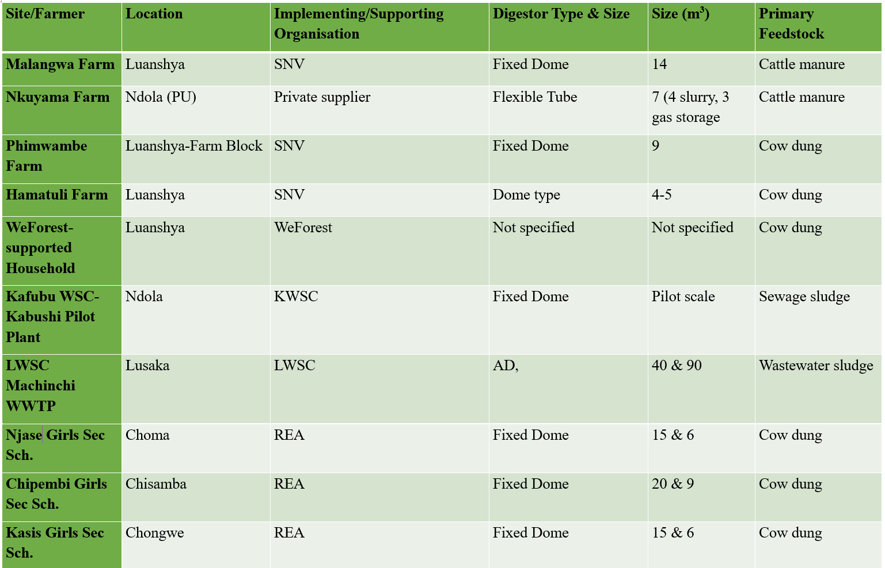

Result 1: Status of Biogas in Zambia
Population of Lusaka Zambia= 1.8million people vs Vaasa Region, Finland= 114k people
Biogas Plant in Vaasa Region (SS & Biowaste
One New Reactor Size (m³)
4 400

Slide 13
Project Results 2: Biogas Production & Process Design Capacity Building at HEI level
Lab-Scale Pilot Plant Design: Pilot to be located at UNZA
CSTR
Dual-line, 200L Reactors
Multi-functional: BMP test & production
More controlled process
Variety of feedstock
More efficient use of feedstock and water
Higher yields- recirculation
Pilot Design
Figure 1: Schematic design of the lab-scale biogas pilot plant

Slide 14
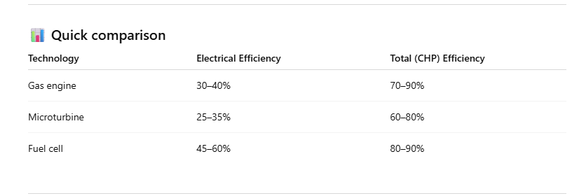
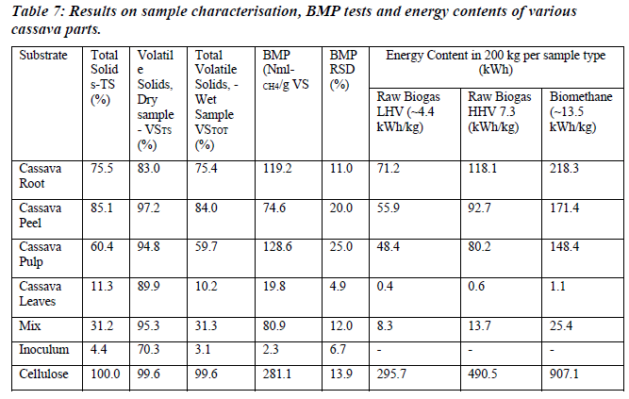
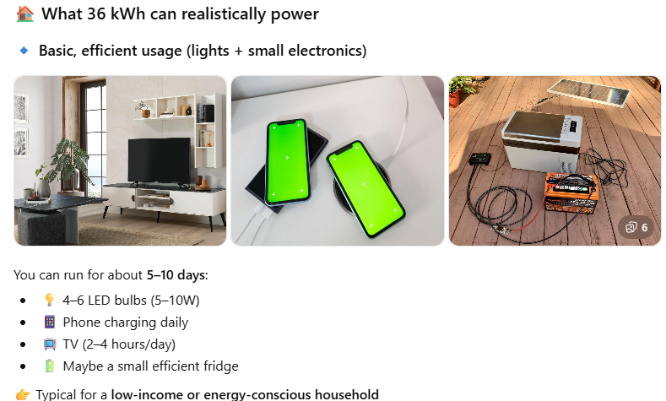
Result-3: Biochemical Methane Potential of Cassava
I asked AI what 36kWh can power in Zambia
Take-Away: BMP tests are very controlled & more stable than actual production (Lit values higher than obtained here, VS- insight in inorganic content (bio-fertiliser) & TS on reactor sizing

Slide 15
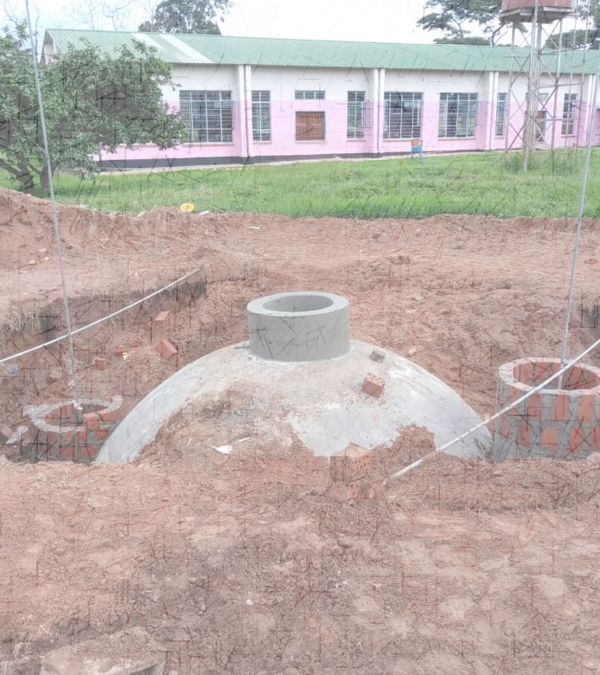
Conclusion
There is interest for biogas in Zambia
Current biogas plants are run inefficienctly due to limited understanding of the biogas production process
  Process preparation & monitoring
  No measurement instruments
  Understanding of feedstock
Pilot plant a game-changer for biogas in Zambia
Feedstocks varieties not explored- mostly animal manure
Cassava a potential feedstock but may require co-digestion with nitrogen-rich feedstocks to get even higher yields.
Photo: Rural Electrification Authority, Zambia

Slide 16
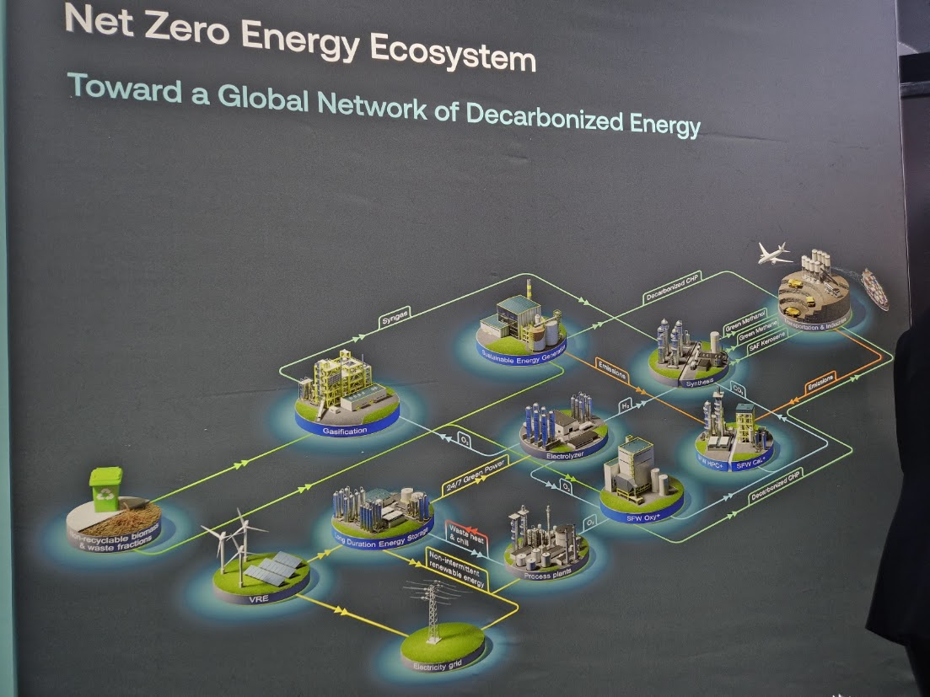
Recommendations
Legislation to support sustainable implementation
Technical support for biogas producers
Understanding & planning of biogas ecosystems
Societal education on biogas- biogas is a community project!
Biogas production should be seen as a by-product of waste management
LET’S NOT STOP HERE, WE ARE JUST GETTING STARTED!
Photo: Sumitomo Corporation Presentation at H2 Expo 2026, Finland

Slide 17
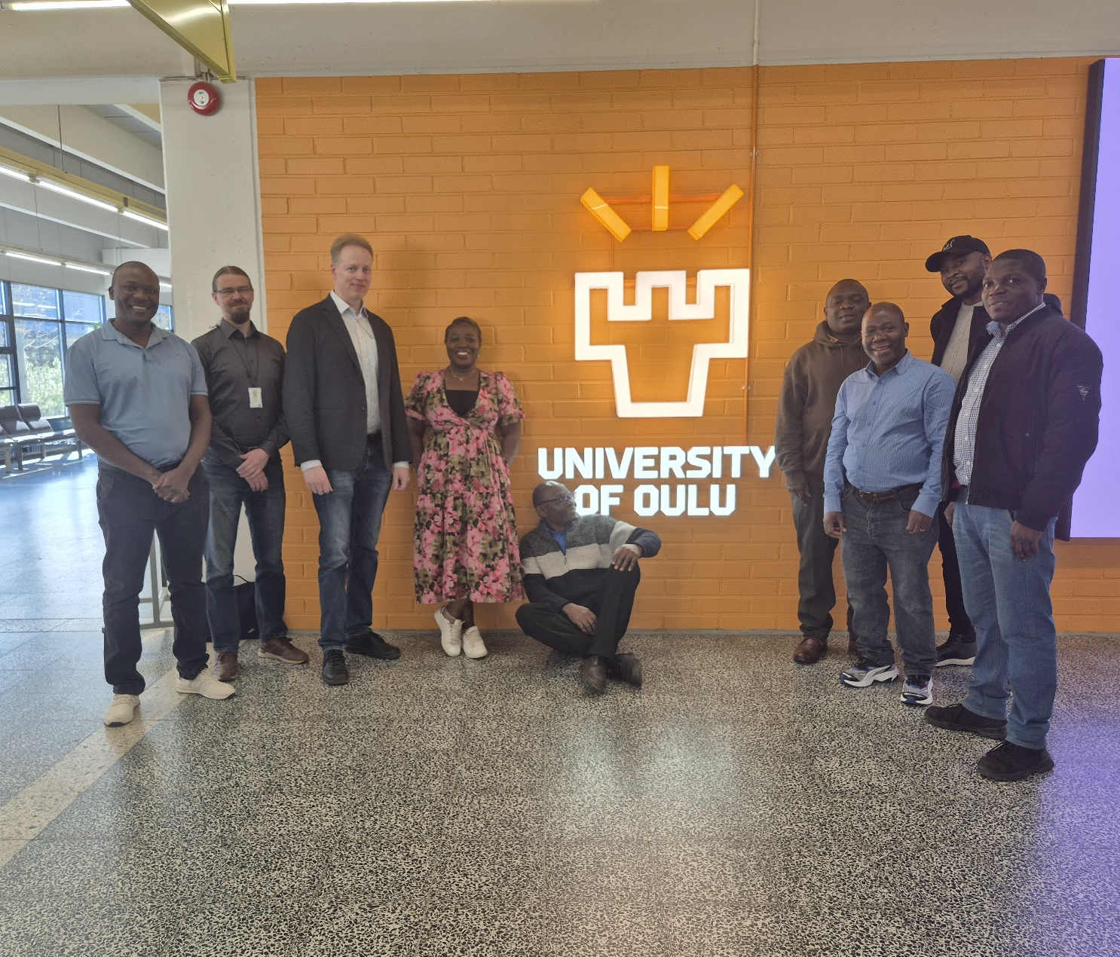
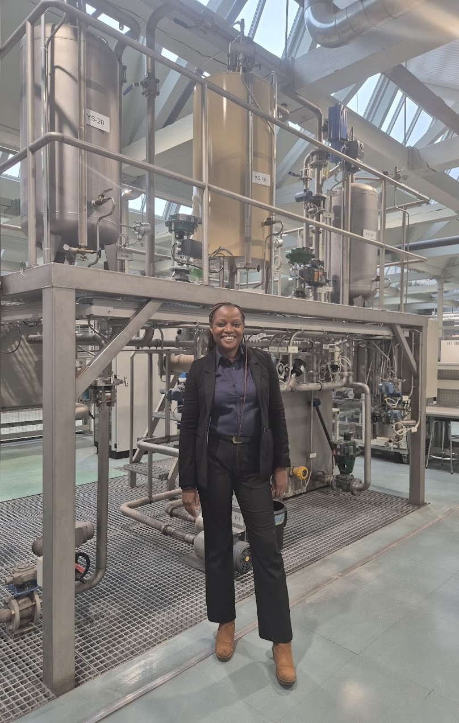
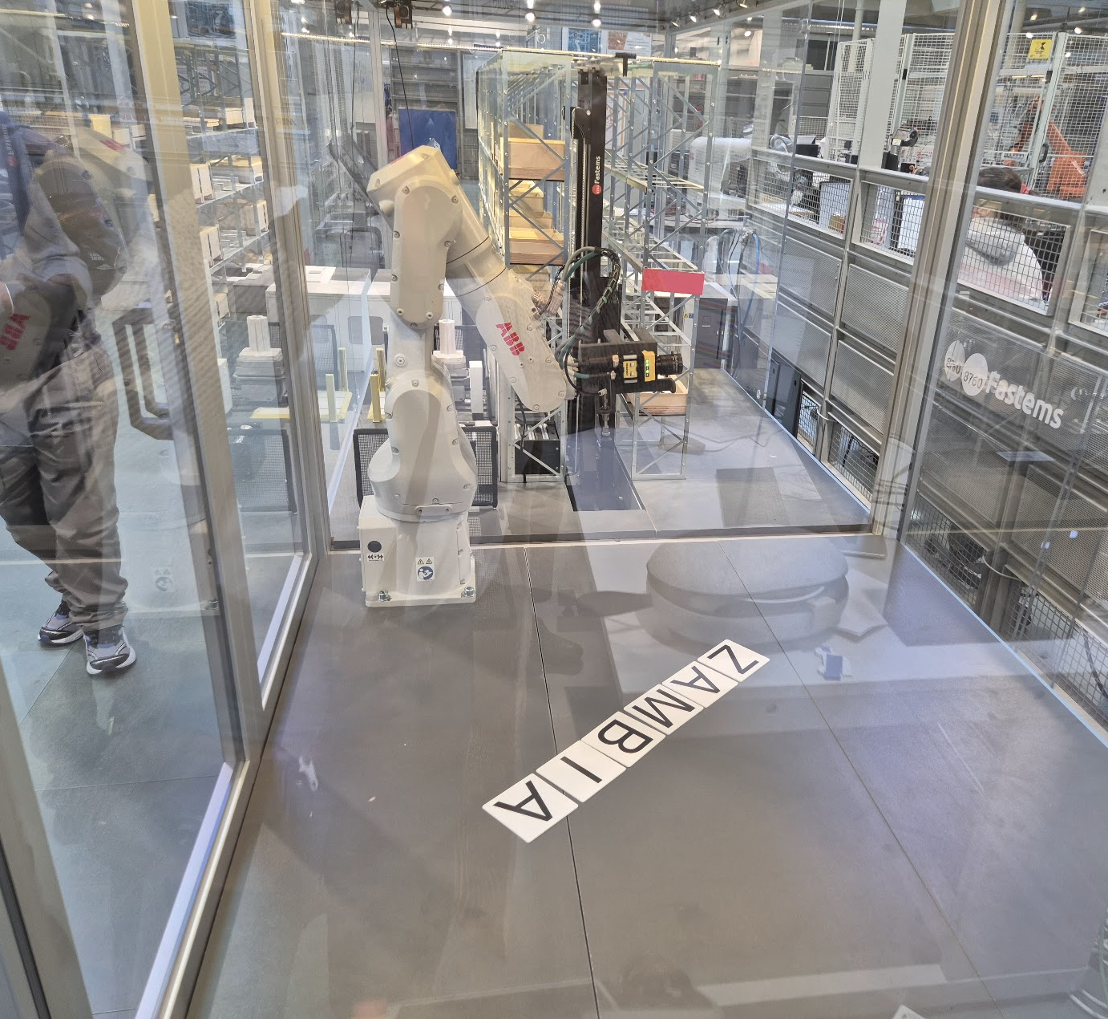
Acknowledgements
Co-Authors
University of Zambia:
Dr. Mwansa Kaoma, Dr. Mabvuto Mwanza & Dr. Shadreck Mpanga
Copperbelt University:
Dr. Agabu Shane, Dr. Mweene Himwiinga, Dr. Jhonnah Mundike, Eng. Ackim Mvula & Dr. Kelvin Akapelwa
University of Oulu:
Prof. Mika Ruusunen & Dr. Petri Hietarharju

Slide 18
The End
THANK YOU FOR YOUR ATTENTION.

