Slide 1

2026 ENGINEERING INSTITUTION OF ZAMBIA SYMPOSIUM
Enhancing Residential Energy Efficiency through Audits, Net Metering, and Digital Modeling in Zambia
Authors : Dr. Patrick Mubanga, Aaron Munyanya
DATE : Friday 17th April 2026
Avani Victoria Falls Resort, Livingstone, Zambia

Slide 2
Outline of Presentation
Introduction
Problem Statement
Rationale
Research Aim and Objectives
Literature Review
Methodology
Work Plan and Timeline
Expected Impact
Conclusion
References
Questions and Discussions

Slide 3
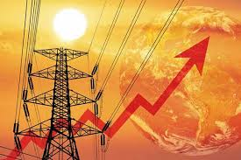
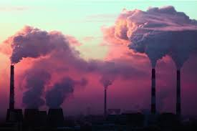
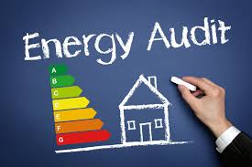
Introduction
Energy demand in residential and industrial sectors across Africa continues to increase
This is directly as a result of a growing population and increasing industrial activity
However, conventional energy auditing processes are typically slow and labour-intensive, resulting in limited accountability in energy usage and consumption patterns.

Slide 4
Problem Statement
Zambia’s residential electricity demand is rising due to population growth and increased appliance use
National Grid Faces Challenges:
  Seasonal Hydropower Shortages
  Peak Demand Pressures
  Improper Integration of distributed renewable energy (e.g., Rooftop solar)
  Inefficient appliances and energy practices
Barriers to smart energy solutions:
  Limited adaptation of digital tools in the energy sector
  Little use of artificial intelligence in load prediction and management

Slide 5
Rationale
Energy demand in Zambia’s residential sector is increasing, driven largely by inefficient consumption patterns.
The proposed solution leverages python programming and artificial intelligence to rapidly identify inefficiencies, generate actionable recommendations and improve energy management and cost savings.
This approach supports sustainable energy use, enhances grid stability, and maximises the benefits of renewable energy integration in Zambia

Slide 6
Research Aim
AIM:
To develop and evaluate an integrated residential energy software model for Zambia that combines energy auditing, efficiency analysis, and net metering to optimise energy consumption, reduce costs and support grid stability
Objectives:
Develop a software-based energy auditing and analysis too
Identify and Quantify inefficiencies in residential energy use
Integrate net metering strategies with solar PV systems
Assess contribution to National Grid of alternative renewable energy solutions

Slide 7
Literature Review
Area | Key Findings (Authors) | Limitations/Gaps
Energy Consumption | Rising demand due to inefficiencies in lighting, appliances, and buildings (IEA, 2022) | Limited accountability in household energy use
Energy Audits | Can reduce energy use by 20–40% (Saidur, 2009; UNEP, 2022) | Traditional audits are slow and labour-intensive
Energy Efficiency | LEDs reduce use by up to 80%; behavioUr adds 5–15% (Ozturk & Dincer, 2021; Abrahamse & Steg, 2013) | Adoption barriers and lack of monitoring tools
Net Metering & Solar | Reduces costs by 30–60% (Khalil et al., 2020; IEA, 2023; Awerbuch & Preston, 2019) | Limited effectiveness without efficiency improvements
Zambian Context | Hydropower dependence; need for solar integration (ZESCO, 2023; ERB, 2022) | Lack of integrated residential energy optimisation systems
Limited research integrates energy auditing, efficiency measures, and net metering into a unified residential energy model for Zambia.

Slide 8
Methodology
The Software is built using WxPython Graphics Library and the Python Programming Language
1. Software built with WxPython as separate modules then integrated in one system.
2. Inefficiencies are identified and recommendations are made with the help of sci-kit learn

Slide 9
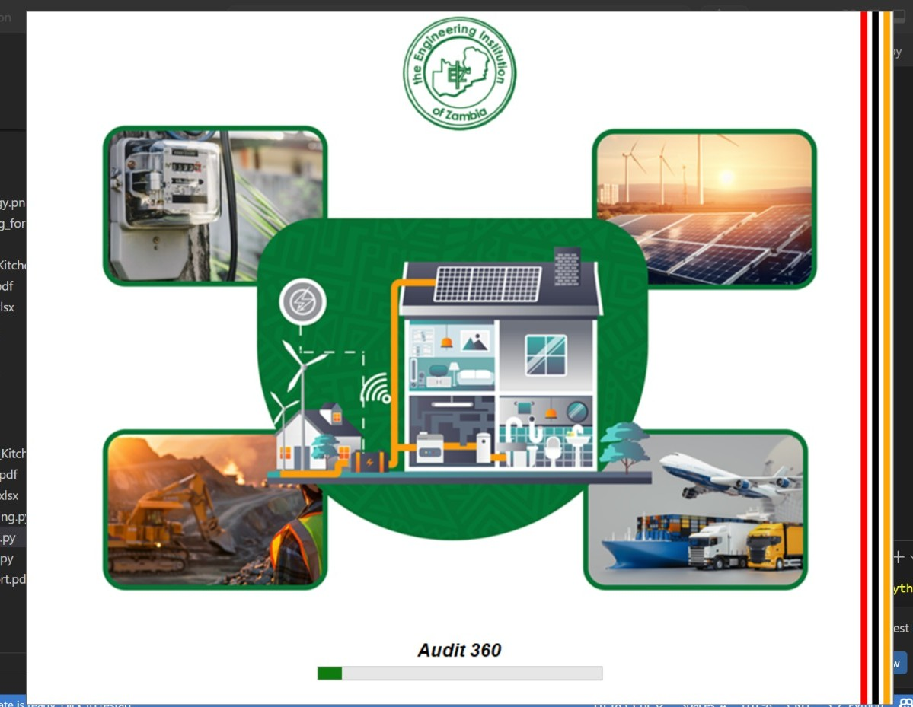
Work Done So Far
System Overview:
The system is designed for net metering and energy audits in various industries
Key Features:
Weather Prediction for more informed decision making.

Slide 10
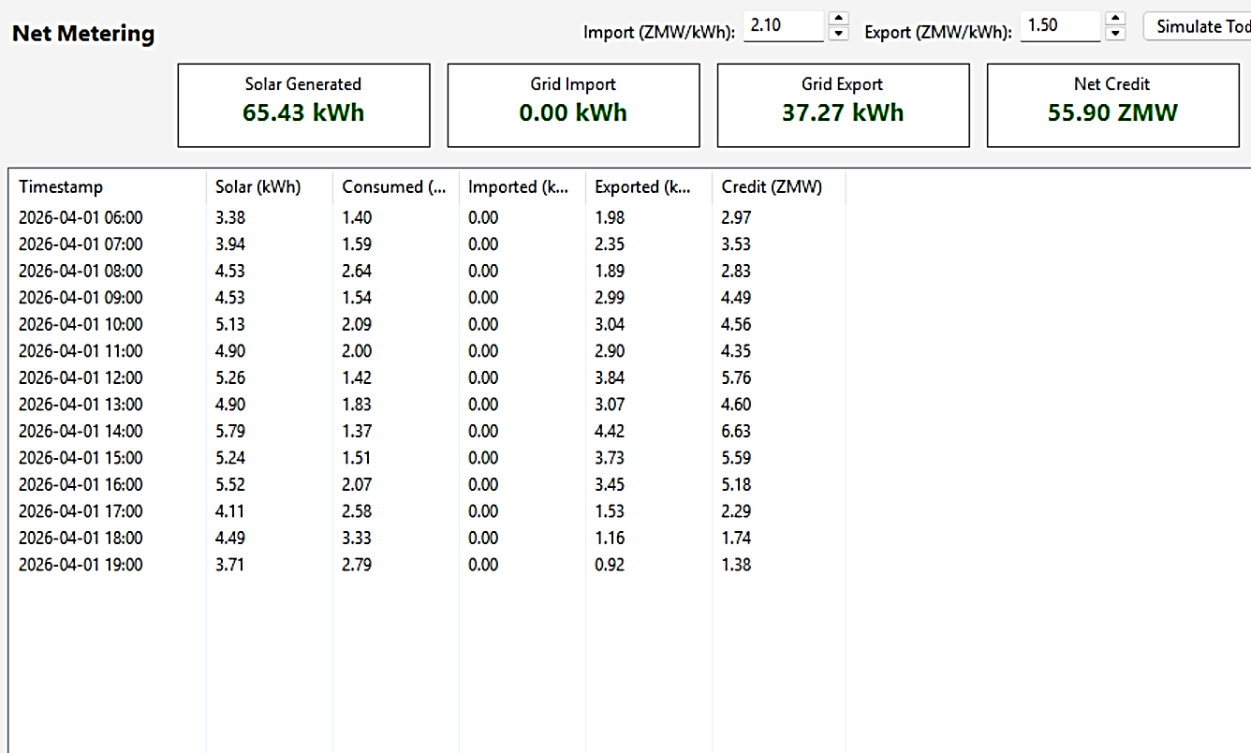
Real Time Net Metering Monitoring
Real-time net metering monitoring tracks energy inflow, on-site generation, and energy exported to the grid, allowing continuous evaluation of net power and system performance.

Slide 11
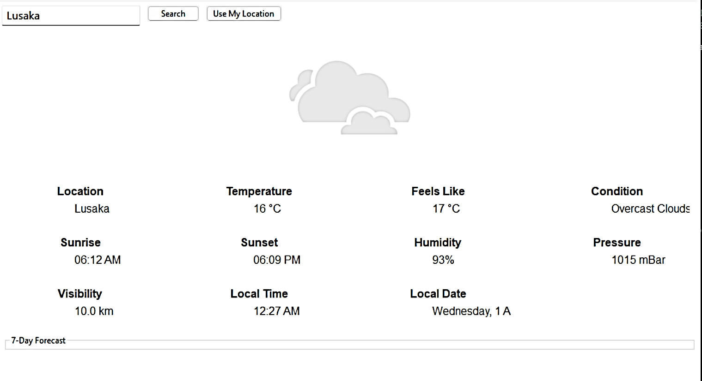
Weather Prediction
The model incorporates weather prediction to optimise energy generation and consumption based on environmental conditions.

Slide 12
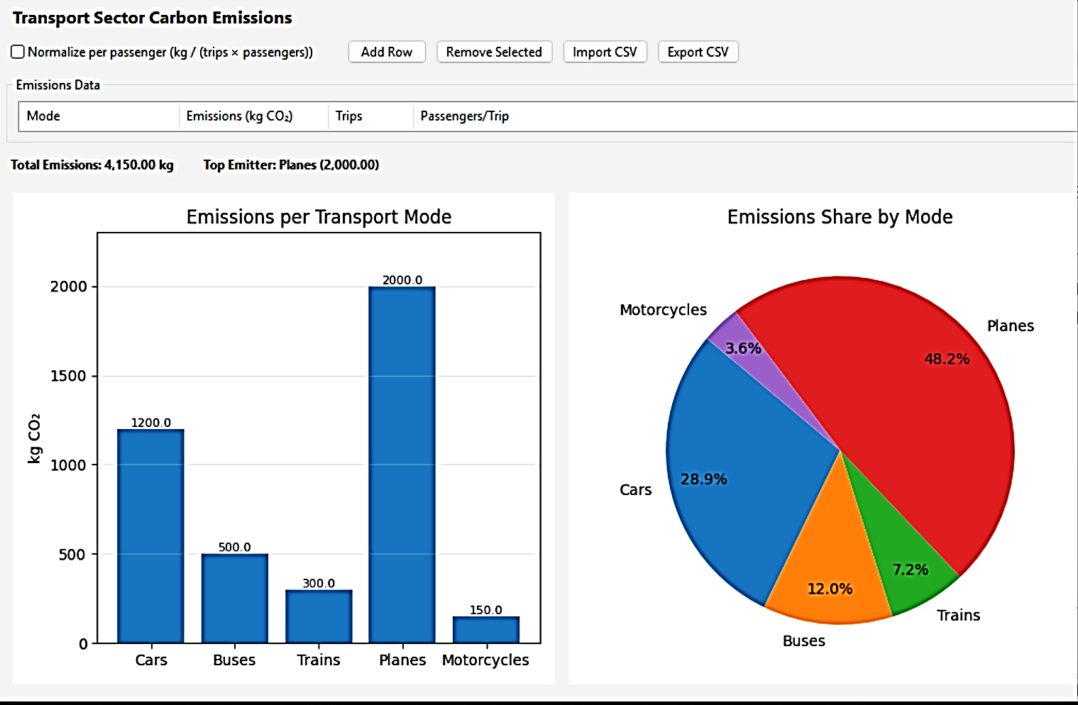
Carbon Footprint Monitoring
Carbon Emissions in the transport sector can be estimated to see the impact of clean energy in reducing emission (energy audits in the transport sector)

Slide 13
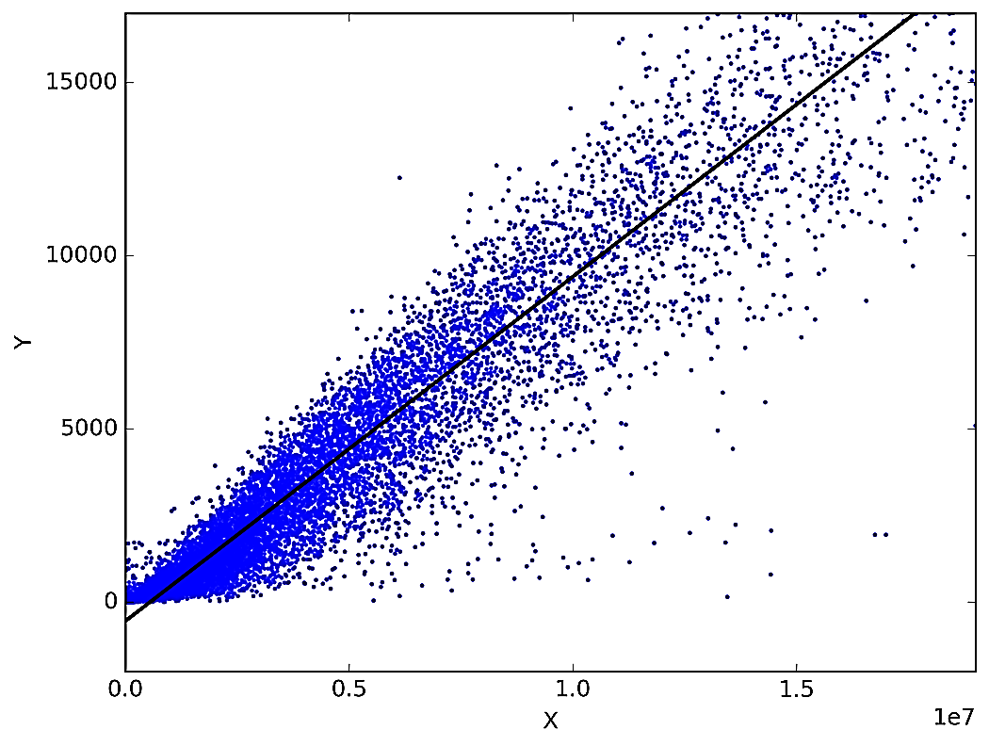
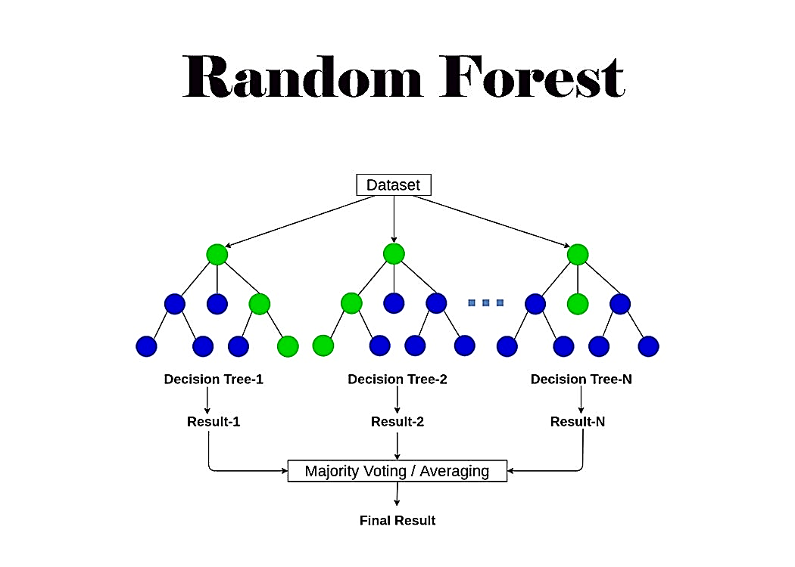
Integration Of Machine Learning
The model utilises supervised learning algorithms, including Linear Regression and Random Forest, to forecast energy usage and derive efficiency recommendations.
Linear regression predicts energy consumption by modeling the relationship between input variables and output using a best-fit line.
Random Forest improves prediction accuracy by combining multiple decision trees to model complex energy usage patterns.

Slide 14
Activity Timeline
Phase | Activity | Start Month | End Month
1 | Stakeholder Engagement | Feb | Feb
2 | Perfection of Weather Forecasting Component; Field Audits and Data Collection | Feb | Apr
3 | Data Collection and Integration of Net Metering | Apr | May
4 | Pilot Testing and Evaluation | May | May
5 | Reporting and Dissemination | Jun | Jun

Slide 15
Expected Impact
No | Aspect | Impact
1 | Household energy audits | Identify key inefficiencies in lighting, refrigeration, and heating to target energy savings.
2 | Efficiency interventions | Upgrades like efficient lighting, refrigeration, and heating practices significantly reduce household energy demand.
3 | Net-metering with PV systems | Increases energy export potential, accumulates monthly credits, and lowers dependence on grid electricity.
4 | Integrated energy model | Improves overall household energy balance and reduces electricity costs.
5 | System-level impact | Supports grid stability, reduces peak demand, and advances renewable energy adoption in Zambia.

Slide 16
Conclusion
Integrated framework combines household energy audits, efficiency improvements, and solar PV net metering
Targeting inefficiencies in lighting, refrigeration, and heating can cut electricity use significantly
The proposed solution provides a practical too for sustainable residential energy management in Zambia

Slide 17
References
Abrahamse, W., & Steg, L. (2013). Social influence approaches to encourage resource conservation: A meta-analysis. Global Environmental Change, 23(6), 1773–1785.
Atikol, U., & Ugursal, V. I. (2020). Comparison of residential energy systems for improved efficiency. Energy and Buildings, 210, 109736.
Awerbuch, S., & Preston, A. (2019). Distributed solar in emerging markets: Economic impacts and household benefits. Renewable Energy Journal, 145, 1230–1242.
Energy Regulation Board (ERB). (2022). Net Metering Guidelines for Zambia. ERB Publications.
International Energy Agency (IEA). (2022). Energy Efficiency 2022: Analysis and Outlook. IEA Publications.
International Energy Agency (IEA). (2023). Solar PV and Demand Reduction Strategies. IEA Renewable Integration Series.
Khalil, M., Al-Shetwi, A., & Hisham, A. (2020). Net metering policies and their impact on rooftop solar adoption: A global review. Energy Policy, 146, 111770.
Ozturk, H., & Dincer, I. (2021). Residential energy efficiency improvements and their implications. Sustainable Energy Technologies and Assessments, 45, 101142.
Saidur, R. (2009). Energy consumption, energy savings, and emission analysis in Malaysian households. Energy Policy, 37(10), 4104–4113.
United Nations Environment Programme (UNEP). (2022). Energy Efficiency in Buildings: Global Report. UNEP Publishing.
World Bank. (2021). Digital infrastructure for energy systems in Sub-Saharan Africa: Opportunities for smart metering and automation. World Bank Group.
ZESCO Limited. (2023). Annual Energy Report: Hydropower Performance and Renewable Integration. ZESCO Corporate Publications.

Slide 18
The End.
Questions & Discussion

