Slide 1

2026 ENGINEERING INSTITUTION OF ZAMBIA SYMPOSIUM
ASSESSING THE IMPACT OF CLIMATE-INDUCED DROUGHTS ON GROUNDWATER RECHARGE RATES USING A MULTI-METHOD APPROACH IN NDOLA, ZAMBIA
PRESENTER : Mumba Imelda Nkwabilo
SUPERVISORS : Dr. Muumbe K. Lweendo & Ms. Ada Farai Shaba
Mulungushi University
DATE : Friday 17th April 2026
Avani Victoria Falls Resort, Livingstone, Zambia
Notes:
Good day, distinguished guests
My name is Mumba Imelda Nkwabilo, and today I will be presenting my research titled:
‘Assessing the Impact of Climate-Induced Droughts on Groundwater Recharge Rates Using a Multi-Method Approach in Ndola, Zambia.’
This work was conducted under the supervision of Dr. Muumbe K. Lweendo and Ms. Ada Farai Shaba from Mulungushi University.

Slide 2
Presentation Overview
Introduction/Problem Statement
Objectives
  Methodology
  Results & Discussion
  Conclusion
  Recommendations
  Reference
Notes:
I will structure my presentation as follows:
I will begin with the problem and background and end with recommendations

Slide 3
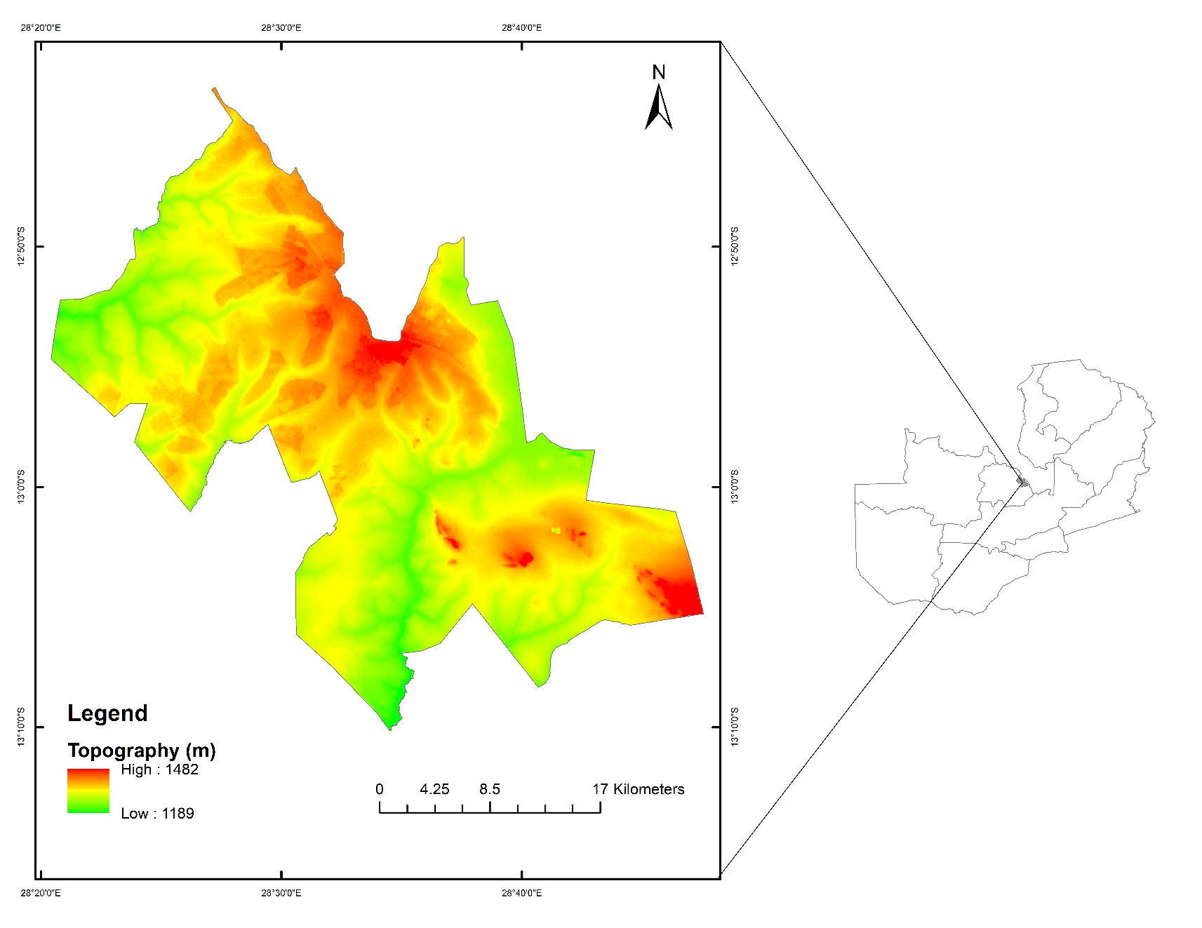
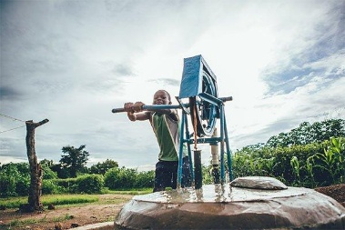
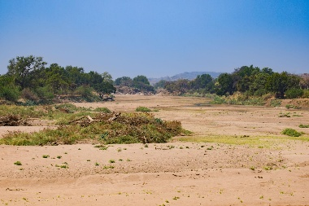
Introduction/Problem Statement
Why groundwater matters
Climate Pressure
Research Gap:
  Recharge dynamics
  Impacts on groundwater
  Figure 1:Study Area Map
Notes:
Groundwater is a vital resource supporting domestic water supply, agriculture, and industry. In many parts of Zambia, including Ndola, it is the most reliable water source.
However, climate change, particularly droughts places increasing pressure on groundwater systems.
One major challenge is the limited understanding of how droughts affect groundwater recharge, which creates a critical research gap and challenges in Groundwater management
This study focuses on addressing that gap using Ndola as a case study.

Slide 4
Objectives
  To estimate groundwater recharge using the Water Table Fluctuation (WTF) method.
Objective 1
Objective 2
  To estimate recharge using Chaturvedi empirical formula.
  To estimate recharge using the Water Balance Method (WBM) implemented in Google Earth Engine.
Objective 3
  To analyze the spatial and temporal variations relative to rainfall and drought.
Objective 4
Notes:
The study was guided by four main objectives:
First, to estimate groundwater recharge using the Water Table Fluctuation method.
Second, to estimate recharge using the Chaturvedi empirical formula.
Third, to estimate recharge using the Water Balance Method implemented in Google Earth Engine.
And finally, to analyze spatial and temporal variations in recharge in relation to rainfall and drought patterns.

Slide 5
Methodology
Data Collection
  Summary of datasets and sources
Data | Source | Resolution
Rainfall | ZMD | Monthly
Groundwater Levels | WARMA | Monthly
CHIRPS | https://www.chc.ucsb.edu/data/chirps | 0.05
MODIS ET | https://modis.gsfc.nasa.gov/data/dataprod/mod16.php | 500m
Soil | Ministry of Agriculture
Geology | Geological Survey Department | 1:100000
Landcover | https://esa-worldcover.org/en/data-access | 2020
Methodology
Methodology
Notes:
To achieve these objectives, multiple datasets were used.
Rainfall data was obtained from the Zambia Meteorological Department and CHIRPS at a resolution of 0.05 degrees.
Groundwater level data was obtained from WARMA.
Evapotranspiration data was sourced from MODIS at 500-meter resolution.
Additionally, soil data was obtained from the Ministry of Agriculture, geology data from the Geological Survey Department, and land cover data from ESA WorldCover.
These datasets formed the foundation for the recharge analysis.

Slide 6
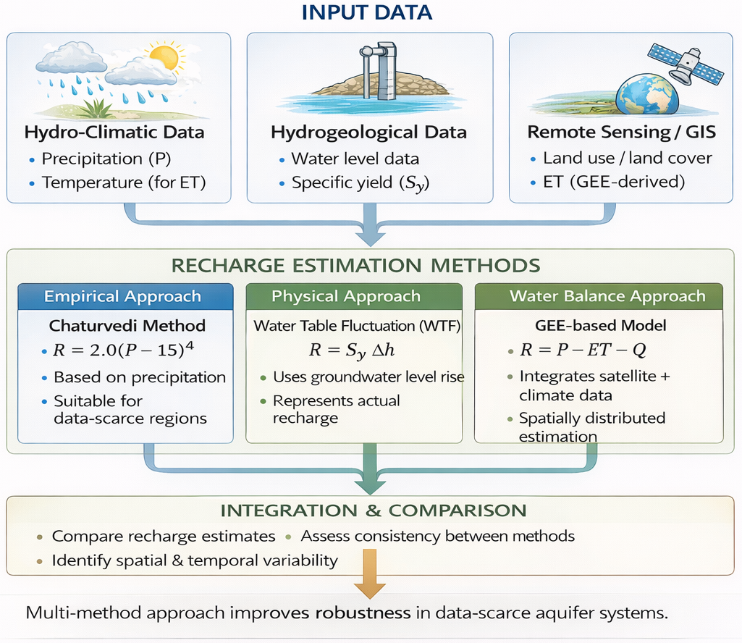
  Figure 2:Methodological Framework for groundwater for recharge estimation
Notes:
This figure shows the overall methodological framework used in the study.
It integrates data collection, preprocessing, and analysis using three different recharge estimation methods.
The framework also incorporates climate data and spatial analysis in Google Earth Engine.
This multi-method approach improves the reliability and robustness of the results.

Slide 7
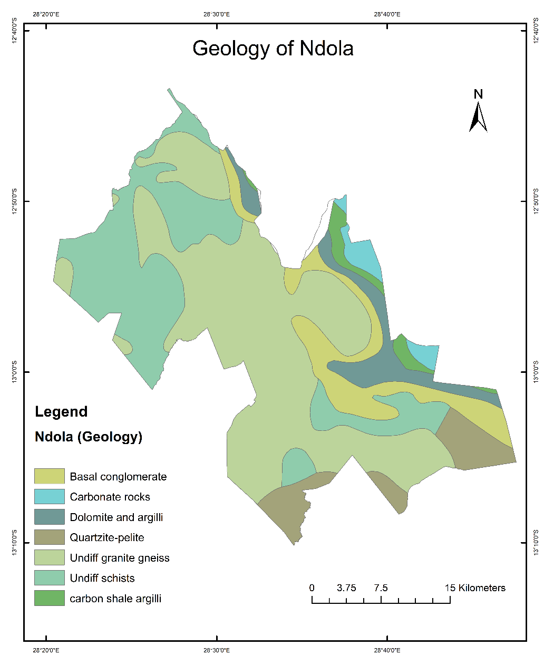
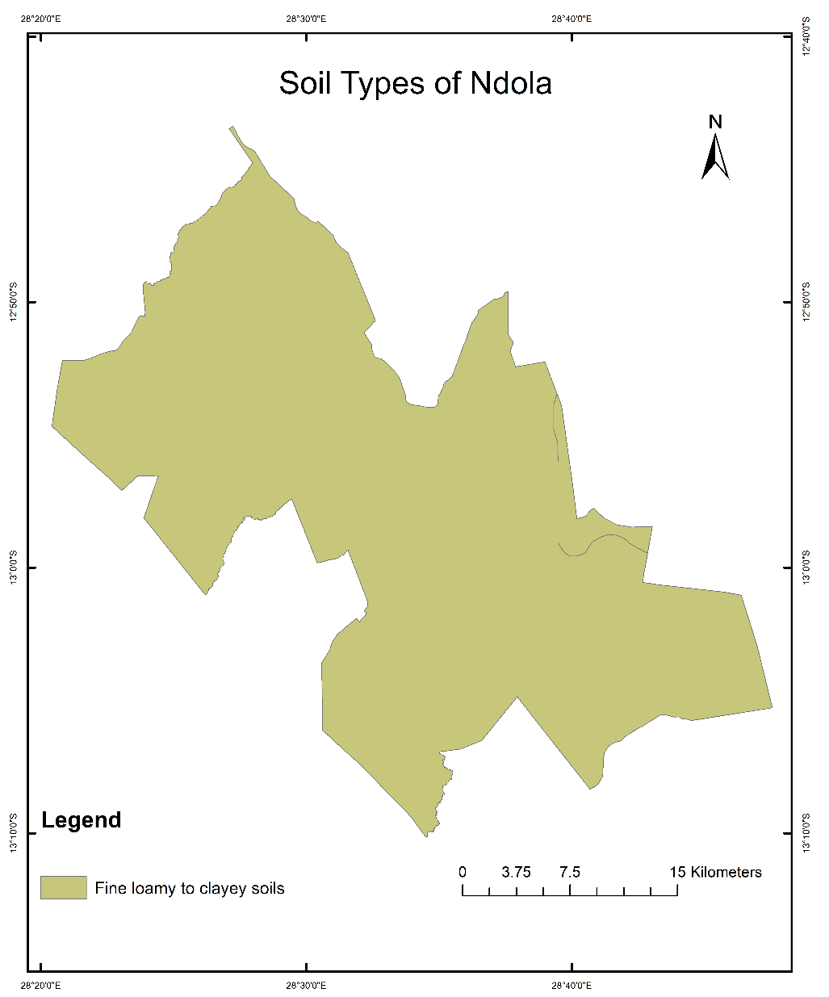
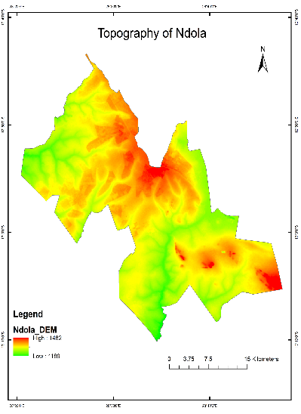
Results: Input Layers
  Climate Variability and Drought Trends
Figure 5: Topography
Figure 3: Geology
Figure 4: Soils
Notes:
Here, we present key input layers used in the analysis, including geology, soil types, and topography.
These physical characteristics play a significant role in controlling groundwater recharge.
For example, permeable soils and favorable geological formations enhance infiltration, while steep slopes may reduce recharge.
Understanding these layers is essential for interpreting recharge patterns.

Slide 8
Results
  Climate Variability and Drought Trends
Figure 6: Rainfall Trend
Figure 7: Temperature Trend
Notes:
This slide shows long-term climate trends.
Rainfall exhibits a decreasing trend over time, as indicated by the negative slope.
On the other hand, temperature shows a gradual increase.
This combination of decreasing rainfall and rising temperatures indicates increasing climate stress and drought conditions.
These trends have direct implications for groundwater recharge

Slide 9
  Results Cont’d
Figure 8: Precipitation anomaly
Drought hotspot years
Notes:
This figure shows precipitation anomalies over time.
Negative anomalies indicate drought years, while positive anomalies represent wet years.
We can clearly identify drought hotspot periods where rainfall was significantly below average.
These drought periods correspond to reduced groundwater recharge, highlighting the sensitivity of recharge to climate variability.

Slide 10
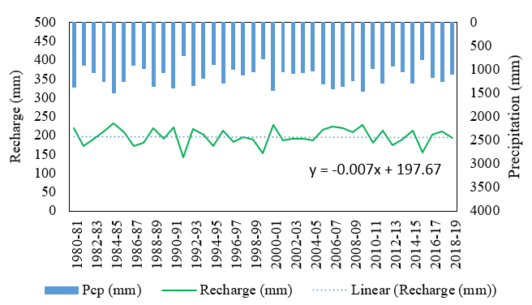
Results Cont’d
Estimation of groundwater recharge
  Figure 4: Recharge estimates from the Chaturvedi method
Figure 9: groundwater recharge
Notes:
This slide presents groundwater recharge estimates obtained using the Chaturvedi empirical method.
This method provides a simplified estimation based on rainfall.
While useful, it does not fully account for spatial variability or land surface processes.
However, it serves as a good baseline for comparison with other methods.

Slide 11
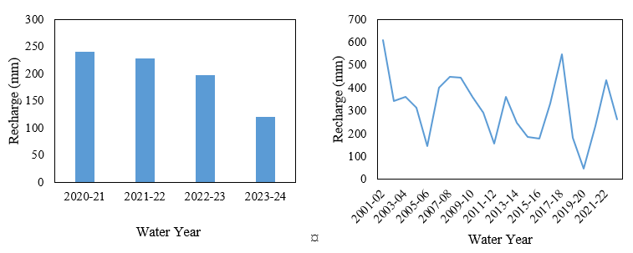
  Results Cont’d
  Figure 10: Recharge estimates from
  using the WTF method
Figure 11: Recharge estimates from WBM
Notes:
Here, we compare recharge estimates from two methods.
The Water Table Fluctuation method uses observed groundwater level changes, making it more data-driven.
The Water Balance Method, implemented in Google Earth Engine, incorporates rainfall, evapotranspiration, and runoff.
Together, these methods provide a more comprehensive understanding of recharge dynamics.

Slide 12
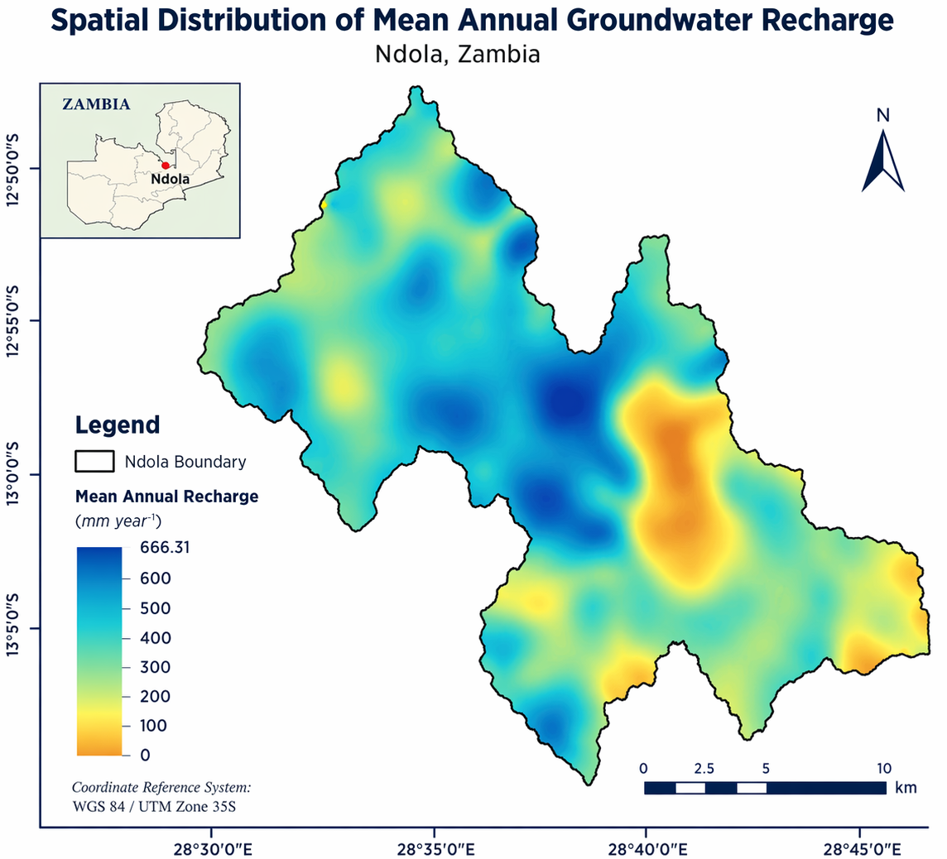
Results Cont’d
  Figure 12: Mean Annual Groundwater Recharge in Ndola (2001-2022)
Notes:
This figure shows the mean annual groundwater recharge in Ndola from 2001 to 2022.
There is noticeable variability across years, largely driven by rainfall patterns.
Wet years show significantly higher recharge, while drought years show sharp declines.
This reinforces the strong link between climate and groundwater recharge.

Slide 13
Conclusion
  Recharge estimates were highly sensitive to rainfall and land cover, ranging from 48 mm to over 600 mm.
  Spatially urbanized zones had the lowest recharge, while vegetated areas had the highest .
  These findings highlight the need for climate-informed groundwater management and protection interventions
Notes:
In conclusion:
Recharge estimates varied widely, ranging from about 48 millimeters to over 600 millimeters.
Urbanized areas showed the lowest recharge, while vegetated areas showed the highest.
Overall, the results emphasize the need for climate-informed groundwater management strategies.
Protecting recharge zones and understanding climate impacts is essential for sustainability

Slide 14
Recommendations
  Protect natural recharge zones.
  Expand groundwater monitoring network.
  Promote artificial recharge.
Notes:
Based on the findings, the following recommendations are made:
Protect natural recharge zones from urban development.
Expand the groundwater monitoring network to improve data availability.
And promote artificial recharge techniques to enhance groundwater storage.

Slide 15
The End
THANK YOU FOR YOUR ATTENTION.

