Slide 1
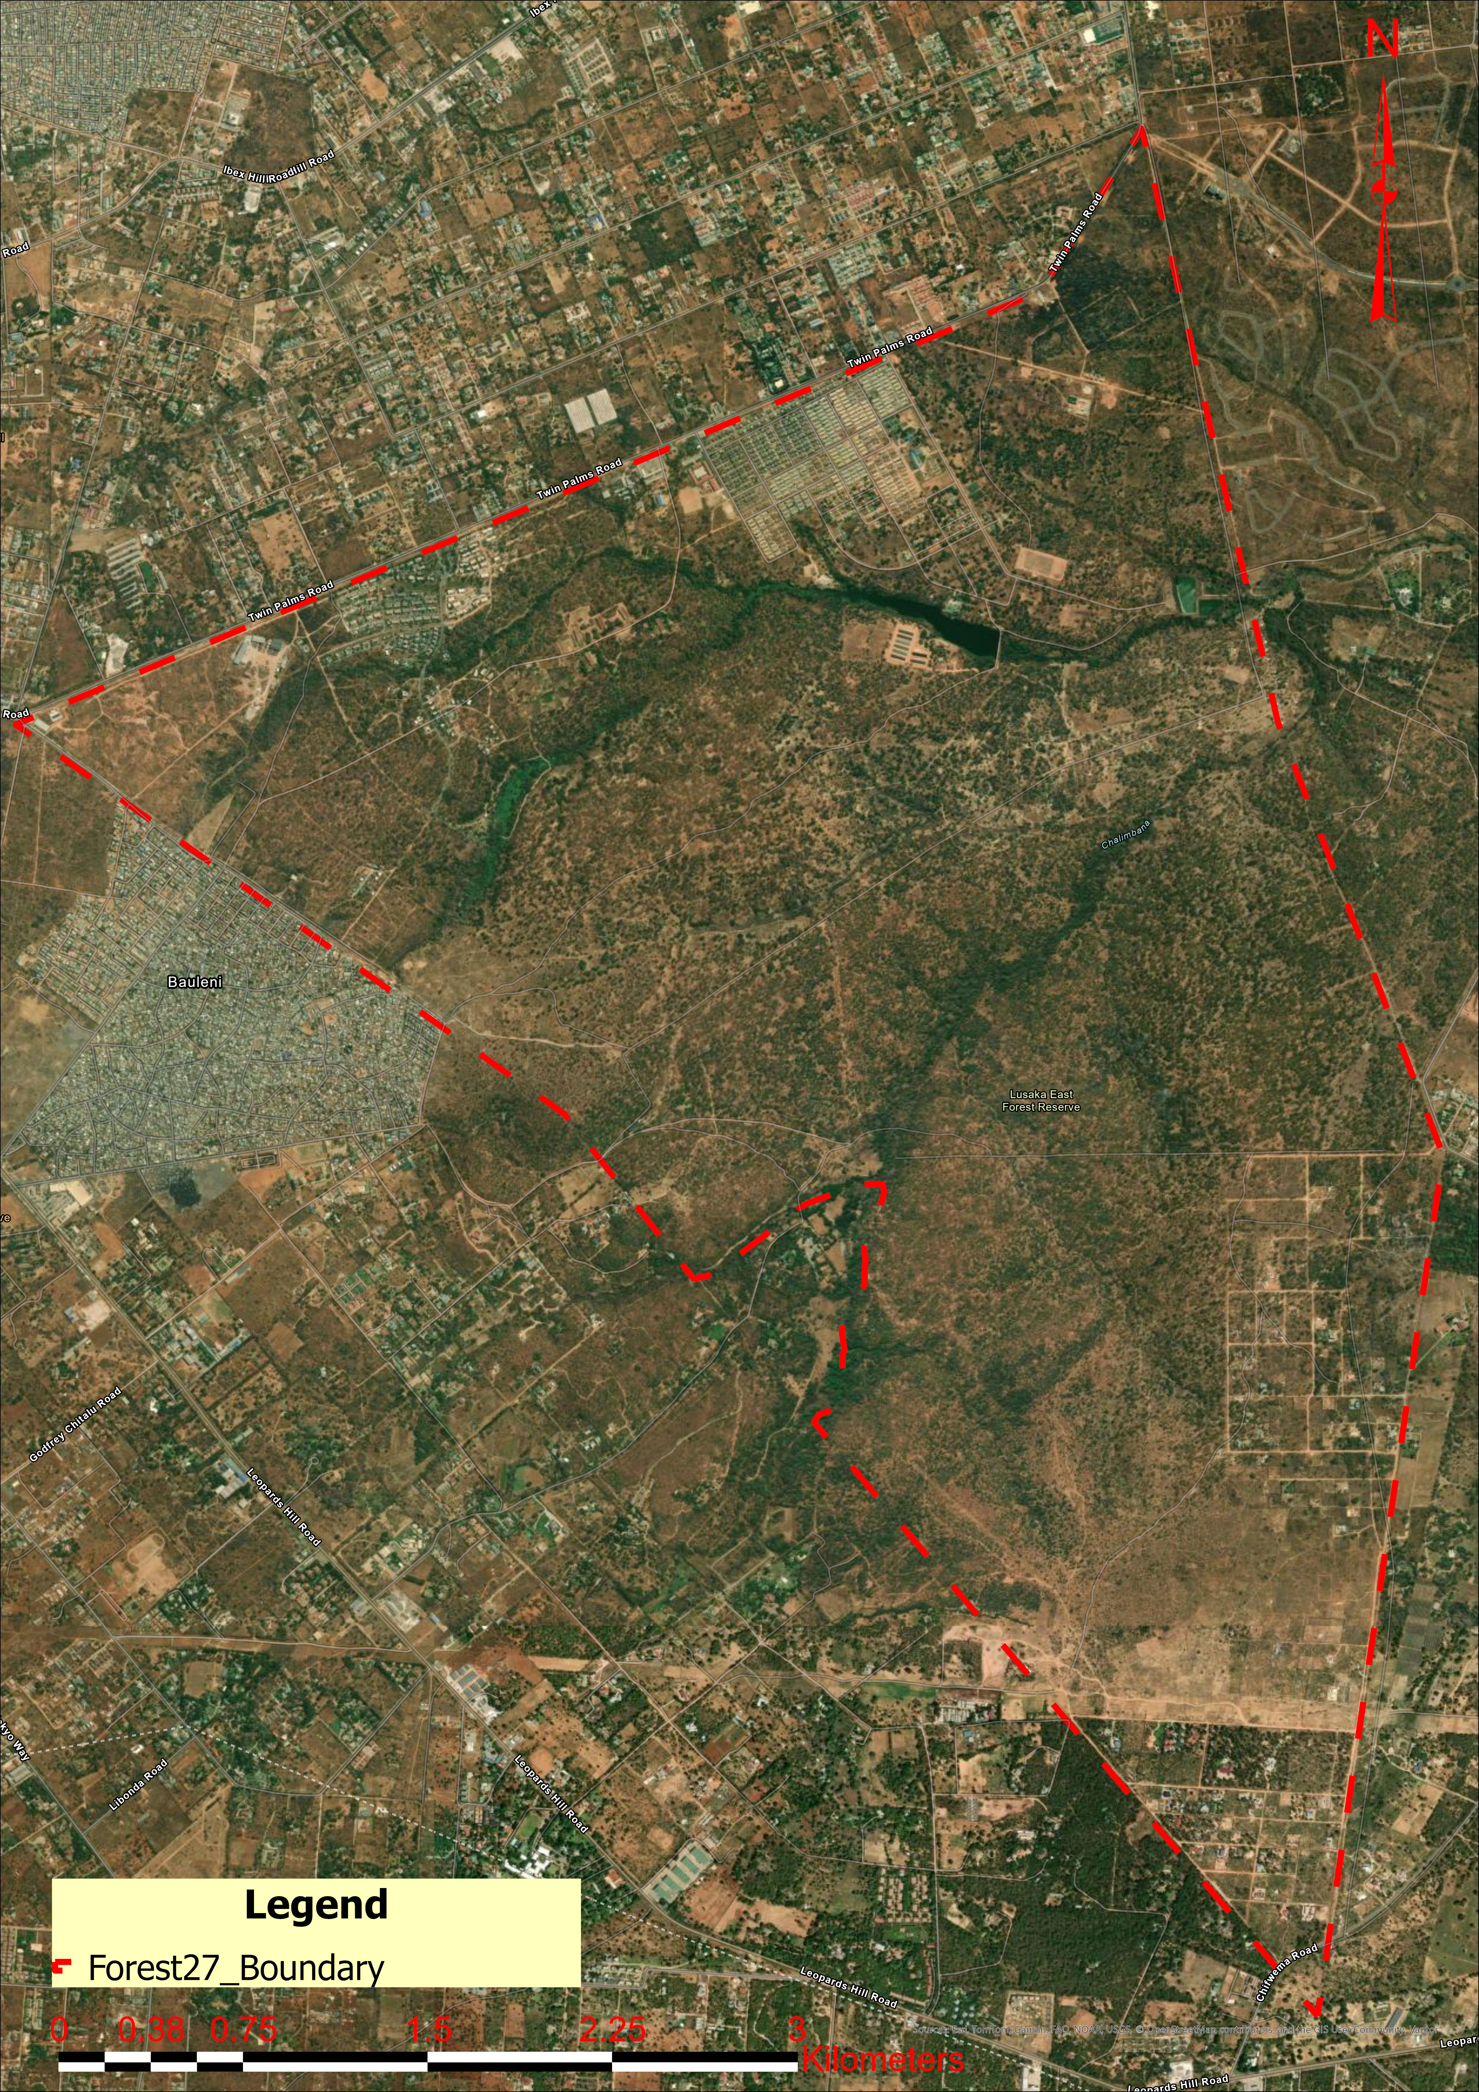

Engineering Institution of Zambia
Annual Symposium 2026
P05
Analysis of Forest Cover Dynamics in Lusaka East Forest Using Multi‑Sensor Remote Sensing and GIS Integration
Lusaka East Forest Reserve No. 27 | 2013 – 2024
Nachaambwa Miyanda Moonga | +260 76 989 0265
Co-Author: Michael Mutale | +260 96 254 9674
Submitted to: EIZ Symposium 2026

Slide 2
Presentation Outline
1
Background & Significance
5
NDVI Classification Results
2
Study Area
6
Land Cover Change Analysis
3
Research Objectives
7
Key Findings & Discussion
4
Data & Methodology
8
Conclusions & Future Work
Study focus: Lusaka East Forest Reserve No. 27 | 2013 – 2024 | Landsat Collection 2 · 30 m resolution
2 / 14

Slide 3
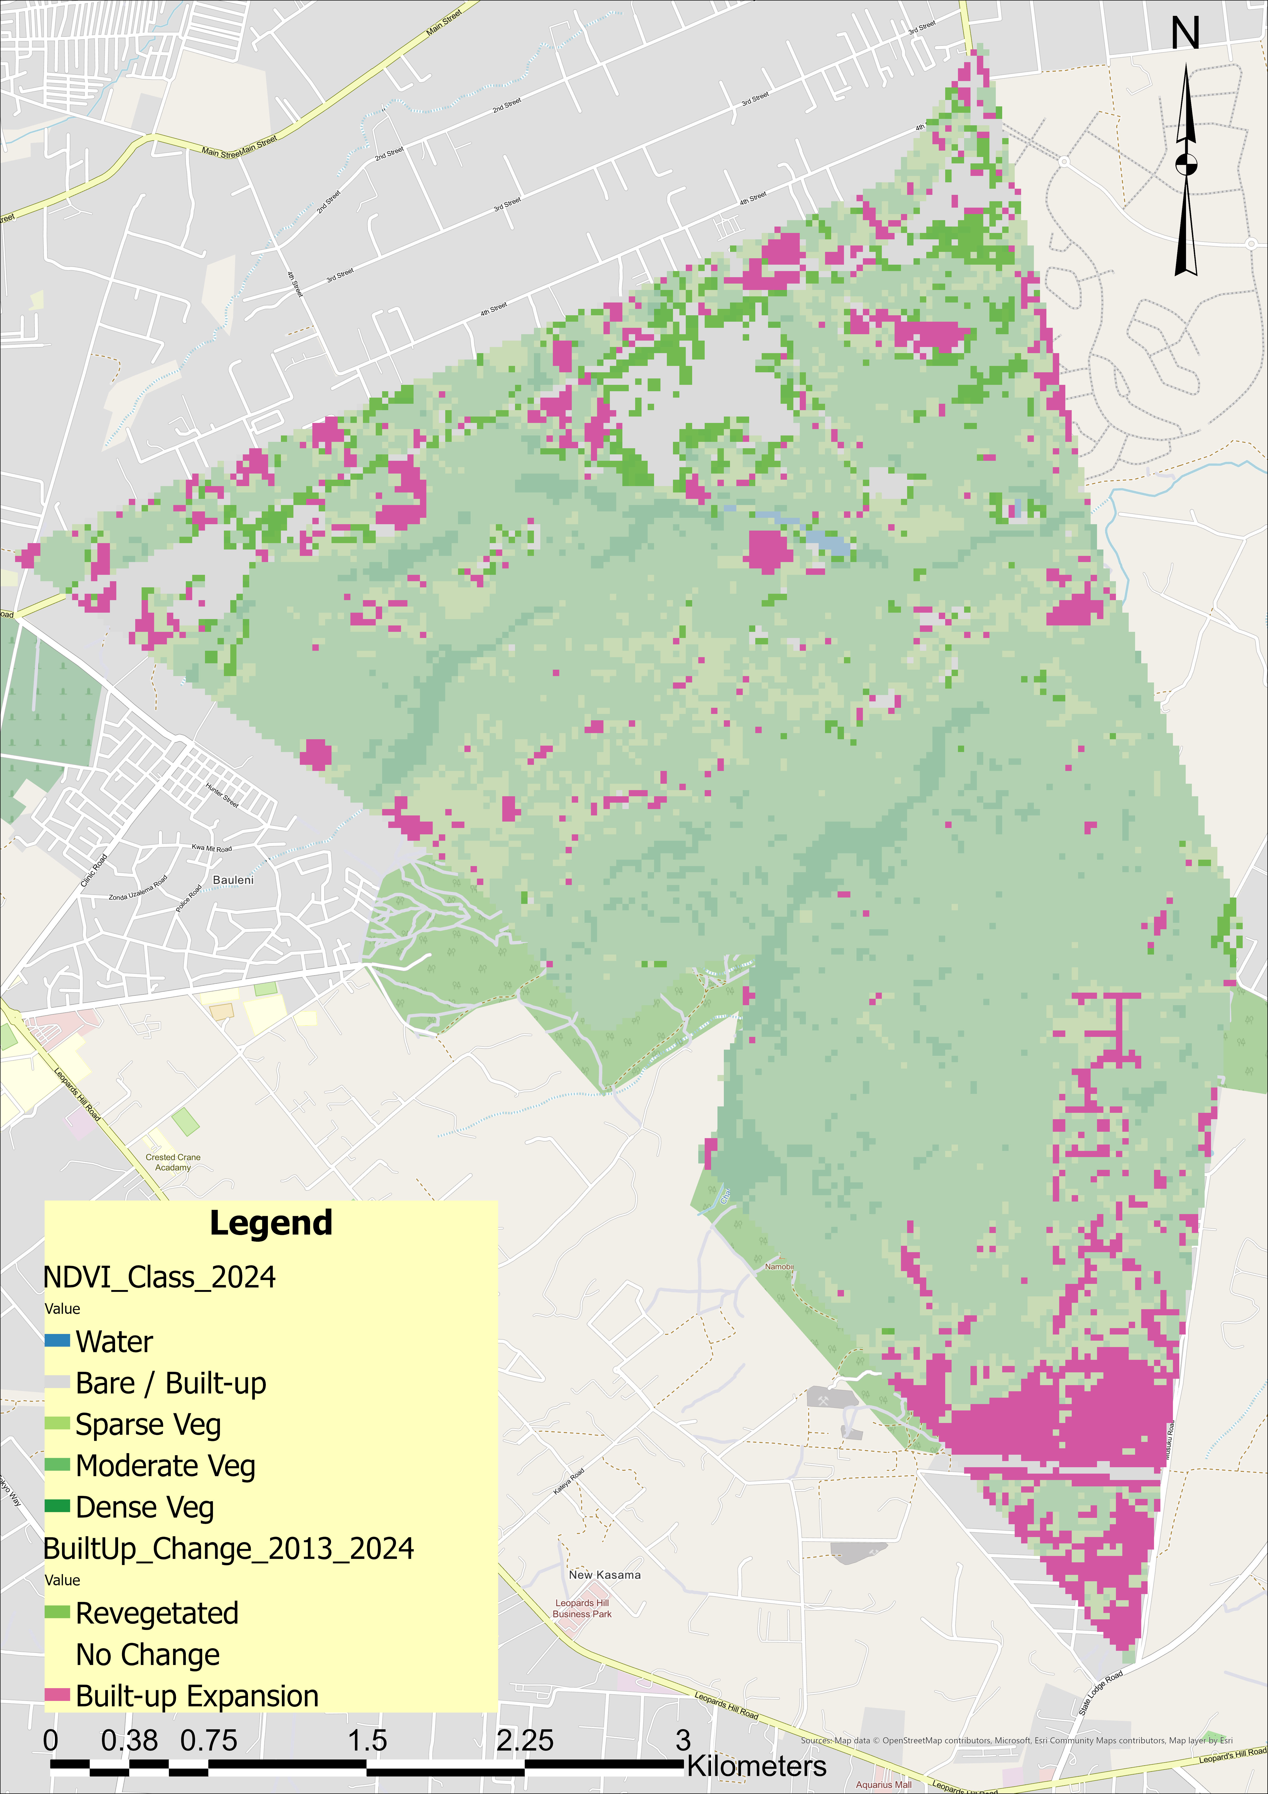
Background & Significance
Urban forests under pressure. Rapid urbanisation in sub-Saharan Africa is driving forest encroachment and informal settlement expansion on peri-urban reserves.
Lusaka's growth trajectory. Zambia's capital is one of Africa's fastest-growing cities, with population growth directly threatening adjacent forest reserves.
NDVI as a monitoring tool. Vegetation indices derived from satellite imagery provide a systematic, repeatable method for land cover change detection at landscape scale.
11-year Landsat time series. Landsat Collection 2 imagery (2013–2024) at 30 m resolution enables evidence-based assessment of forest degradation trends over time.
Global tropical deforestation: ~10 million ha/year — local-scale monitoring is critical (FAO, 2022)
3 / 14

Slide 4
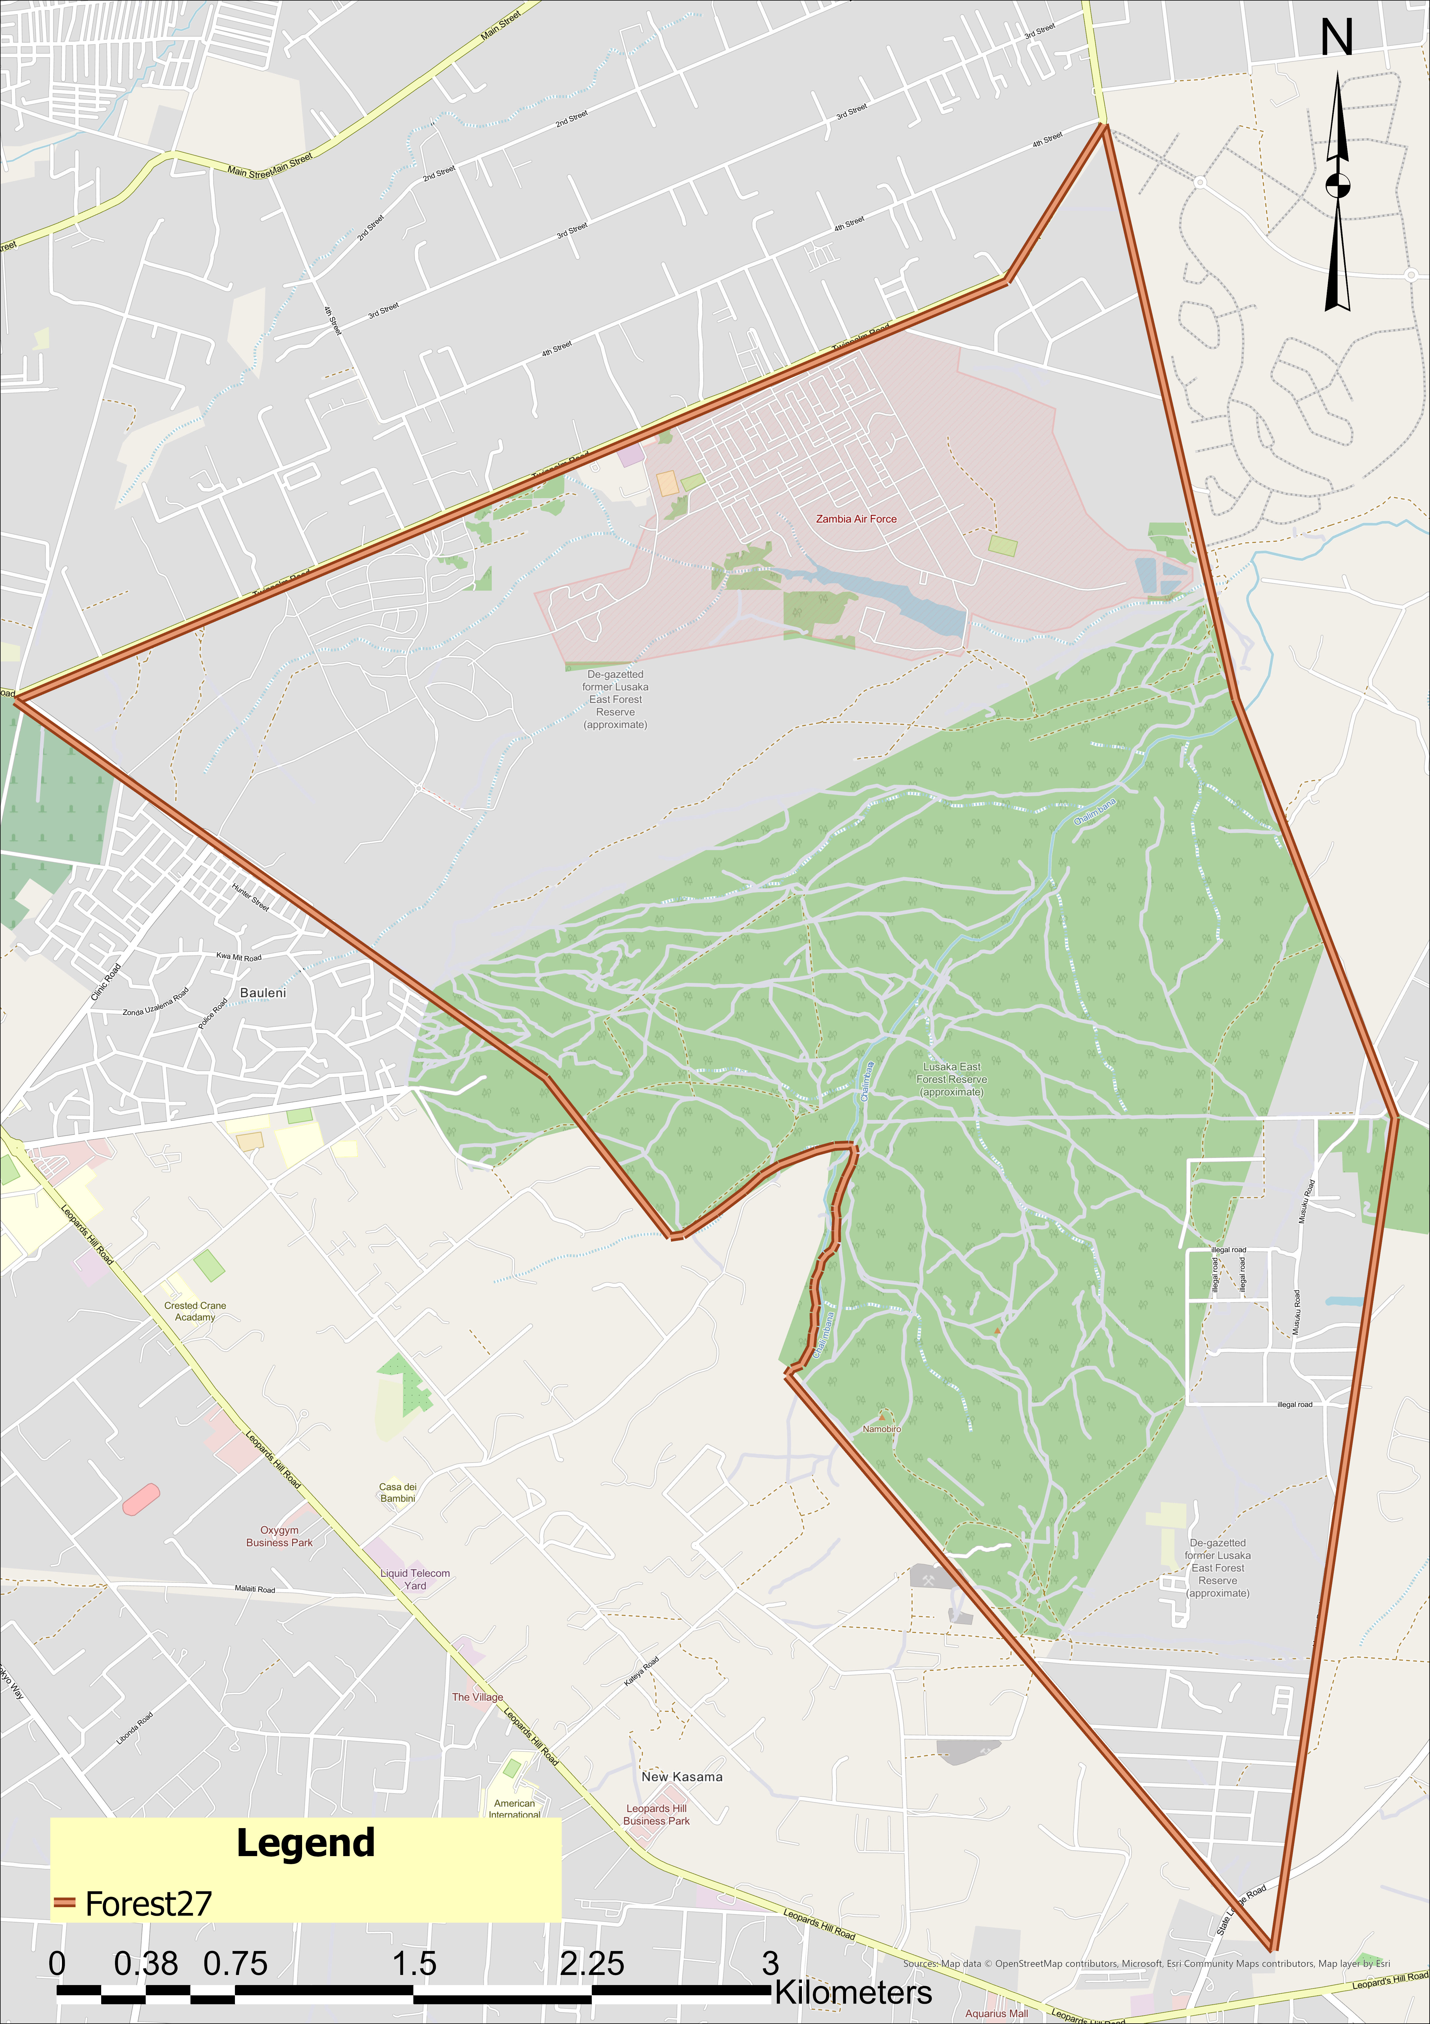
Study Area — Lusaka East Forest Reserve No. 27
Study Area Boundary
Site Profile
~1,788 ha
1,756 ha
Total mapped area
Classified pixels
~15 km
Chalimbana
East of Lusaka CBD
Sub-catchment
Miombo
30 m / 5 yrs
Woodland ecosystem
Resolution / time-steps
Landsat imagery — 30 m spatial resolution
4 / 14

Slide 5
Research Objectives & Methodology
Objectives
Methodology
Map land cover across Lusaka East Forest Reserve No. 27 for 2013–2024
Data Acquisition
Landsat C2 T1 Level-2 — dry season composites (Jun–Aug), 5 epochs
1
Classify five NDVI-based vegetation classes from Landsat Collection 2 Level-2 imagery
2. Preprocessing
DN × 0.0000275 − 0.2 → Surface Reflectance (Collection 2 scale factor)
2
3. Index Computation
NDVI, MNDWI, NDBI, BSI calculated per epoch
Quantify built-up expansion and dense vegetation loss using pixel-based statistics
3
4. Hybrid Classification
Majority-vote built-up mask (≥ 2 of 3: NDBI > 0.05, BSI > 0, NDVI < 0.20)
Identify spatial patterns of encroachment and forest degradation
4
5. Change Analysis
Cross-tabulation pixel statistics — 2013 baseline vs. 2024 final
5 / 14

Slide 6
Hybrid NDVI Classification Approach
Classification Priority
Spectral Indices
1
Water MNDWI > 0
NDVI
(NIR − Red)
──────────────
(NIR + Red)
2
Built-up Dry-season: NDBI > 0.05, BSI > 0, NDVI < 0.20
(majority-vote ≥ 2 of 3 conditions)
MNDWI
(Green − SWIR1)
──────────────
(Green + SWIR1)
3
Dense Veg. NDVI ≥ 0.40 (annual median composite)
4
Moderate Veg. NDVI 0.25 – 0.40
NDBI
(SWIR1 − NIR)
──────────────
(SWIR1 + NIR)
5
Sparse Veg. NDVI 0.10 – 0.25
6
Bare / Residual NDVI < 0.10
BSI
((SWIR1+Red) − (NIR+Blue))
─────────────────────
((SWIR1+Red) + (NIR+Blue))
Miombo context: Wet-season grass inflates NDVI on built-up plots — dry-season sub-composite prevents misclassification (Frost, 1996)
6 / 14

Slide 7
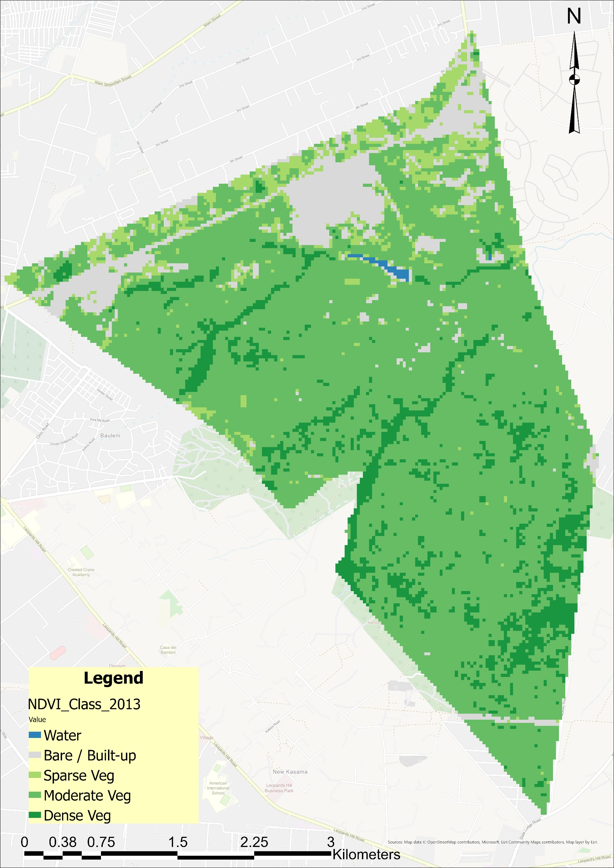
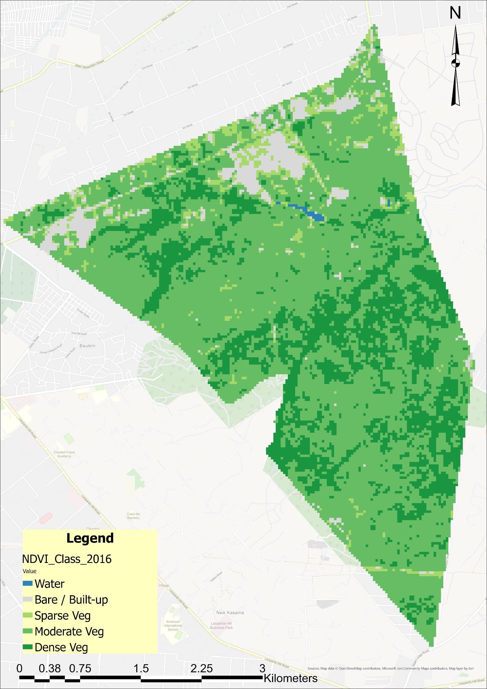
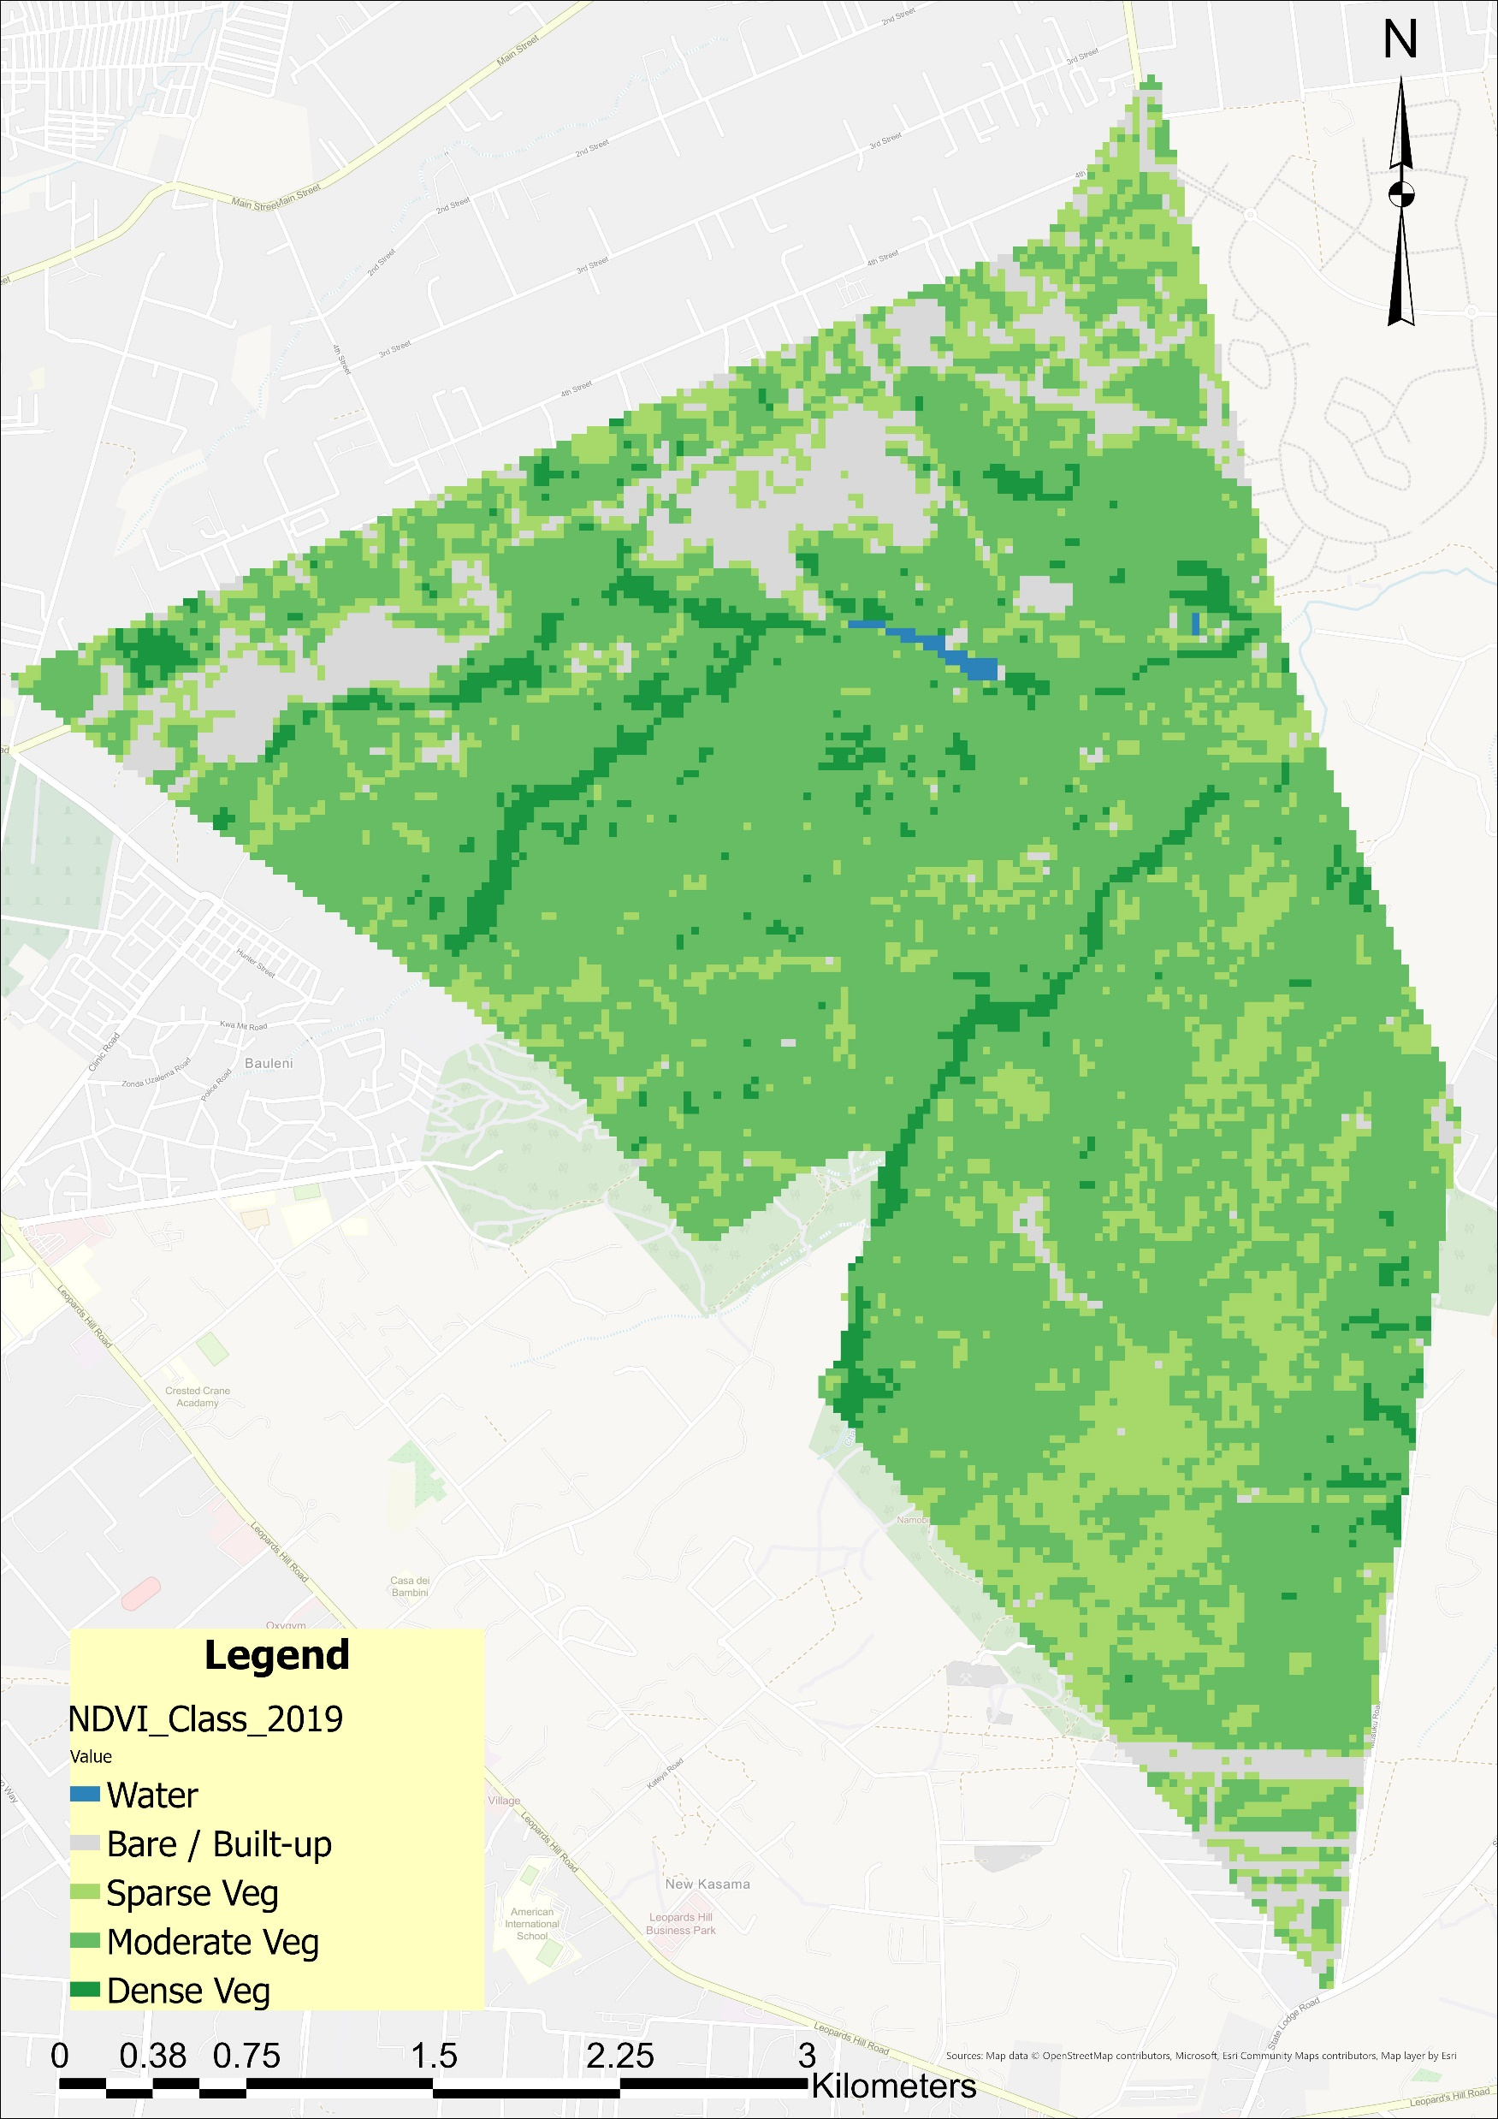
NDVI Land Cover Classification — 2013 · 2016 · 2019
2013
2016
2019
Landsat Collection 2 Tier 1 Level-2 · 30 m resolution · Annual median composite · 5-class NDVI scheme
7 / 14

Slide 8
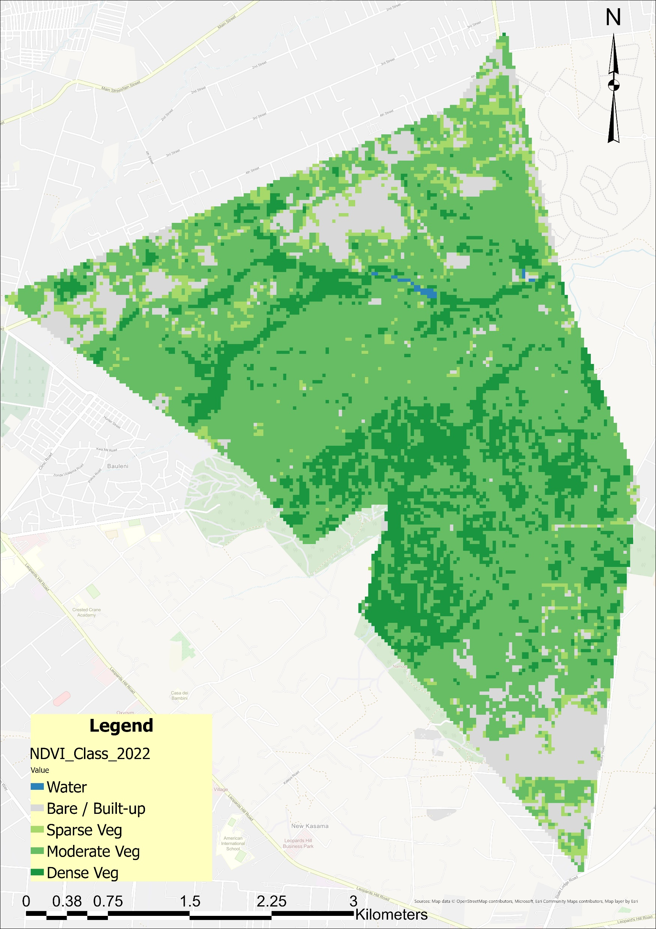

NDVI Land Cover Classification — 2022 & 2024
2022
2024
Key observation: By 2024, built-up and bare surfaces have expanded markedly along the northern and southern reserve boundaries. The 2024 map (right) also encodes the 2013–2024 change layer, revealing encroachment hotspots in pink/magenta.
8 / 14

Slide 9
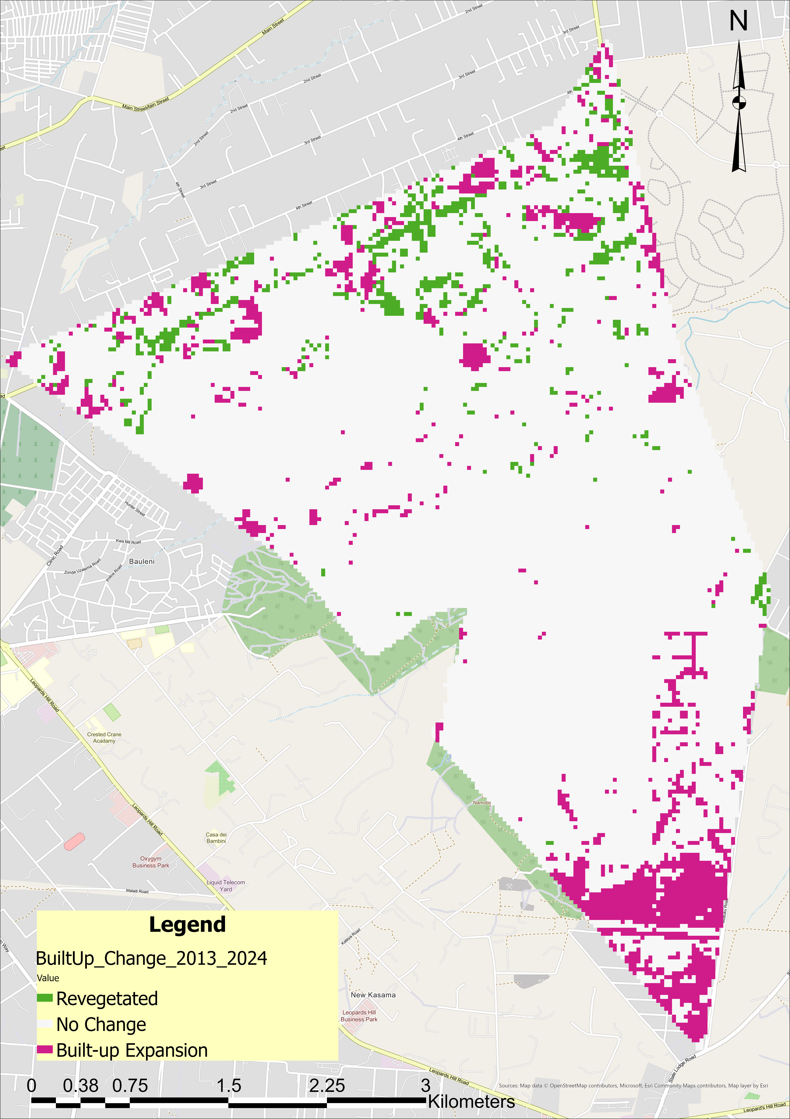
Land Cover Change Analysis — 2013 vs. 2024
Change: 2013 → 2024
Pixel-Level Statistics (n = 20,789 pixels each)
Built-up Expansion (vs. 2013)
9.5%
4.1%
86.4%
1,976 px
Expansion
847 px
Re-vegetated
17,966 px
No Change
Dense Vegetation Change (vs. 2013)
7.2%
2.2%
90.7%
1,488 px
Veg. Loss
450 px
Veg. Gain
18,851 px
No Change
Dense vegetation loss : gain ratio > 3 : 1 — indicating net canopy decline
Pink = Built-up expansion · Green = Revegetation · White = No change
9 / 14

Slide 10
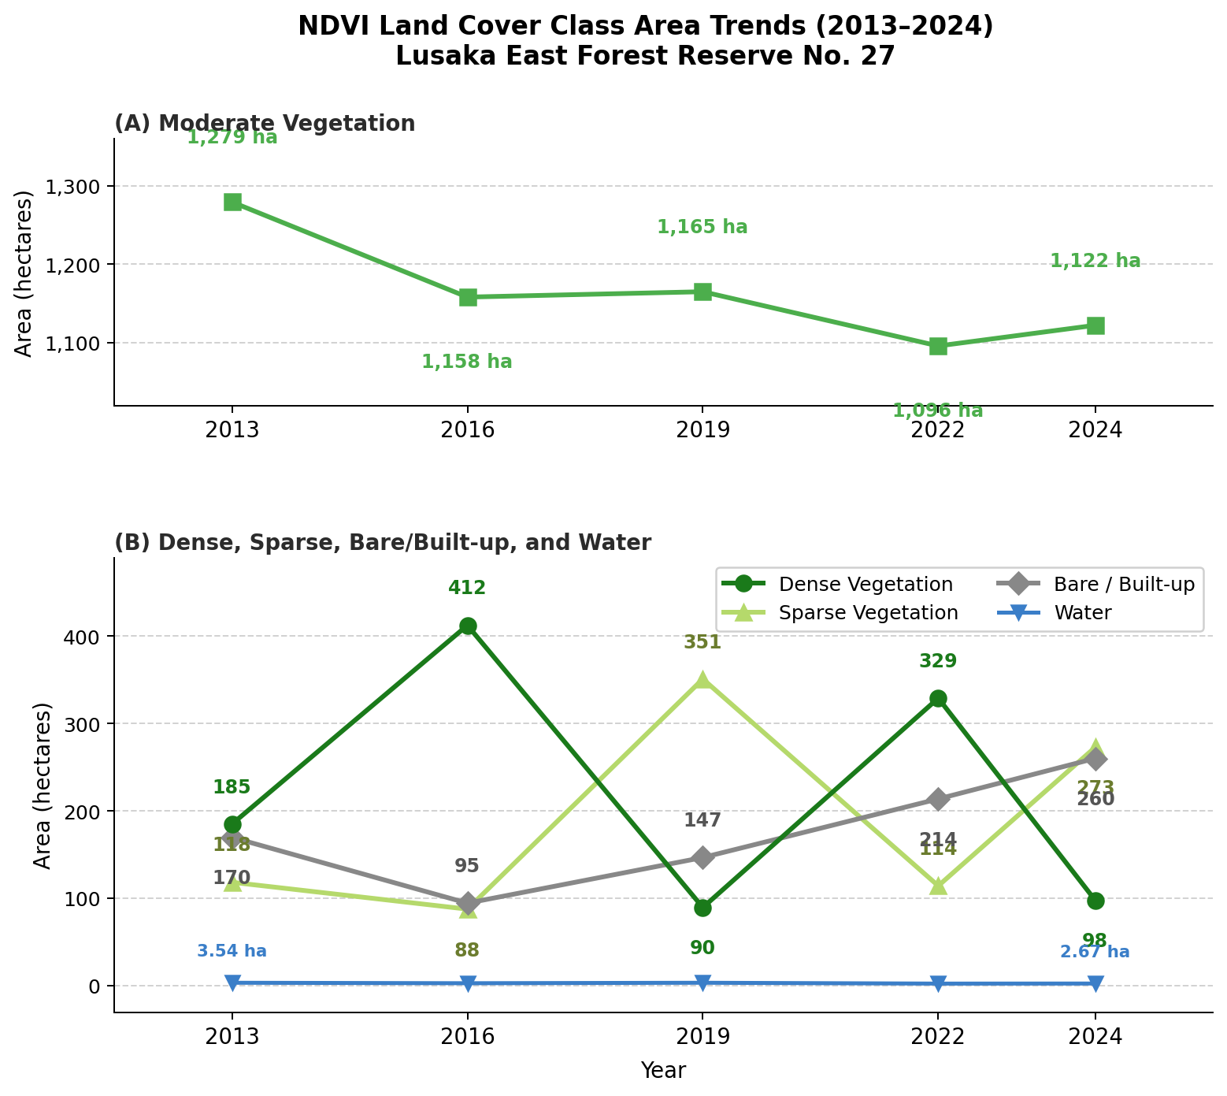
NDVI Land Cover Class Area Trends — 2013 to 2024
Panel A — Moderate Vegetation (dominant class, ~1,000–1,300 ha) · Panel B — Dense, Sparse, Bare/Built-up, Water (0–400 ha)
10 / 14

Slide 11
Key Findings & Discussion
-47.1%
+53.2%
85.0%
Dense Vegetation
185 ha → 98 ha (2013–2024)
Built-up Expansion
+90.34 ha net change
Total Veg. Cover Remaining
(was 90.1% in 2013)
Urban Expansion Pattern
Encroachment concentrated along northern and southern reserve boundaries; built-up expansion (9.5%) far outpaced revegetation (4.1%).
Forest Transition Theory
A loss:gain ratio >3:1 for dense vegetation is consistent with early urbanisation phases described by Rudel et al. (2020) — extraction precedes any recovery.
Miombo Woodland Challenge
Seasonal grass in miombo woodland inflates NDVI on built-up plots — the hybrid dry-season classification approach directly addresses this ecological challenge (Frost, 1996).
Policy Relevance
Spatial evidence supports targeted conservation in alignment with Zambia's Forestry Act and National Climate NDC commitments (Ministry of Lands, 2025).
11 / 14

Slide 12
Conclusions & Future Work
Conclusions
Future Work
Dense vegetation declined 47.1% (185 → 98 ha) while built-up area expanded 53.2% (+90 ha) over 2013–2024.
Participatory Mapping
Engage communities to verify encroachment boundaries and drivers on the ground
1
Total vegetation cover fell from 90.1% to 85.0%, indicating measurable forest degradation.
2
Policy Evaluation
Assess enforcement effectiveness under Zambia's Forestry Act
Encroachment concentrated along the northern and southern reserve boundaries.
3
Restoration Modelling
Identify priority zones for active revegetation interventions
Landsat hybrid NDVI classification effectively distinguished built-up from miombo woodland.
4
Remote sensing confirms the reserve is under significant and ongoing urban pressure.
Climate Integration
Separate climate from anthropogenic drivers using rainfall and temperature data
5
12 / 14

Slide 13
Key References
1
FAO (2025). Global Forest Resources Assessment 2025. Food and Agriculture Organization of the United Nations, Rome.
6
Rudel, T.K. et al. (2020). The global pattern of forest transitions. Global Environmental Change, 63, 102080.
2
Frost, P.G.H. (1996). The ecology of miombo woodlands. In B. Campbell (Ed.), The Miombo in Transition (pp. 11–55). CIFOR.
7
Tembo, E. & Volk, M. (2022). Land use and land cover change in a peri-urban area in Zambia. Land, 11(4), 574.
3
Hansen, M.C. et al. (2013). High-resolution global maps of 21st-century forest cover change. Science, 342(6160), 850–853.
8
Wulder, M.A. et al. (2012). Opening the archive: How free data enabled the Landsat monitoring promise. Remote Sensing of Environment, 122, 2–10.
4
Phiri, D. & Morgenroth, J. (2017). Developments in Landsat land use/land cover analysis. Remote Sensing, 9(9), 967.
9
Ministry of Lands and Natural Resources (2025). Zambia Forestry Act and National Forest Policy. Government of Zambia.
5
Pettorelli, N. et al. (2005). Using the satellite-derived NDVI to assess ecological responses to environmental change. Trends in Ecology & Evolution, 20(9), 503–510.
13 / 14

Slide 14
Thank You
Questions & Discussion
Nachaambwa Miyanda Moonga | +260 76 989 0265
Co-Author: Michael Mutale | +260 96 254 9674
Engineering Institution of Zambia · Annual Symposium 2026
EIZ — Engineering Institution of Zambia

