Slide 1

2026 ENGINEERING INSTITUTION OF ZAMBIA SYMPOSIUM
GIS AND REMOTE SENSING TO ASSESS MINING IMPACTS ON THE ENVIRONMENT: MOPANI COPPER MINES, KITWE
Mopani Copper Mines, Kitwe District: 30 years analysis (1995-2025)
PRESENTER : Eng. Musoka Nyongolo
CO-PRESENTER: Eng. Dr. Penjani Hopkins Nyimbili
DATE : Thursday, 16th April 2026
Avani Victoria Falls Resort, Livingstone, Zambia

Slide 2
PRESENTATION OUTLINE
1. Introduction
Environmental impacts of mining; role of GIS and Remote Sensing
2. Methodology
Study area, Landsat data acquisition, Random Forest classification, spectral indices
3. Results & Analysis
LULC change dynamics (1995–2025)
NDVI and NDWI time-series analysis
Accuracy assessment
4. Discussion
5. Conclusion & Recommendations
2

Slide 3
INTRODUCTION
Mining & Environmental Challenge
Mining: a key economic driver in Zambia, yet it can cause significant environmental degradation
Tailings and waste dumps can affect soil and water systems.
Mining-led urbanisation around Mopani Copper Mines (MCM) severely pressures ecosystems
Why Remote Sensing & GIS?
Field surveys are resource-intensive and limited in scale
Satellite imagery paired with machine learning (Random Forest) enables accurate, large-scale, multi-temporal change detection
Study Objective
Develop a GIS-RS framework to assess environmental influence of MCM over 30 years (1995–2025)
Quantify vegetation loss, urban expansion and water dynamics to support sustainable policy and management
3

Slide 4
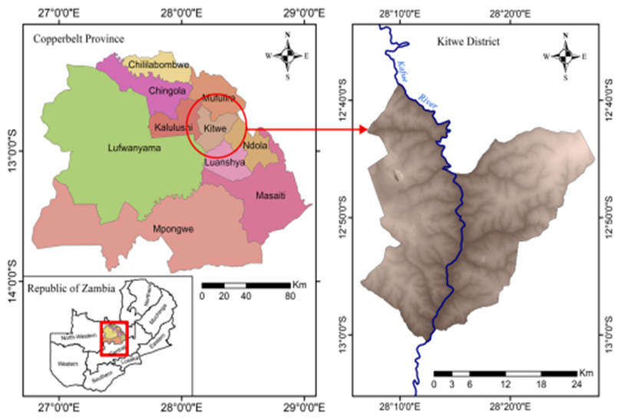
METHODOLOGY
Study Area
Kitwe District, Copperbelt Province (12.80°S, 28.21°E) | 2 km buffer around MCM tailings dams.
Fig 1: Location of Kitwe district on the Copperbelt Province (Nguvulu et al, 2023)
4

Slide 5
METHODOLOGY (Cont’d)
1
Define AOI
(buffers & overlays)
2
Acquire Landsat
(1995–2025)
3
Pre‑process
(geo/atmo/rad.)
4
Random Forest
LULC classification
5
Spectral indices
(NDVI, NDWI)
6
Validate
(OA + Kappa)
7
Change analysis
& comparison
8
Impact maps
& reporting
Fig 2: Methodology flow chart
4

Slide 6
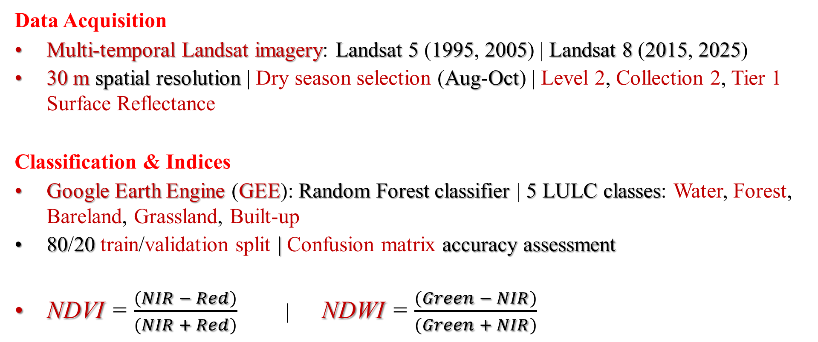
METHODOLOGY (Cont’d)
Data Acquisition
Multi-temporal Landsat imagery: Landsat 5 (1995, 2005) | Landsat 8 (2015, 2025)
30 m spatial resolution | Dry season selection (Aug-Oct) | Level 2, Collection 2, Tier 1 Surface Reflectance
Classification & Indices
Google Earth Engine (GEE): Random Forest classifier | 5 LULC classes: Water, Forest, Bareland, Grassland, Built-up
80/20 train/validation split | Confusion matrix accuracy assessment
NDVI = $\frac{(NIR − Red)}{(NIR + Red)}$ | NDWI = $\frac{(Green − NIR)}{(Green + NIR)}$
4

Slide 7
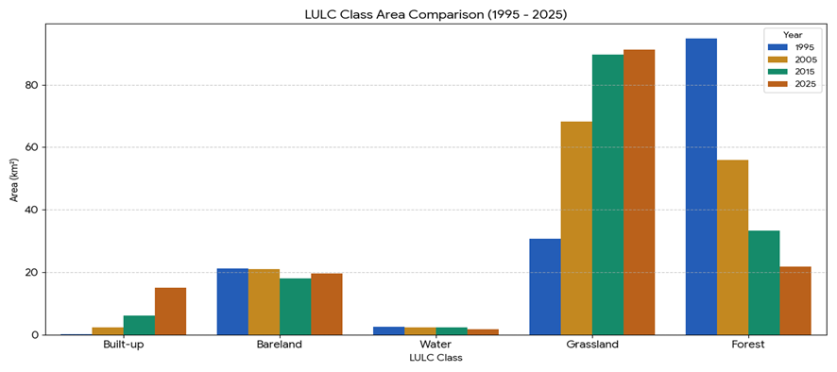
RESULTS - LULC DYNAMICS (1995–2025)
Major transformations
−47.26%
Forest cover change
+41.71%
Grassland change
+10.28%
Built‑up growth
Interpretation: persistent bare land near tailings and urban expansion pressure
Fig 3: Percentages of land cover types (1995–2025)
5

Slide 8
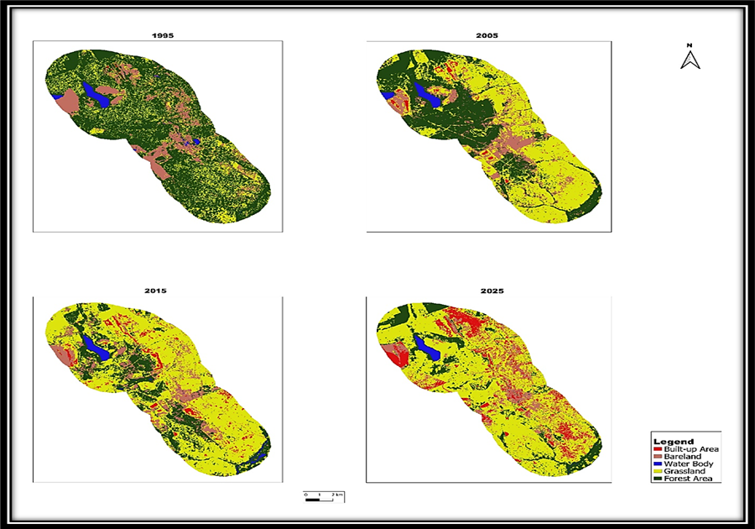
RESULTS - LULC DYNAMICS (1995–2025)
Fig 4: LULC maps for the years 1995, 2005, 2015 and 2025
5

Slide 9
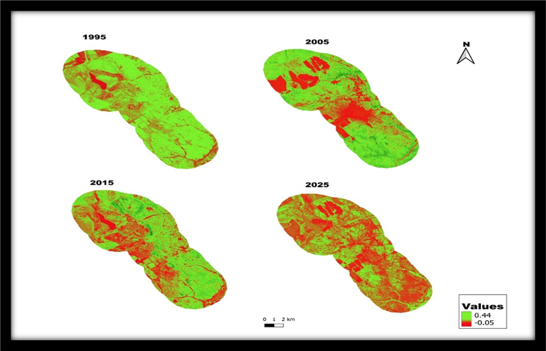
RESULTS - VEGETATION & WATER INDICES
Key message
Consistent decline in vegetation health across 1995–2025
Low NDVI near mining operations and tailings dams
Signals land degradation and slow recovery
Fig 5: NDVI Time series maps
6

Slide 10
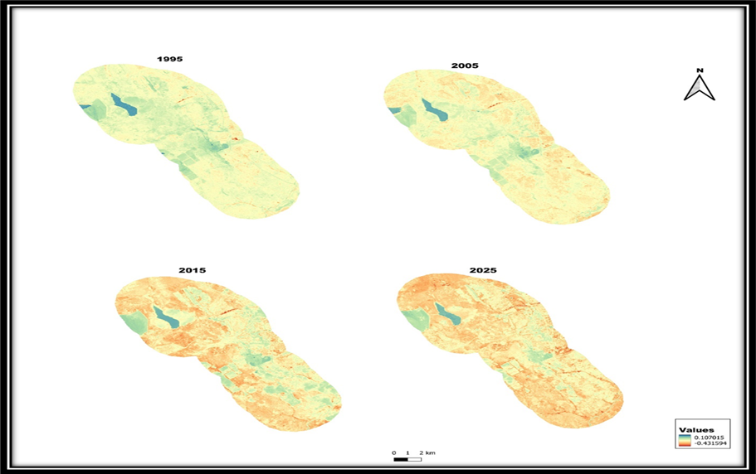
RESULTS - VEGETATION & WATER INDICES
Key message
Water bodies remain minimal across the AOI
Slight decline suggests encroachment/ siltation risk
Useful for screening potential mine‑impact hotspots
Fig 6: NDWI Time series maps
6

Slide 11
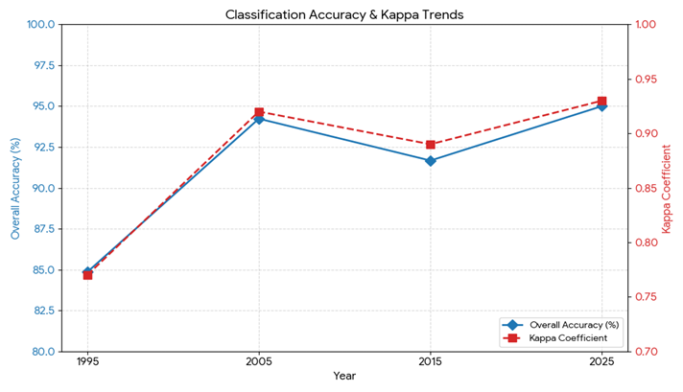
RESULTS - VEGETATION & WATER INDICES
Accuracy Assessment
84.9–95%: Overall classification accuracy across all years
0.77–0.93 : Kappa coefficient - strong agreement with reference data
Fig 7: Accuracy Assessment Results
6

Slide 12
DISCUSSION | Interpreting the change signals
Forest loss & degradation
Urban expansion
Why this framework works
Deforestation linked to clearing, waste disposal and infrastructure
Degraded grassland expands as recovery slows
Tailings‑adjacent areas remain stressed
Built‑up growth reflects labour migration and mining‑driven development
Expansion patterns align with Copperbelt town dynamics
Requires land-use governance
Random Forest + Landsat is scalable and repeatable
Indices (NDVI/NDWI) enable continuous screening
Supports regulators and rehabilitation planning
7

Slide 13
CONCLUSION & RECOMMENDATIONS
Key Findings
GIS and RS successfully quantified massive landscape alteration around MCM over 30 years (1995–2025)
Severe deforestation (-47.26%), urban sprawl (+10.28%) and persistent land degradation confirmed
High classification accuracy (84.85–95%) validates Random Forest methodology for environmental monitoring
Recommendations
Mining companies: to implement aggressive reforestation and land rehabilitation programmes for tailings dam areas
Regulators: to adopt the automated GIS-RS monitoring system for compliance and sustainable mining oversight
Framework is scalable - applicable to other mining regions in Zambia and comparable contexts
8

Slide 14

REFERENCES
Acharya, P. and Liu, F. (2023) "Spectral Index Monitoring for Temporal Changes in Mining Areas," Remote Sensing, 15.
Ayres, R.U., Ayres, L.W. and Råde, I. (2002) "Life cycle of copper, its co-products and by-products," Mining, Minerals and Sustainable Development, No. 24.
Belgiu, M. and Drăgu, L. (2016) "Random Forest in remote sensing: A review of applications and future directions," ISPRS Journal of Photogrammetry and Remote Sensing, 114, pp. 24–31.
Choate, M. J., et al. (n.d.) Landsat Collection 2, U.S. Geological Survey.
De, A. and Kumar, D. (2018) "Remote sensing and GIS for assessment and prediction of environmental hazards due to mine wastes: case study from Daitari iron ore mines, Odisha, India," Environmental Earth Sciences.
Government of the Republic of Zambia (2017) Seventh National Development Plan (7NDP) 2017–2021, Lusaka: Ministry of National Development Planning.
Kazindu, H., Mupenzi, C. and Maniragaba, A. (2020) "Environmental Impacts Analysis of Mining on the Surrounding Communities: A Case Study of Rutongo Mines Ltd in Rulindo District, Northern Province of Rwanda," Journal of Geoscience and Environment Protection, 8.
McFeeters, S.K. (1996) "The use of the Normalised Difference Water Index (NDWI) in the delineation of open water features," International Journal of Remote Sensing, 17(7), pp. 1425–1432.
Sikamo, A.M., Mwanza, A. and Mweemba, C. (2016) "Copper mining in Zambia - history and future," The Journal of the Southern African Institute of Mining and Metallurgy, 116.
Tiamgne, X., Kalaba, F. and Nyirenda, V. (2021) "Land use and Cover Change dynamics in Zambia's Solwezi Copper Mining District," Scientific African, 13.
Tucker, C.J. (1979) "Red and photographic infrared linear combinations for monitoring vegetation," Remote Sensing of Environment, 8(2), pp. 127–150.
USGS (2017) Copper Statistics and Information, National Minerals Information Centre.

Slide 15
The End
THANK YOU FOR YOUR ATTENTION.
Questions

