Slide 1

2026 ENGINEERING INSTITUTION OF ZAMBIA SYMPOSIUM
Computer Vision Based Approach For Automated Bird Counting in Poultry Houses
PRESENTER(S) : Siwale E and Dr. Chileshe J.M
DATE :
Avani Victoria Falls Resort, Livingstone, Zambia

Slide 2
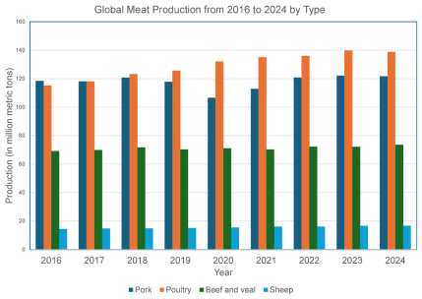
Introduction
Agriculture is an important to the global economy, supporting food, raw materials, and livelihoods for billions
Livestock is the fastest growing and highest-value agricultural sub-sector globally (Corporate Strategy, 2024)
There has been an increase in demand for poultry products worldwide

Slide 3
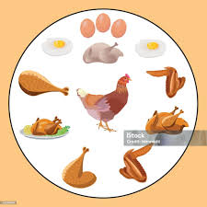
Introduction cont’d
In Zambia, poultry accounts for 4.8% to the agricultural GDP and represents 48% of the livestock value addition, making it the largest subsector in the livestock industry(Agriprofocus,2015).
Demand for poultry products has been driven by versatility of poultry products in various cuisines, affordability and faster production cycles compared to other meat proteins

Slide 4
Problem Statement
Agriculture faces increasing pressure from resource constraints and a growing global population.
There is need for food systems to adapt to meet demand while maintaining productivity and economic viability.
Effective flock management is important in maintaining profitability and sustainability
One critical Aspect of effient and effective poultry flock management is accurate flock counting.

Slide 5
Problem Statement Cont’d
Manual counting is labour intensive, time consuming, lacks real-time monitoring capabilities, scalability and prone to human error.
Poor Stock monitoring results in underfeeding, overcrowding, wrong medical dosing, poor mortality tracking and significant declines in farm productivity and profitability.
The modern solution lies in embracing technological solutions which are improving in accuracy and reducing in price.

Slide 6
Rationale
Precise: Ability to identify and count birds in large dense flocks
Sustainable: supports better resource allocation and minizes waste
Scalability: It can be used across multiple breeds, bird ages, and deployed across multiple poultry houses.

Slide 7
OBJECTIVE
To implement and evaluate a computer vision based system for automated real-timebird counting using a trained object detection model.
Specific Objectives
Implement an existing detection algorithm.
Train the algorithm using labeled poultry dataset.
Evaluate the model performance
Deploy the model for real-time monitoring.

Slide 8
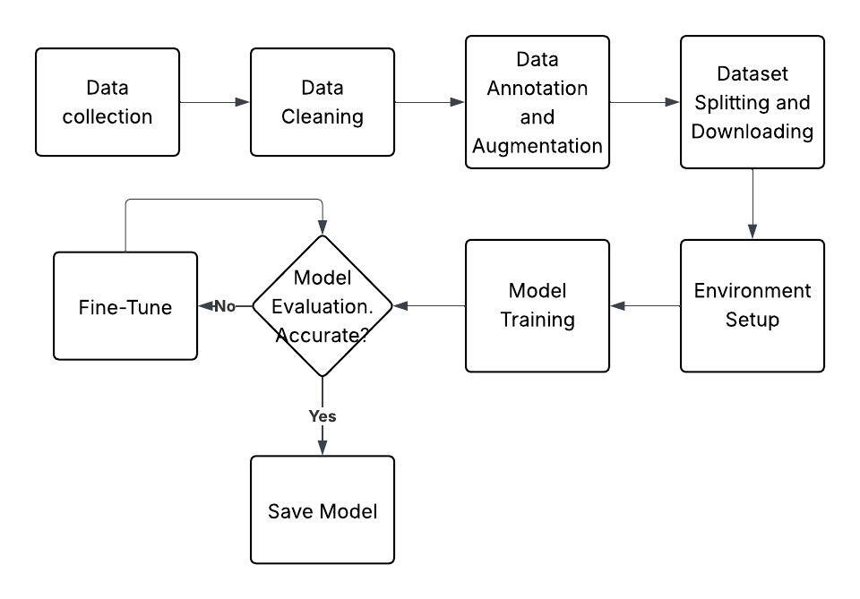
Methodology
The training of the model was an iterative process

Slide 9
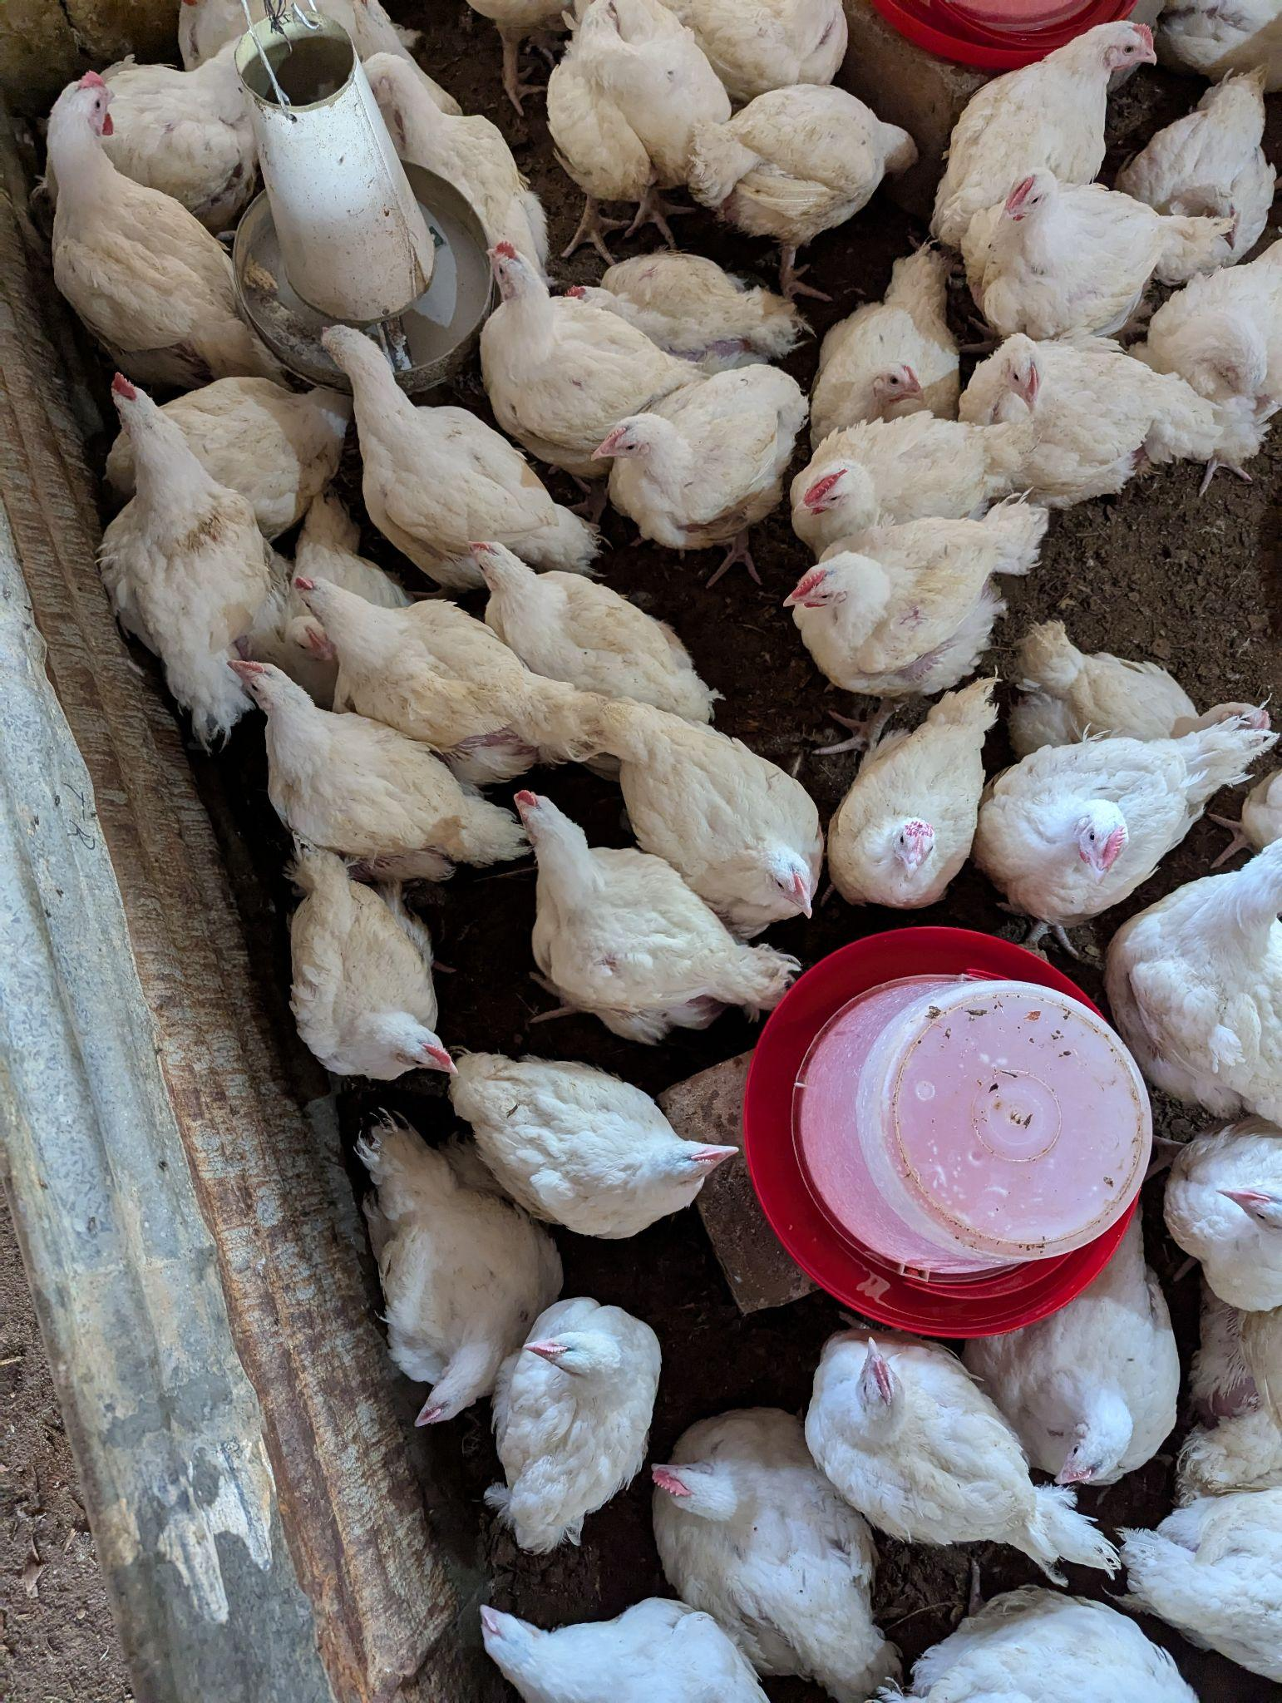
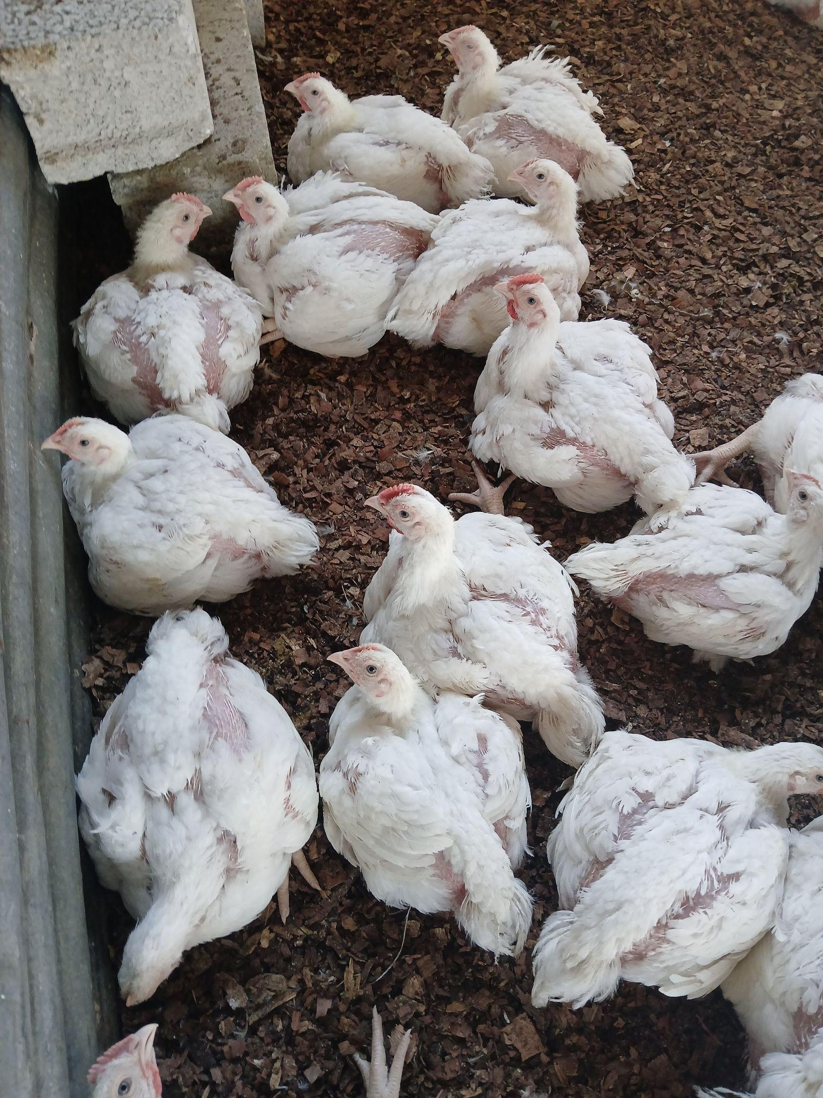
Data Collection
collecting of data from poultry houses

Slide 10
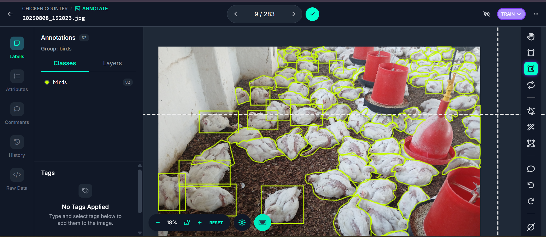
Data Preparation
Bounding box and polygon labeling in Roboflow for robust detection.
Data split was 80:20 for training and validation

Slide 11
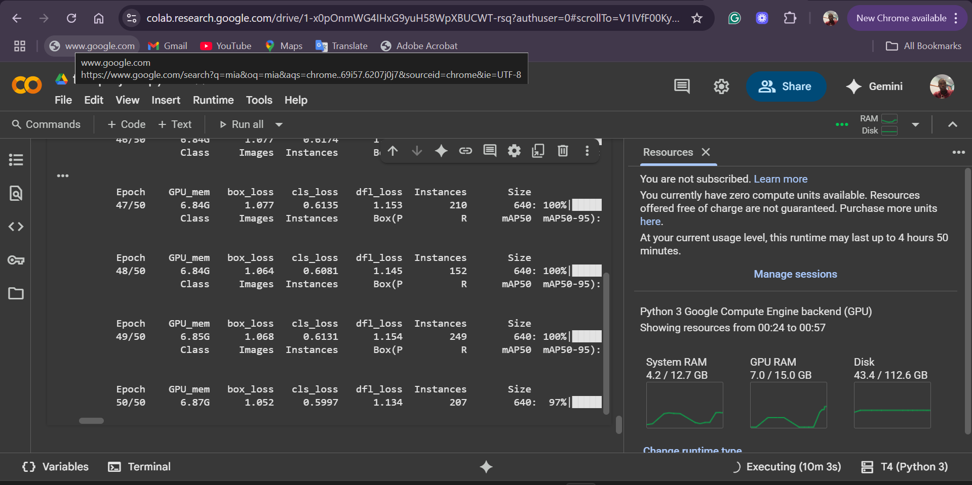
Model Training
Training was done in Google colab.

Slide 12
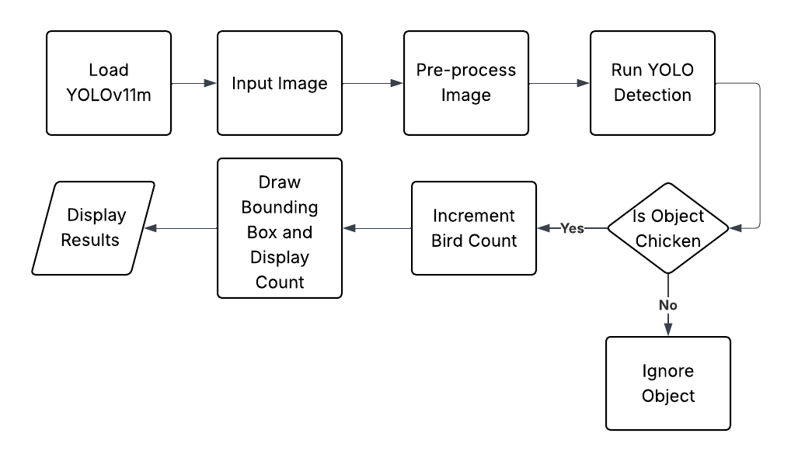
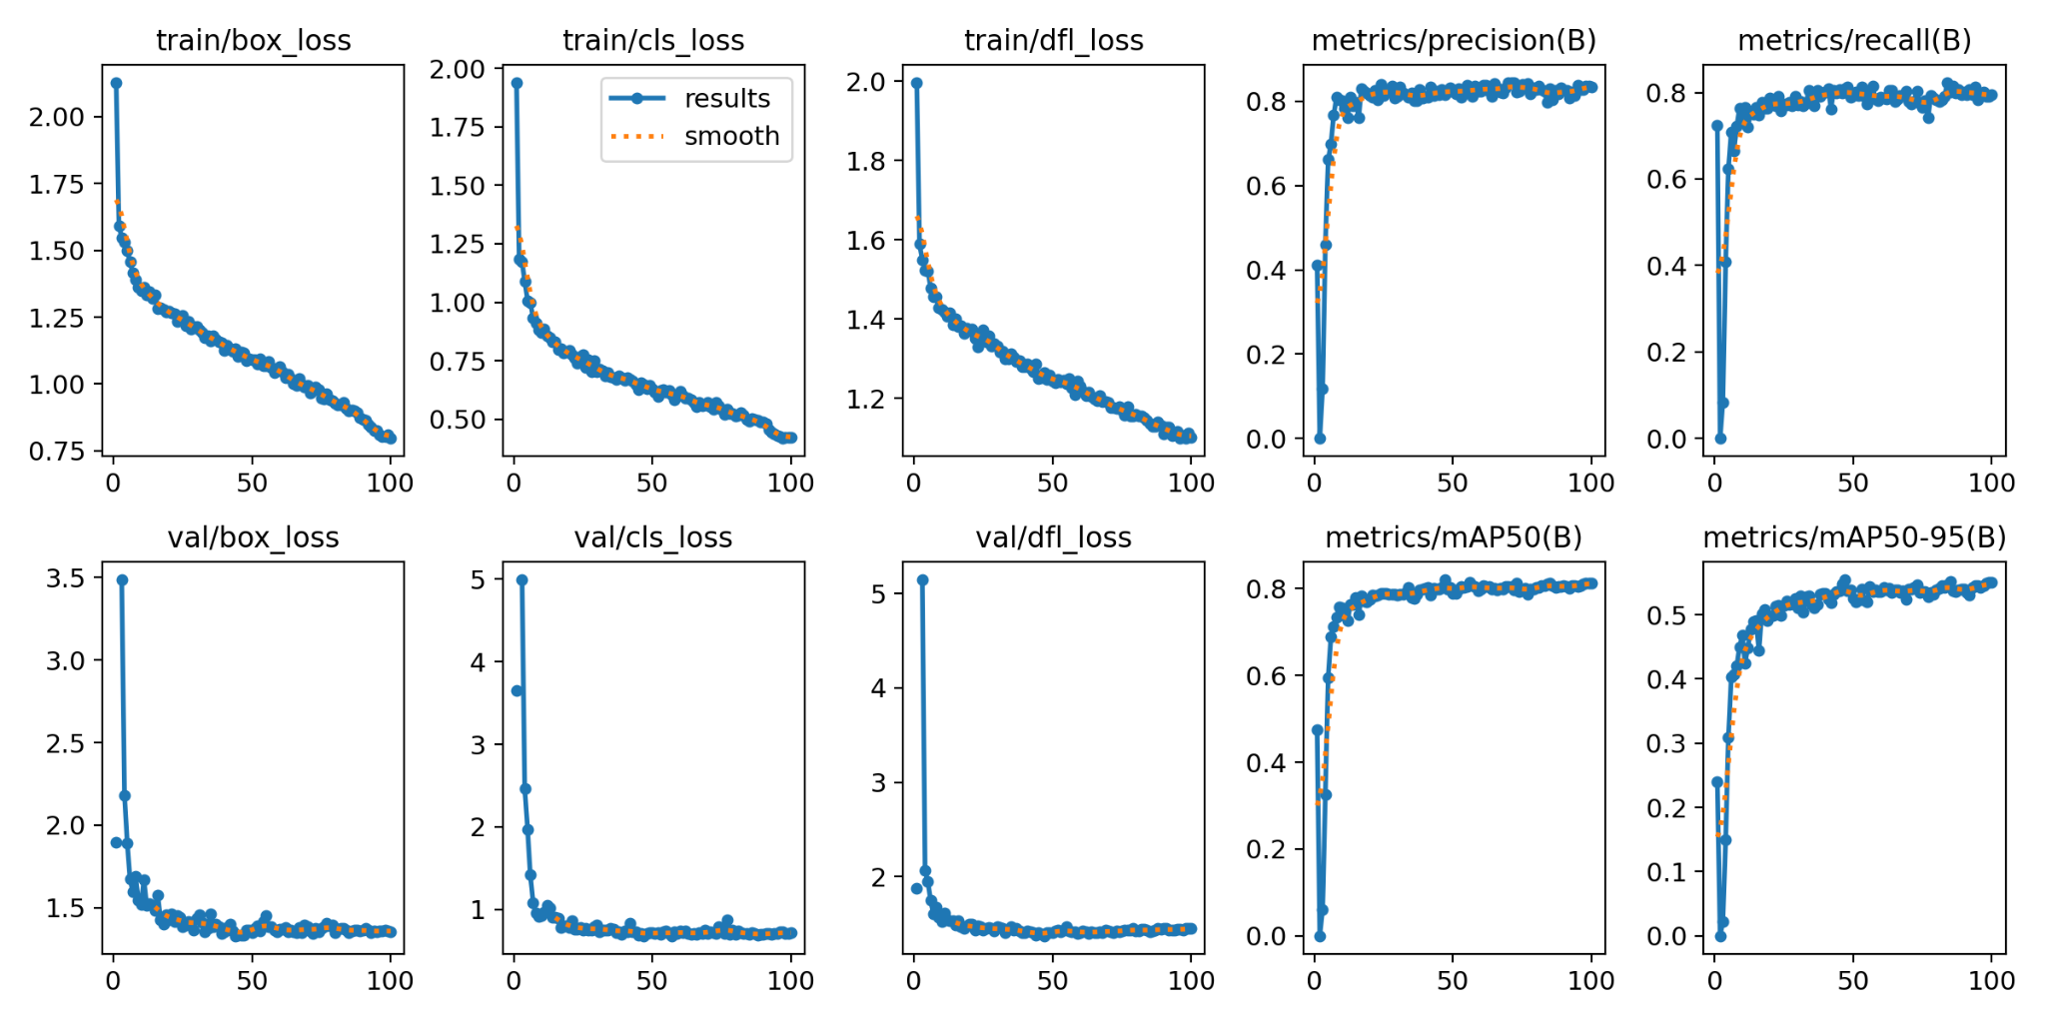
YOLO Detection Workflow

Slide 13
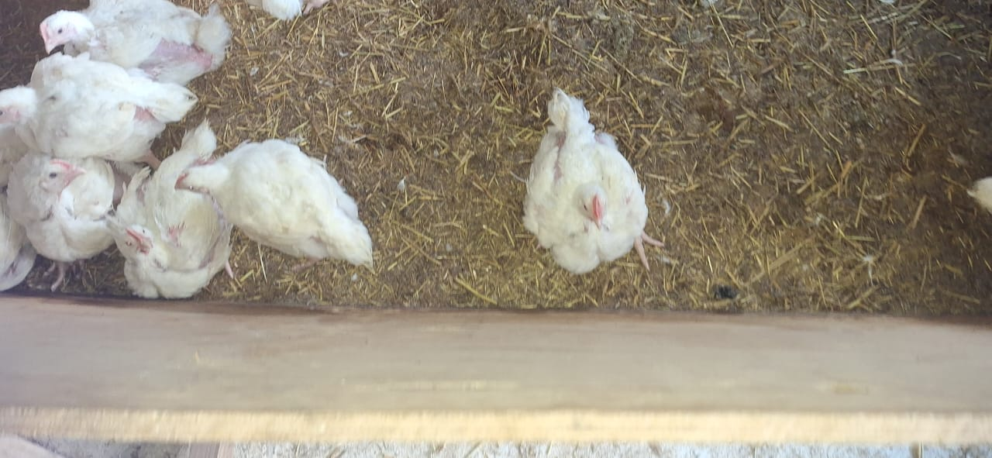
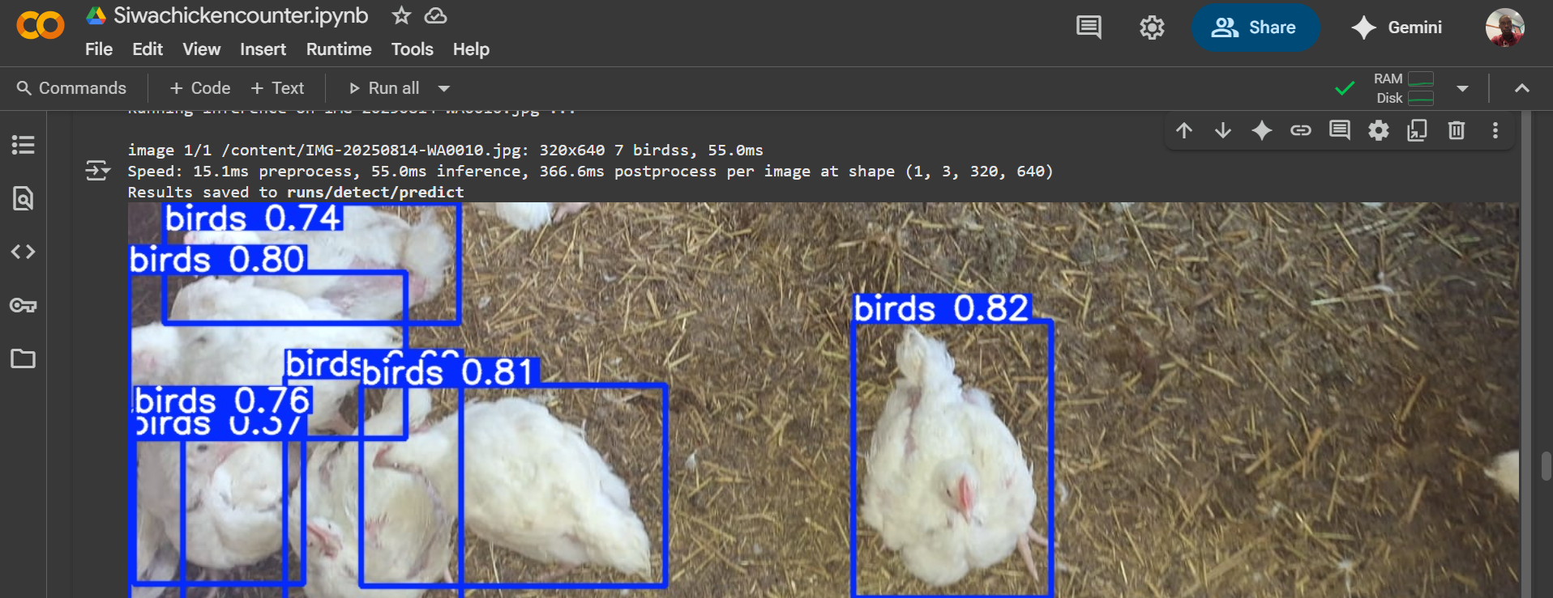
Results
Illustration of how the model works

Slide 14
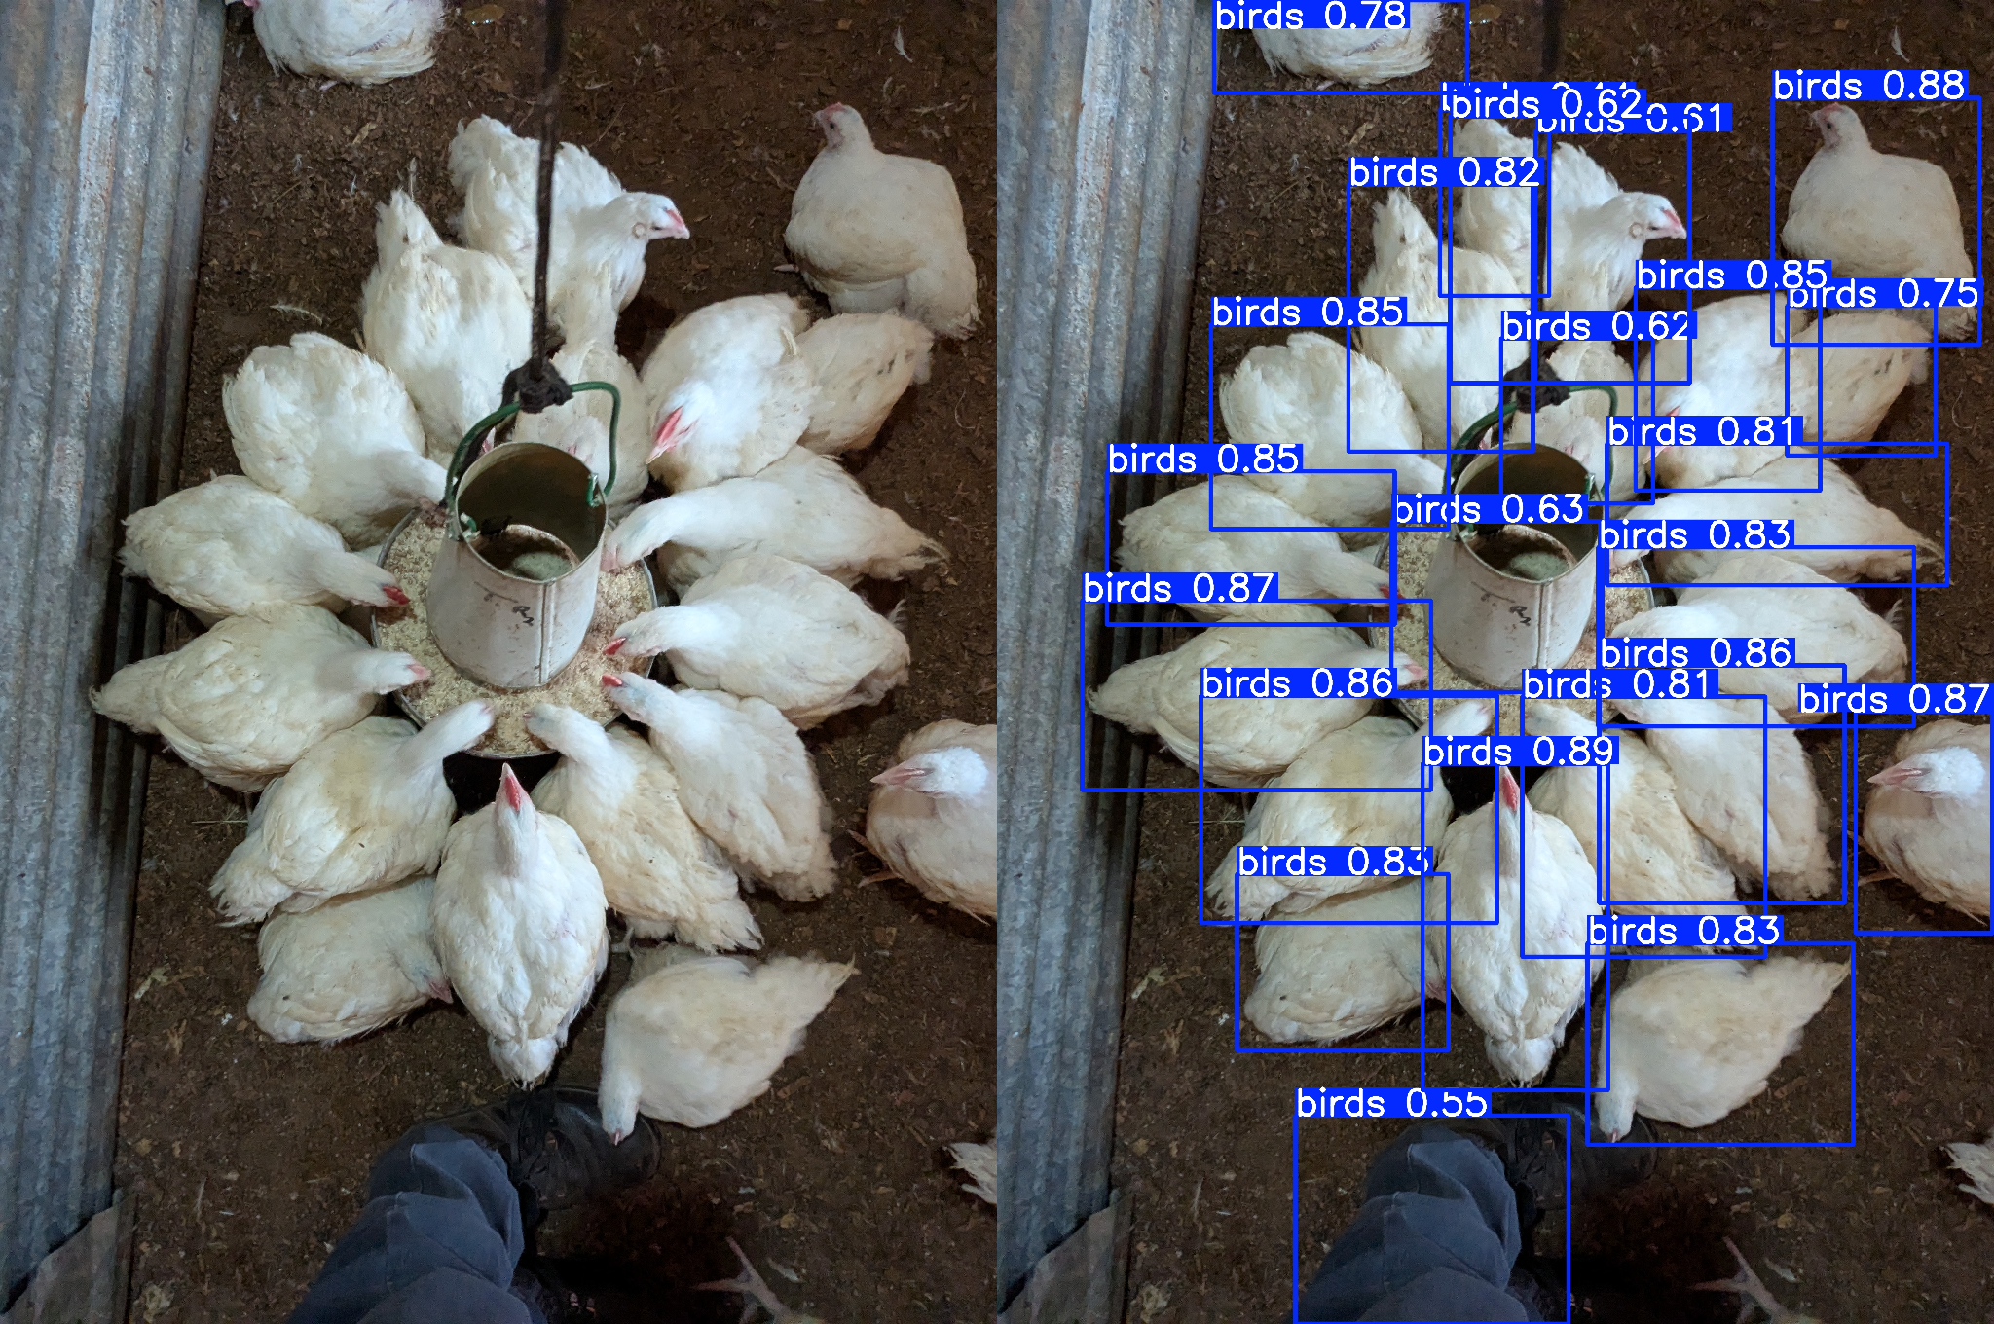
Results Cont’d

Slide 15
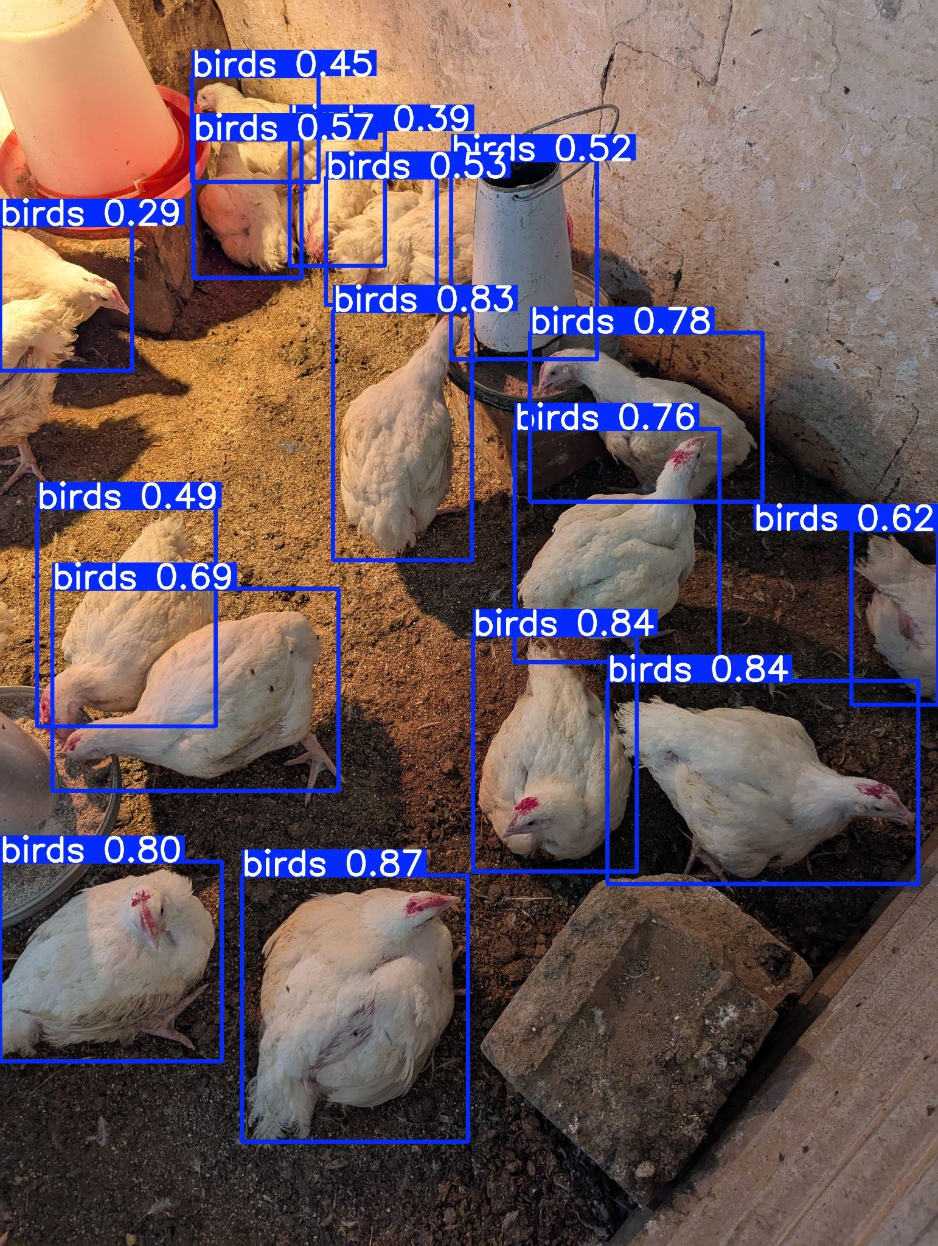
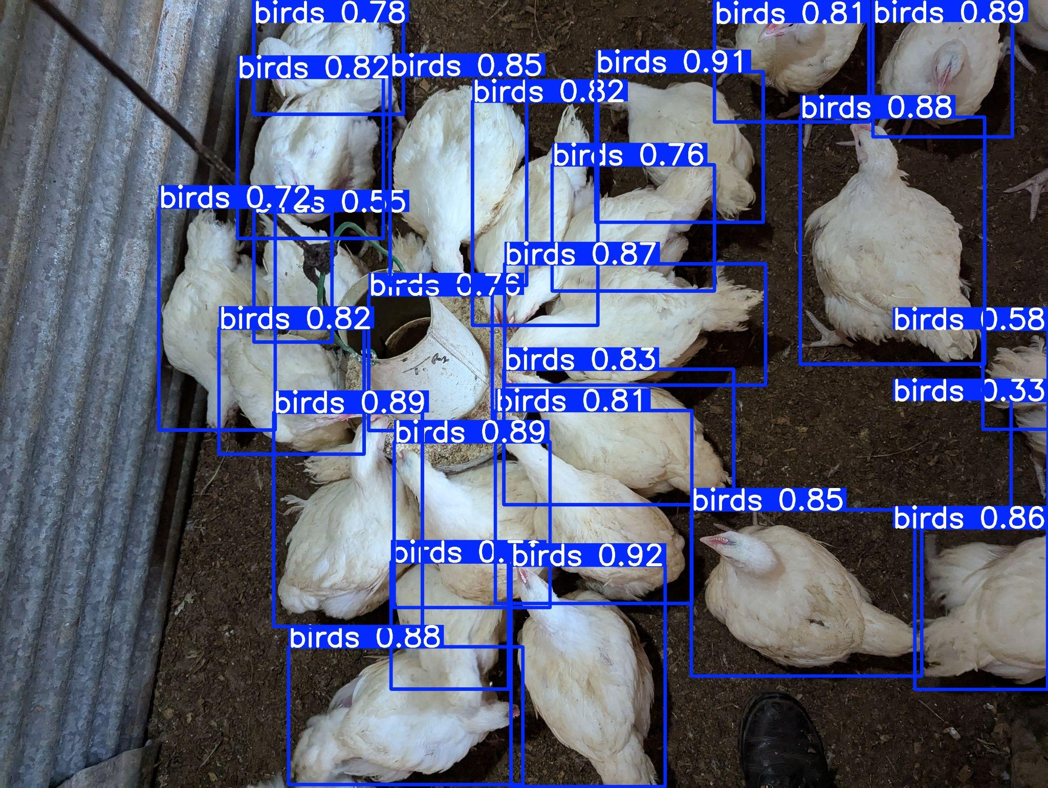
Results cont’d

Slide 16
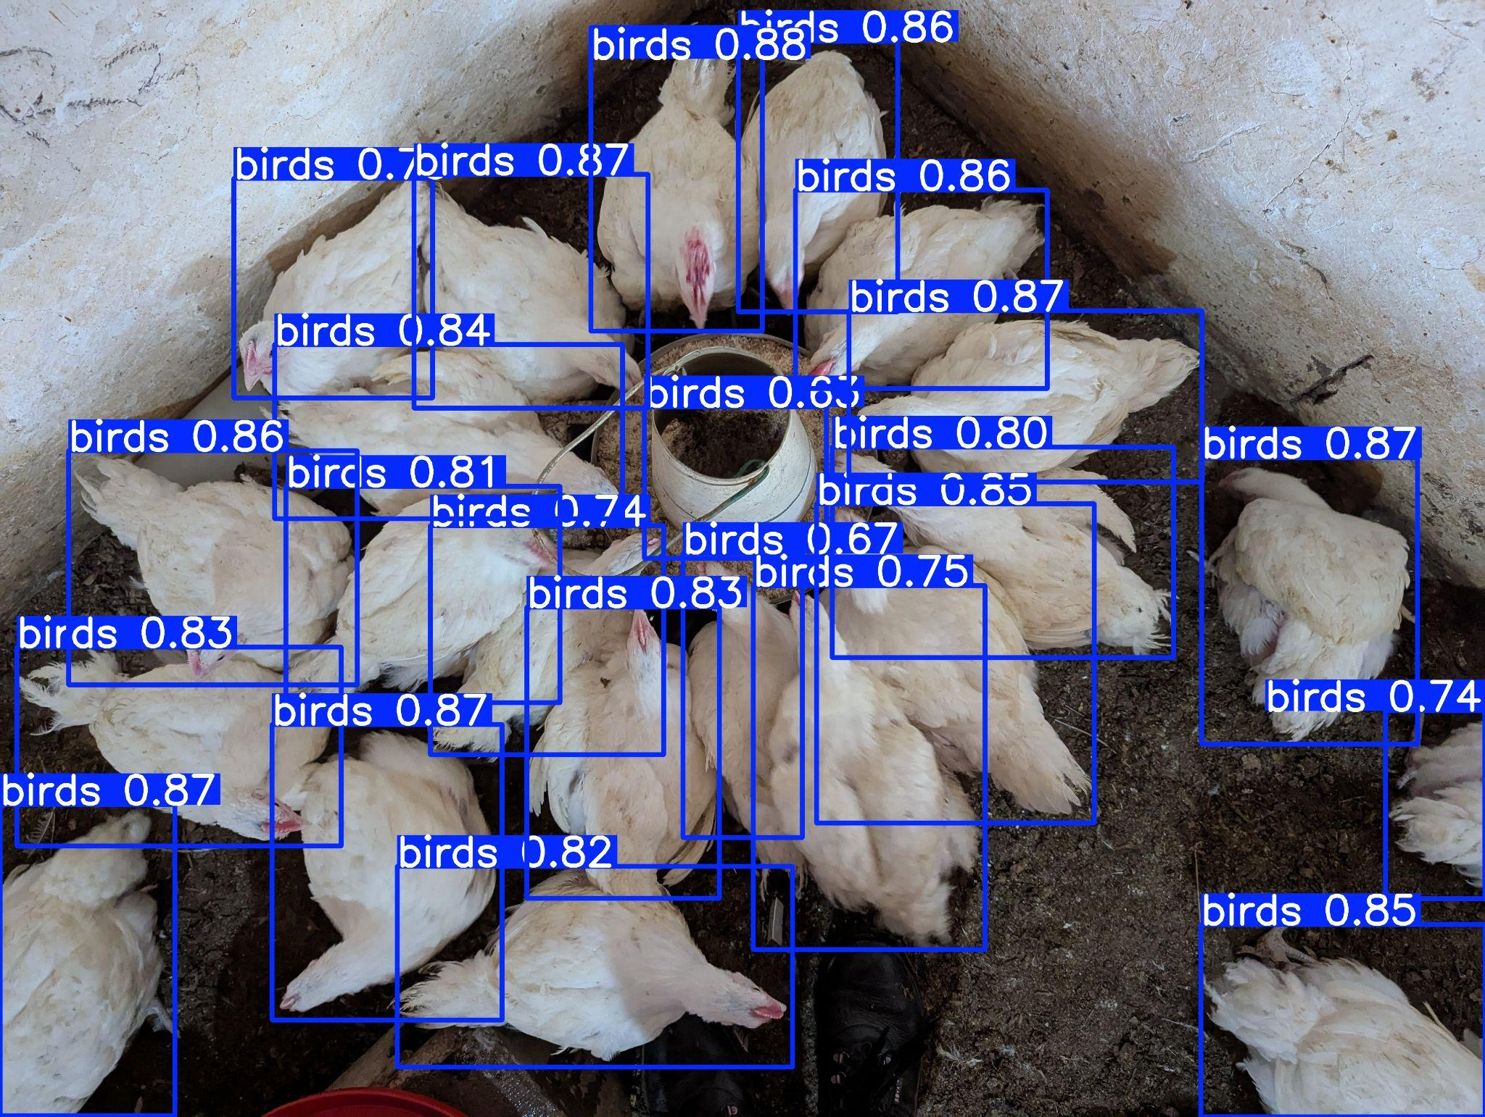
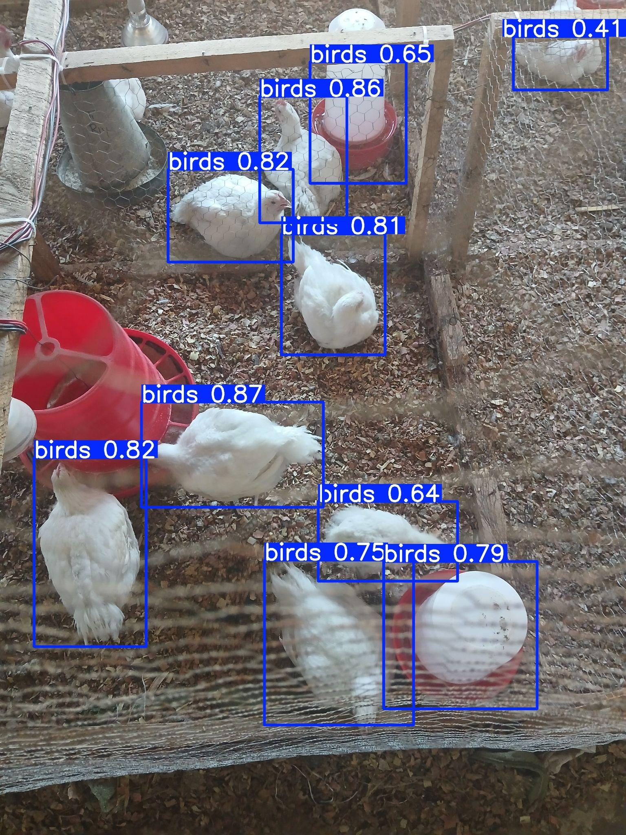
Results cont’d

Slide 17
Results
Total Images | Model Count | True Positive(TP) | False Negative(FN) | False Positives(FP)
69 | 1880 | 1799 | 34 | 81
Model Count= TP + FP
Recall = TP/(TP+FN)= 1799/(1799+34) = 98.15%
Precision = TP/(TP+FP) = 1799/(1799+62)= 96.69%
Accuracy = TP/model Counts = 1799/1881 = 95.69%

Slide 18
Discussion
Accuracy of 95.6% indicates high overall correctness in bird detection and counting.
Precision of 96.7% shows most detected birds were correctly identified.
High recall (98.15%) means minimal missed detection.
Accuracy (95.6%)
Model performed well under bird overlap(occlusion).
Performance is influenced by dataset diversity and input data quality.

Slide 19
Conclusion
A Computer-Vision automated bird counting was successfully implemented using YOLO model
The model achieved accuracy, Recall, and precision of 95.6%, 98.1%, 96.7% on a locally sourced dataset
Results confirm the applicability of automated counting
This study demonstrates the potential of AI-tools for precision livestock farming
Future work: dataset diversity, edge deployment and real-time video monitoring

Slide 20
References
6Wresearch. (n.d.). Global Poultry Market (2025—2031) | Trends, Outlook & Forecast. RetrievedDecember5,2025, from https://www.6wresearch.com/industry-report/global-poultry-market
Bronkhorst, B., & Chongo, R. M. (2015). Market study – Poultry: Investment opportunities in the Zambian poultry sector (and in the Katanga Region of the DR Congo). AgriProFocus Zambia.
Corporate strategy. (2024, June 10). https://www.ilri.org/corporate-strategy.
ltd, M. D. F. (2025). Global Poultry Market Size, Share, Growth & Trends, 2033. Market Data Forecast. https://www.marketdataforecast.com/market-reports/poultry-market
Okinda, C., Nyalala, I., Korohou, T., Okinda, C., Wang, J., Achieng, T., Wamalwa, P., Mang, T., & Shen, M. (2020). A review on computer vision systems in monitoring of poultry: A welfare perspective. Artificial Intelligence in Agriculture, 4, 184–208. https://doi.org/10.1016/j.aiia.2020.09.002
UN News (2013). World must sustainably produce 70 per cent more food by mid-century – UN report | UN News. (2013, December 3). https://news.un.org/en/story/2013/12/456912

Slide 21

The End
THANK YOU FOR YOUR ATTENTION.

