Slide 1

2026 ENGINEERING INSTITUTION OF ZAMBIA SYMPOSIUM
Application of Digital Twin Technology in Slope Stability Monitoring and Prediction of Potential Slope Failures in Open Pit Mines
PRESENTER : Winson Munyenyembe
DATE : Friday 17th April, 2026
Avani Victoria Falls Resort, Livingstone, Zambia

Slide 2

Contents
Introduction
What digital twins are, their elements and development
Steps in Creating Digital Twins for Slope Monitoring and Failure Prediction
Fundamental Mathematical Model for Structural Twins
Use in slope monitoring and failure prediction
Application in underground mining and mineral processing
Current applications
Early Challenges in Adoption
Critical Criteria for Feasibility
Conclusion

Slide 3
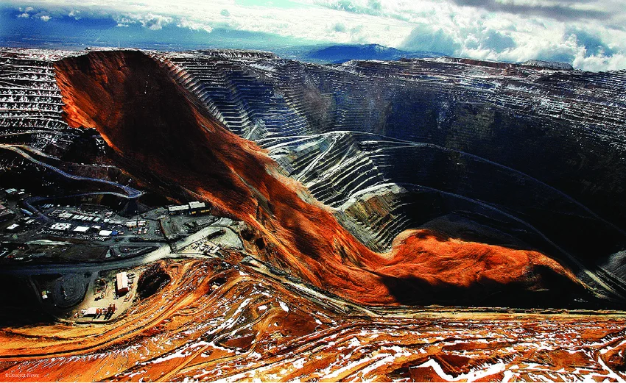
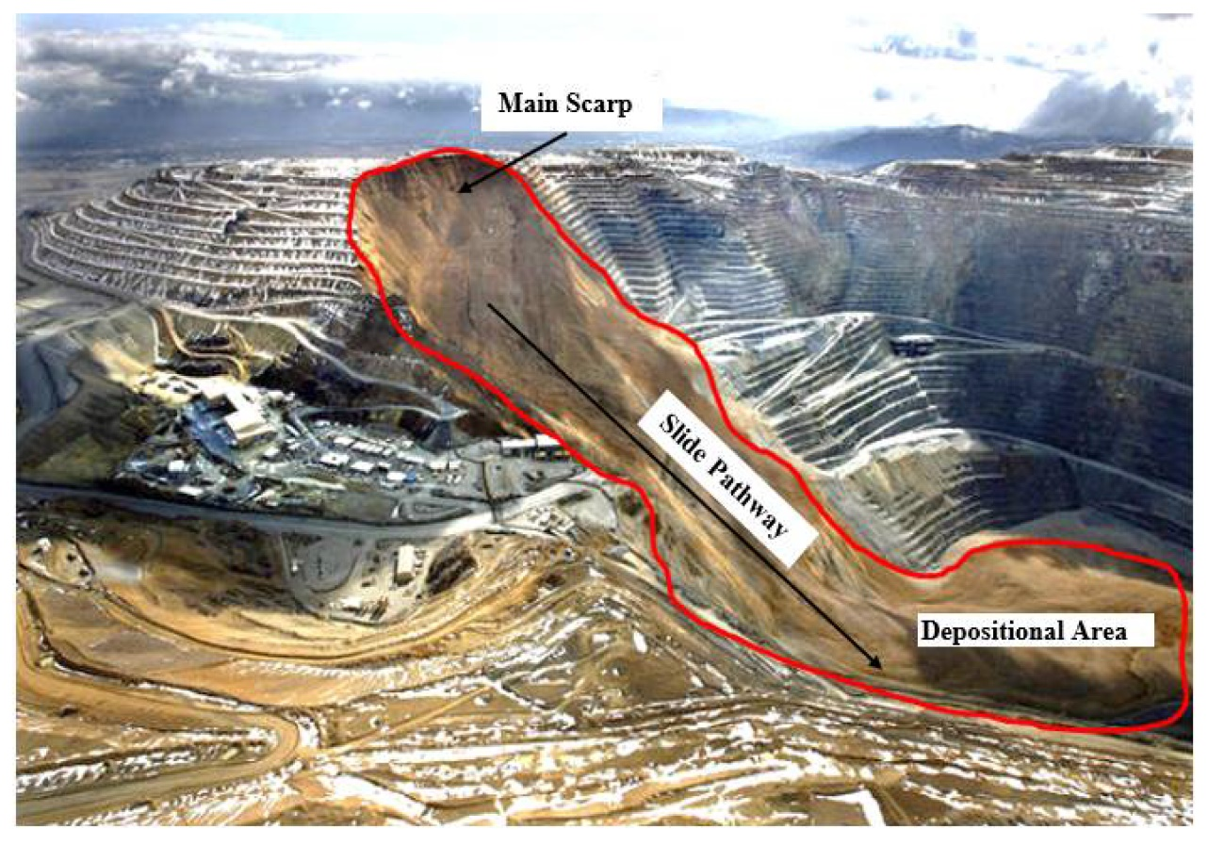
Introduction
Slope failures can have devastating economic effects on mining operations. Hence the need to prevent them is a very important geotechnical task in open pit mines.
What if we could monitor slope conditions and predict slope failures before they happen? We will explore how this can be done using digital twin technology.

Slide 4
What are digital twins?
They are live virtual replicas of a physical item, system or process that mirrors the exact state, structure and behavior of the physical counterpart.
Digital twins:
Are personalized models of a physical system
Are dynamic
Evolve in real time
Are updated from real time sensor data
Digital twins are not mere simulations, they are a lot more than that!

Slide 5

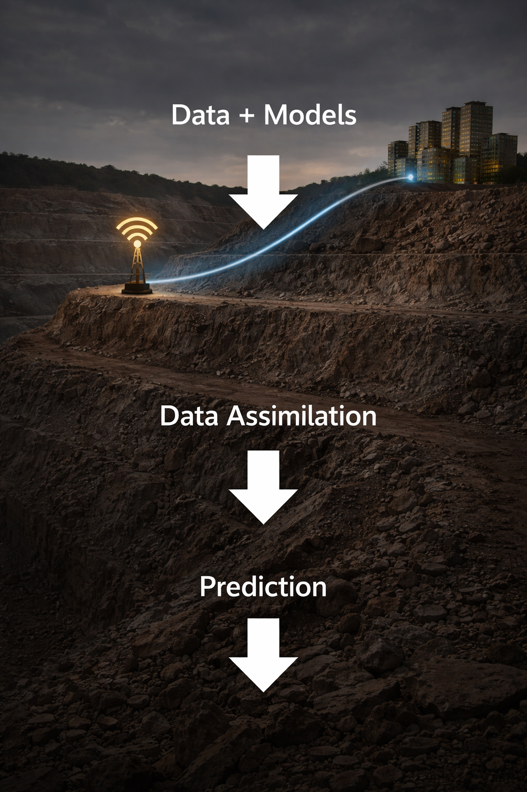
Fundamental Elements of Digital Twins
Data: First, data is obtained using sensors on the physical asset.
Models: Formulating of the mathematical models to be used; these are grounded in physics.
Data Assimilation: Combining the data and models, this personalizes the models to the specific asset being monitored.
Prediction: We can then make predictions about the future conditions of our physical asset

Slide 6
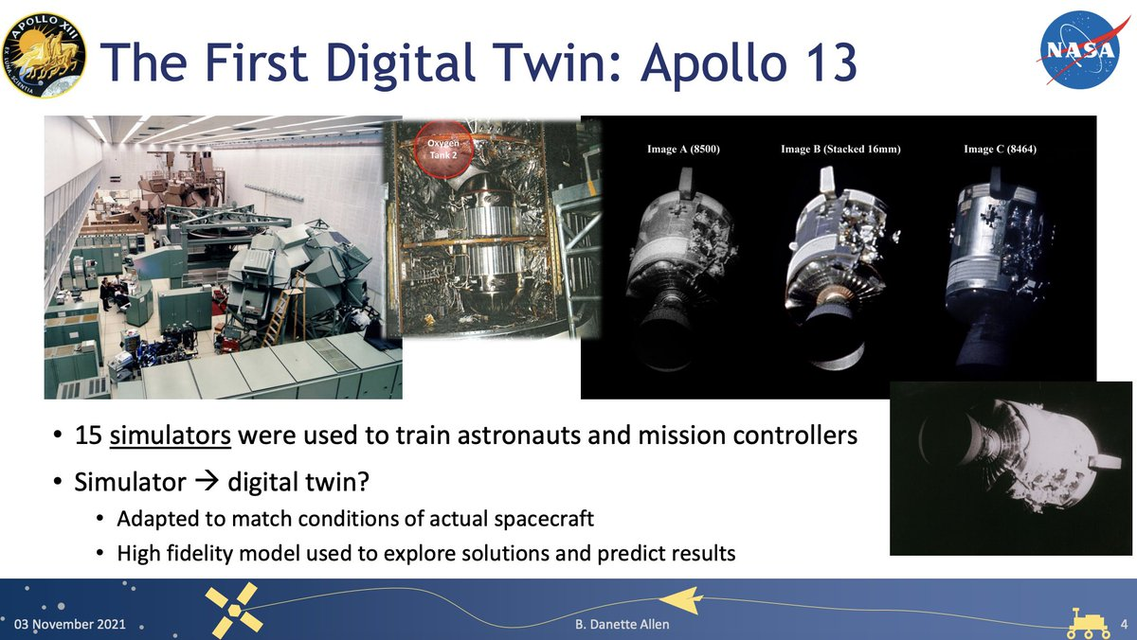
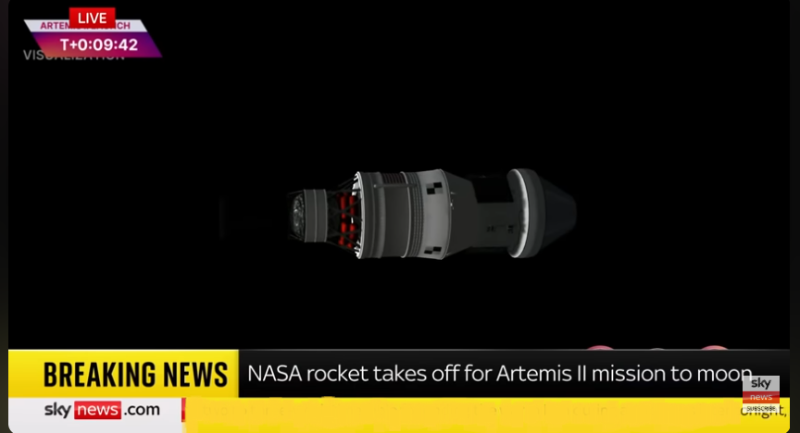
History of Digital Twins
Artemis II 2026

Slide 7
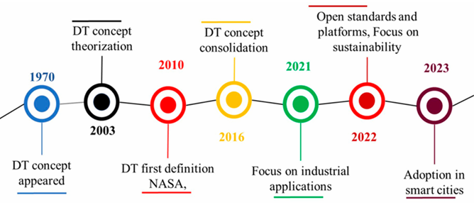
Development of Digital Twin Technology

Slide 8
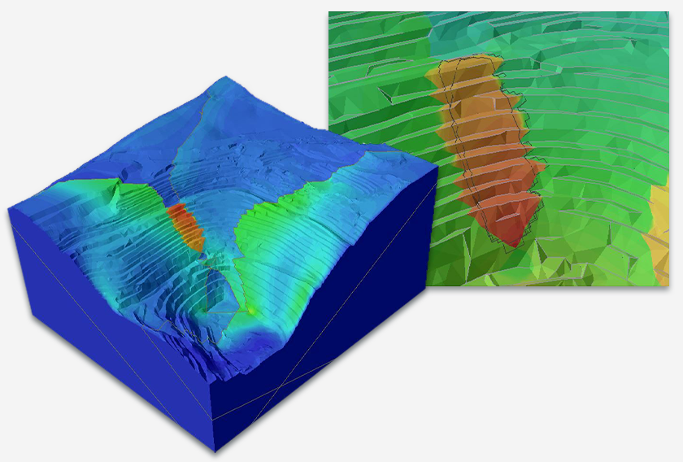
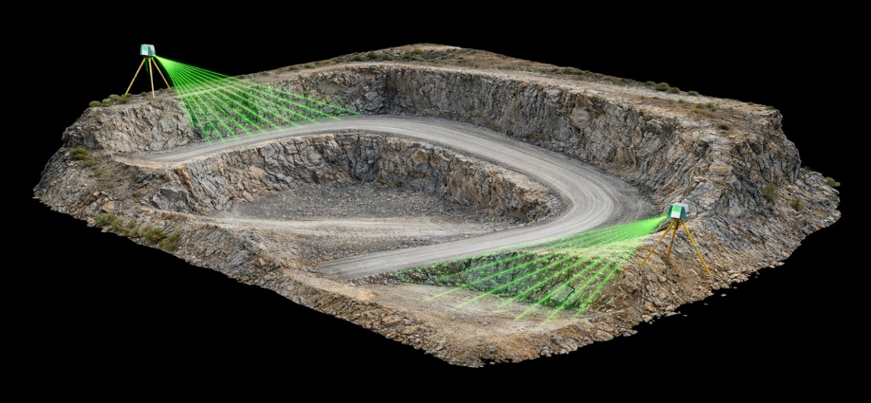
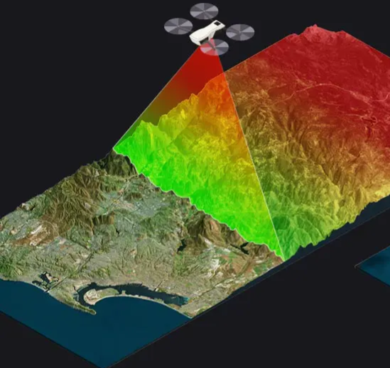
Steps in Creating Digital Twins for Slope Monitoring and Failure Prediction
Design of the Physical slopes and the computational models
2. Capture of the physical slopes

Slide 9
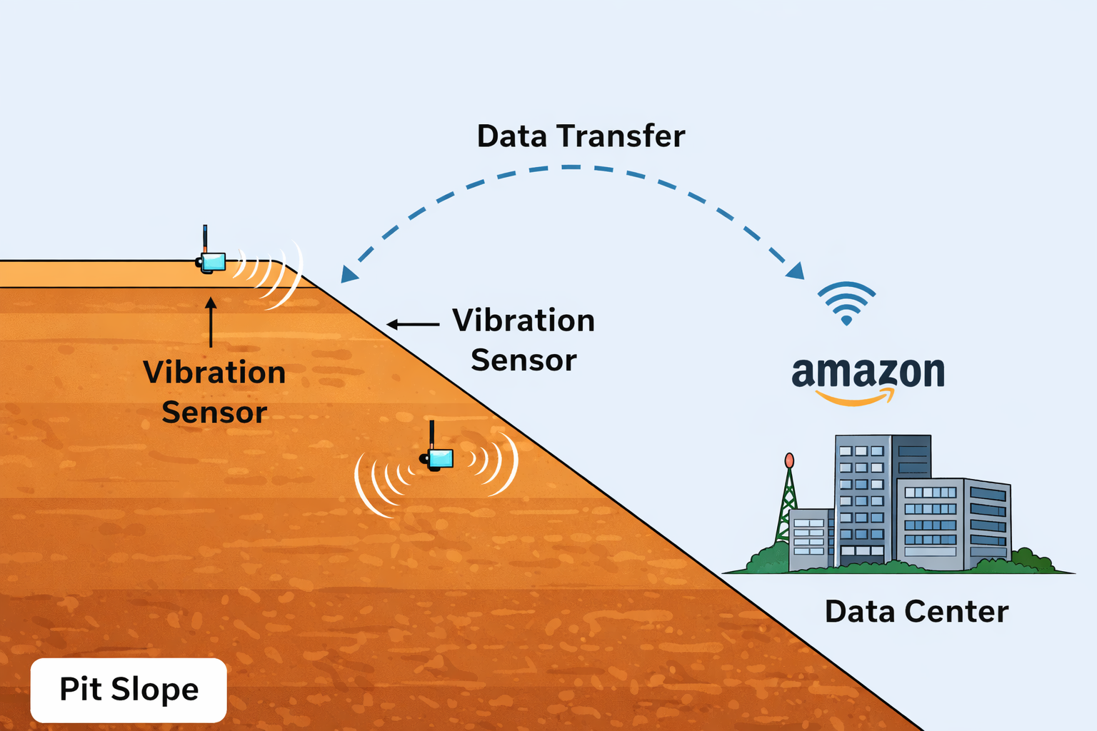

3. Data acquisition using sensors

Slide 10
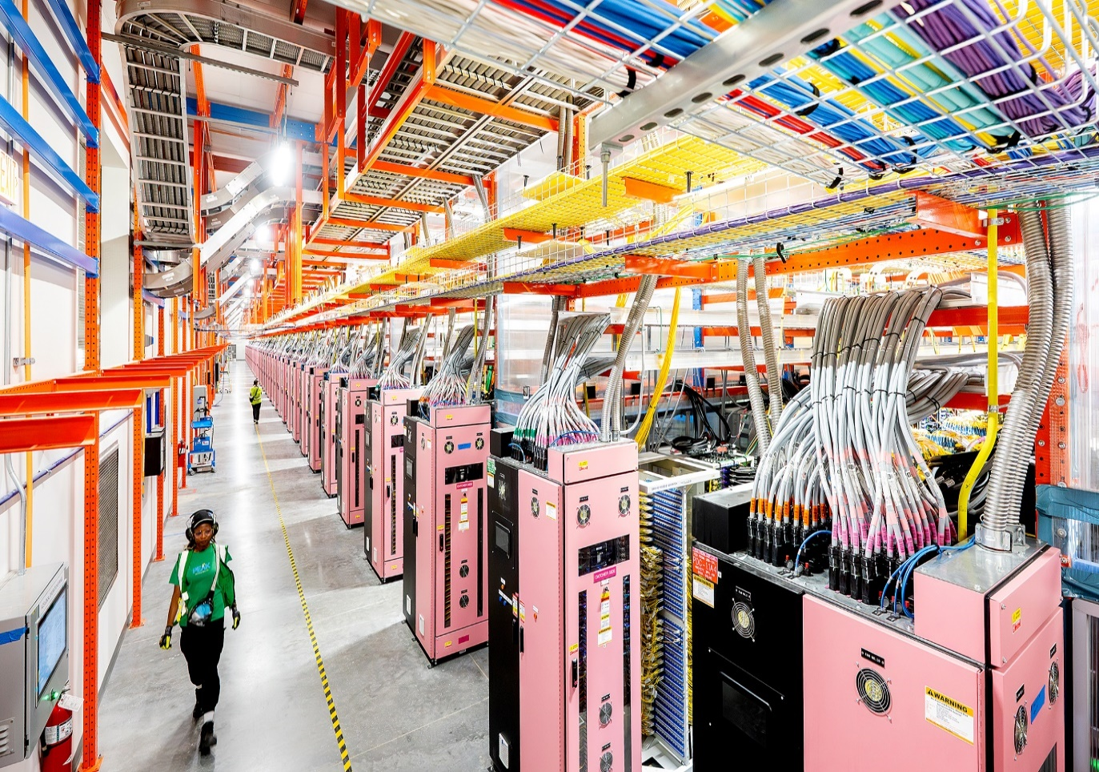
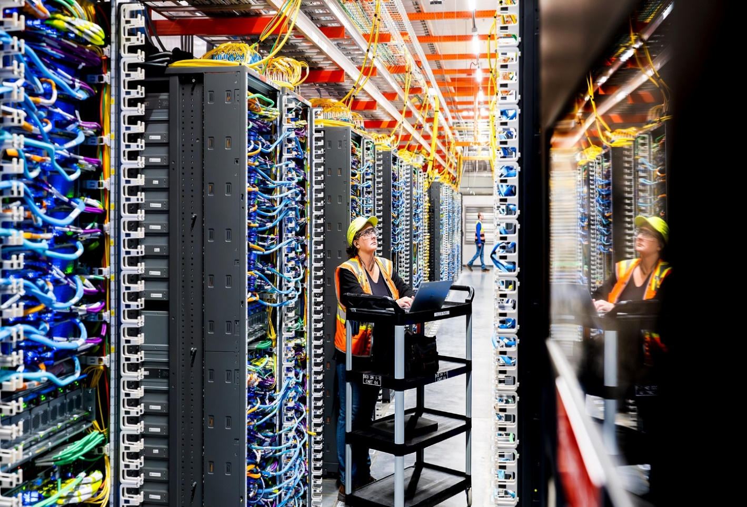
4. Data transmission, data platforms and computational infrastructure
Amazon Web Services (AWS) Data Centers
5. Data analytics with machine learning models

Slide 11

Fundamental Mathematical Model for Structural Twins
Digital twins of any physical structure are modelled based on the laws of structural dynamics. With the matrix form of Newton`s Second Law as the fundamental mathematical model.
M= Mass of slopes
K= Stiffness
C= Damping
X‘’= Acceleration
X’= Velocity
X= Displacement
F(t)= Force

Slide 12
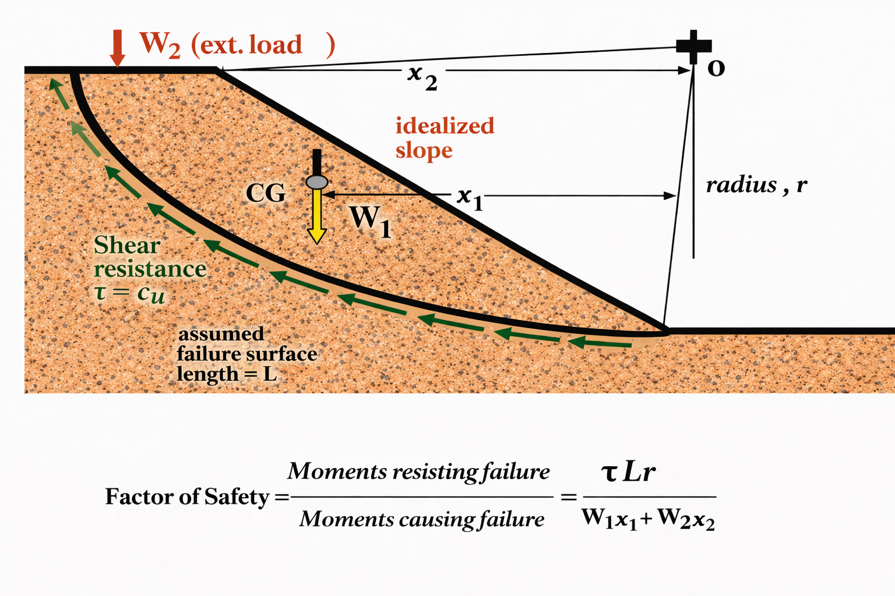
Failure Prediction
The computational models will contain geotechnical concepts such as the limit equilibrium method.
The model will be calculating factors of safety instantaneously.
Alarms will be raised when factors of safety start operating towards the allowable limit.

Slide 13
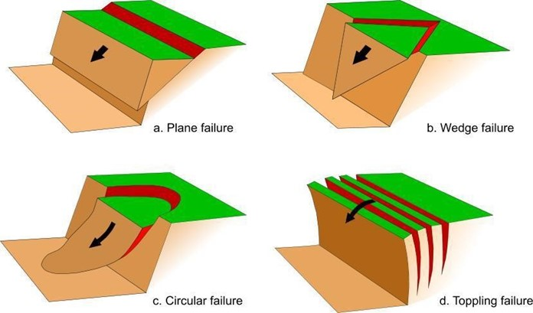
Predicting the Mode of Failure
Every structure has a natural frequency at which it vibrates.
The vibration mode changes when cracks develop.
Analysis of vibrations can tell which part of the slopes is weakening.
Failure mode can then be predicted and the best slope stabilization techniques used.

Slide 14
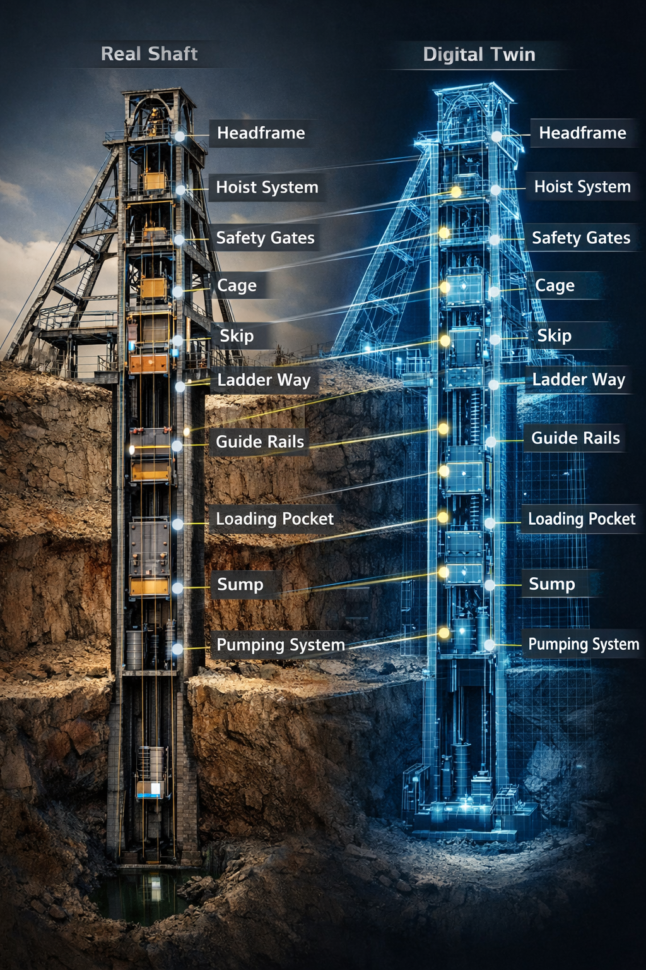
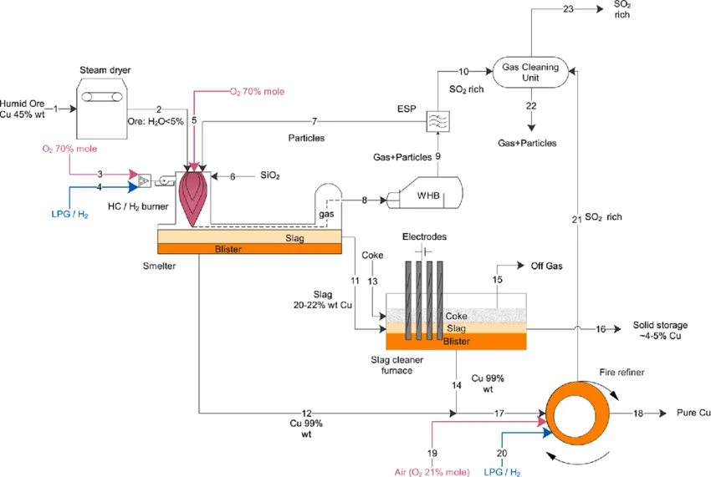
Application in Underground Mining and Mineral Processing

Slide 15
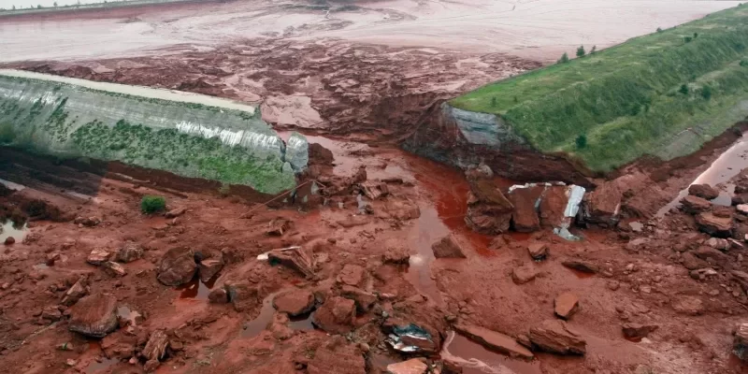
Monitoring the structural health of tailings dams
2025 Sinno metals tailings dam collapse in Chambishi, Zambia.

Slide 16
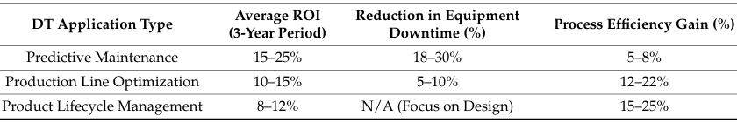
Current Aplications
Digital twins are actively being used. Several companies as those below are currently using digital twins:
NASA, SpaceX, Boeing
Mercedes Benz
In silico drug testing in health care, etc.

Slide 17
Critical Criteria for Feasibility
Technically Feasible
Economically viable/Cut costs
Safety and Risk Reduction

Slide 18
Conclusion
Digital twin technology is not a futuristic concept.
For slope stability monitoring and failure prediction, the mathematical framework already exists.
All that’s needed is integration of already established mathematical models with real-time sensor data.
Adoption does not require us to start from zero.

Slide 19
The End
THANK YOU FOR YOUR ATTENTION.

