Slide 1

2026 ENGINEERING INSTITUTION OF ZAMBIA SYMPOSIUM
MODELLING AND OPTIMIZATION OF WET SCRUBBER EFFICIENCY IN NITROUS FUME REMOVAL IN NITRIC ACID TREATMENT OF GOLD-COPPER CONCENTRATE AT KANSANSHI MINE, ZAMBIA.
PRESENTER : PATRICK MUVWENDE
DATE : Friday 18th April 2026
Avani Victoria Falls Resort, Livingstone, Zambia

Slide 2
CONTENT
INRODUCTION/LITERATURE REVIEW
PROBLEM STATEMENT
PROBLEM JUSTIFICATION
METHODOLOGY
RESULTS AND DISCUSSION
RECOMMENDATIONS
CONCLUSION
REFERENCES

Slide 3
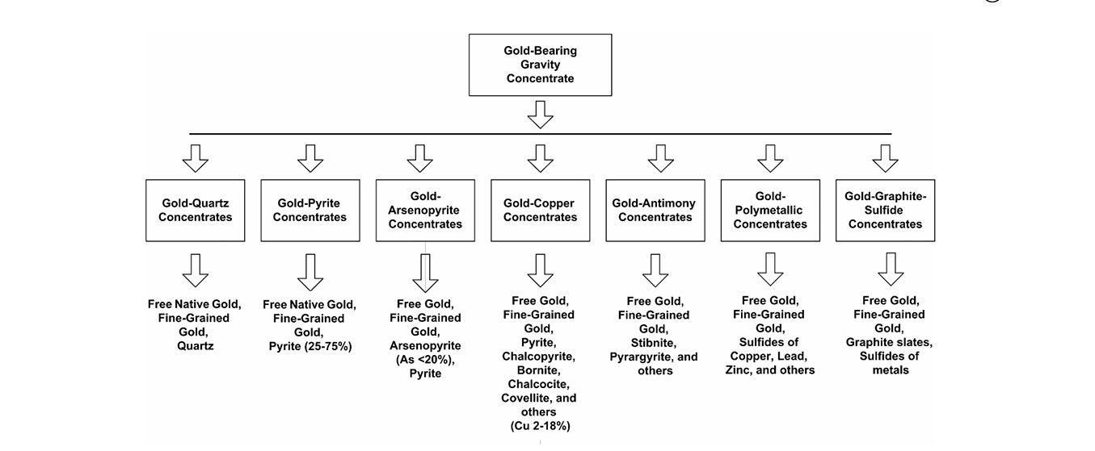
INRODUCTION/LITERATURE REVIEW
The Process: Nitric acid leaching is used to strip impurities like sulphides and arsenides from gold concentrates.
The Risk: This method releases hazardous nitrogen oxides (NO and NO₂), which are toxic to health and the environment.
The Solution: Industrial Absorbers are required to neutralize these fumes before they are released into the atmosphere.
(Surimbayev et al., 2024).
1

Slide 4
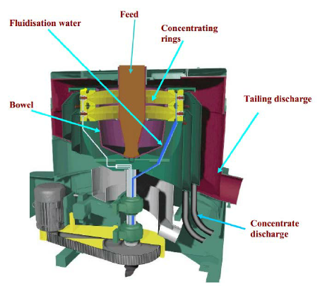
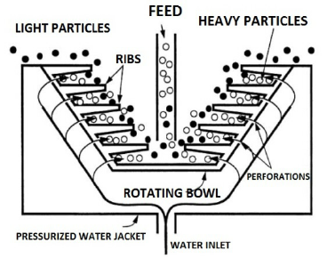
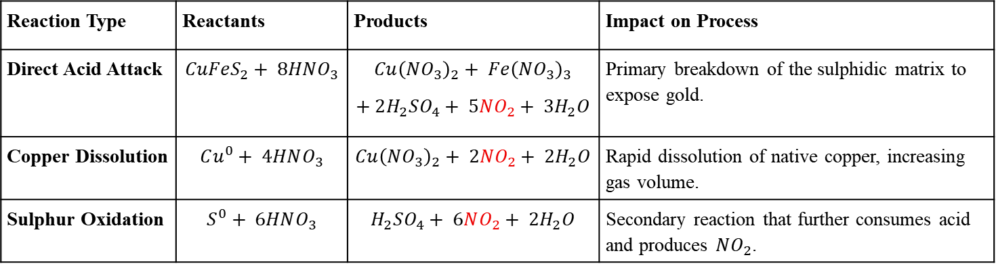
INRODUCTION/LITERATURE REVIEW CONT’D
  Chemical Reactions and Byproducts
The Increased Emission Load: High copper content in Knelson concentrates drives multiple reaction pathways, generating hazardous (NOₓ) fumes and increasing scrubber load by 30–40% compared to standard ores (Surimbayev et al., 2024).
Reaction Type | Reactants | Products | Impact on Process
Direct Acid Attack | $$CuFeS_{2}+ 8HNO_{3}$$ | $$Cu{\left(NO_{3}\right)}_{2}+ Fe{\left(NO_{3}\right)}_{3}$$ $$+ 2H_{2}SO_{4}+ 5NO_{2}+ 3H_{2}O$$ | Primary breakdown of the sulphidic matrix to expose gold.
Copper Dissolution | $$Cu^{0}+ 4HNO_{3}$$ | $$Cu{\left(NO_{3}\right)}_{2}+ 2NO_{2}+ 2H_{2}O$$ | Rapid dissolution of native copper, increasing gas volume.
Sulphur Oxidation | $$S^{0}+ 6HNO_{3}$$ | $$H_{2}SO_{4}+ 6NO_{2}+ 2H_{2}O$$ | Secondary reaction that further consumes acid and produces $NO_{2}$.
2

Slide 5
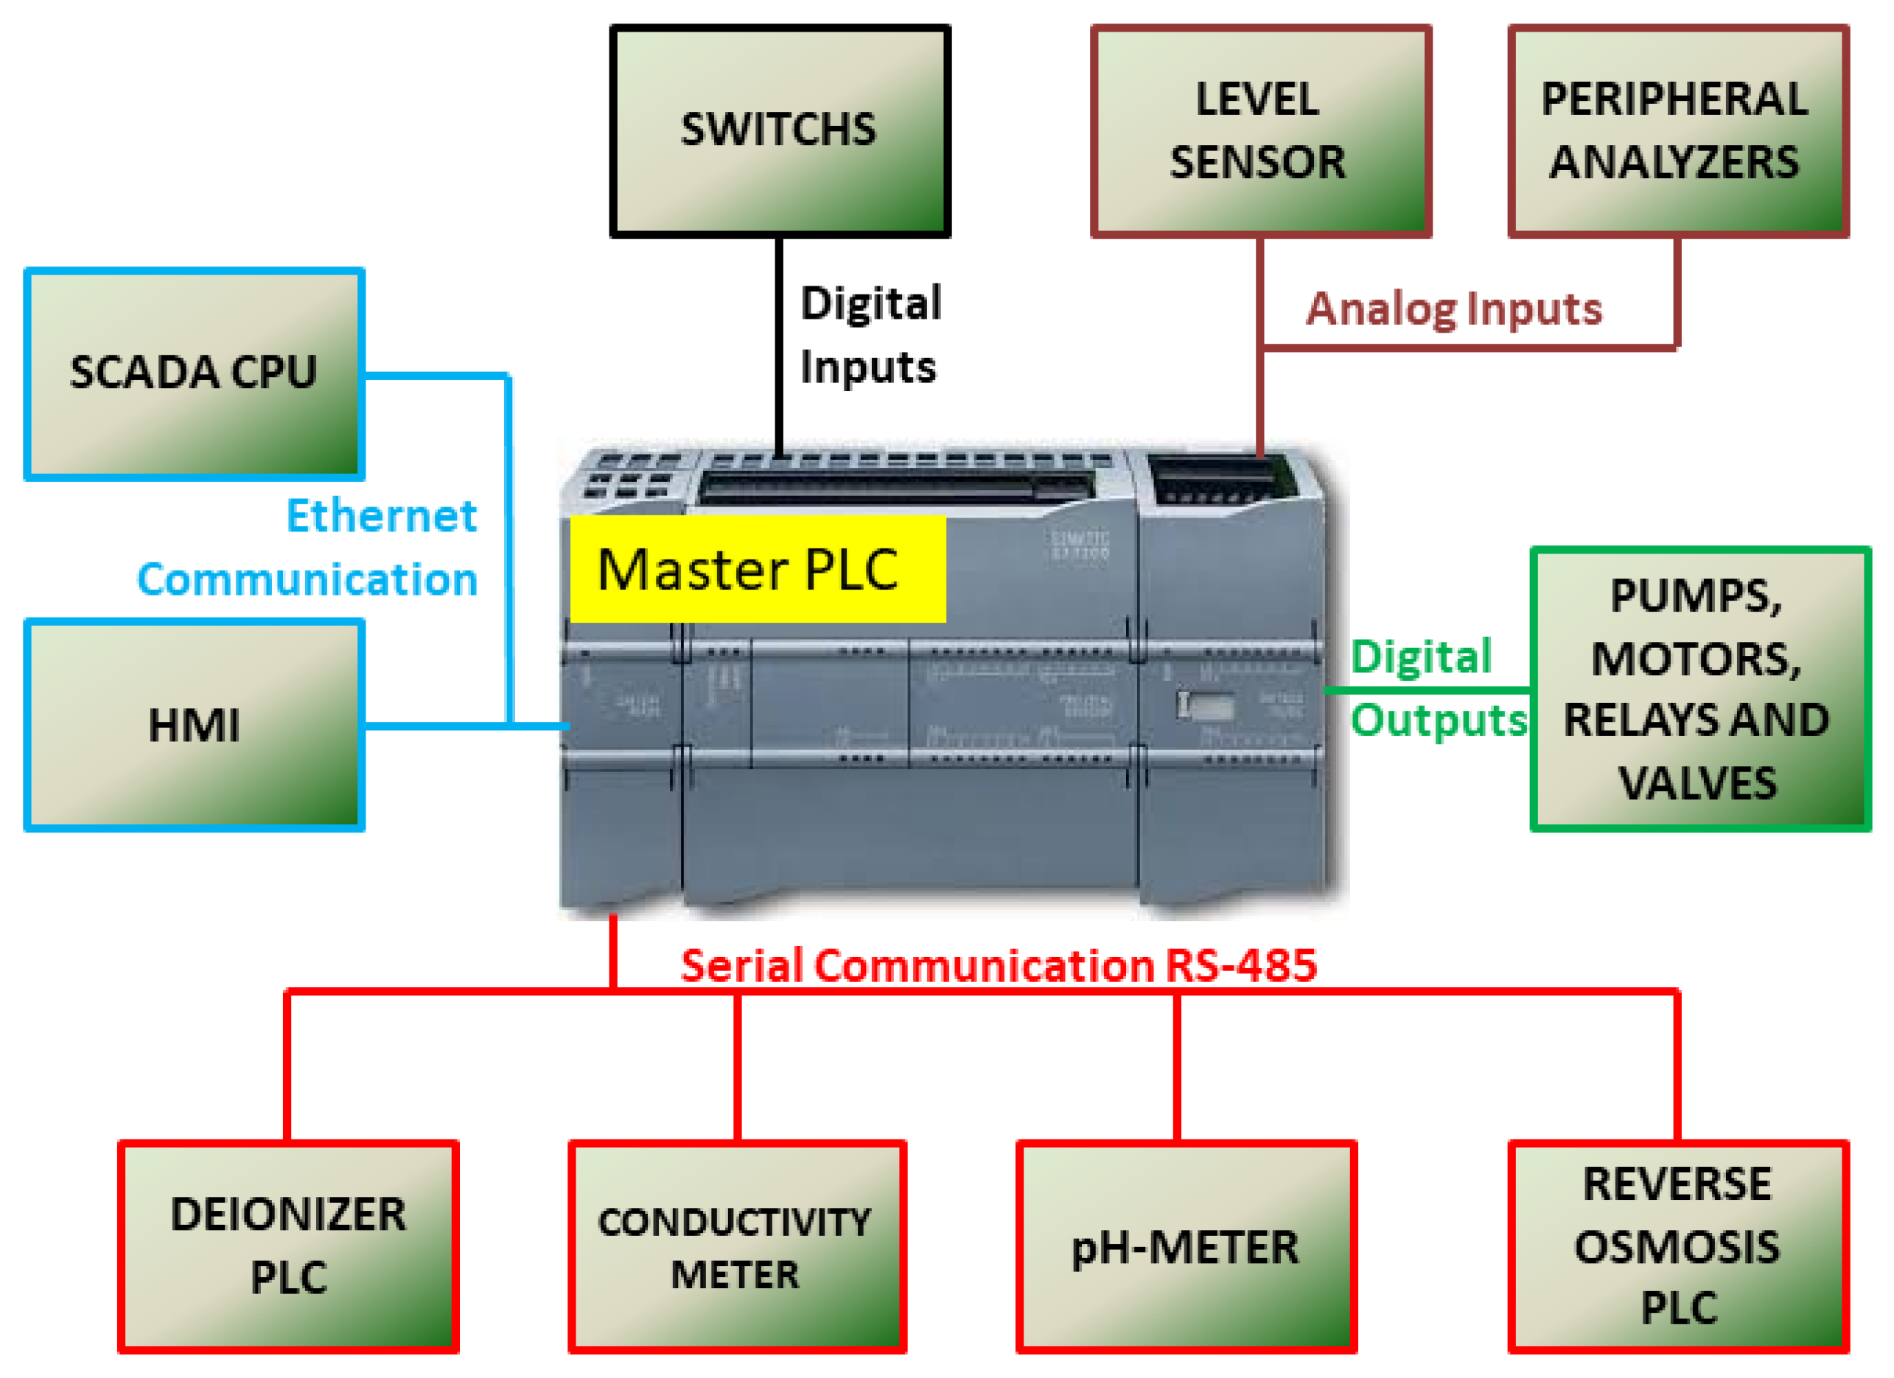
INRODUCTION/LITERATURE REVIEW CONT’D
Computers in Control System Engineering
Unified Testing: Software creates a single workspace to simulate and predict how a system will work before building it.
Easy Adjustments: Digital tools simplify complex designs, making it fast and flexible to test different ideas.
Lower Costs: Computer models save money by replacing expensive physical trials and filtering out real-world errors.
(Åström, K.J. and Murray, R.M., 2010.)
3

Slide 6
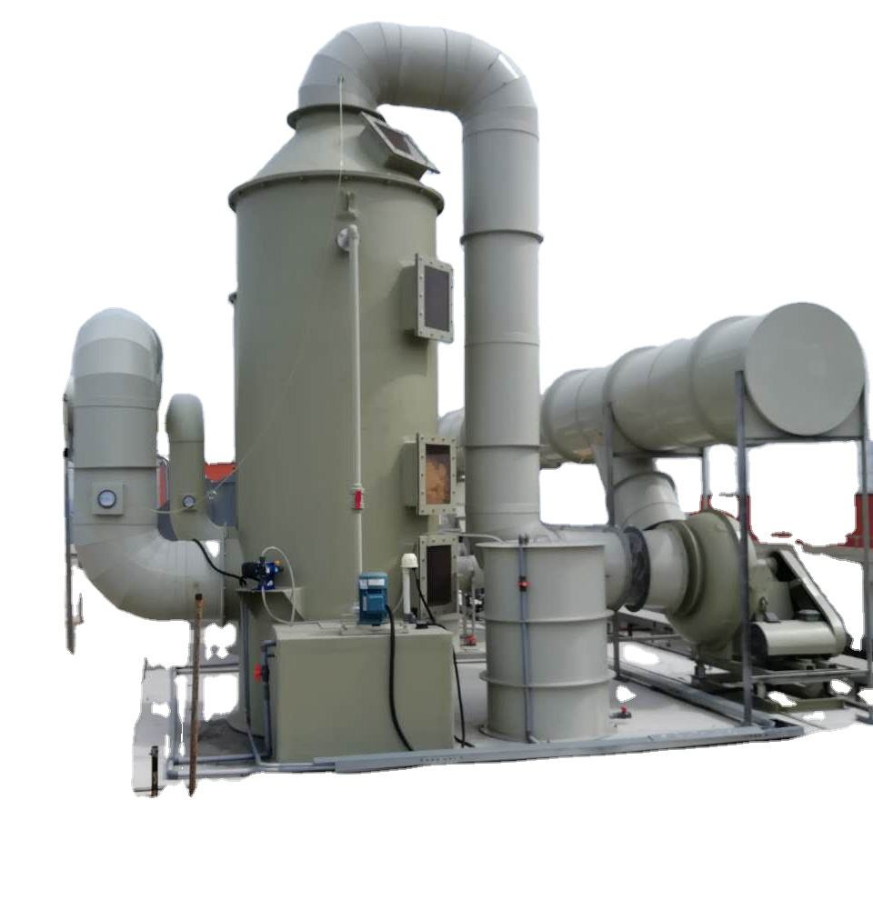
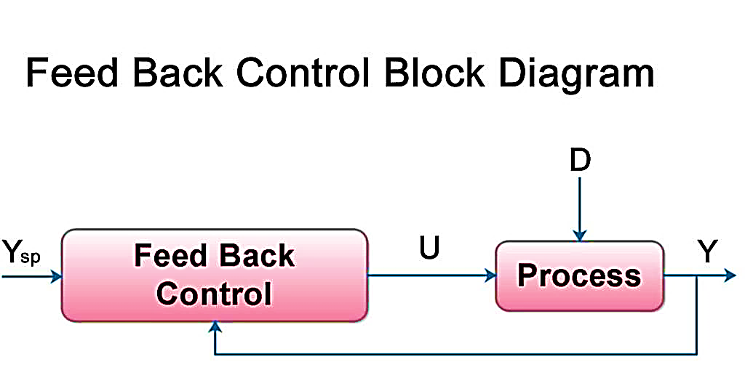
INRODUCTION/LITERATURE REVIEW CONT’D
Complex Dynamics: These units are notoriously difficult to control due to slow responses, dead times, and non-linear behaviour.
Process Interaction: Columns are deeply integrated with plant energy and materials, creating complex multivariable interactions.
Operational Stability: Reliable control is essential for the overall safety and economic success of the entire plant.
Feedback Control: A versatile, standard method that regulates processes using set gain values and time constants without needing deep knowledge of the system's internal dynamics.
(Bauyrzhan Surimbayev etal, 2024)
(Skogestad & Postlethwaite, 2005)
4

Slide 7
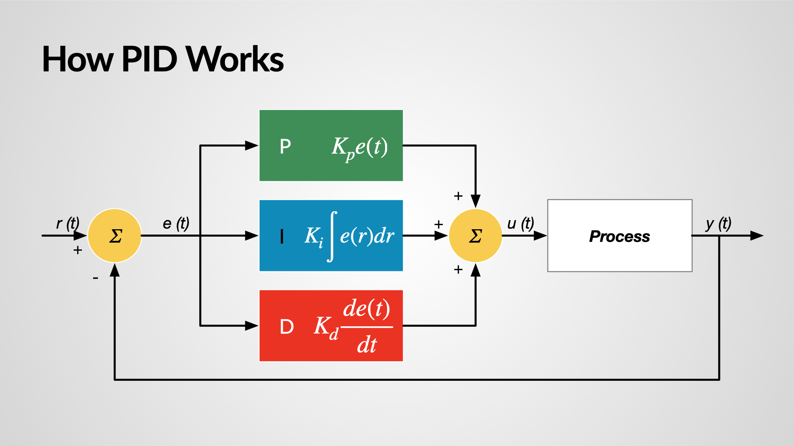
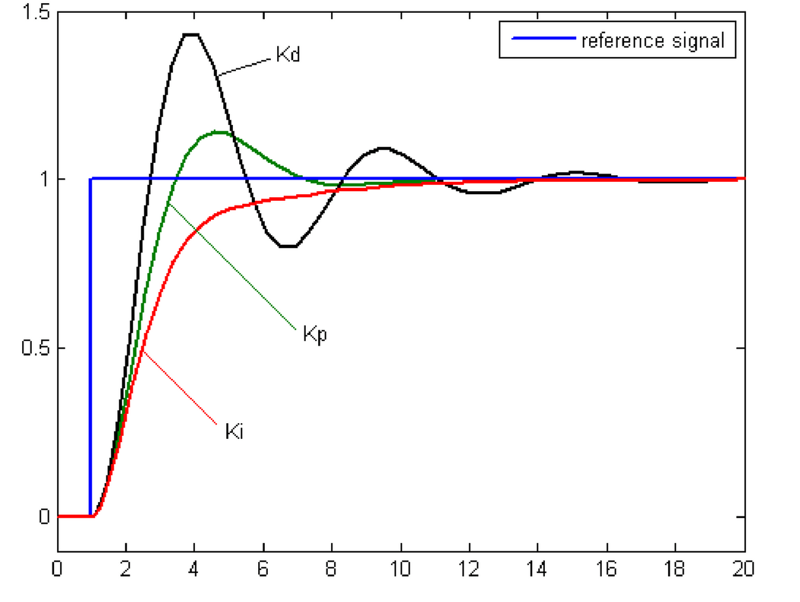
INRODUCTION/LITERATURE REVIEW CONT’D
PID Controller (Classical Control)
Proportional (P) Term : Corrects proportional to error size – fast initial correction.
Integral (I) Term: Eliminates steady-state error – accumulates past error.
Derivative (D) Term Term: Predicts future error – dampens oscillations.
Pros: Simple, widely used, works well for many processes.
Cons: Needs tuning; derivative term sensitive to noise.
(Seborg et al., 2010).
5

Slide 8
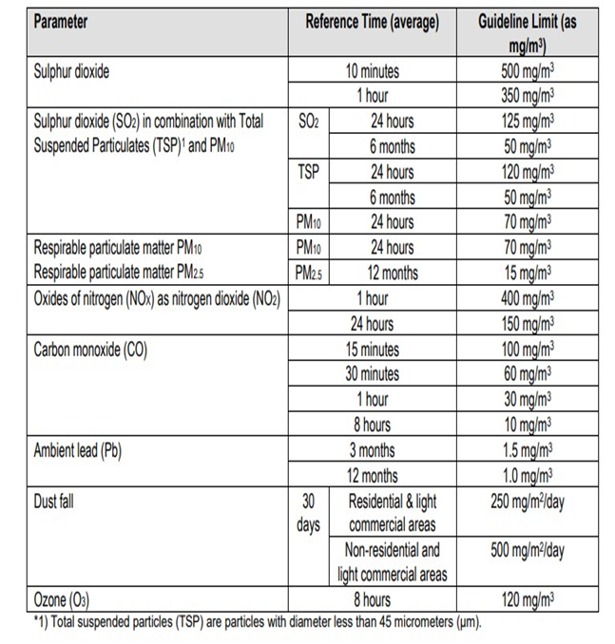

PROBLEM STATEMENT
Frequent deviations from target pH after NaOH dosing.
Inefficient gas–liquid interaction leading to incomplete NO₂ absorption.
No integrated control strategy hence unstable operation, higher reagent use.
PROBLEM JUSTIFICATION
Environmental: Meet strict NO₂ emission limits.
Operational: Meet target Set- point, Increased Operation and Reagent use efficiency.
Safety: Exposure to hazardous gases.
Sustainability: Establish robust automated control
(ZEMA, 2015).
6

Slide 9
PROJECT SPECIFIC OBJECTIVES
The principal objective of this project is to evaluate the operational efficiency and control performance of the wet scrubber system used in nitrous fume removal from the nitric acid treatment of gold concentrate.
Specific Objectives
To develop an Aspen Plus absorption model.
To analyse key operating parameters via sensitivity analysis.
To develop dynamic FOPDT models from plant data.
To optimise PID controller parameters using MATLAB/Simulink.
7

Slide 10
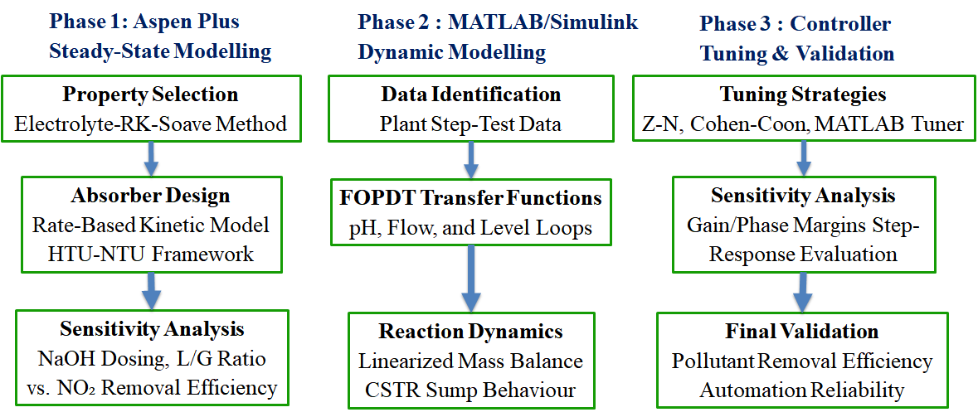
METHODOLOGY
8

Slide 11
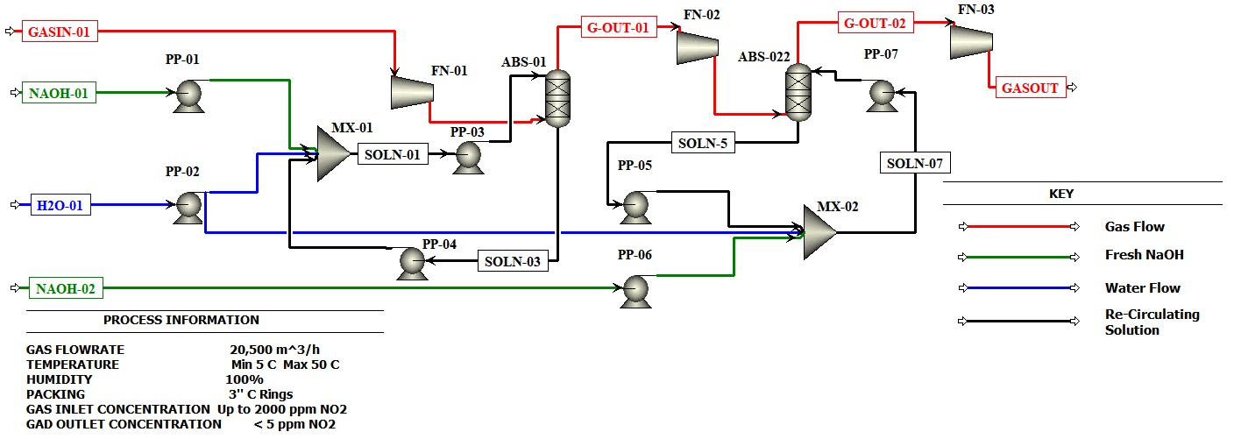
METHODOLOGY CONT’D
Aspen Plus Modelling
Process Flow Diagram
Components: NO₂, NaOH, H₂O, Air, reaction products.
Property method: Electrolyte RK-SOAVE(Hierarchy Blocks).
Sensitivity: Effect of NaOH & water flow on NO₂ removal.
(Muvwende & Chiyesu, 2024)
9

Slide 12
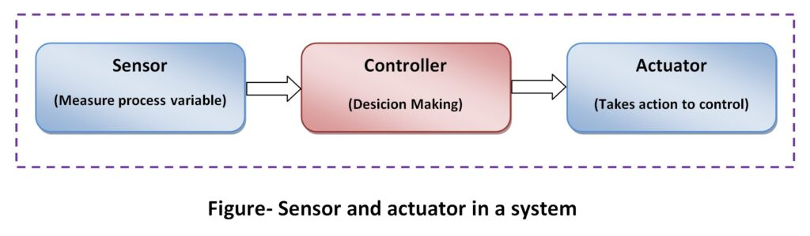


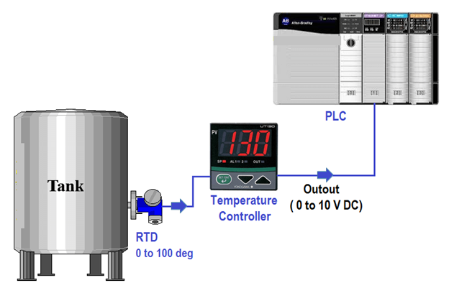
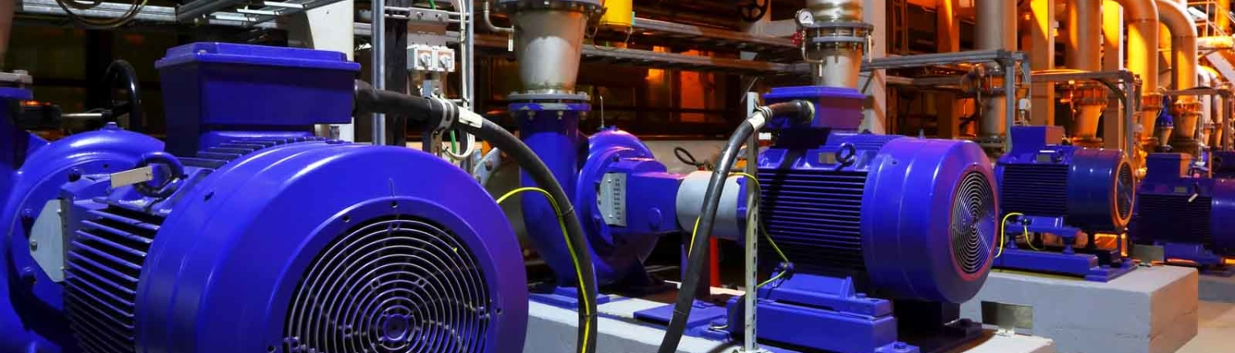
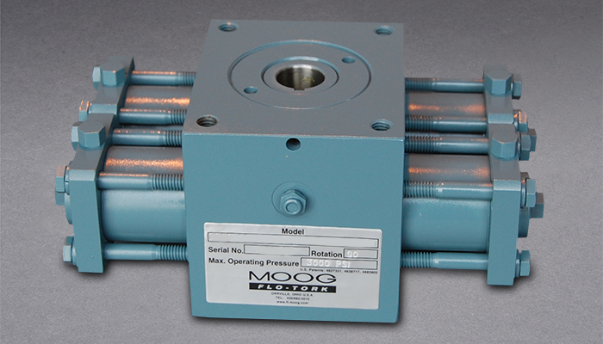
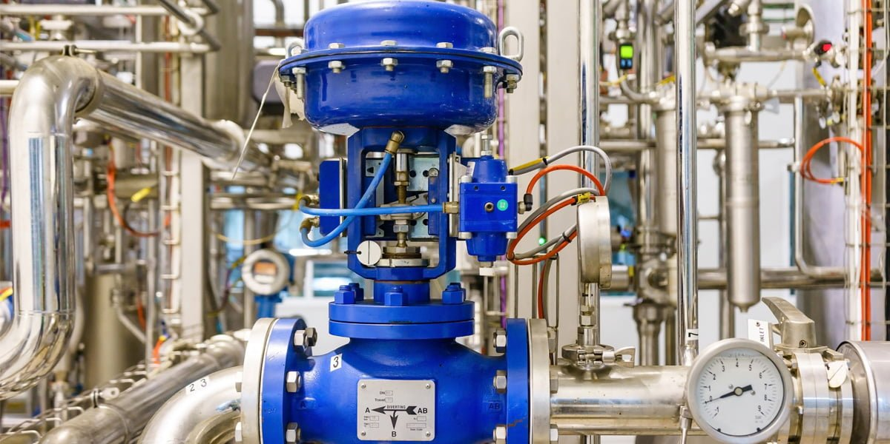
METHODOLOGY CONT’D
Data collection: Plant instrumentation readings.
A sensor - Detects a physical quantity and can generate a measurable output which is a function of the amplitude of physical quantity.
Outputs can be in the forms of visual indication e.g. Graphics.
That source of energy can be in 3 different forms:
  Electric
  Hydraulic
  Pneumatic
10

Slide 13
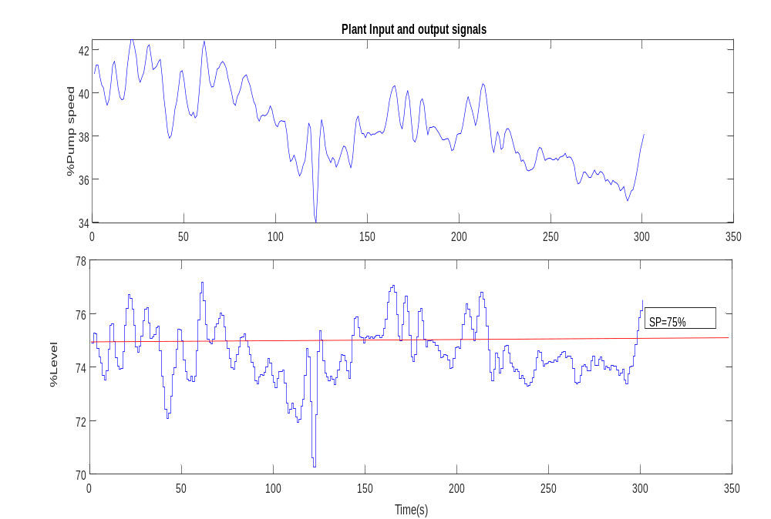
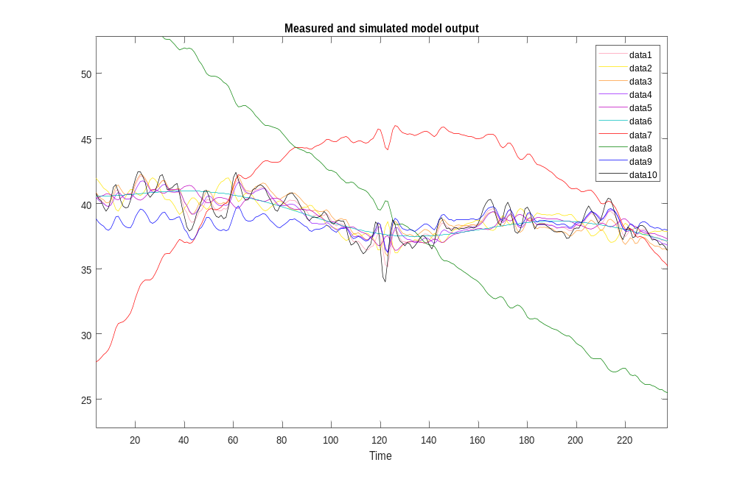

METHODOLOGY CONT’D
Controller design & tuning
Validation and Model Selection
Time plot of the input and output signals from the plant.
11

Slide 14
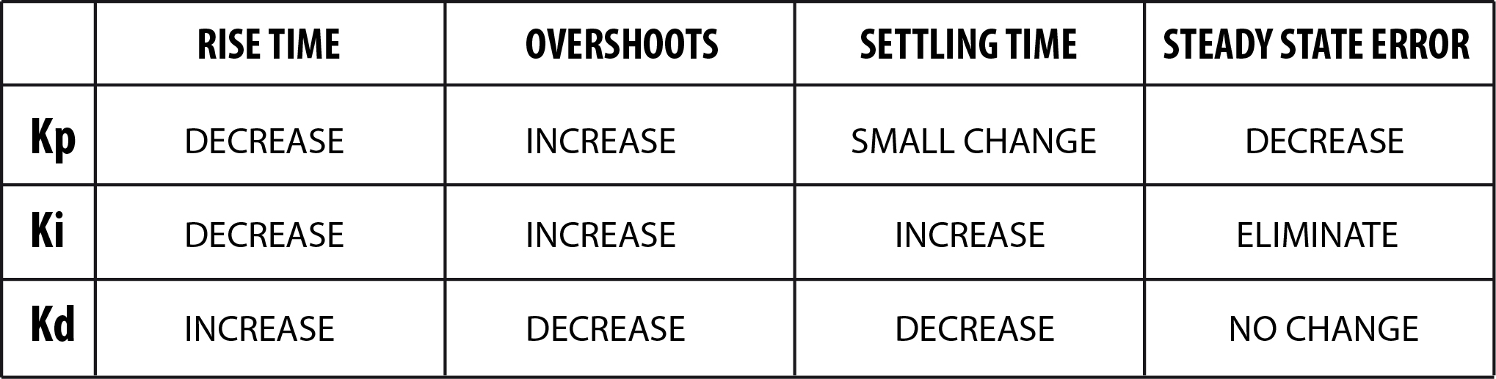
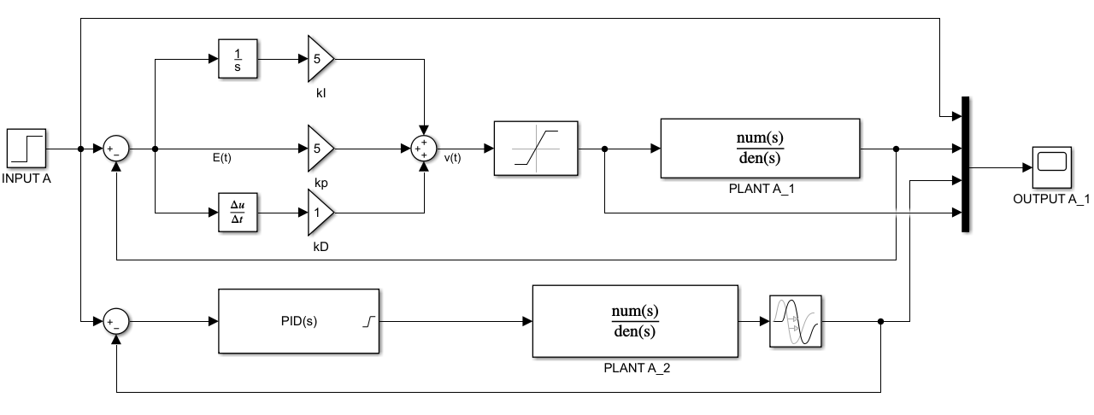
METHODOLOGY CONT’D
Control design and Controller tuning
Rise Time: How fast the robot approaches the setpoint.
Overshoot: How much the robot overshoots its goal.
Settling Time: How long it takes the robot to stop moving.
Steady State Error: How far away the robot is from its goal once it stops moving.
PID Controller
12

Slide 15
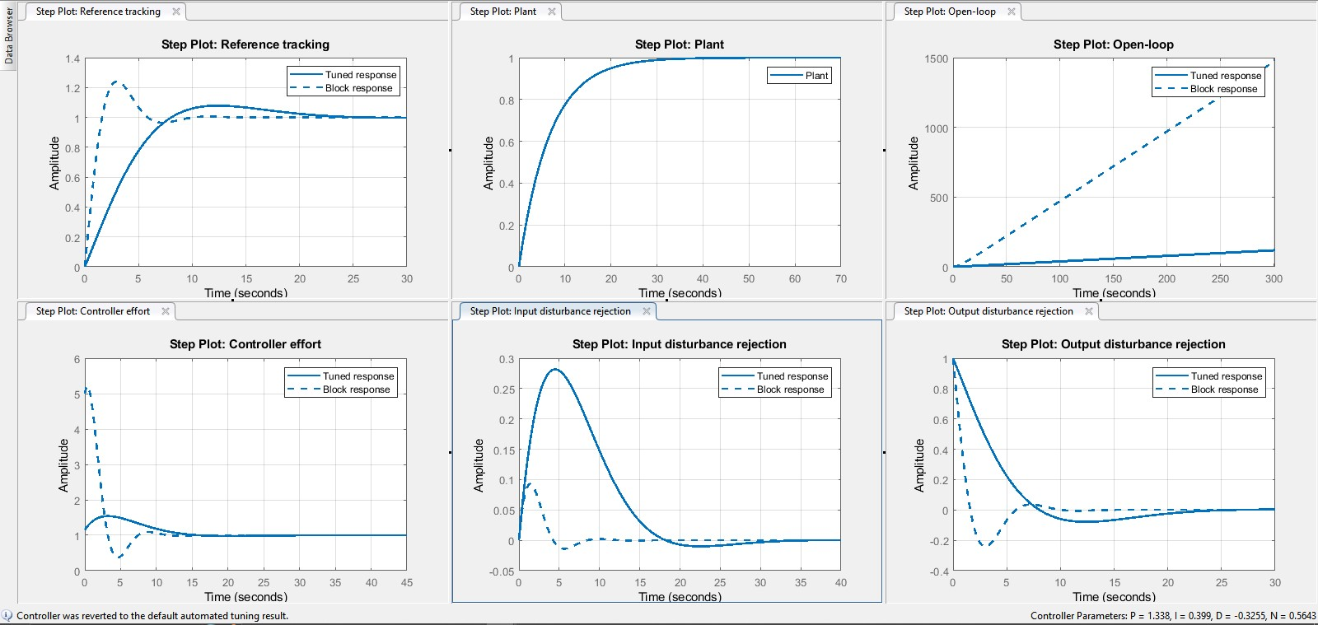
METHODOLOGY CONT’D
Controller tuning
Parameters adjusted for fast response with minimal overshoot.
(Ziegler &Nichols, 1942)
Metric / Method | Description / Procedure | Key Advantage | Main Limitation
Ziegler–Nichols | Increase gain until the system oscillates (Ultimate Gain). | Simple and fast; no complex model needed. | Aggressive/Risky: High overshoot; forces system to instability.
Cohen–Coon | Uses a single step-test to measure delay and reaction rate. | Safer: No oscillations; handles "dead time" well. | Specific: Assumes a simple model (FOPDT); complex math.
MATLAB PID Tuner App | Automatic Tuning: Launch via PID Tuner or Simulink to auto-linearize the plant. | Interactive: Uses sliders to balance speed vs. robustness in real-time. | Software-Dependent: Requires a linear plant model and specific toolboxes.
13

Slide 16
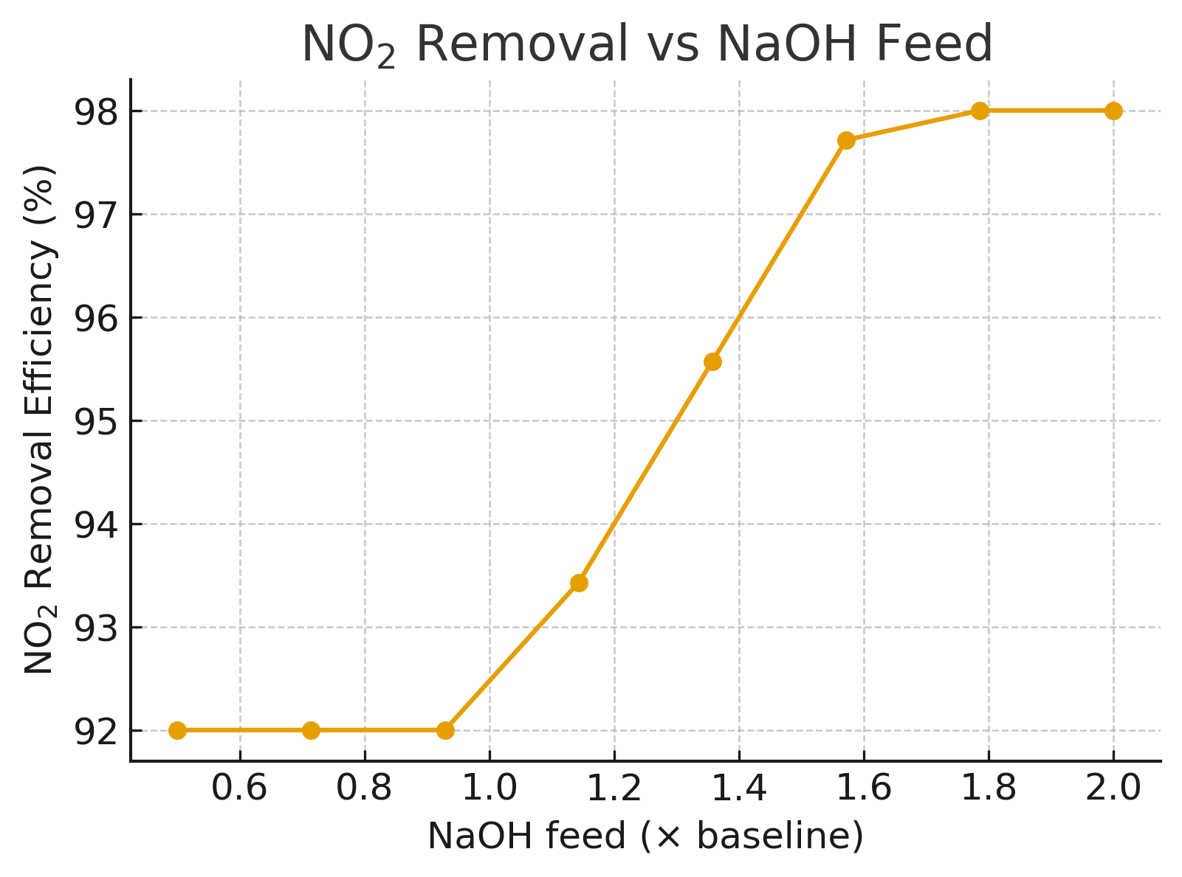
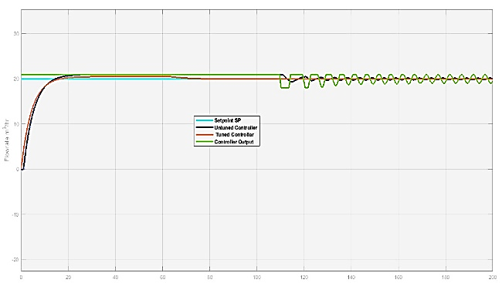
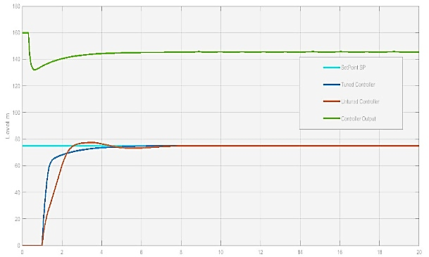
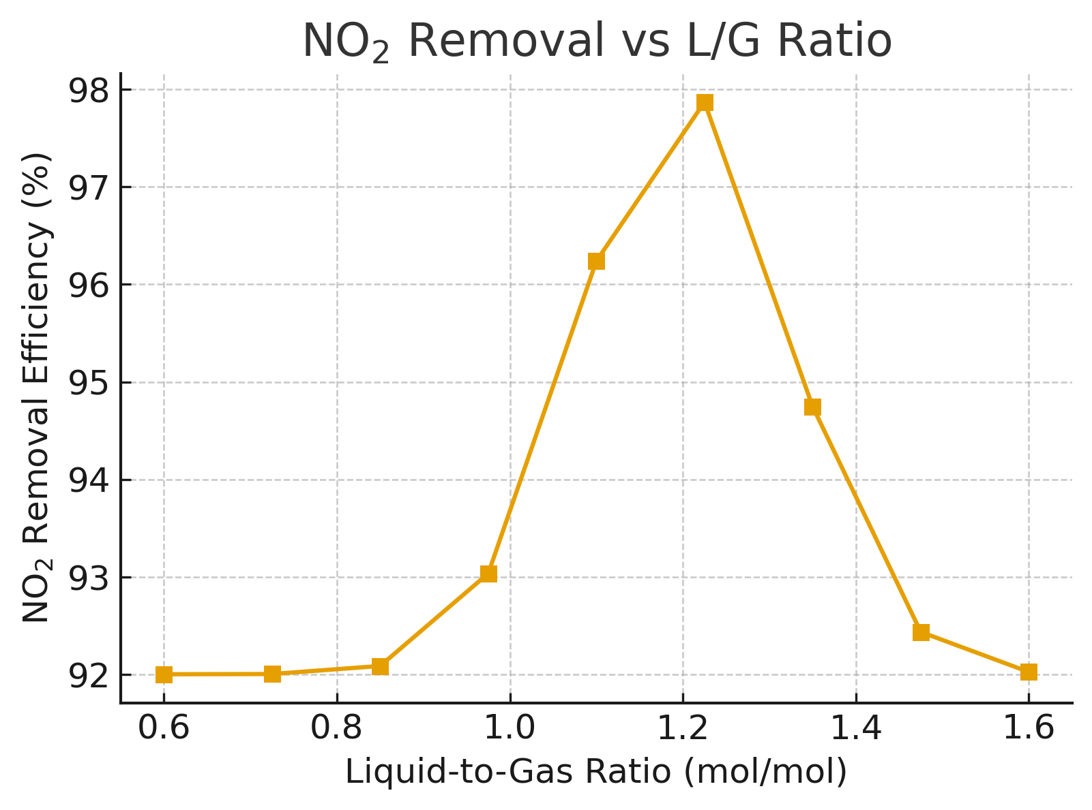
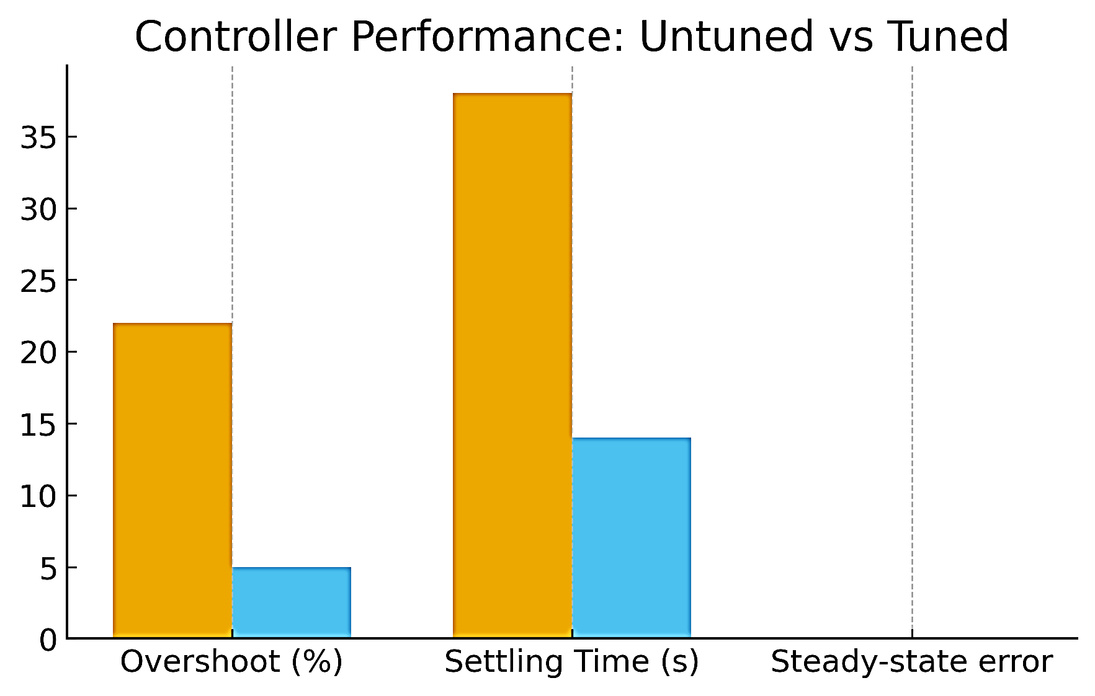
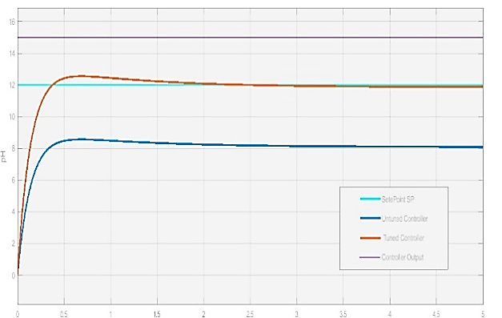
RESULTS AND DISCUSSION
Process Optimization: Sensitivity analysis achieved 98% NO₂ removal at an optimal L/G ratio of 1.2, identifying the point where further reagent dosing yields diminishing returns.
Control Refinement: Transitioning from aggressive Ziegler-Nichols tuning to a damped PID configuration increased the phase margin to 69°, prioritizing stable, oscillation-free pH regulation over raw response speed.
Refined PID tuning: Improved system stability by reducing overshoot from 24.1% to 7.86% and enhancing robustness, ensuring consistent emission compliance.
Flow Response
Level Response
pH Response
14

Slide 17
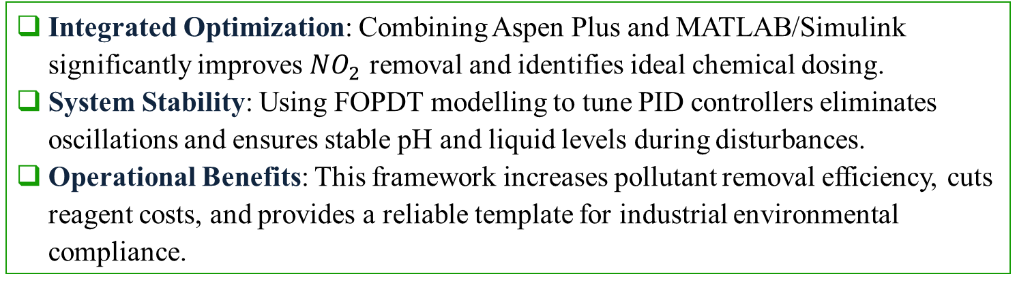
CONCLUSIONS
Integrated Optimization: Combining Aspen Plus and MATLAB/Simulink significantly improves $NO_{2}$ removal and identifies ideal chemical dosing.
System Stability: Using FOPDT modelling to tune PID controllers eliminates oscillations and ensures stable pH and liquid levels during disturbances.
Operational Benefits: This framework increases pollutant removal efficiency, cuts reagent costs, and provides a reliable template for industrial environmental compliance.
15

Slide 18
RECOMMENDATIONS
Deployment & Maintenance: Implement controllers in live plant settings with periodic retuning to ensure long-term stability.
Advanced Control Upgrades: Transition to Fuzzy Logic or Model Predictive Control (MPC) to better manage non-linear pH and flow interactions.
Process Efficiency: Use adaptive dosing and high-efficiency hardware to prevent gas channelling and minimize chemical waste.
Smart Monitoring: Integrate NO₂ analyzers and machine learning analytics for real-time performance tracking and fault detection.
16

Slide 19
REFERENCE LIST
Muvwende, P. & Chiyesu, A., 2024. Evaluation of scrubber efficiency at Kansanshi Gold Plant. Solwezi: Unpublished technical report.
Seborg, D.E., Edgar, T.F., Mellichamp, D.A. & Doyle, F.J., 2010. Process dynamics and control. 3rd ed. Hoboken, NJ: John Wiley & Sons.
Skogestad, S. & Postlethwaite, I., 2005. Multivariable feedback control: Analysis and design. 2nd ed. Chichester: Wiley.
Surimbayev, B., Bolotova, L., Akcil, A. & Yessengarayev, Y., 2024. Gravity concentration of gold-bearing ores and processing of concentrates: A review. Mineral Processing and Extractive Metallurgy Review, 46(7), pp.734–735.
ZEMA, 2020. Zambia air quality standards. Lusaka: Zambia Environmental Management Agency.
Ziegler, J.G. & Nichols, N.B., 1942. Optimum settings for automatic controllers. Transactions of the ASME, 64(11), pp.759–768.
19

Slide 20

THANK YOU

