Slide 1

2025 ENGINEERING INSTITUTION OF ZAMBIA SYMPOSIUM
BIO-SMART MINING - BIOTECHNOLOGICAL INNOVATIONS FOR CLIMATE-RESILIENT MINE WASTE TREATMENT AND ENHANCED RESOURCE RECOVERY IN DEVELOPING MINERAL ECONOMIES
PRESENTER : Ebelia Manda
DATE : Friday 17th April 2025
Avani Victoria Falls Resort, Livingstone, Zambia

Slide 2
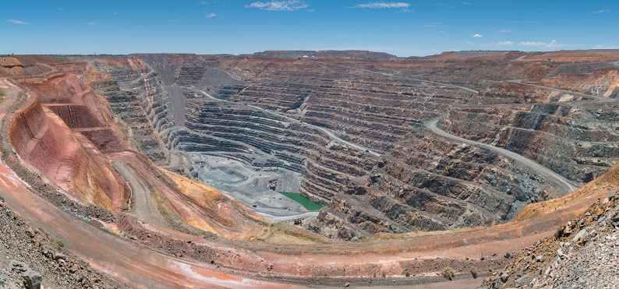
Background
Mining generates massive waste
Tailings
Waste water
Waste rock
Slurry
Acid Mine Drainage(AMD) is a major challenge

Slide 3
Background
Acid Mine Drainage Characteristics
Sulfide minerals
Effluents
Acidic
Metal-rich
Low pH (1.5 to 3)
Water
Oxygen
Environmental contamination
Rivers
Groundwater systems
Soils
Notes:
Consequently, AMD is characterized by elevated concentrations of dissolved iron, arsenic, zinc, and copper, as well as high sulfate loads that contribute to persistent acidity and long-term ecological degradation (Nordstrom, 2011).

Slide 4
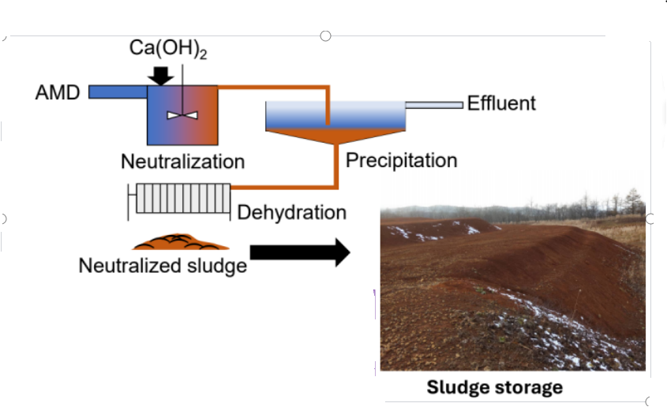
Background
Current AMD Treatment
Lime-based neutralization Produces large volumes of metal-rich sludge
Key challenges:
High handling and disposal costs
Long-term storage requirements
Continuous monitoring needed
Environmental concern:
Secondary waste management problem

Slide 5
Aim of Study
Synthesise current biotechnologies for AMD treatment
Evaluate microbial biosorption for AMD treatment
Propose a conceptual bio-smart mining framework that integrates biological systems with digital monitoring and climate-resilient waste management.

Slide 6
Study Methodology
Literature review
AMD treatment
Microbial biosorption & SRB
Phytoremediation
Bioleaching & metal recovery
Biomaterials
Digital mining (AI, IoT, remote sensing)
Experimental case
Microbial AMD treatment
As: 7.2 → <0.2 mg/L
Fe: 320 → 79.1 mg/L
Framework development
Conceptual Bio-Smart framework integrating biotechnology + digital monitoring

Slide 7
Biotechnologies
Microbial Biosorption in AMD Treatment
Use of microorganisms to remove dissolved metals from contaminated water
AMD
Bacteria
Clean Water
Recovered metals
Key Mechanisms:
Biosorption (surface binding)
Bioaccumulation
Bioprecipitation
Microorganisms involved:
Acidophilic bacteria
Sulfate-reducing bacteria (SRB)
Mixed microbial consortia

Slide 8
Biotechnologies
Microbial Biosorption in AMD Treatment
Use of microorganisms to remove dissolved metals from contaminated water
AMD
Bacteria
Clean Water
Recovered metals
Performance:
Up to 90% arsenic removal
~70% iron reduction
Effective in low pH environments
Advantages:
Low chemical and energy requirements
Reduced sludge generation
High metal selectivity
Potential for metal recovery (circular economy)
Notes:
A sustainable and cost-effective alternative to conventional AMD treatment

Slide 9
Biotechnologies
Phytoremediation in Mine Rehabilitation
Use of plants to immobilise or extract contaminants from polluted soils
Plant
Soil
Microbe interaction
Recovered plants
Key strategies:
Phytostabilisation (immobilisation)
Phytoextraction (uptake of metals)
Effective plant species:
Vetiver
Willow
Pteris vittata
Main benefits:
Soil stabilization
Reduced erosion
Restoration of degraded ecosystems

Slide 10
Biotechnologies
Enhanced Phytoremediation
Improvement strategies:
Addition of organic matter
Integration with microbial activity
Use of biological substrates (e.g., compost, woodchips)
Performance:
Up to 88% removal of metals and sulfate
Enhanced plant growth and soil quality
Additional benefits:
Increased biodiversity
Biomass production (bioenergy potential)
Long-term ecosystem restoration
Notes:
Phytoremediation is a cost-effective and sustainable solution for mine site rehabilitation and closure

Slide 11
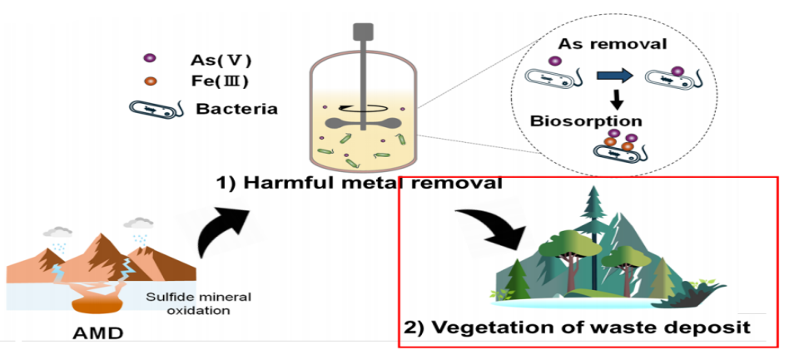
Experimental Results on Microbial Treatment of Acid Mine Drainage
Combined biological approach for acid mine drainage management
KEY IMPACT
Reduced toxicity
Lower sludge generation
Improved efficiency of neutralisation
Potential for water reuse

Slide 12
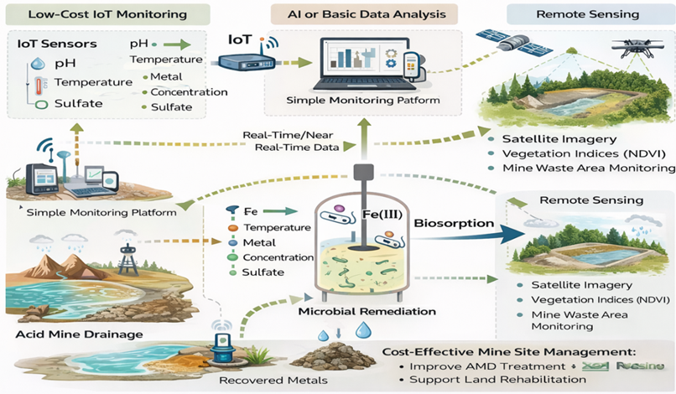
Integrating Biotechnologies with Digital Smart Mining Systems
Conceptual Smart-Biotech AMD Monitoring System Diagram
Notes:
Emerging approach: Integration of biotechnology + digital technologies
Improved environmental protection while maintaining operational efficiency in mining

Slide 13
Integrating Biotechnologies with Digital Smart Mining Systems
Road-map for implementation in developing economies
PHASE 1
RESEARCH & CAPACITY BUILDING
PHASE 2
FIELD IMPLEMENTATION & ECOSYSTEM REHABILITATION
PHASE 3
BIO-SMART ENVIRONMENTAL MONITORING
Notes:
Emerging approach: Integration of biotechnology + digital technologies

Slide 14
Conclusion
Biotechnology is a sustainable solution for Acid Mine Drainage (AMD)
Experimental Results on Microbial Treatment of Acid Mine Drainage showed significantly reduced As and Fe, confirming high efficiency in metal removal.
This study proposed a Bio-Smart framework integrating Microbial remediation, phytoremediation, and IOT & remote sensing

Slide 15
Recommendations
Policy & Research:
Promote environmental biotechnology
Support pilot projects & academic–industry collaboration
Technology adoption:
Implement IoT monitoring and remote sensing systems
Improve data-driven decision-making
Circular economy:
Apply biosorption, bioleaching, phytomining
Recover valuable metals from waste
Capacity building:
Strengthen training, skills, and research infrastructure
Notes:
Enable large-scale adoption of Bio-Smart Mining systems for sustainable development

Slide 16
The End
THANK YOU FOR YOUR ATTENTION.

