Slide 1

2025 ENGINEERING INSTITUTION OF ZAMBIA SYMPOSIUM
Local Manufacturing and Innovation of Climate-Smart Mechanization Technologies in Zambia: Building a Sustainable and Self-Reliant Agricultural Engineering Ecosystem
PRESENTER : Joseph Mwape Chileshe
DATE : Friday 16th April 2026
Avani Victoria Falls Resort, Livingstone, Zambia

Slide 2
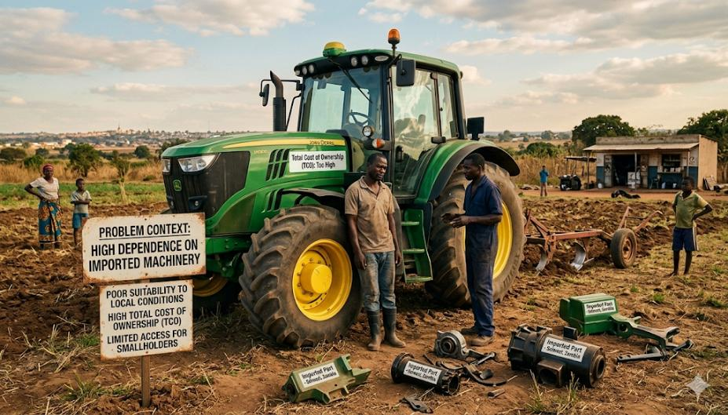

Problem Context
High dependence on imported machinery
Poor suitability to local conditions
High Total Cost of Ownership (TCO)
Limited access for smallholders
Notes:
This image highlights the key challenges facing agricultural mechanization in Zambia, focusing on:
Import Dependence: An aging, massive imported tractor, marked as a foreign model, symbolizing a heavy reliance on imports.
Unsuitability to Local Conditions: The tractor is ill-equipped for the small, irregular, and difficult-to-plough fields common in the region.
High Total Cost of Ownership: The scene is one of struggle and neglect. A mechanic is fighting to get the tractor running, and broken parts, clearly labeled "Imported," are scattered about, illustrating high costs for specialized parts and lengthy downtime.
Barriers to Adoption: A local smallholder farmer is standing nearby, completely sidelined and unable to afford or utilize this technology.

Slide 3
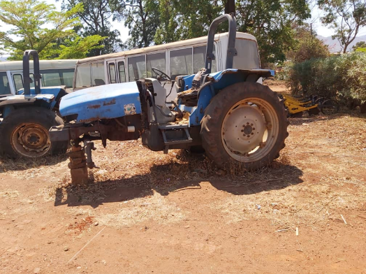
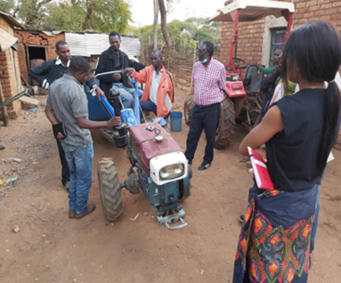
Challenges in Chipata. Disused tractor and 2 wheel tractor is not suitable for the heavy clay soil

Slide 4
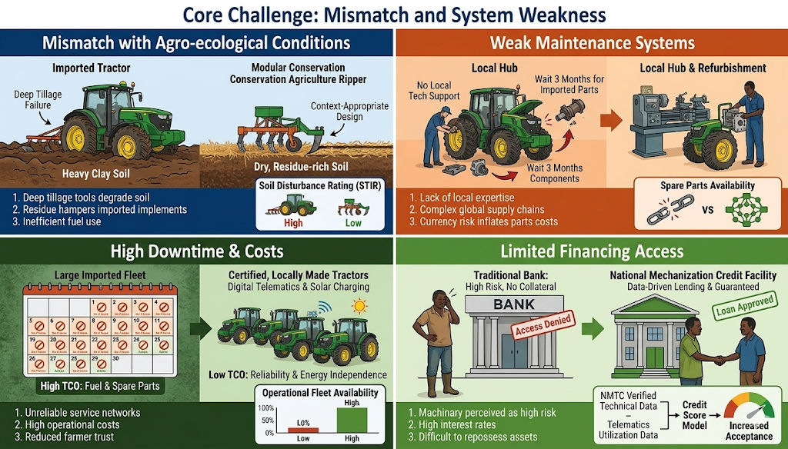
Core Challenge
Mismatch with agro-ecological conditions
Weak maintenance systems
High downtime and costs
Limited financing access
Notes:
Mismatch with Agro-Ecological Conditions: This panel contrasts large, imported equipment—like the tractor in the context—sinking in muddy clay soil (a failure of deep tillage), against a small, locally-fabricated 'Modular Ripping Implement' that efficiently works the residue-rich soil (a 'Right-Sized' and 'Climate-Smart' success).
Weak Maintenance Systems: This section shows a broken-down imported tractor with text indicating the long delay for imported parts at a repair hub, next to an active 2WT and a local fabricator effortlessly swapping a modular component at a simple 'Fabrication & Repair Hub'.
High Downtime and Costs: This panel visualizes the economic and environmental burden by comparing a broken imported machine and a small locally made alternative, emphasizing high total cost of ownership (TCO) from fuel and repairs against the cost-saving benefits of locally accessible 'Refurbishment and Component Reuse'.
Limited Financing Access: The final section visualizes the finance gap, contrasting a bank building rejecting an emergent farmer, and the solution from section 7.3: a NMTC 'Certified Equipment' verification and 'Digital Telematics' feeding data into a successful performance-based lending decision.

Slide 5
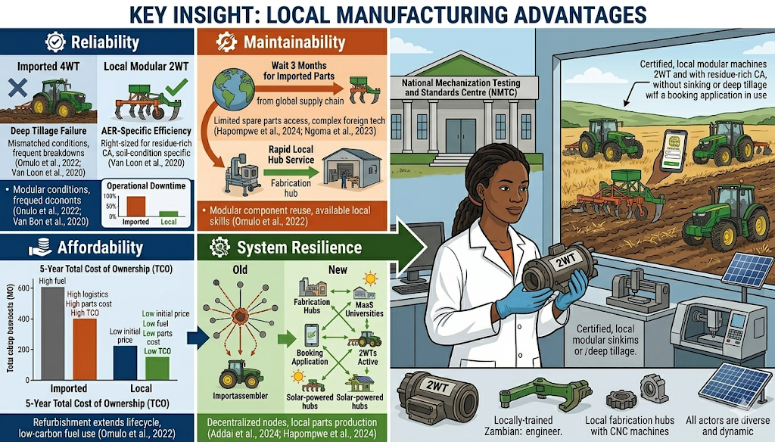
Key Insight
Local manufacturing improves:
Reliability
Maintainability
Affordability
System resilience

Slide 6
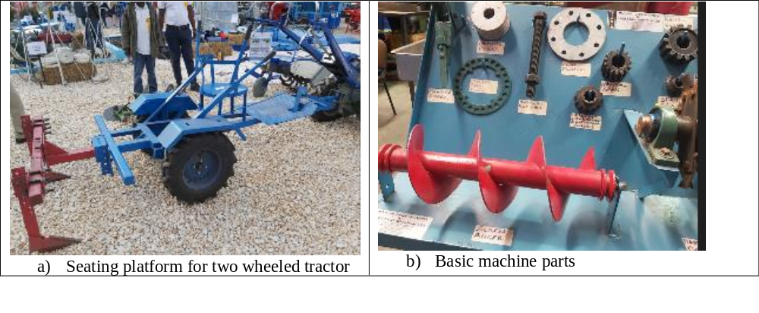
Some companies that are in manufacturing..
SARO AGRO INDUSTRIAL LTD,
Notes:
SARO AGRO INDUSTRIAL LTD, is a multi faceted supplier and manufacturer of machines. SARO has a state-of-the-art laser cutting matching which has made them be able to manufacture new products which include rippers, hammer mills, threshers and feed mixers. SARO AGRO has a team of technicians the workshop and can be able to make 1400 pieces of equipment (thresher, feed mixer and hammer mill) per year.

Slide 7
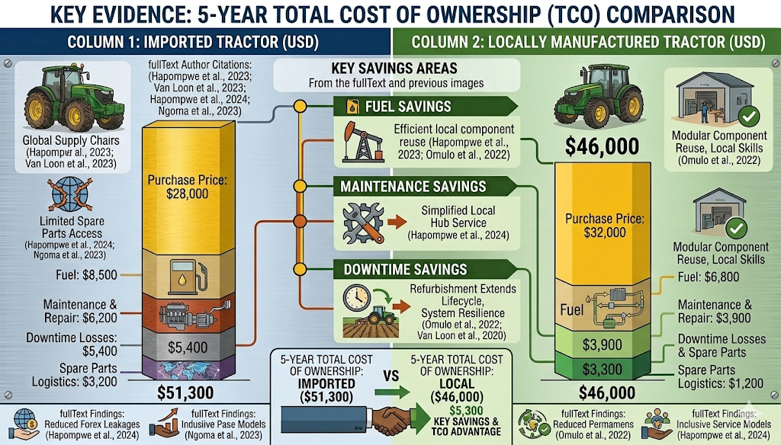
Evidence: TCO Comparison
Imported Tractor (5-year TCO): $51,300
Local Tractor (5-year TCO): $46,000
Key savings from maintenance, fuel, downtime

Slide 8
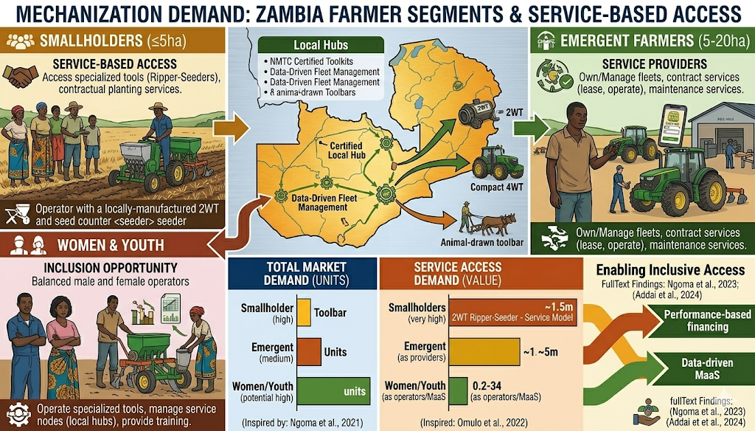
Mechanization Demand
Smallholders: service-based access
Emergent farmers: service providers
Women & youth: inclusion opportunity
Notes:
For Smallholders (≤5 ha), the image illustrates demand for low-cost tools like animal-drawn toolbars and two-wheel tractor rippers, with access provided through specialized contractual planting services.
Emergent Farmers (5–20 ha) are depicted as dynamic service providers, managing machinery fleets and offering leasing and operational contracts that incorporate digital booking and maintenance services.
For Women and Youth, the infographic focuses on inclusion and innovation, showing diverse operators using locally made, ergonomic 2WT seeders. It links certified training programs with performance-based finance and data-driven fleet management to create new jobs.

Slide 9
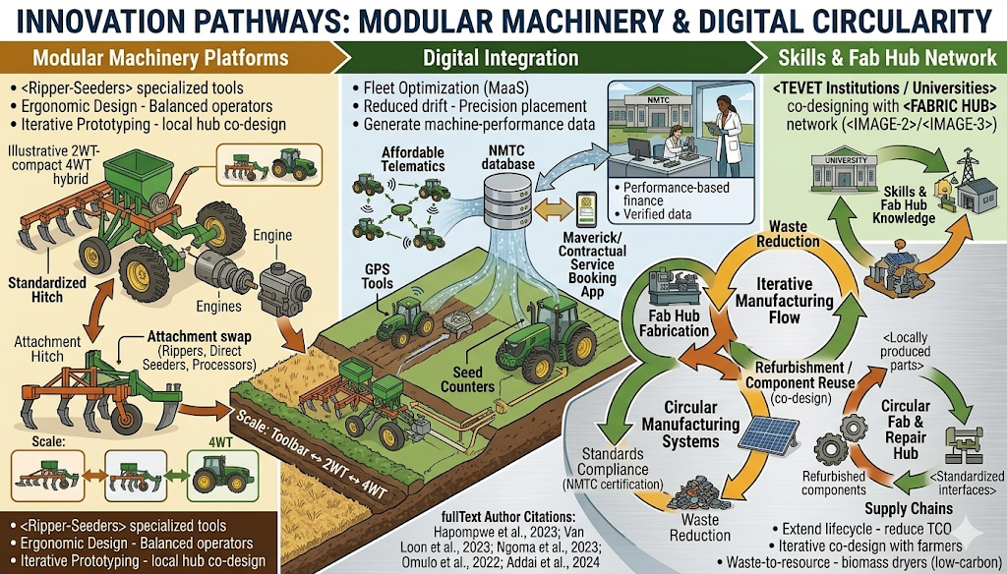
Innovation Pathways
Modular machinery platforms
Digital integration (GPS, telematics)
Circular manufacturing systems

Slide 10
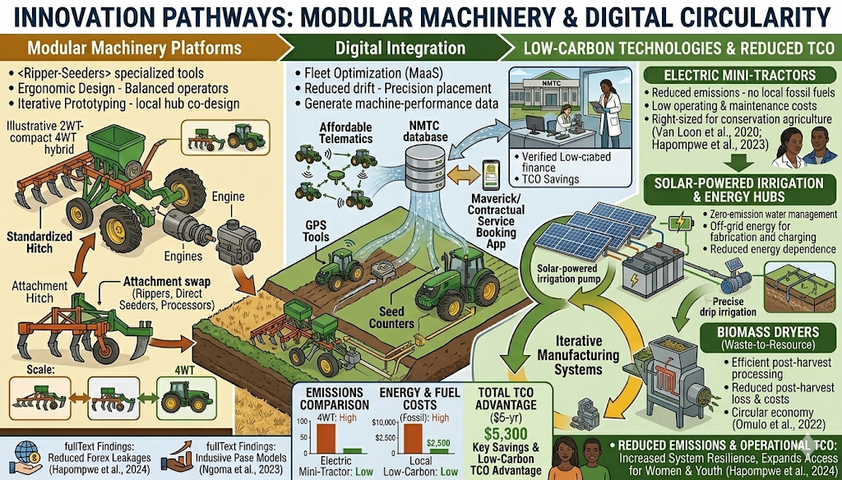
Low-Carbon Technologies
Electric mini-tractors
Solar irrigation
Biomass dryers
Reduced emissions & costs

Slide 11
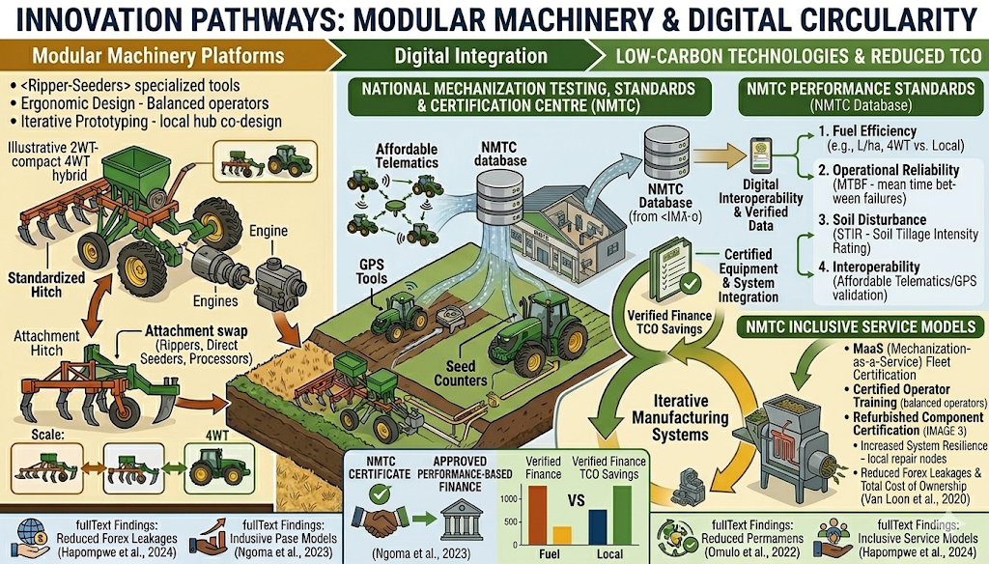
Institutional Solution: NMTC
Testing & certification centre
Performance standards
Link to finance & procurement

Slide 12
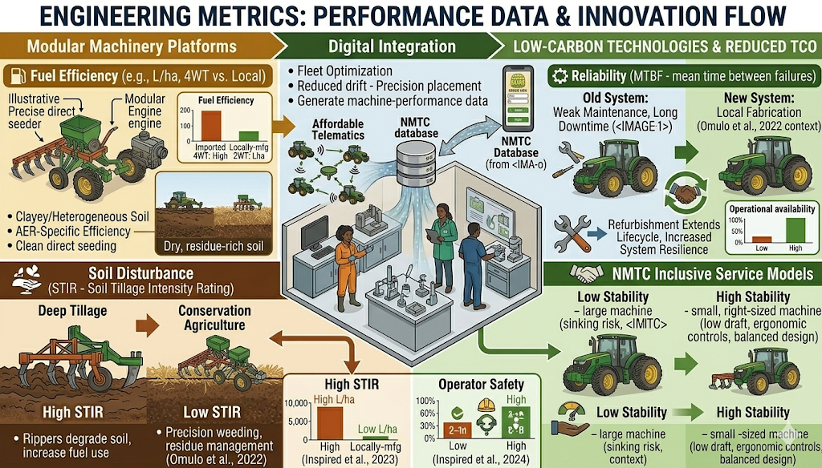
Engineering Metrics
Fuel efficiency
Reliability (MTBF)
Soil disturbance (STIR)
Operational stability

Slide 13
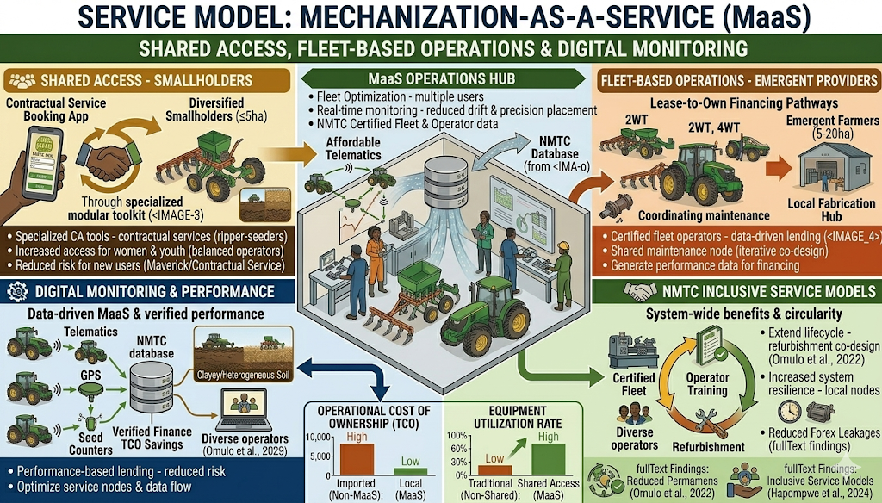
Service Model
Mechanization-as-a-Service (MaaS)
Shared access
Fleet-based operations
Digital monitoring

Slide 14
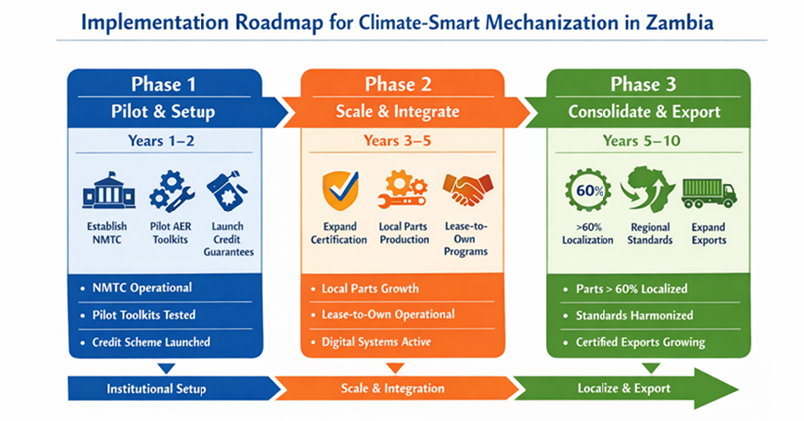
Implementation Roadmap
Phase 1: Setup NMTC, pilots
Phase 2: Scale manufacturing
Phase 3: Export & regional integration

Slide 15
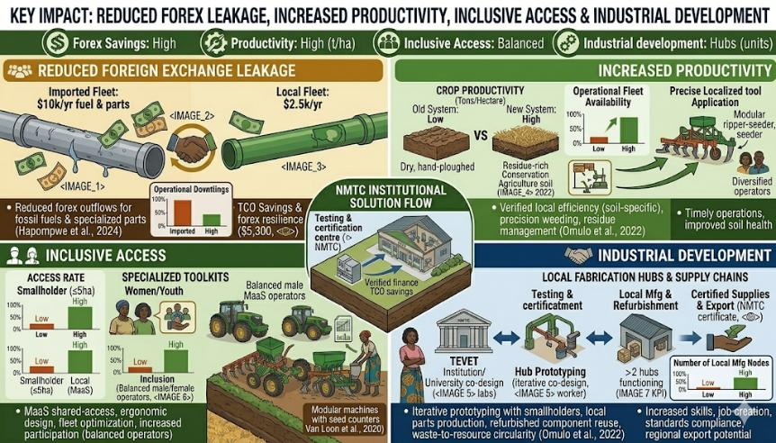
Key Impact
Reduced foreign exchange leakage
Increased productivity
Inclusive access
Industrial development

Slide 16
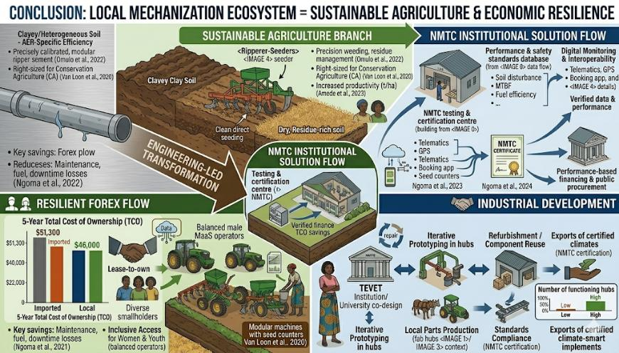
Conclusion
Local mechanization ecosystem =
Sustainable agriculture
Economic resilience
Engineering-led transformation

Slide 17

The End
THANK YOU FOR YOUR ATTENTION.

