Slide 1

2026 ENGINEERING INSTITUTION OF ZAMBIA SYMPOSIUM
ARTISANAL AND SMALL-SCALE MINING IN CRITICAL MINERALS IN ZAMBIA: CHALLENGES AND OPPORTUNITIES
PRESENTER : Precious Chisala Mwanza (Dr.)
DATE : Friday 17th April 2026
Avani Victoria Falls Resort, Livingstone, Zambia

Slide 2

TABLE OF CONTENTS
Introduction & Global Context
Defining ASM and Critical Minerals
Key Challenges – Regulatory & Technical
Key Challenges – Health, Environment & Gender
Land degradation from the ASM Sector
Water pollution from ASM
Opportunities for Transformation
Recent Legislative Progress
Strategic Recommendations
Conclusion
References

Slide 3
Introduction & Global Context
The Global Transition: Rising demand for critical minerals driven by low-carbon energy, electrification, and digital technologies.
Strategic Importance: Mineral-rich developing countries like Zambia are central to global supply security and ethical sourcing.
Zambia’s Role: Historically a copper giant (LSM), but now a key source for cobalt, lithium, manganese, and nickel.
The Rise of ASM: Expanded significantly over two decades, providing livelihoods for hundreds of thousands of Zambians.

Slide 4
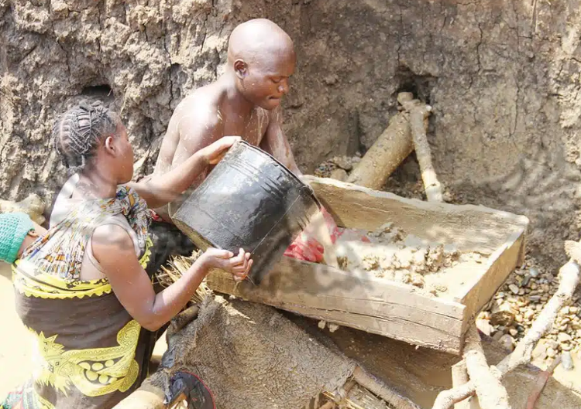
Defining ASM and Critical Minerals
What is ASM? Activities with low mechanization, limited capital, and labor-intensive methods, often operating informally.
Definition of Critical Minerals: Minerals essential to modern technology, economic development, and national growth.
Zambia’s Identified Critical Minerals:
  Copper, Cobalt, Lithium, Manganese
  Nickel, Graphite, Tin, Sugilite, Uranium, and REEs
Figure 1: Artisanal and small scale mining (ZCCM-IH , 2026)

Slide 5
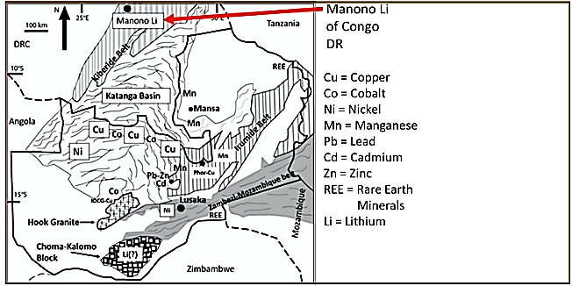
Figure 2: Critical mineral locations in Zambia and lithium in the Congo DR (NCMS, 2024)

Slide 6
Key Challenges – Regulatory & Technical
Regulatory Informality: Complex licensing and high compliance costs lead to widespread informal operations.
Institutional Fragmentation: Overlapping mandates between government agencies cause regulatory ambiguity.
Knowledge Gaps: Lack of reliable geological data leads to "blind" mining, low recovery rates, and increased risks.
Financial Exclusion: Formal banks rarely lend to ASM due to perceived risk and lack of collateral.

Slide 7
Key Challenges – Health, Environment & Gender
Environmental Impact: Land degradation, deforestation, water pollution, and heavy metal contamination.
Occupational Safety: Risks include unstable pits, lack of protective equipment, and chronic exposure to dust and noise.
Gender Inequalities:
  Women are often restricted to lower-paid tasks (sorting/washing).
  Structural barriers limit women's access to credit, licenses, and leadership roles.

Slide 8
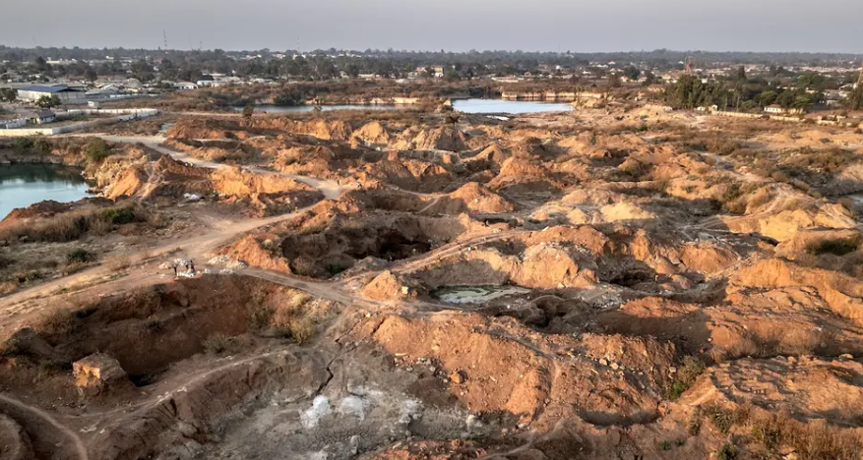
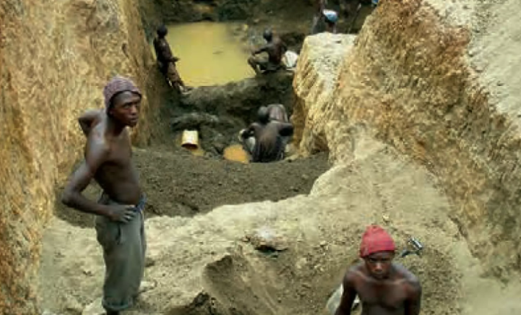
Land degradation from the ASM Sector
(a)
(b)
Figure 3a and 3b: Land degradation resulting from ASM sector

Slide 9
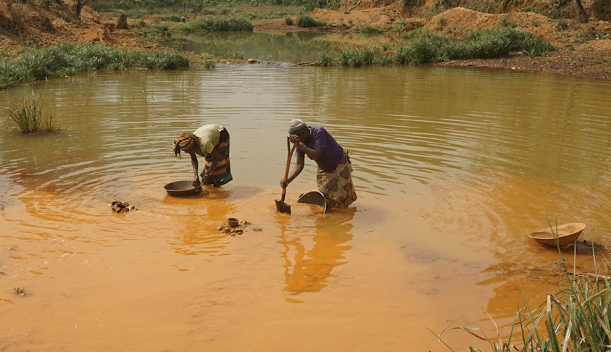
Water pollution from ASM
Figure 4: Water pollution from small scale mining

Slide 10
Opportunities for Transformation
Exploiting Marginal Deposits: ASM can mine near-surface or geologically complex deposits unattractive to large-scale companies.
Global Market Integration: Rising demand for "responsible sourcing" allows formalized ASM to access premium international markets.
Value Addition: Opportunities for local processing and beneficiation facilities to keep more mineral value within Zambia.
Inclusive Growth: ASM as a tool for poverty reduction and rural economic diversification.

Slide 11


Opportunities for transformation
Figure 5(a) Access to International Markets
Figure (5b) Production of copper cathodes into value addition products

Slide 12
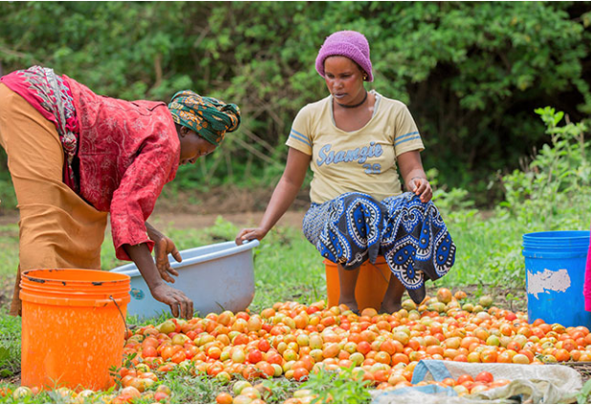
Inclusive Growth via rural diversification
Figure 6: Good yields from farming as a result of access to farming inputs – ASM diversification

Slide 13
Recent Legislative Progress
Geological and Minerals Development Act (2025): Strengthens mandates for systematic geological surveying and data sharing.
Minerals Regulation Commission Act (2024): Designed to streamline licensing, improve transparency, and reduce institutional fragmentation.
National Critical Minerals Strategy (NCMS): A framework to integrate ASM into formal value chains and enhance supply resilience.

Slide 14
Strategic Recommendations
Licensing Reform: Simplify and decentralize procedures; reduce administrative costs, and introduce transparent and accessible digital licensing systems to enable greater formal participation.
Innovative Finance: Develop state-backed credit, equipment leasing, and cooperative financing models.
Gender-Responsive Policy: Proactively facilitate women's access to mining rights, training, and finance.
Formalization as a Process: View formalization as a gradual, enabling journey rather than just a legal requirement.

Slide 15
Conclusion
ASM is a legitimate livelihood strategy characterized by deep structural challenges but immense latent potential.
By aligning ASM with geological intelligence and regulatory coherence, Zambia can secure its place in the global energy transition.
Transforming ASM into an inclusive, responsible, and economically meaningful sector for Zambia can help the country achieve the 2030 national vision for job creation .

Slide 16
References
Buxton, A. (2013). Responding to the challenge of artisanal and small-scale mining. How can knowledge networks help? IIED.
GRZ (Government of the Republic of Zambia). (2021). Eighth National Development Plan 2022–2026.
Hentschel, T., Hruschka, F., & Priester, M. (2002). Global report on artisanal and small-scale mining. IIED & WBCSD.
Hilson, G. (2016). Artisanal and small-scale mining and rural development. Journal of Rural Studies, 47, 217–228.
Hilson, G., Hilson A, Siwale A., & R. Maconachie (2018). Female Faces in Informal ‘Spaces’: Women and Artisanal and Small-scale Mining in sub-Saharan Africa, Africa Journal of Mgt., 4:3, 306-346,

Slide 17
The End
THANK YOU FOR YOUR ATTENTION.

