Slide 1

2026 ENGINEERING INSTITUTION OF ZAMBIA SYMPOSIUM
Integrated mineralogical and geochemical characterisation of
Lithium – bearing resources from the Mapatizya area, Zambia
PRESENTER : James Mulwanda
DATE : Friday 16th April 2026
Avani Victoria Falls Resort, Livingstone, Zambia

Slide 2
Research team & Acknowledgements:
Team
James Mulwanda : Copperbelt University (CBU) Leonard Kabondo :CBU Musango Lungu : CBU Tina Phiri Chanda: CBU John Siame : CBU Munyadziwa Ramakokovhu: University of Johannesburg (UJ) Simon Mwale : University of Zambia (UNZA) Gift Paul Mwaula; Geological Survey (Zambia)
Acknowledgement
Financial support for this research came from a collaborative partnership between the Africa Centre of Excellence for Technological Studies (ACTS, Kenya) and the National Science and Technology Council (NSTC, Zambia), under Grant Number ACTS/RIMP/NSTC/CBU/2023.

Slide 3
Overview:
Introduction.
Aim & Objectives:
Characterization Methods:
  Chemical Composition.
  Mineralogical Composition.
  Results.
  Conclusions.

Slide 4
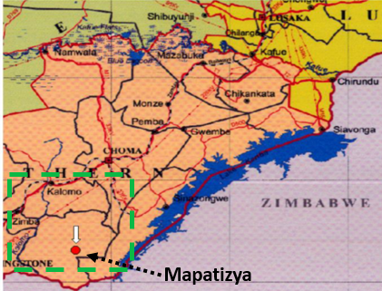
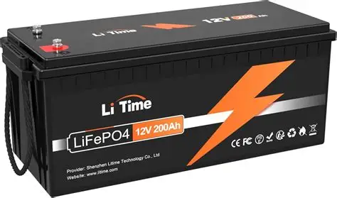

Introduction:
  The recent discoveries of lithium in Southern Province underscore Zambia’s potential contribution to the global battery minerals supply chain^{[1].}
  Lithium is a critical component of rechargeable lithium-ion batteries (LIBs)^{[2]}
  LIBs application dominate energy storage, electric vehicles (Evs) & portable electronics^{[3]}.

Slide 5
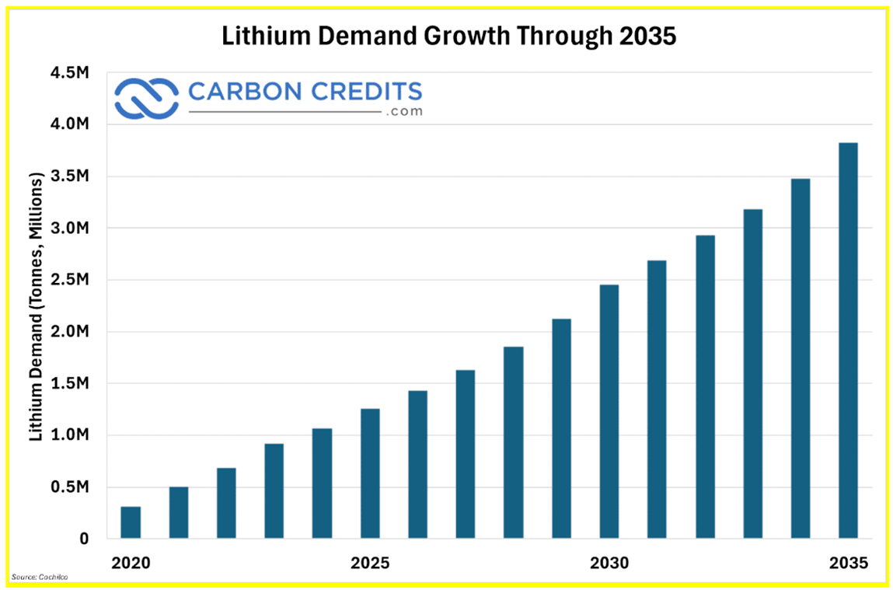
Introduction Cont’d:
  Global lithium demand projected to rise sharply over the next decade^{[4]}.
  Developing domestic lithium resources is essential for supporting sustainable energy transitions and enhancing local industrial capacity.
  Despite this potential, research on the beneficiation and value addition of battery-critical minerals in Zambia remains limited

Slide 6
Introduction Cont’d:
  The Zambian government has emphasized that local processing of critical minerals can stimulate job creation, economic growth, and technological advancement
  Understanding the mineralogical and geochemical characteristics of lithium-bearing ores is crucial for designing effective beneficiation strategies and value addition processes.

Slide 7
AIM & Objectives:
  To study the mineralogical and geochemical characteristics of the deposits from Zambia’s Southern province, Mapatizya district.
Objectives:
  To collect ore samples from mine stockpiles at various locations within the Mapatizya region.
  To perform chemical analysis
  To conduct bulk mineralogical analysis

Slide 8
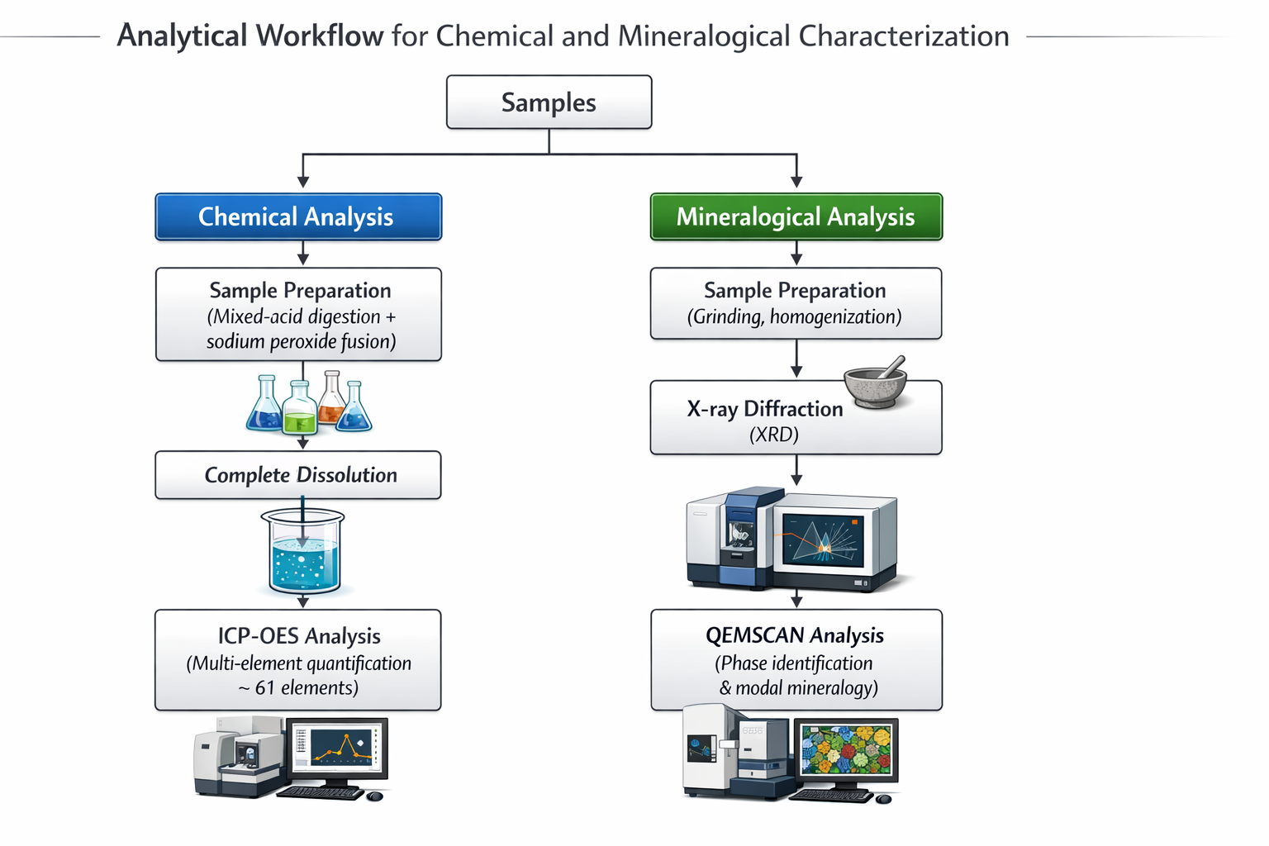

Slide 9
Results: Chemical composition: Major & minor elements
Table 1. Major and minor elements
Element (wt.%) | Li | P | Rb | Cs | Fe | Al | Ca | Na | K | Si
Madonga | 0.19 | 0.04 | 0.48 | 12.9 | 0.11 | 9.28 | 0.24 | 3.79 | 1.09 | 28.7
Sinkwaya | 1.19 | 3.32 | 0.29 | 0.16 | 0.14 | 10.7 | 0.21 | 3.26 | 3.26 | 27.7

Slide 10
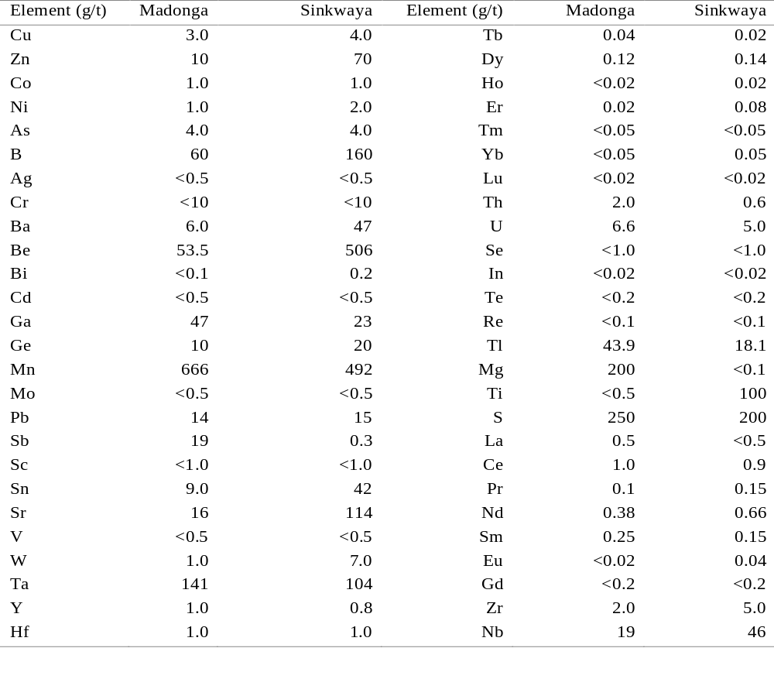
Results: Chemical composition: Trace elements
Table 2. Trace elemental composition

Slide 11
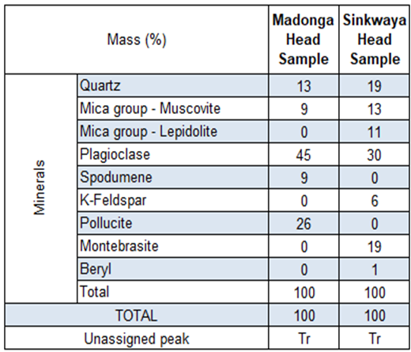
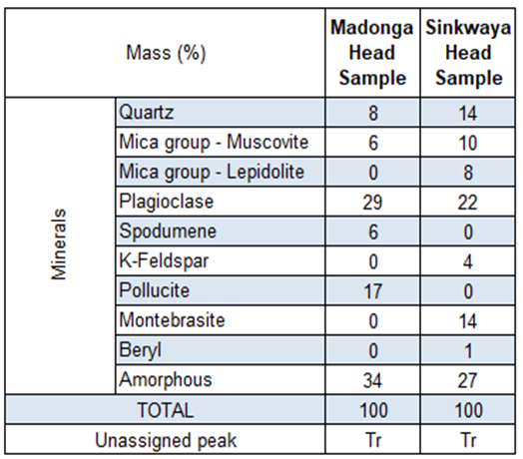
Results: Mineralogy (XRD):
Table 3. Quantitative XRD results (crystalline - wt.%)
Table 4. Quantitative XRD results (amorphous - wt.%)

Slide 12
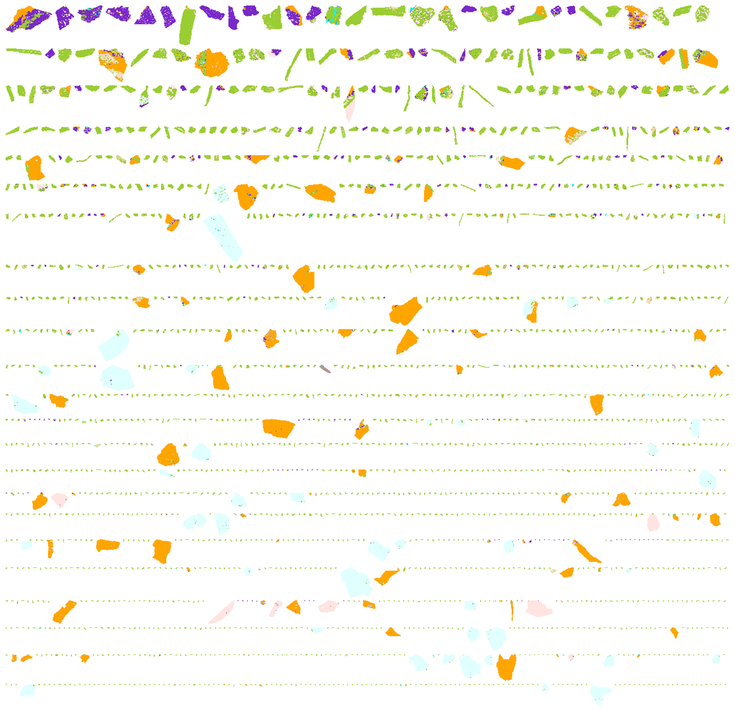
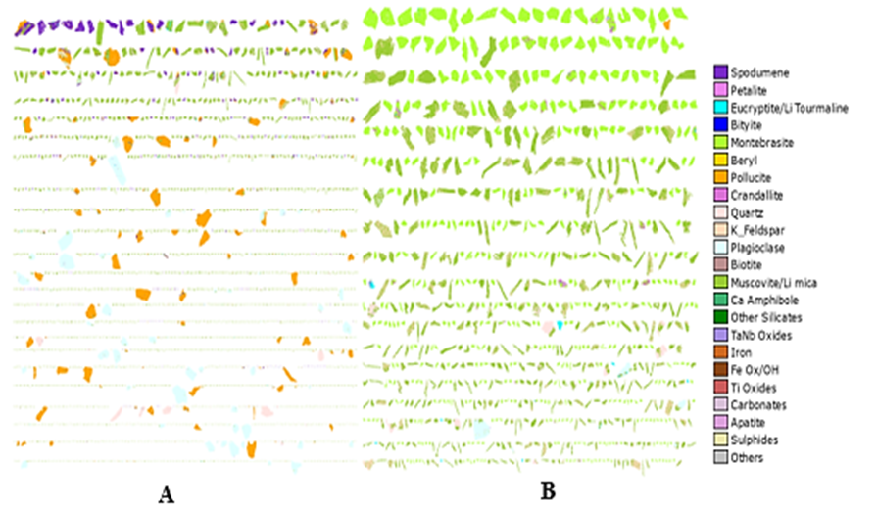
Results: Mineralogy (QEMSCAN):Images
(A)
(B)
Figure 2. QEMSCAN images of (A) Madonga and (B)Sinkwaya samples

Slide 13
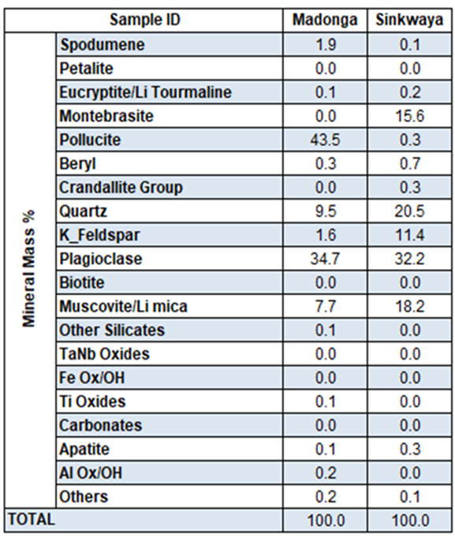
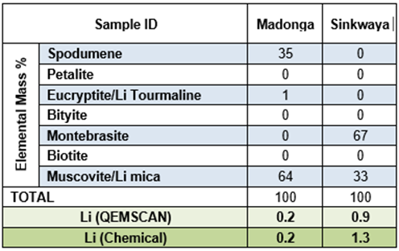
Results: Mineralogy (QEMSCAN): Mineral abundance & Li deportment
Table 5. Mineral abundance summary
Table 6. Lithium deportment
In Madonga, lithium is mainly hosted by muscovite/Li-mica (64%) and spodumene (35%)
For Sinkwaya, lithium is overwhelmingly associated with montebrasite (67%), with the balance hosted by Li-micas (33%).

Slide 14
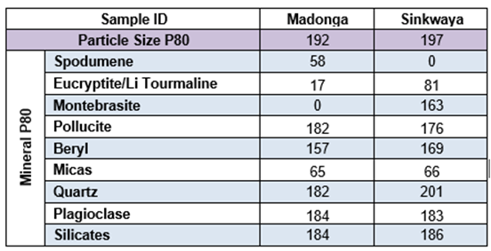
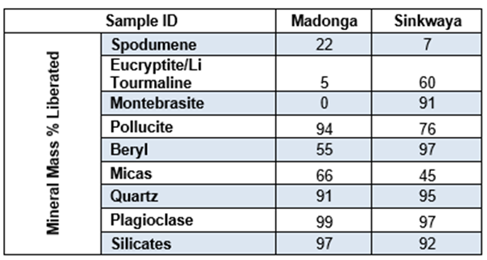
Results: Mineralogy (QEMSCAN): Grain size distribution & liberation
Table 7. Grain size distribution summary
Table 8. Mineralogical liberation summary
Both samples display similar bulk particle size distributions
Lithium-bearing minerals exhibit contrasting grain size characteristics.
In Madonga, spodumene is relatively fine-grained (P80 ≈ 58 µm),
Li-micas are moderately fine-grained (P80 ≈ 65 µm).
In Sinkwaya, montebrasite shows a coarser grain size (P80 ≈ 163 µm),
Li-micas remain relatively fine-grained (P80 ≈ 66 µm).
Limited liberation (22%) of spodumene in Madonga
Li-micas exhibit moderate liberation (66%),
In Sinkwaya, montebrasite is exceptionally well liberated, with 91%.

Slide 15
Conclusions:
Madonga and Sinkwaya ores represent two distinct rare-element systems with contrasting processing responses.
Sinkwaya is a higher-grade lithium resource (~1.2 wt% Li) enriched in phosphorus and dominated by lithium phosphate mineralisation (montebrasite).
Madonga contains lower lithium (~0.2 wt% Li) but is strongly enriched in Cs and Rb, reflecting a system dominated by pollucite and Li-micas.
XRD and QEMSCAN results confirm that Madonga is a Cs–Li silicate system with coarse, well-liberated pollucite and lithium hosted mainly in fine-grained spodumene and Li-micas,
Sinkwaya is a lithium-phosphate–mica system dominated by coarse, well-liberated montebrasite.
These characteristics imply early gravity recovery of pollucite at Madonga, followed by fine grinding for lithium recovery,
Sinkwaya is amenable to lithium concentration at coarser grind sizes with phosphate-specific downstream processing

Slide 16
References:
Zambia Daily Mail; https://ground.news/article/locals-first-in-lithium-zambia-daily-mail [12-10-2023]
Chagnes, A., Swiatowska, J., (2015). Lithium Process Chemistry: Resources, Extraction, Batteries, and Recycling, Elsevier, Amsterdam, Netherlands.
Garrett D.E., (2004). Handbook of Lithium and Natural Calcium Chloride: Their deposits, Processing, Uses and Properties, Elsevier academic Press
Carboncredits.com https://carboncredits.com[01-03-2026]

Slide 17
The End
THANK YOU FOR YOUR ATTENTION.

