Slide 1


Blockchain-Enabled Digital Traceability for ESG Performance Monitoring in ASM
2026 ENGINEERING INSTITUTION OF ZAMBIA SYMPOSIUM
Dickson Wachira*, Antoine F. Mulaba-Bafubiandi,, Jan Clemens Bongaerts, Bernard Alunda¹
Taita Taveta University, Kenya; *Corresponding E-mail: wachiramdickson@gmail.com
University of Johannesburg, South Africa
Universite de Mbuji-Mayi, Republique Democratique du Congo
TU Bergakademie Freiberg, Germany

Slide 2
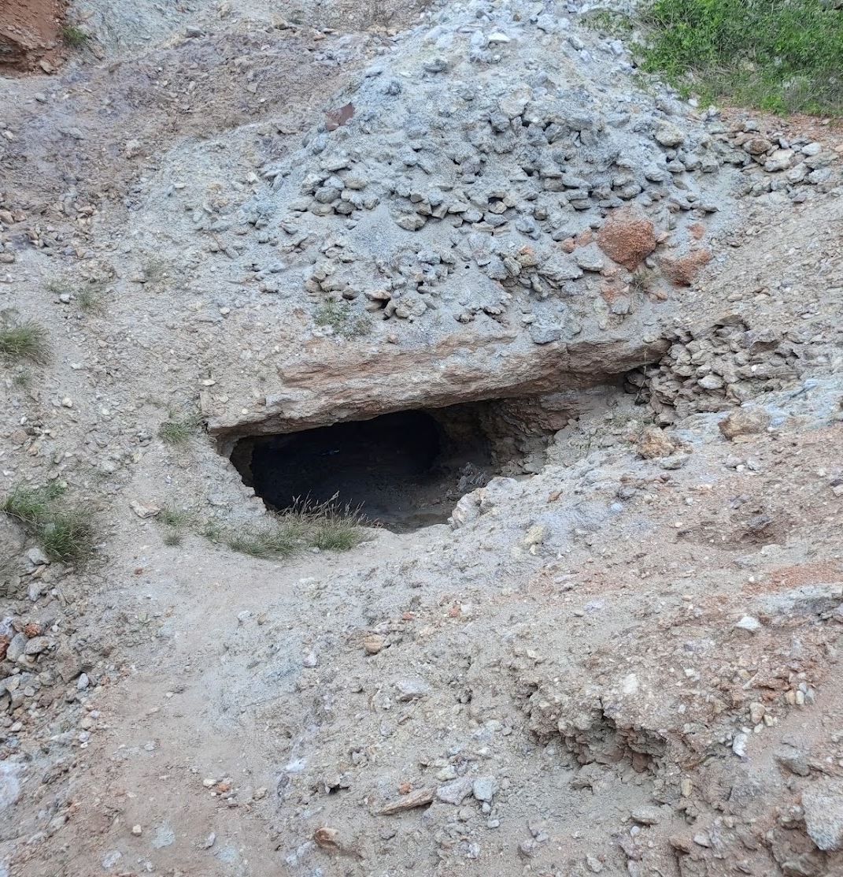
Artisanal and Small-Scale Mining (ASM)
Supports millions of livelihoods globally over 44 million people directly and 150 million indirectly/
Key source of gemstones and critical minerals…Tantalum (25–26%), Tin (25%), Cobalt (15–20% of DRC supply), Gold (20%), Copper (0.3–0.5%), and Sapphire (80%).
Increasing demand for responsible sourcing
Key Issue:
Environmental Social Governance (ESG) compliance is now a requirement in mineral markets

Slide 3

ESG Reporting Challenges in ASM
Informal and fragmented operations
Weak regulatory oversight
Limited data systems
Result:
ESG data is based on sporadic inspections and are retrospective
Difficult to verify
Not reliable for decision-making

Slide 4

Limitations of Existing Approaches
Manual reporting and inspections
Centralized databases
High monitoring costs
Dependence on third-party audits
Gap:
No system supports continuous, verifiable ESG monitoring

Slide 5
Research Objective
Objective:
To develop a blockchain-enabled digital traceability framework for ESG monitoring in ASM
Approach:
Integrate traceability with ESG indicators
Enable real-time data capture and verification

Slide 6
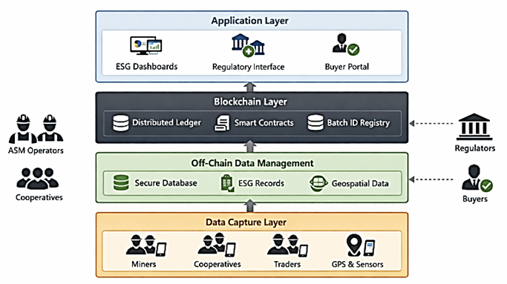
Proposed Solution
Blockchain-Enabled Traceability Framework
Key components:
Mobile-based data capture
Off-chain data storage
Blockchain validation
Role-based access interfaces
Goal:
Continuous and auditable ESG monitoring

Slide 7
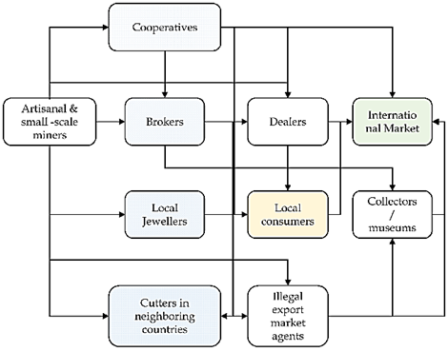
System Overview
Mineral Flow with Data Integration
At each stage:
Production data recorded
ESG indicators captured
Transactions validated
Mine
Cooperative
Trader
Exporter

Slide 8
System Architecture
Data Capture Layer
Mobile data entry at mine and trade points
Off-chain Layer
Storage of detailed ESG and production data
Blockchain Layer
Validation and immutable record (hashing
Application Layer
Dashboards and verification interfaces

Slide 9
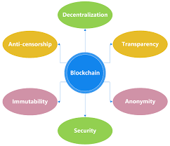
Role of Blockchain
Decentralization → reduces reliance on central authority
Transparency → improves trust
Immutability → prevents data tampering
Smart contracts → enforce ESG rules
Traceability → full audit trail

Slide 10
ESG Integration
Environmental:
Land disturbance
Waste management
Social:
Safety practices
Working conditions
Governance:
Licensing compliance
Transaction transparency
Notes:
Embedded in Operations
Key Point:
ESG is captured during activities, not after

Slide 11
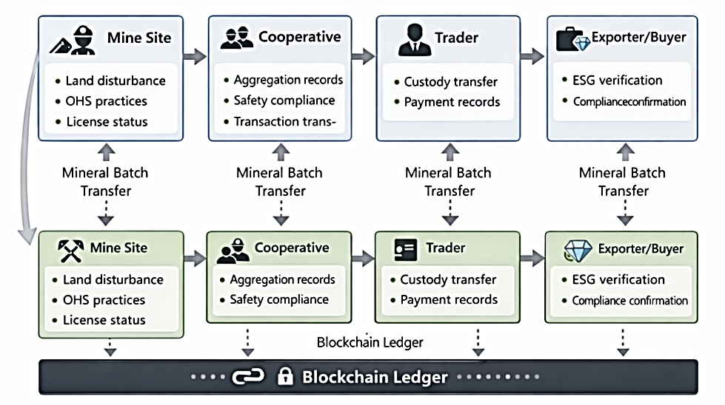
Data Flow
Mineral batch created at mine
ESG data linked to batch
Transfers recorded at each stage
Blockchain stores cryptographic hashes
Outcome:
End-to-end traceability with ESG linkag

Slide 12
Case Application (Gemstone ASM)
Gemstone Characteristics
High-value, low-volume minerals
Fragmented value chains
Strong demand for provenance
Actors:
Miners
Brokers / cooperatives
Traders
Exporter
System Outputs
For Regulators:
ESG dashboards
Risk-based monitoring
For Buyers:
Verified sourcing
Compliance assurance
For ASM actors:
Increased transparency
Improved market access

Slide 13
Key Contribution
Integrates ESG into traceability systems
Moves ESG from narrative reporting to data-driven monitoring
Provides an engineering-based solution for ASM

Slide 14

Practical Considerations
Limited connectivity
Digital literacy challenges
Adoption and trust issues
Mitigation:
Offline data capture
Training and stakeholder engagement
Incremental implementation

Slide 15

Conclusion
ESG reporting in ASM is currently weak and fragmented
Blockchain enables:
  Continuous monitoring
  Verifiable data
  Improved transparency
A practical pathway toward responsible and traceable ASM supply chains

Slide 16
Thank you
Get in touch dicksonwachira@ttu.ac.ke

