Slide 1


2026 ENGINEERING INSTITUTION OF ZAMBIA SYMPOSIUM
Demystifying Local and Lightning Protection Earthing System
Installations in Zambia
Presenter: Eng. Sebastian K. Namukolo
Date: 16th April 2026
Avani Victoria Falls Resort, Livingstone, Zambia

Slide 2
AGENDA
1. INTRODUCTION- WHAT IS EARTHING
2. THREE TYPES OF EARTHING AND THEIR USES
3. EARTHING MYTHS
4. IMPORTANCE OF BONDING
5. CONCLUSION

Slide 3
INTRODUCTION:WHAT IS EARTHING/GROUNDING?
Earthing and Grounding are safety features in electrical installations that connect equipment and circuits to earth (0V)to prevent electric shocks and damage to equipment.
Earthing protects personnel by connecting noncurrent carrying metallic parts of equipment to ground.
Grounding mainly ensures system stability and reliable operation by connecting the neutral point to ground. No floating voltage

Slide 4
THREE TYPES OF EARTHING:
Utility Grounding/Earthing
Local Grounding/Earthing
Lightning Protection
Grounding/Earthing
neutral
earthing
E
Neutral
N
spike
LOCAL EARTHING
Lightning earth termination

Slide 5
How they are connected
TRANSFORMER
CHASSIS
DB
Electrical equipment
LIVE
MOTOR
NEUTRAL
EARTHING
UTILITY GROUNDING/
EARTHING
Local Grounding

Slide 6

LIGHTNING PROTECTION GROUNDING
Lightning is a bolt of charge from cloud to earth
Coupling to conductors galvanically, inductively, and capacitively
Capacitive coupling ic = Cdv/dt
Inductive coupling vl = ldi/dt
Galvanic v =iR
spike
Down conductors
Lightning Protection
Grounding

Slide 7
Myths of earthing systems:
Myth1: Lightning protection protects equipment from damage.
No! LPS protects structures and contents in the structure by providing a low impedance path to ground of direct strike. Earth termination resistance must be as low as possible.
Note that what causes more damage to equipment is the indirect effect through magnetic coupling to cables.
Myth2: Putting salt to local earthing system reduces earthing resistance on a long period.
No! The earthing resistance will be reduced temporarily. salt will leach out due to rain and corrode the Earthing system metallic parts. It should never be used nowadays.

Slide 8
Myth3: Low local Earthing protects equipment
No! Grounding mainly ensures system stability and reliable operation by connecting the neutral point to ground or some reference point. No floating voltage. Equipment doesn’t care how low earthing resistance is. Airplanes are not earthed but the complex electronics work well. But standards require compliance. Surge protection, bonding and other protection arrangements protect equipment.
Myth4: LPS earthing can be terminated on local earthing.
No! LPS must have a separate low earthing but be bonded to local earthing system.

Slide 9
Importance of bonding:
Bonding is a way of equalizing potential difference that avoids current flowing from point A to B
With bonding
50kA
Without bonding
50kA
50kV
50kV
50kV
Low inductance cable or bar
1 ohm RE
0V
V =IR ohm’ law
I =V/R high I
A
A
B
I = 0/R = 0 amps
B

Slide 10
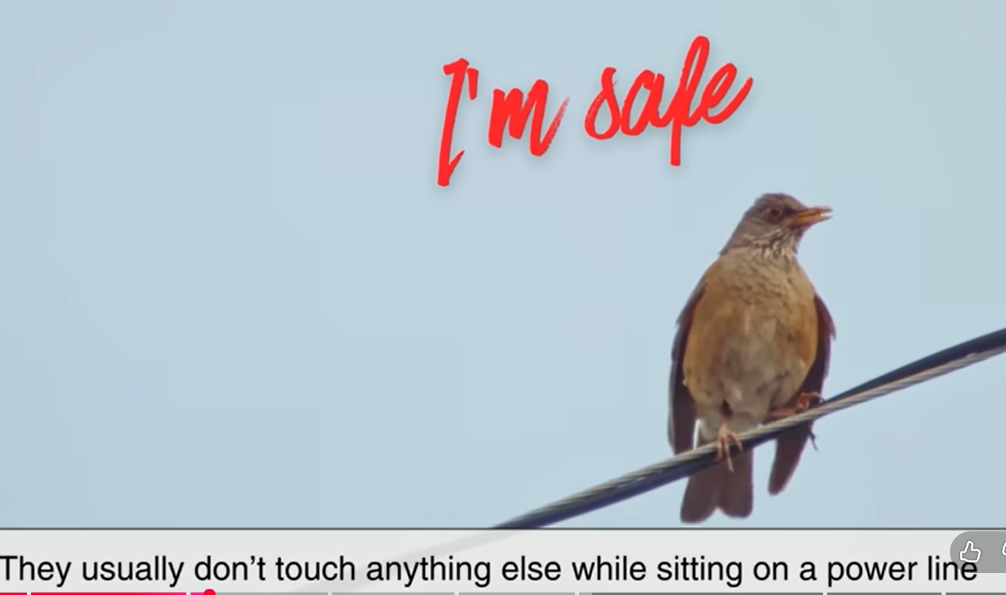
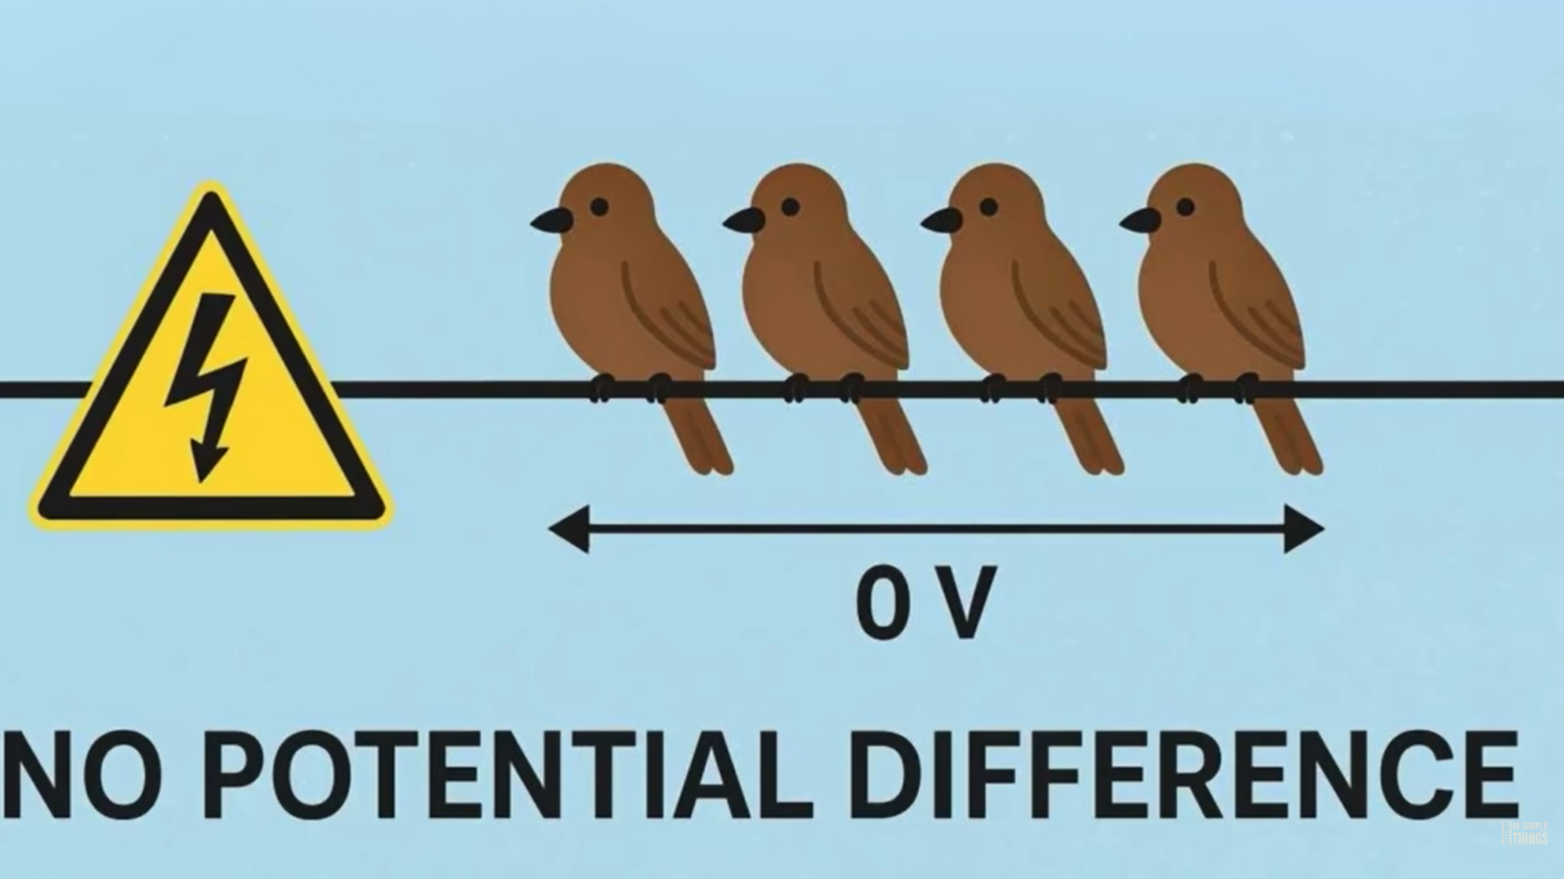
We have all seen them

Slide 11
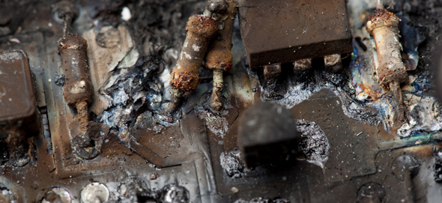
Result of not bonding and protecting

Slide 12
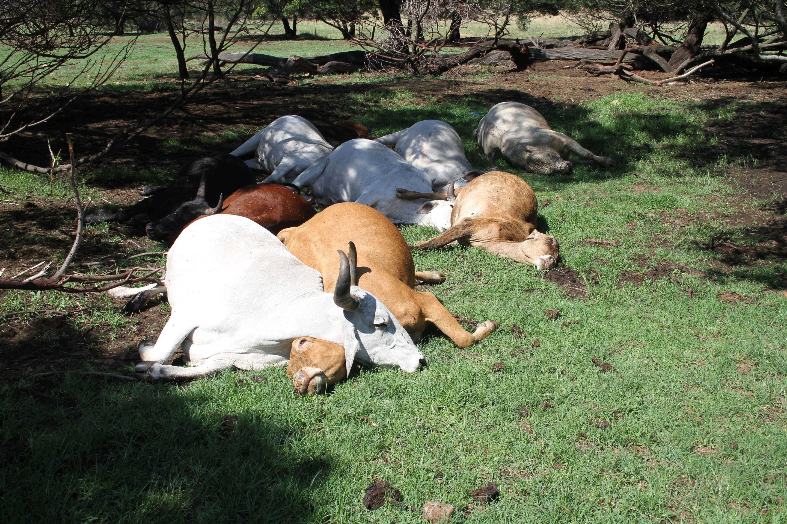
Could be caused by Step potential due to the 4 legs

Slide 13

Step potential illustrated. Current passed on skin

Slide 14

Happened in Norway in 2016. over 300 reindeers were killed by lightning. The dead animals covered a space of 80m
Cause: Experts believe the animals were killed by ground current after a powerful lightning strike (or strikes) hit the wet ground

Slide 15
CONCLUSION:
Three main earthing systems are utility, local and lightning
In Zambia the main myths widely held and demystified are that
Lightning protection does not protect equipment but structures and their contents
Using salt for enhancing earthing resistance is a temporary solution and can be more harmful to earthing conductors.
Low local earthing does not protect equipment only provides stable reference point. Airplanes are not earthed but operate perfectly.
LPS earthing should never terminate on the local earth but should be bonded.

Slide 16

The End
THANK YOU FOR YOUR ATTENTION.

