Slide 1

2026 ENGINEERING INSTITUTION OF ZAMBIA SYMPOSIUM
A REVIEW OF FORECASTING APPROACHES FOR PHOTOVOLTAIC ENERGY PRODUCTION
PRESENTER : Situmbeko Nyirenda
DATE : Thursday 16th April 2025
Avani Victoria Falls Resort, Livingstone, Zambia

Slide 2
Presentation Content
Introduction
Motivation
Problem Statement
Objectives
Methodology
Findings
Conclusion

Slide 3
Introduction
The electrical grid demands a balanced supply and demand energy state for optimal stability.
Popular ML algorithms for PV forecasting are based on Deep Learning (DL) which has high predictive accuracy but poor inherent explainability.
Photovoltaic (PV) power generation exhibits variable behaviour, and this can cause challenges with reliable energy supply using such technology.
Machine learning (ML) is a computing approach that has been used to develop PV power forecasting systems in recent years.

Slide 4
Motivation
Mitigate electrical grid power supply and demand imbalance risks.
Support and facilitate an evidence-based planning approach for PV dependent energy generation stakeholders.
Mitigate energy uncertainty for PV dependent energy generation stakeholders.

Slide 5
Problem Statement
PV power generation is dependent on weather processes that cause power output fluctuations.
High accuracy correlates to poor explainability in ML algorithm design.
Stochastic forecasting environment
Obscure forecasting models
Evidence is required for decisions
Stakeholders relying on ML systems must be able to show clear logic for decisions that have been made based on model predictions.
Energy balance challenges
Grid integrated PV plants must plan effectively for energy surplus and deficits to maintain grid stability

Slide 6
Objectives
Review literature on modern explainable ML (XAI) based, power forecasting algorithms.
Publish findings and recommendations in a research manuscript.
Synthesize useful approaches to implement explainable ML systems and understand their limitations.

Slide 7
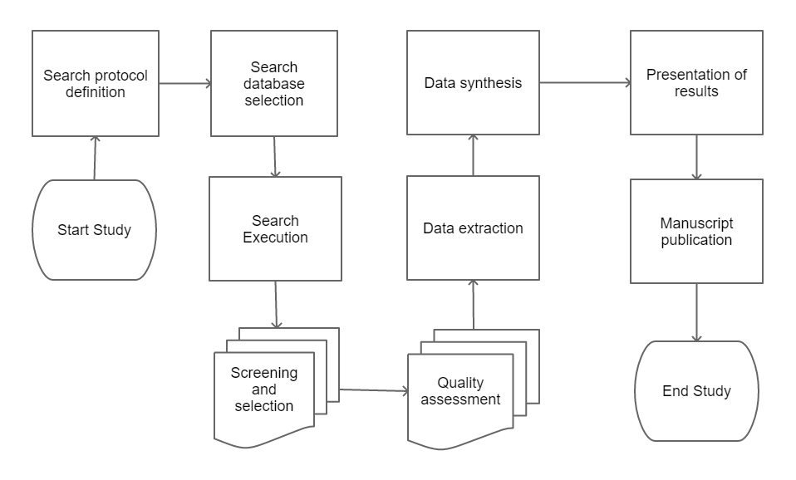
Methodology

Slide 8
Findings
Modern ML systems combine different design architectures to improve performance and robustness.
Modern ML uses hybrid system designs
ML systems are data bound
Predictions are directly dependent on datasets used for training and validation.
Explainability is limited by predictive design
High accuracy ML methods lack sufficient explainability for stakeholders in critical applications where root cause analysis is essential.

Slide 9
Findings
Predictive ML approaches do not empower stakeholders to estimate causal effects of interventions.
Modelling interventions is not feasible.
Counterfactual estimation is not possible.
Mitigating confounding bias is challenging because models can be affected by biases in data and in model architecture.
Predictive modelling cannot estimate probable alternative outcomes of interventions on data.
Confounder management is not model integrated.

Slide 10
Conclusion
Predictive ML is limited to insights within datasets
Predictive ML has poor generalizability
ML training and validation datasets determine how models perform on unseen data.
ML explainability is generally modelled on available data and not domain knowledge.
Causal based algorithms can facilitate root cause analysis.
Causal approaches are based on domain knowledge and intrinsically model confounding.
Causal based algorithms can support evidence-based decision making.
Causal approaches can model counterfactuals and the effects of interventions.

Slide 11
The End
THANK YOU FOR YOUR ATTENTION.

