Slide 1

2025 ENGINEERING INSTITUTION OF ZAMBIA SYMPOSIUM
Precision Mechanization as a Catalyst for Climate-Smart and Regenerative Agriculture in Zambia: A Pathway to Sustainable Productivity and Resilience
PRESENTER : Joseph Mwape Chileshe
DATE : Friday 16th April 2026
Avani Victoria Falls Resort, Livingstone, Zambia

Slide 2
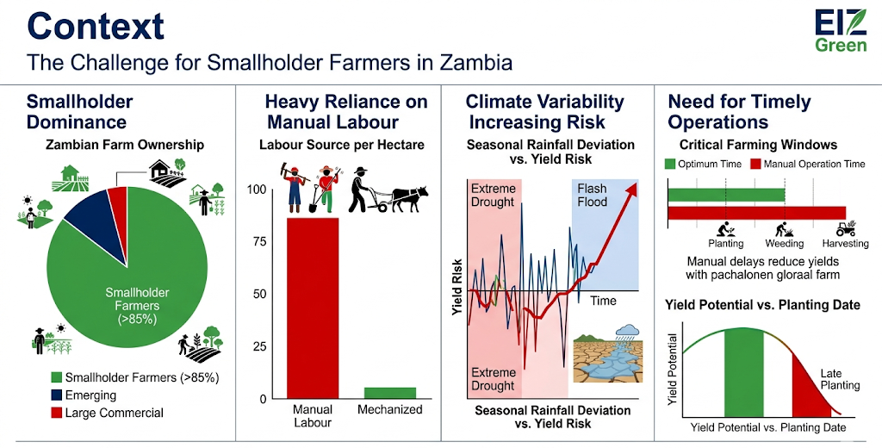
Context
Smallholder dominance
Heavy reliance on manual labour
Climate variability increasing risk
Need for timely operations

Slide 3
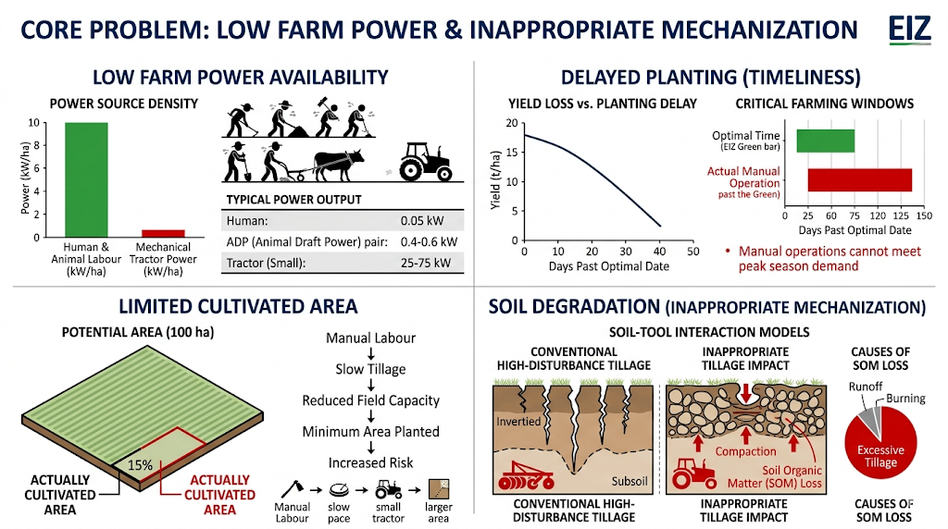
Core Problem
Low farm power availability
Delayed planting
Limited cultivated area
Soil degradation from inappropriate mechanization
Notes:
This visualization presents a detailed analysis of the core problems facing smallholder agriculture in Zambia. It is structured around four engineering data points: (Top Left) A dramatic power gap, where human/animal labor provides massive kW density compared to minimal mechanical tractor power; (Top Right) A functional graph quantifying how delayed planting beyond the optimal window leads to severe yield reduction; (Bottom Left) A comparative visual showing only a fraction of potential farm area being cultivated; and (Bottom Right) Soil-tool interaction diagrams illustrating how inappropriate mechanization leads to compaction and soil degradation, visualized with engineering force vectors and data on soil organic matter loss.

Slide 4
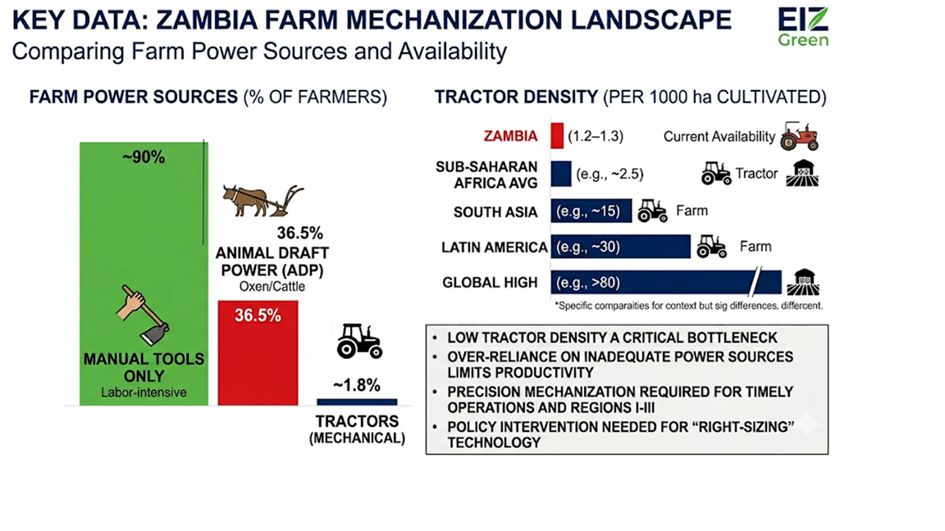
Key Data
~90% farmers use manual tools
36.5% animal draft power
~1.8% tractors
1.2–1.3 tractors per 1000 ha
Notes:
This visualization presents a detailed comparative analysis of farm power in Zambia. A pie chart clarifies that over 90% of farmers rely solely on manual tools, while just over 1.8% have access to tractors. Complementing this, a horizontal bar chart compares Zambia's low tractor density (~1.25 tractors per 1000 ha cultivated) against other regions, visually illustrating the scale of the bottleneck. This data provides a direct basis for the presentation's arguments on low mechanization intensity and the resulting productivity gap.

Slide 5
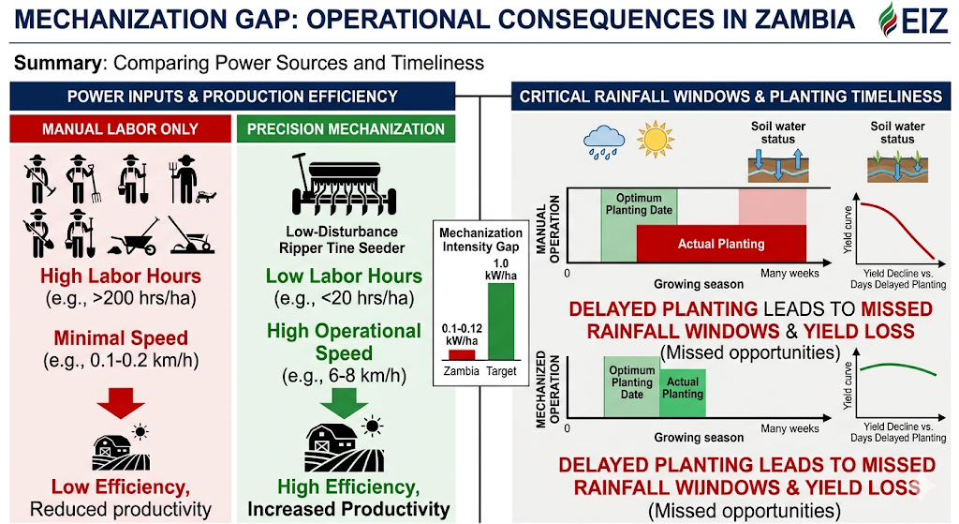
Mechanization Gap
Imbalance between labour and machinery
Low operational efficiency
Reduced productivity
Missed rainfall windows
Notes:
This technical graphic for an engineering presentation slide, developed for the Engineering Institution of Zambia (EIZ), visualizes the critical "Mechanization Gap" and its operational consequences. The slide is split into two sections:
Power Inputs & Production Efficiency: A comparison chart shows "MANUAL LABOR ONLY" (high labor, minimal speed, red arrows to low efficiency) against "PRECISION MECHANIZATION" (low labor, high speed, green arrows to high efficiency), using icons for small tools vs. a low-disturbance ripper tine seeder. It includes a specific data point: Zambia's current 0.1 kW/ha vs. a target of 1.0 kW/ha.
Critical Rainfall Windows & Planting Timeliness: Functional curves show yield decline vs. days of delayed planting. Time-series timelines depict how "MANUAL OPERATION" overruns "Optimum Planting Date" by many weeks, leading to missed rainfall, whereas "MECHANIZED OPERATION" aligns precisely within the optimum window.

Slide 6
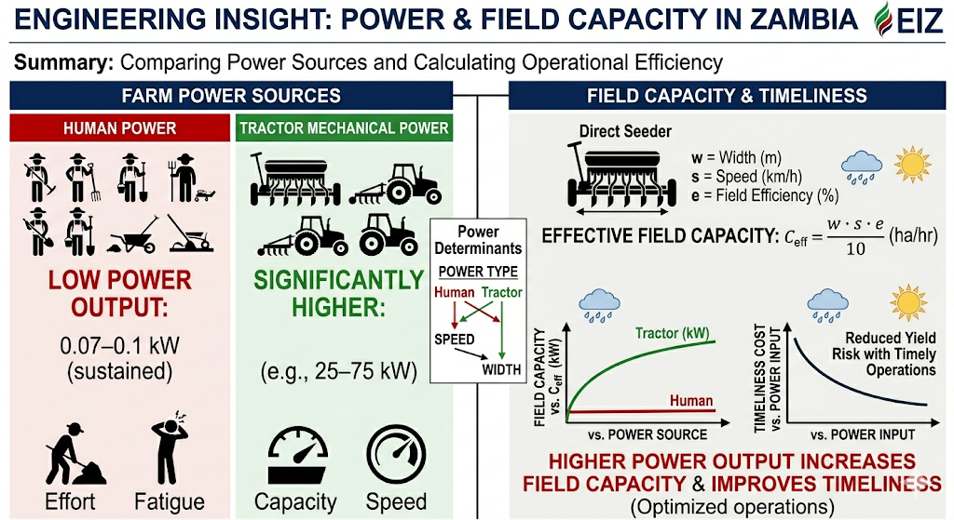
Engineering Insight
Human power: 0.07–0.1 kW
Tractors: significantly higher
Power determines field capacity and timeliness
Notes:
This slide presents key engineering insights for the EIZ presentation, building directly on the context and data flow from image_10.png.
Farm Power Sources (LEFT): It establishes the power differential. "HUMAN POWER" is quantified at a low 0.07–0.1 kW (red arrow to Low Speed/Width), contrasted against "TRACTOR MECHANICAL POWER" (significantly higher, with examples like 25–75 kW, green arrow to High Speed/Width). Functional curves illustrate how Field Capacity ($C_{eff}$) increases with power. Icons for Effort and Capacity reinforce the concept.
Field Capacity & Timeliness (RIGHT): It demonstrates how power translates into operational success. A diagram of a direct seeder breaks down the equation for Theoretical Field Capacity ($C_t = w \cdot s \cdot e / 10$) into its component variables (w=width, s=speed, e=efficiency). A graph of "Timeliness Cost" visually demonstrates how yield risk is drastically reduced with timely operations, made possible by increased power.
A final green summary box at the bottom quantifies the outcome: "HIGHER POWER OUTPUT INCREASES FIELD CAPACITY & IMPROVES TIMELINESS (Optimized operations)." The entire layout adheres to the professional slide format with EIZ green accents.

Slide 7
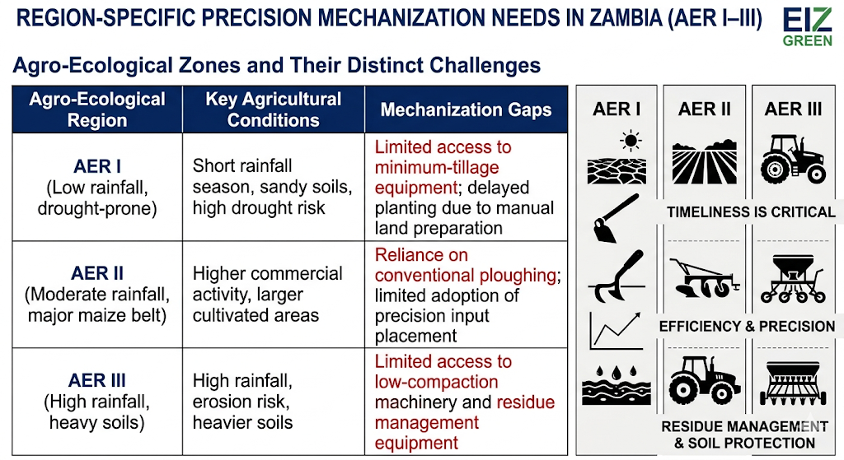
Region-Specific Precision Mechanization Needs in Zambia (AER I–III)
Agro-Ecological Region | Key Agricultural Conditions | Mechanization Gaps
AER I (Low rainfall, drought-prone) | Short rainfall season, sandy soils, high drought risk | Limited access to minimum-tillage equipment; delayed planting due to manual land preparation
AER II (Moderate rainfall, major maize belt) | Higher commercial activity, larger cultivated areas | Reliance on conventional ploughing; limited adoption of precision input placement
AER III (High rainfall, heavy soils) | High rainfall, erosion risk, heavier soils | Limited access to low-compaction machinery and residue management equipment

Slide 8
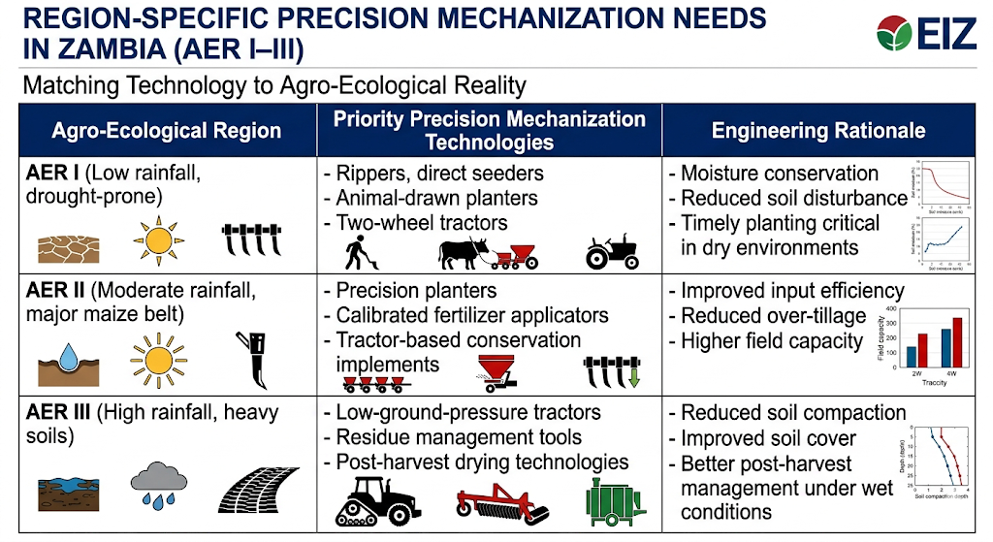
Region-Specific Precision Mechanization Needs in Zambia (AER I–III)
Agro-Ecological Region | Priority Precision Mechanization Technologies | Engineering Rationale
AER I (Low rainfall, drought-prone) | Rippers, direct seeders, animal-drawn planters, two-wheel tractors | Moisture conservation, reduced soil disturbance, and timely planting are critical in dry environments
AER II (Moderate rainfall, major maize belt) | Precision planters, calibrated fertilizer applicators, tractor-based conservation implements | Improved input efficiency, reduced over-tillage, and higher field capacity
AER III (High rainfall, heavy soils) | Low-ground-pressure tractors, residue management tools, post-harvest drying technologies | Reduced soil compaction, improved soil cover, and better post-harvest management under wet conditions
Notes:
This technical slide replaces the previous general "Mechanization Gaps" with specific, prioritized precision solutions tailored to each of Zambia's three major Agro-Ecological Regions. It uses clean, high-contrast columns—Region, Technologies, and Rationale—to ensure clarity. For AER I, it visualizes rippers and two-wheel tractors alongside small moisture curves. AER II emphasizes precision planters with fertilizer calibration for input efficiency. AER III contrasts these with low-ground-pressure tracks and a large, wide-tired tractor, supported by depth-compaction data. The entire layout maintains a professional, presentation-ready format suitable for a technical engineering audience.

Slide 9
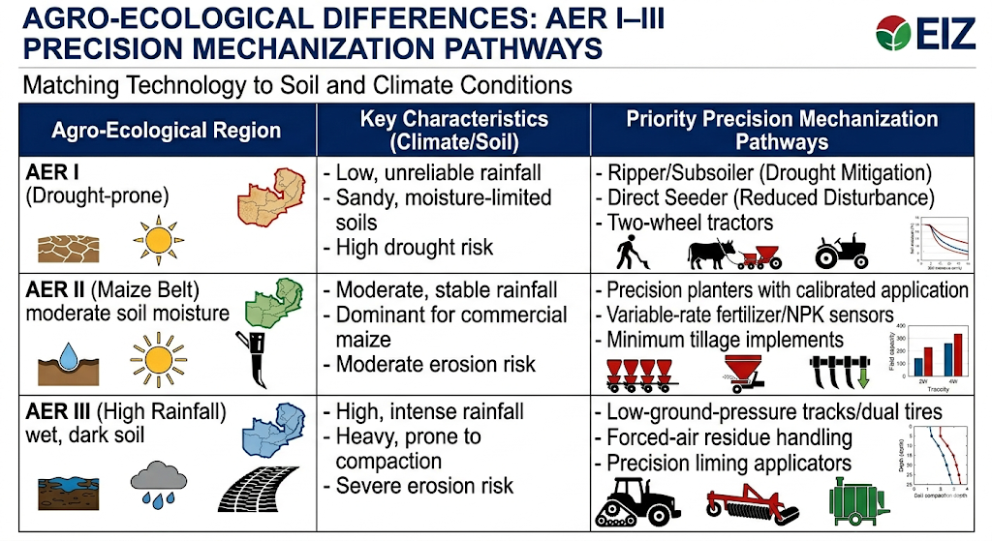
Agro-Ecological Differences
AER I: drought-prone → moisture conservation tools
AER II: maize belt → precision input technologies
AER III: high rainfall → low-compaction machinery
Notes:
This technical presentation slide visualizes the direct link between Zambia's three main Agro-Ecological Regions and the appropriate precision mechanization solutions. A multi-column layout presents:
AER I (Drought-prone): A conceptual graph shows how specialized "Moisture Conservation" tools, such as deep rippers, subsoilers, and direct seeders (indicated by Icons like oxen with a ripper, a two-wheel tractor), mitigate drought risk and conserve moisture by reducing soil disturbance.
AER II (Maize Belt): A field capacity chart visualizes how "Precision Input Technologies," like variable-rate fertilizer applicators and multi-row planters (Icons of modern planters with depth control), maximize efficiency in the major commercial maize region.
AER III (High Rainfall): A soil compaction depth profile demonstrates how "Low-Compaction Machinery," such as tracked dual-wheel tractors and large forced-air residue handlers (Icons of large, wide-track vehicles), are essential for protecting heavy soils from compaction and erosion risk under wet conditions.

Slide 10
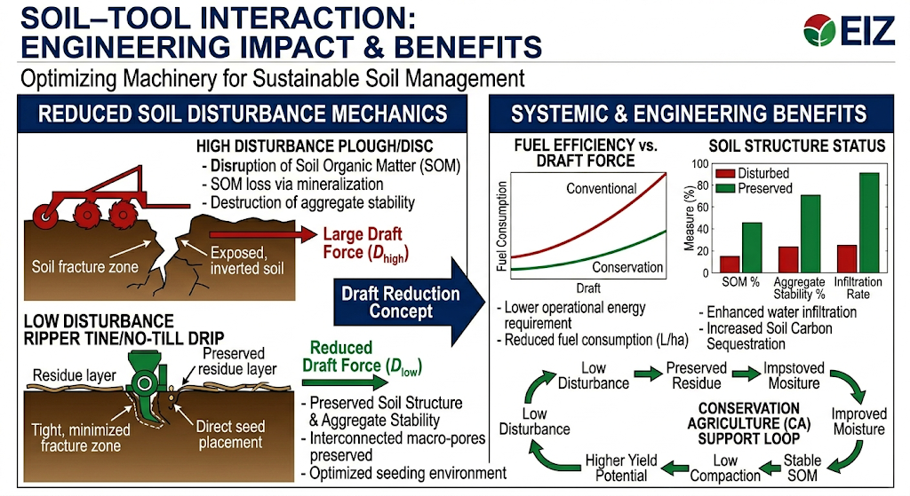
Soil–Tool Interaction
Reduced disturbance lowers draft force
Improves fuel efficiency
Preserves soil structure
Supports conservation agriculture
Notes:
Reduced Soil Disturbance Mechanics (LEFT): It establishes the draft reduction concept. Annotated soil profile diagrams visualize the difference. A Red icon of a massive disc plough contrasts against an EIZ Green icon of a low-disturbance ripper tine seeder. Specific Red force vectors indicate "Large Draft Force (D_high)," pointing to destruction of aggregate stability and organic matter, whereas Green force vectors indicate "Reduced Draft Force (D_low)," demonstrating preservation of structure and a stabilized seeding environment.
Systemic & Engineering Benefits (RIGHT): It quantifies the outcomes. A line graph of "Fuel Efficiency vs. Draft Force" shows Increasing Fuel Consumption with increasing Draft for a Conventional vs. Conservation system. A chart of "Soil Structure Status" uses columns to compare Disturbed (red bars) vs. Preserved (green bars) soil, looking at SOM %, Aggregate Stability %, and Infiltration Rate, proving enhanced sequestration and water infiltration.
A conceptual green "Conservation Agriculture Support Loop" illustrates how these specific, low-disturbance interactions drive a positive feedback of higher yield potential and stable soil.

Slide 11
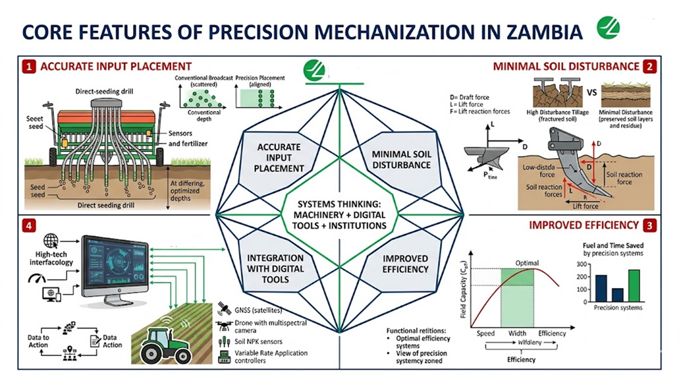
Precision Mechanization
Accurate input placement
Minimal soil disturbance
Improved efficiency
Integration with digital tools

Slide 12
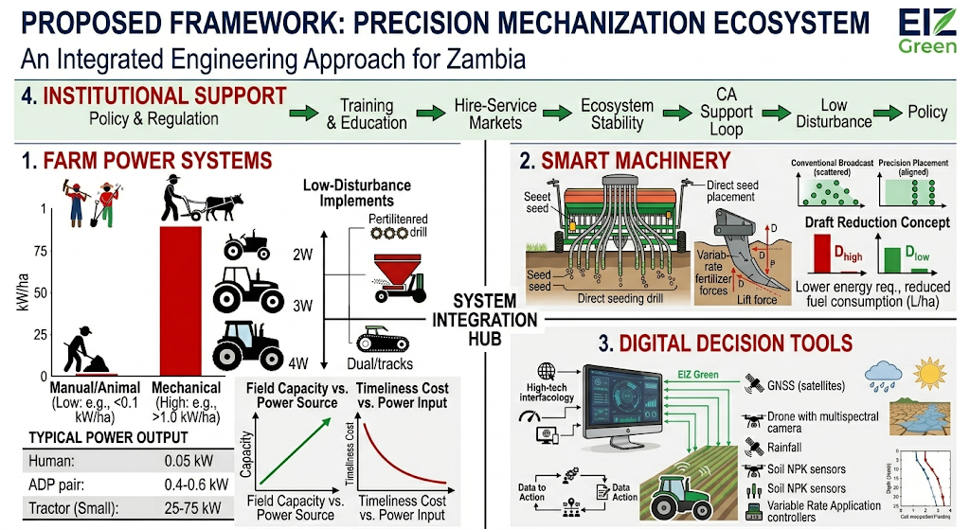
Proposed Framework
Farm power systems
Smart machinery
Digital decision tools
Institutional support

Slide 13
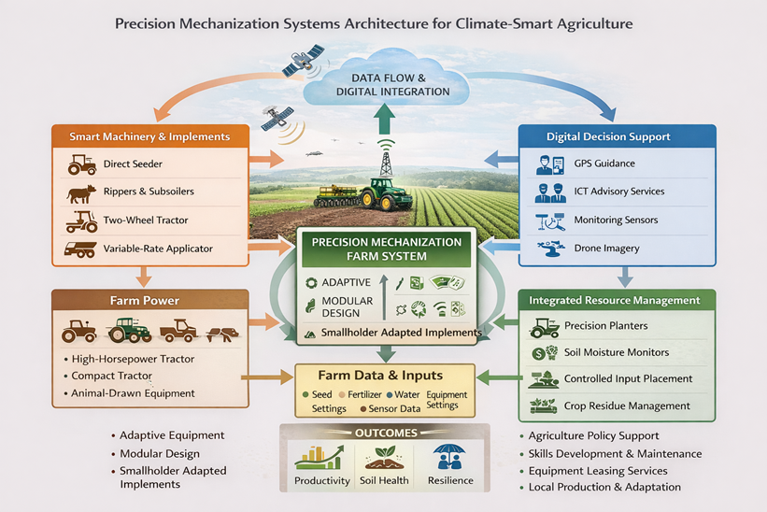
Proposed Framework
Farm power systems
Smart machinery
Digital decision tools
Institutional support

Slide 14
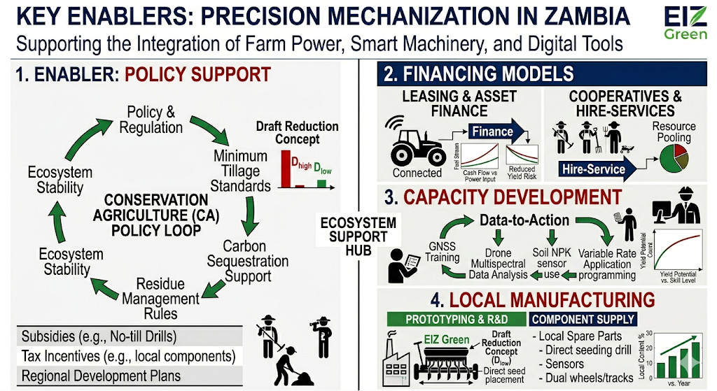
Key Enablers
• Policy support
• Financing models (leasing, cooperatives)
• Capacity development
• Local manufacturing
Notes:
This slide, "Key Enablers," acts as the supporting system for the integration framework presented in Slide 19. It uses a clean, multi-column system architecture to visualize the necessary infrastructure:
Policy Support (Left Column): A 'CONSERVATION AGRICULTURE (CA) POLICY LOOP' cyclical flowchart demonstrates how policy decisions (e.g., minimum tillage standards, carbon support, and residue rules) reinforce the systemic stability and carbon sequestration previously established in the 'CA Support Loop' (image_20.png, image_22.png). Icons like the 'Draft Reduction Concept' are integrated for clarity. A list of policy types—'Subsidies', 'Tax Incentives', and 'Regional Plans'—provides specific depth.
Financing Models (Top Right): Two large icons with data flow visualize 'LEASING & ASSET FINANCE' (a connected tractor with 'Finance' data and 'Reduced Yield Risk' curves) and 'COOPERATIVES & HIRE-SERVICES' (resource pooling with multiple farmers).
Capacity Development (Middle Right): A 'Data-to-Action' loop flowchart with specific training steps (GNSS Training, Multispectral Data Analysis, Sensor use, VRT application) illustrates how the digital tools previously discussed require localized expertise, leading to a conceptual 'Yield Potential vs. Skill Level' curve.
Local Manufacturing (Bottom Right): A schematic diagram with specific examples—'PROTOTYPING & R&D' and 'COMPONENT SUPPLY' (local parts for no-till seeders, sensors, and Dual wheels/tracks)—shows the desired engineering independence. It includes a small bar chart 'Local Content % vs. Year' with a positive trend.

Slide 15
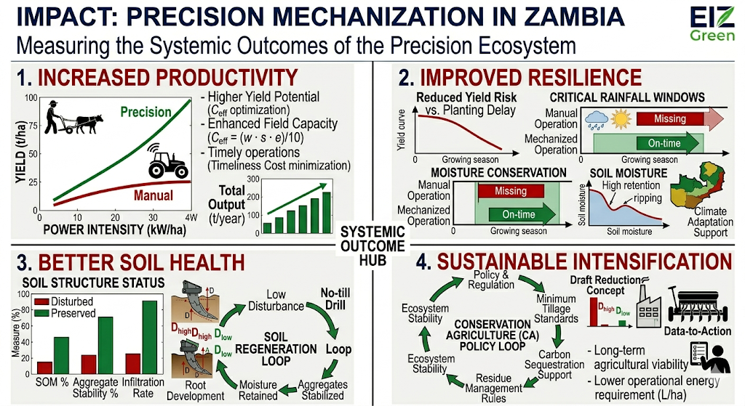
Impact
• Increased productivity
• Improved resilience
• Better soil health
• Sustainable intensification

Slide 16
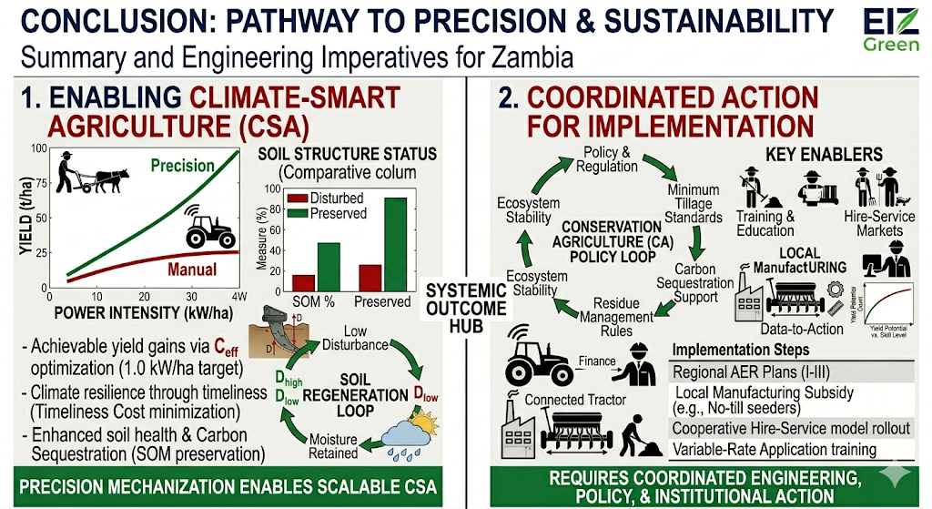
Conclusion
Precision mechanization enables scalable climate-smart agriculture in Zambia.
Requires coordinated engineering, policy, and institutional action.

Slide 17
The End
THANK YOU FOR YOUR ATTENTION.

