Slide 1

Thynk Unlimited
2026 ENGINEERING INSTITUTION OF ZAMBIA SYMPOSIUM
MONITORING OF ROAD MARKINGS USING ARTIFICIAL INTELLIGENCE
By : Silishebo Litebele & Balimu Mwiya
DATE : Friday 17th April 2026
Avani Victoria Falls Resort, Livingstone, Zambia

Slide 2

LAYOUT OF THE PRESENTATION
Introduction
Literature Review
Methodology
Results
Conclusion
Limitations
Recommendations
References

Slide 3
INTRODUCTION
Road markings ensure safety for all road users such as drivers,pedestrians,cyclicts and motocylists.
Road markings manage and regulate traffic through rules,obligations and restrictions
(Babic et al., 2022)
Thynk Unlimited

Slide 4
INTRODUCTION
Markings comprise longitudinal lines such as centre lines, edge lines. Transverse lines such as stop lines and give way lines
(Ministry of Transport and Communication, 2016)
Worn-out markings and visibility are some of the cited causes of traffic accidents
(Office of the Auditor General, 2015).
Manual inspections by RDA and RTSA are time consuming, prone to human error and costly.
Lack of automated systems makes road marking monitoring inefficient
Thynk Unlimited

Slide 5

REVIEWED LITERATURE
Advancement in digital technology, have increased interest in remote road maintenance and monitoring (Karimzadeh and Shoghli, 2020).
Smart dashboard cameras extend beyond conventional video recording functionality;
They are incorporated with sophisticated systems that perform real-time visual data analysis.

Slide 6
REVIEWED LITERATURE
With the use of wide-angle and high-resolution cameras,which capture clear and detailed road footage (Heravi et al., 2024).
These advanced systems use algorithms to automatically detect and classify road defects
AI will struggle to detect worn markings without proper training to distinguish them from proper ones (Kong et al., 2022)

Slide 7

METHODOLOGY
Study focuses on regulatory markings which are longitudinal and pedestrian markings in Lusaka, Zambia.
Equipment, AI and applications that are currently being used on monitoring of road markings on a global scale were considered.

Slide 8
METHODOLOGY
Expert Consultation
In-depth interviews with technical experts at R.D.A on the challenges and procedures in monitoring of road markings detection.
Field Site Identification
Strategic selection of roads with longitudinal and pedestrian markings without obscuring trees and shadows within Lusaka.

Slide 9
METHODOLOGY
Experimental and Simulation
Dataset of 1,900 transverse and longitudinal road marking images were obtained from RDA and captured during daylight.
The datasets were divided into training, testing and validation in an 70:20:10 ratio.

Slide 10
METHODOLOGY
Three AI object detection models were trained namely YOLOv8, YOLOv11 and RT-DETR on different rate areas:
  Precision
  Mean average precision (mAP50)
  Recall.
Real-time detection framework or validation was evaluated on the Nangwenya Road in Lusaka.

Slide 11
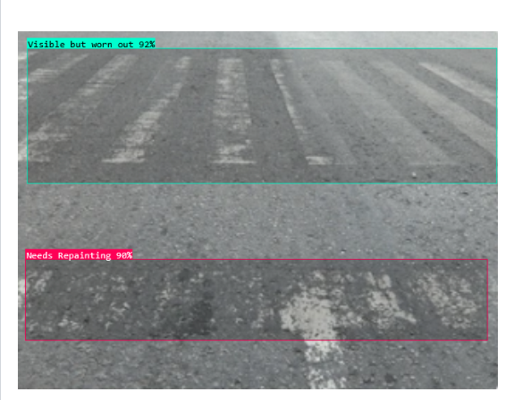
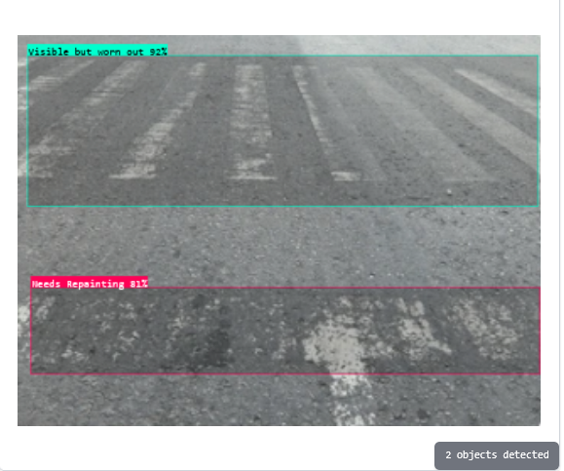
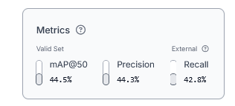
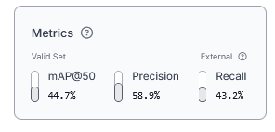
AI MODELS TRAINED
YOLOv8
YOLOv11
RESULTS

Slide 12
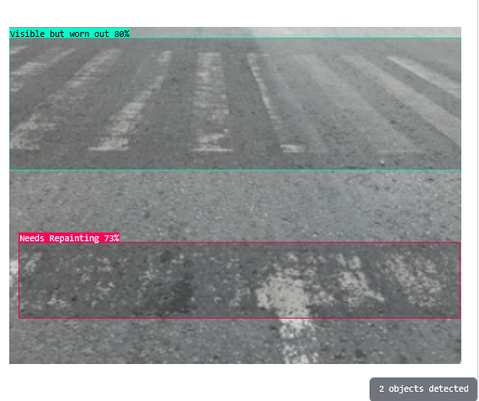
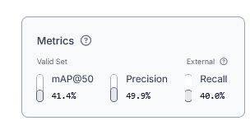
AI MODELS RESULTS
RT-DETR
RESULTS
Model Name | Precision (%) | Recall (%) | mAP50 (%) | F1-Score = (2x )x100%
YOLOv8 | 44.3 | 42.8 | 44.5 | 0.44
YOLOv11 | 58.9 | 43.2 | 44.7 | 0.5
RT-DETR | 49.9 | 40.0 | 41.4 | 0.45

Slide 13
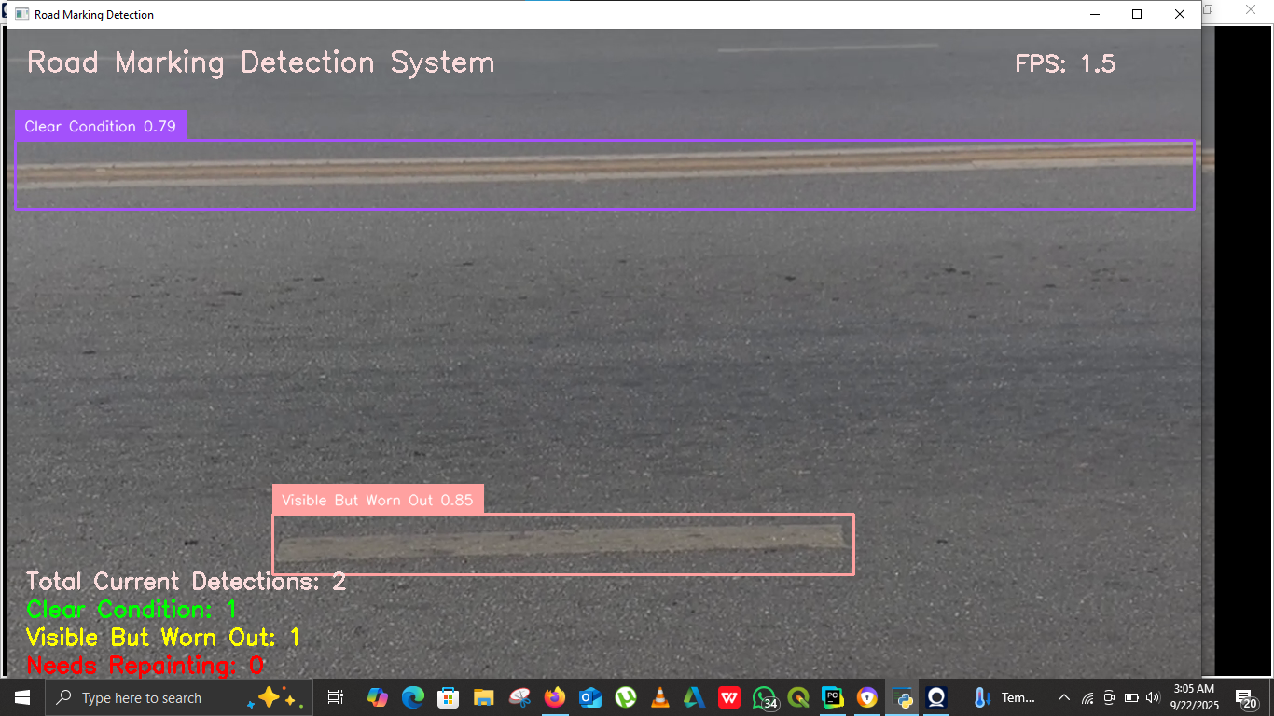
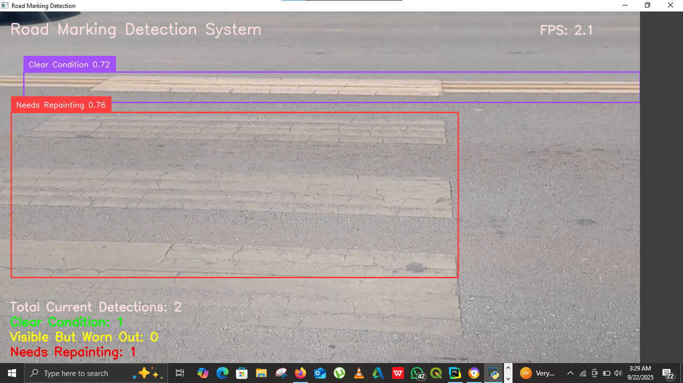
REAL-TIME DETECTION RESULTS
YOLOv8
YOLOv11

Slide 14
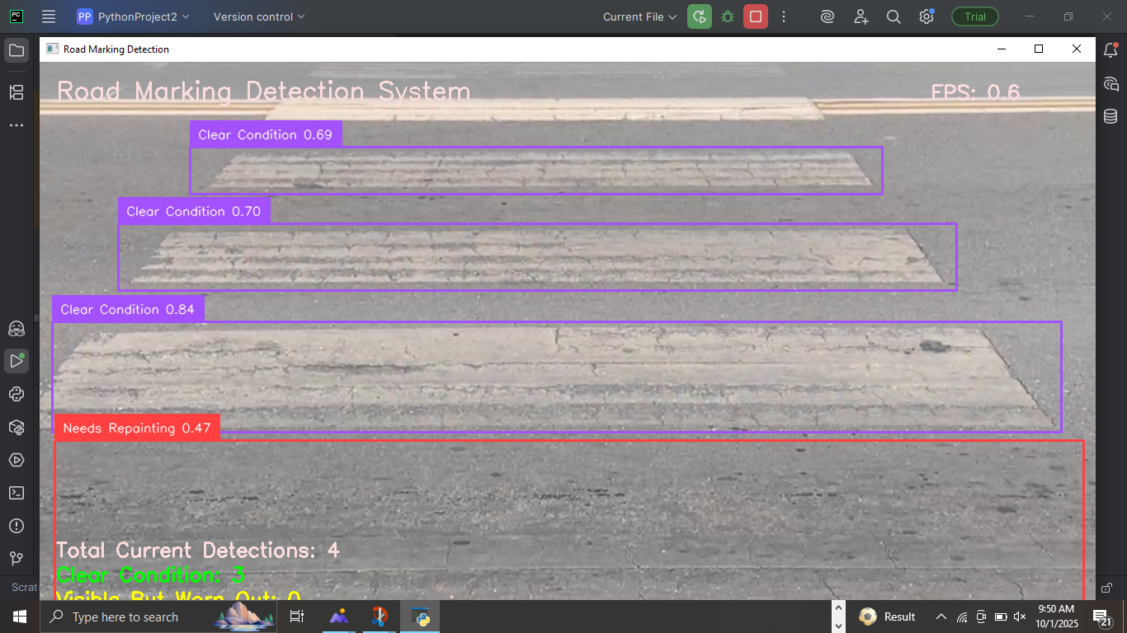
REAL-TIME DETECTION RESULTS
Real-Time Detector Transformer

Slide 15
CONCLUSION
Existing practices in detecting road markings
Visual inspection of road markings conducted on a quarterly basis
Challenges in detecting road markings
Lack of a automated system and laid down standards for monitoring them
Poor quality paints that are non reflective
Input factors for classifying and assessing road markings
High-resolution visuals of the road surface
Lighting conditions which will enable the cameras or sensors detect the road markings accurately

Slide 16
CONCLUSION
Proposed AI model to detect road markings
YOLOv11 was found to be a superior AI model compared to YOLOv8 and RT-DETR
YOLOv11-based automated road marking system is feasible for integration with RDA systems.
Despite its viability, the model cannot guarantee 100% detection accuracy due to false negative rate.
Therefore, human verification or secondary validation remains essential to ensure all markings are detected.

Slide 17
LIMITATIONS
Sample size of 525 images can be considered a modest dataset.
Though adequate to begin training a model, but in comparison to some studies which use 1,000 images, it is a modest sample.
Practical challenges of obtaining labelled infrastructure data, affect model performance specifically for RT-DETR, as larger training set sizes are usually recommended.

Slide 18
RECOMMENDATIONS
RDA should utilize large datasets for enhanced analysis and train the model under challenging conditions.
RDA should work with different types of road markings to ensure comprehensive coverage.
RDA should invest in high-performance computer hardware with recommended specifications such as CPU: i9/Ryzen 9,GPU: RTX 4080/4090, RAM 64GB+ and storage of 2TB SSD.

Slide 19
REFERENCES
Antariksa, G., Chakraborty, R., Somvanshi, S., Das, S., Jalayer, M., Patel, D. and Mills, D., 2025. Comparative analysis of advanced AI-based object detection models for pavement marking quality assessment during daytime. arXiv preprint arXiv:2503.11008. https://doi.org/10.48550/arXiv.2503.11008 [Accessed on 20th June 2025]
Bernard, H. R. (2002). Research methods in anthropology: Qualitative and quantitative approaches (3rd ed.). Walnut Creek, CA: Alta Mira Press.
Braun, V. and Clarke, V. (2006). Using thematic analysis in psychology. Qualitative Research in Psychology, [online] 3(2), pp.77–101. doi:https://doi.org/10.1191/1478088706qp063oa. [Accessed 29 Jun. 2025]
Chengula,D.H (2018) Study on Performance of Road Signs and Markings along TANZAM Highway in Mbeya Region, Tanzania .Mbeya: University of Mbeya.
Kabamba.C (2024) Rda And Ernkate Launch Road Safety Mobile Application.[Online] Available from: https://www.rda.org.zm/?p=2862 [Accessed: 19th March 2025]

Slide 20
THE END

