Slide 1


2026 ENGINEERING INSTITUTION OF ZAMBIA SYMPOSIUM
ENGINEERING WASTE-TO-VALUE SYSTEMS FOR
A CIRCULAR ECONOMY IN ZAMBIA
Integrating Recycling, Composting and Anaerobic Digestion
Presenter: Eng. Robert Mwenya
Date: Thursday, 16ᵗʰ April 2026
Avani Victoria Falls Resort, Livingstone, Zambia

Slide 2
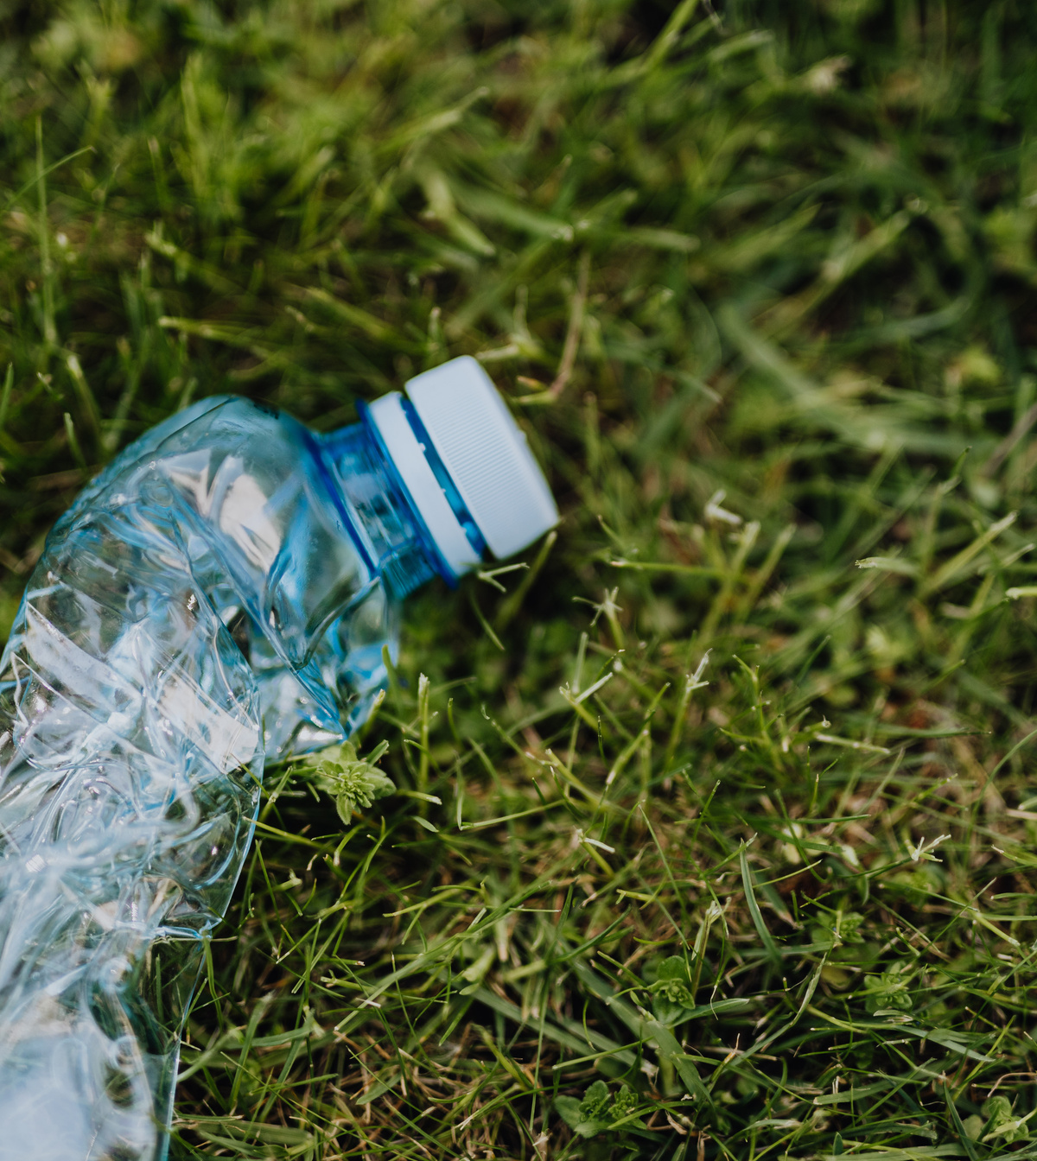
THE CHALLENGE: MUNICIPAL SOLID WASTE IN ZAMBIA
  Rapid urbanisation → ↑ municipal solid waste (MSW)
  0.5–0.7 kg/person/day waste generation
  Organic fraction >50%
  Disposal-dominated systems
  Low material and energy recovery
  Environmental impacts:
  Methane emissions
  Groundwater contamination
02

Slide 3
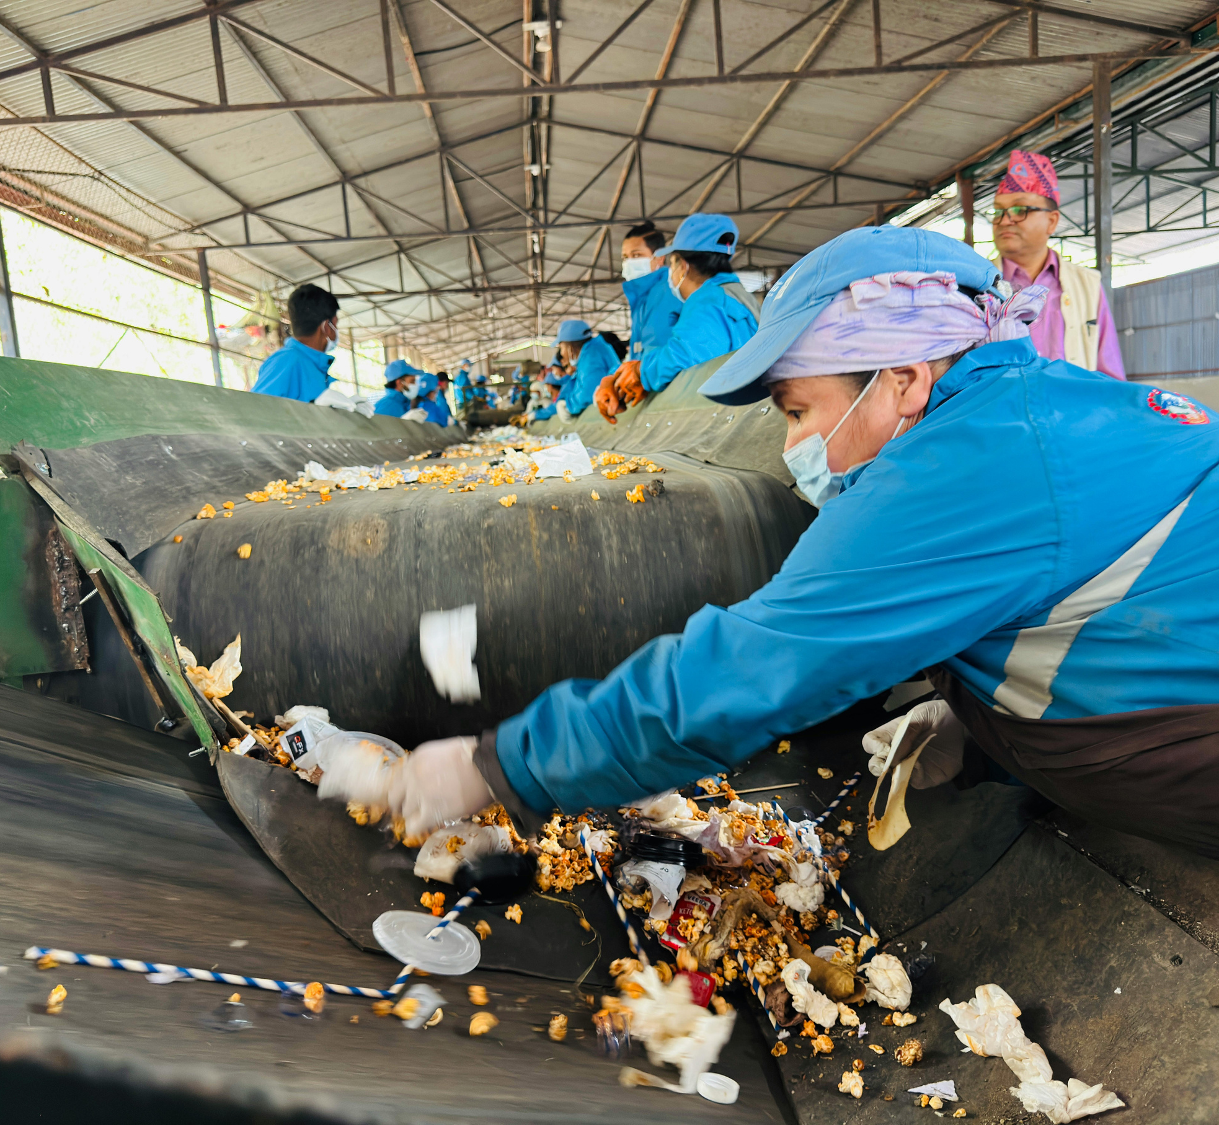
OPPORTUNITY: RESOURCE RECOVERY POTENTIAL
  High organic waste fraction (>50%)
  Suitable for biological treatment:
    Composting
    Anaerobic digestion (AD)
  Recoverable recyclables:
    Plastics
    Metals
    Paper
  Untapped energy potential from waste
  Opportunity for local value addition (SMEs)
  Transition from waste disposal → resource recovery
03

Slide 4
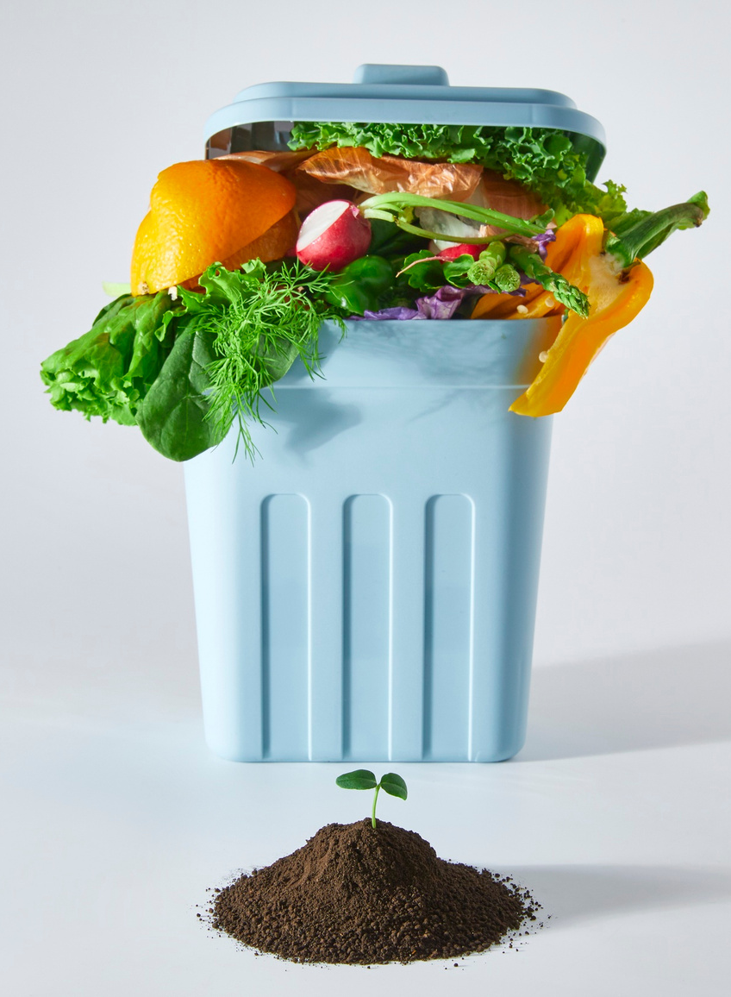
STUDY OBJECTIVES
  Assess challenges in MSW management in Zambia
  Develop an integrated Waste-to-Value (WTV) system
  Combine:
    Recycling
    Composting
    Anaerobic digestion
  Evaluate environmental and economic benefits
  Propose a phased implementation strategy
04

Slide 5

WASTE-TO-VALUE (WTV) CONCEPT
  Conversion of waste into valuable products
  Circular economy approach
  Resource recovery pathways:
    Materials (recycling)
    Energy (biogas)
    Soil products (compost, digestate)
    Integrated waste management system
    Reduces reliance on disposal
05

Slide 6
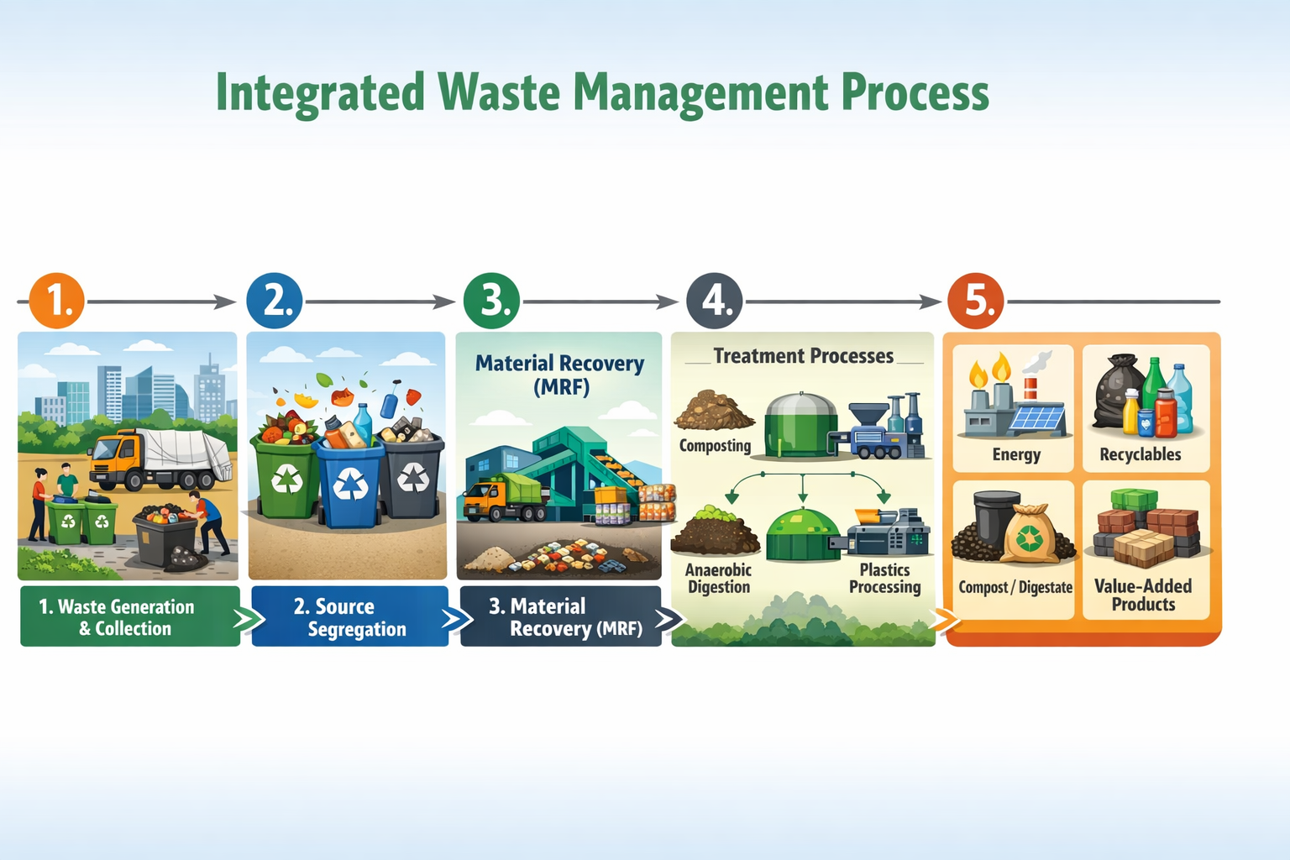
INTEGRATED WASTE-TO-VALUE SYSTEM
06

Slide 7

METHODOLOGICAL APPROACH
  System boundary: waste generation → final products
  Functional unit: 1 tonne of municipal solid waste (MSW)
  Feedstock characterisation:
    Organic fraction
    Moisture content
    Recyclables content
  Process synthesis:
    Segregation → MRF → Treatment pathways
    Mass and energy balance estimation
  Performance evaluation:
    Material recovery
    Energy generation
    Environmental impact
07

Slide 8

DESIGN BASIS AND KEY ASSUMPTIONS
  Organic fraction: ~55% of total MSW
  Biogas yield: ~100 m³/tonne of organic waste
  Electrical conversion efficiency: ~35%
  Plastics recovery efficiency: 70–75%
  Compost/digestate yield: 25–35% of organic input
  System scale: 100 tonnes/day (illustrative case)
08

Slide 9
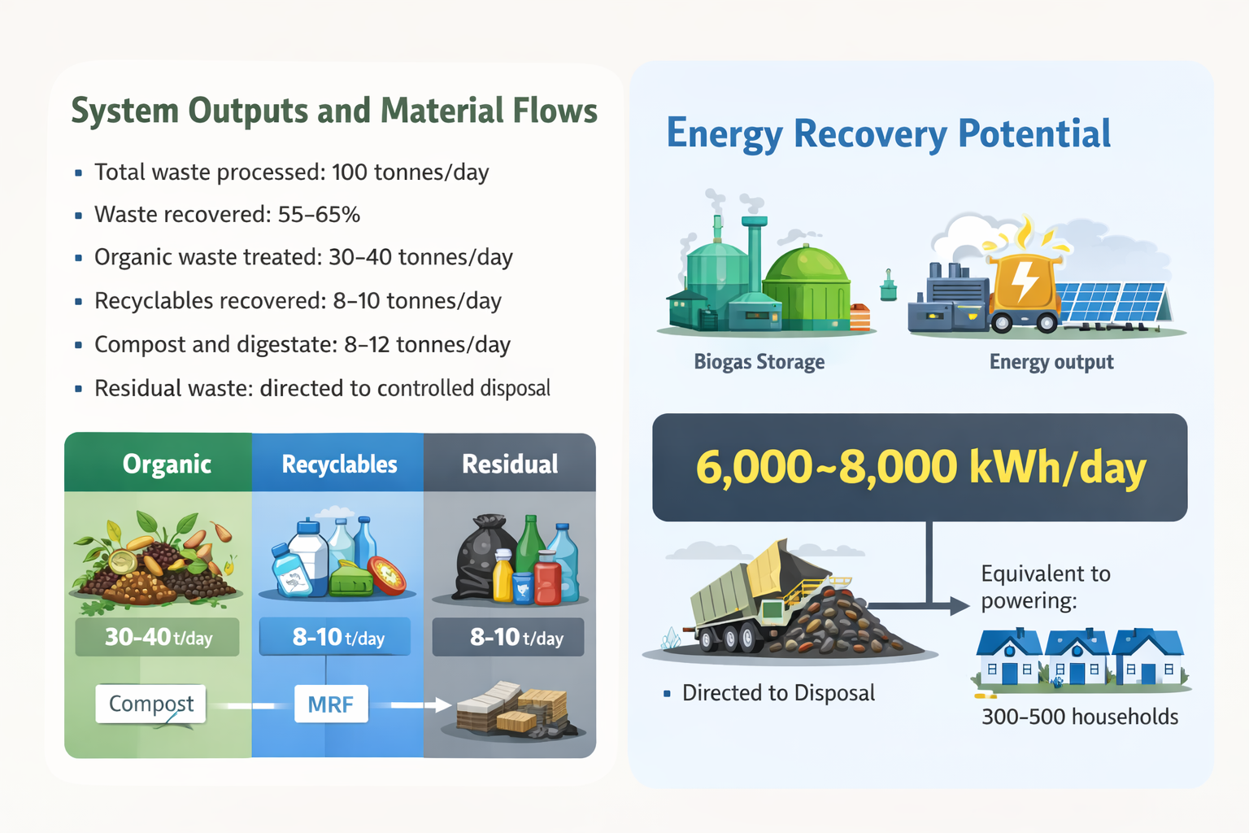
SYSTEM OUTPUTS AND MATERIAL FLOWS
  Total waste processed: 100 tonnes/day
  Waste recovered: 55–65%
  Organic waste treated: 30–40 tonnes/day
  Recyclables recovered: 8–10 tonnes/day
  Compost and digestate: 8–12 tonnes/day
  Residual waste: directed to controlled disposal
09

Slide 10
ENERGY RECOVERY POTENTIAL
  Biogas production: 3,000–4,000 m³/day
  Derived from organic waste fraction
  Electrical conversion efficiency: ~35%
  Energy output: 6,000–8,000 kWh/day
  Equivalent to powering:
    300–500 households
10

Slide 11
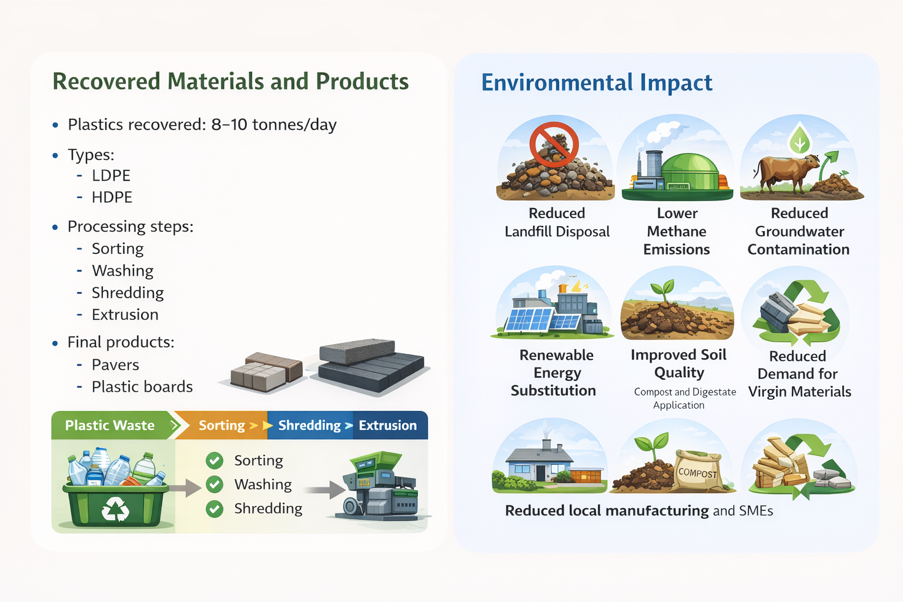
RECOVERED MATERIALS AND PRODUCTS
Plastics recovered: 8–10 tonnes/day
11

Slide 12
ENVIRONMENTAL IMPACTS
12

Slide 13
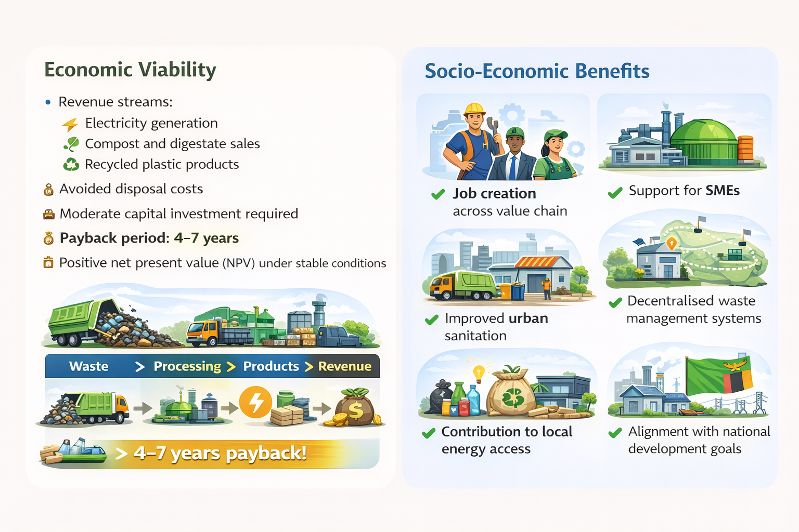
SOCIO-ECONOMIC BENEFITS
13

Slide 14
ECONOMIC VIABILITY
  Revenue streams:
    Electricity generation
    Compost and digestate sales
    Recycled plastic products
    Avoided disposal costs
  Moderate capital investment required
  Payback period: 4–7 years
  Positive net present value (NPV) under stable conditions
14

Slide 15
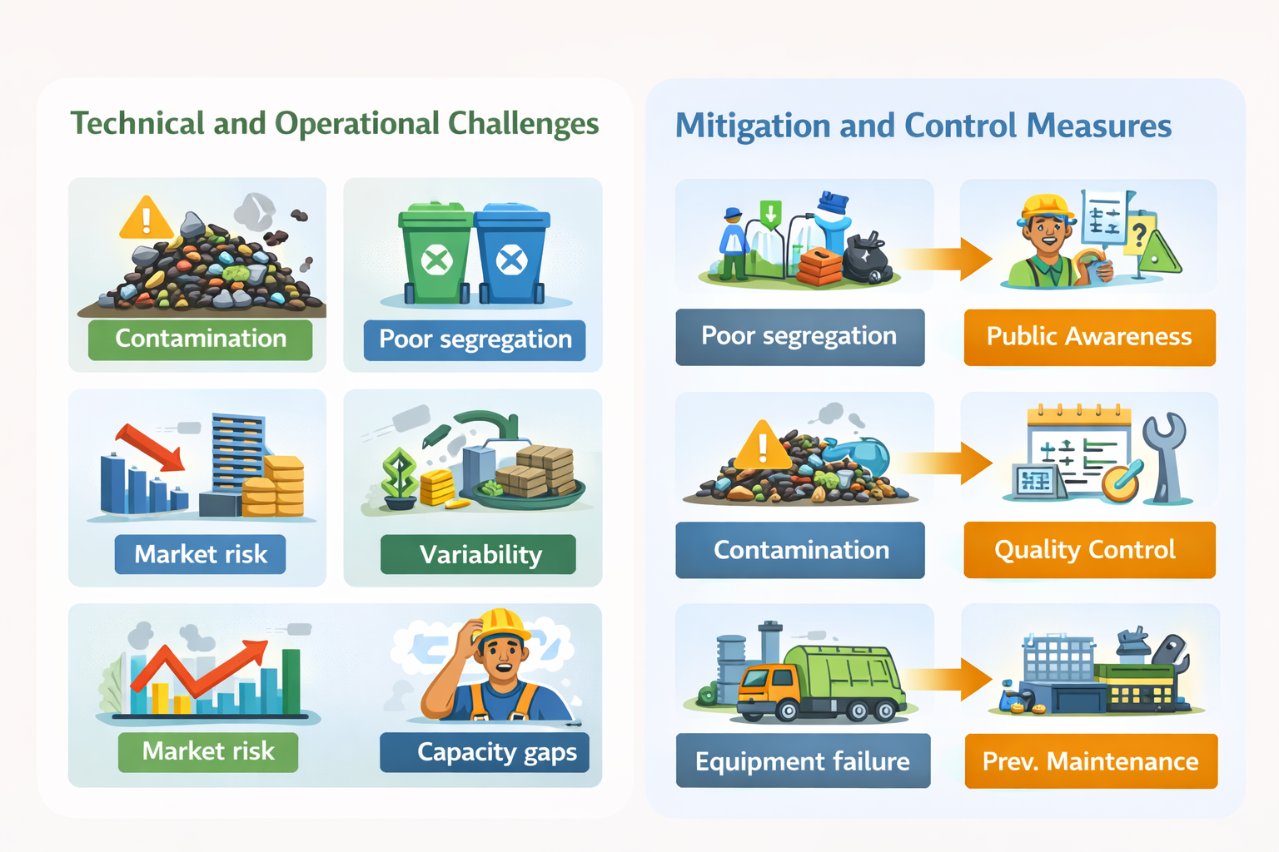
TECHNICAL AND OPERATIONAL CHALLENGES
  Poor source segregation at household level
  Feedstock contamination (mixed waste)
  Variability in waste composition
  Equipment downtime and maintenance issues
  Market uncertainty for recycled products
  Limited technical capacity in local systems
15

Slide 16
MITIGATION AND CONTROL MEASURES
  Strengthen source segregation systems
  Public awareness and stakeholder engagement
  Preventive maintenance scheduling
  Quality control and monitoring systems
  Long-term supply and off-take agreements
  Phased and modular implementation
16

Slide 17
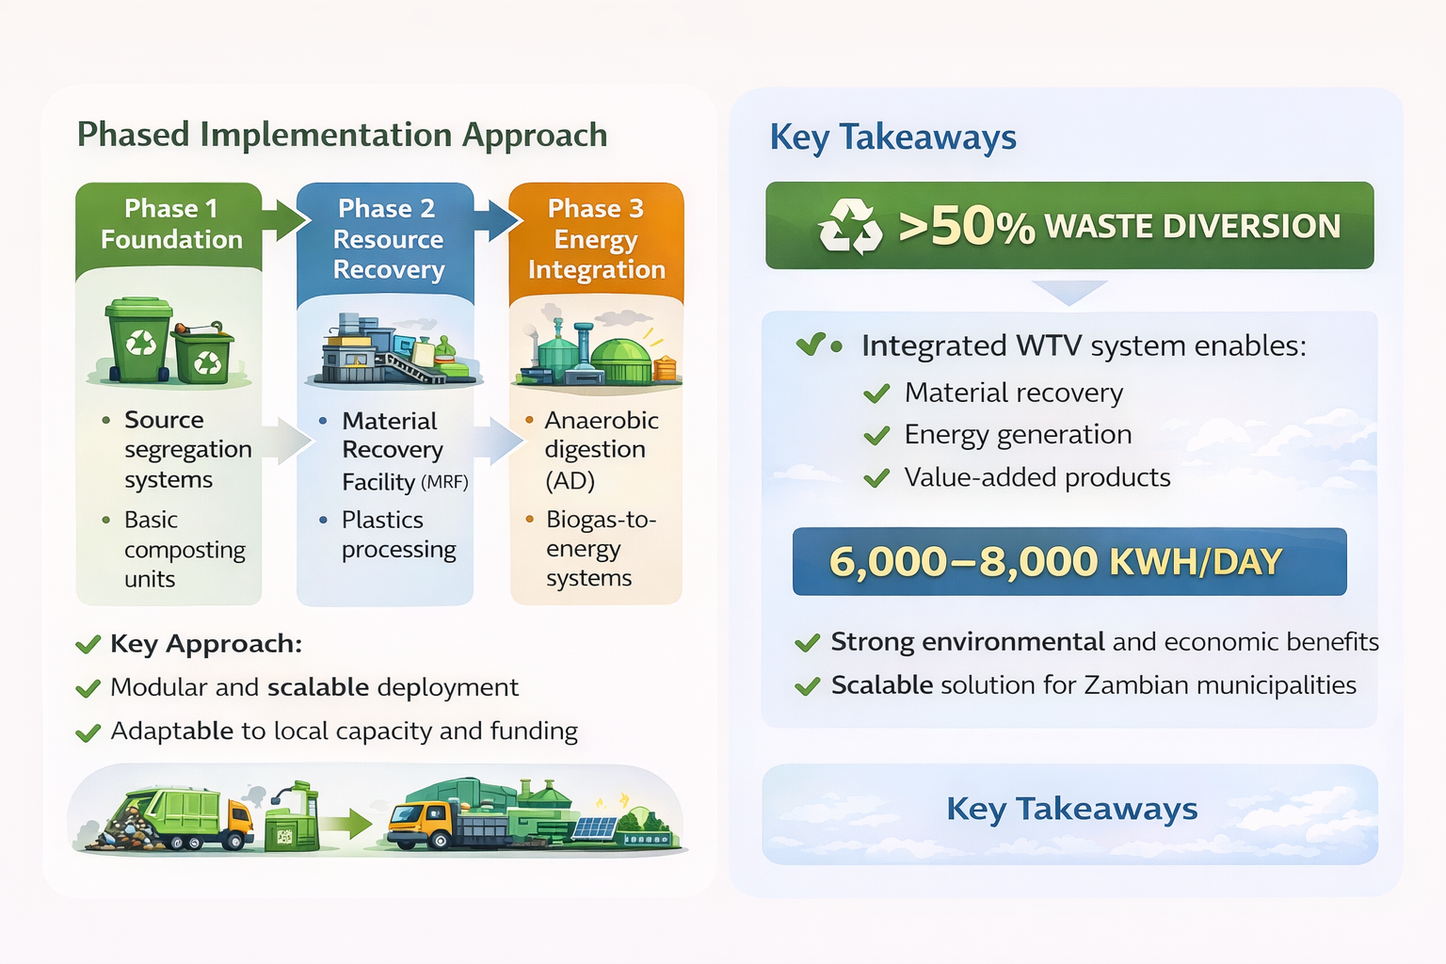
PHASED IMPLEMENTATION APPROACH
  Phase 1: Foundation
    Source segregation systems
    Basic composting units
  Phase 2: Resource Recovery
    Material Recovery Facility (MRF)
  Plastics processing
  Phase 3: Energy Integration
    Anaerobic digestion (AD)
    Biogas-to-energy systems
    Key Approach:
    Modular and scalable deployment
    Adaptable to local capacity and funding
17

Slide 18

KEY TAKEAWAYS
  50% waste diversion achievable
  Integrated WTV system enables:
    Material recovery
    Energy generation
    Value-added products
    Estimated energy: 6,000–8,000 kWh/day
    Strong environmental and economic benefits
    Scalable solution for Zambian municipalities
18

Slide 19

THANK YOU
FOR YOUR ATTENTION
“The greatest threat to our planet is the belief that someone else will save it.”
— Robert Swan
19

