Slide 1

2026 ENGINEERING INSTITUTION OF ZAMBIA SYMPOSIUM
SOLAR WASTE MANAGEMENT IN ZAMBIA: ENGINEERING FRAMEWORK AND BENCHMARKING FOR SOLAR PV END‑OF‑LIFE MANAGEMENT
PRESENTER : Eng. Mabo Sampule
DATE : Friday 16th April 2026
Avani Victoria Falls Resort, Livingstone, Zambia

Slide 2
Table of Content
Background
Solar PV Growth in Zambia
Problem Statement
Research Objectives & Approach
Solar waste components
Material Composition of PV Modules
Failure modes of Solar Systems
Solar waste timing & Current status of E-Waste in Zambia
Regulatory Framework & Regional Benchmarking
Technical options for Solar waste
Institutional Roles & Financing Models
Environmental & Health risks
Roadmap for Zambia (2025 – 2035)
Expected outcomes & Conclusion

Slide 3
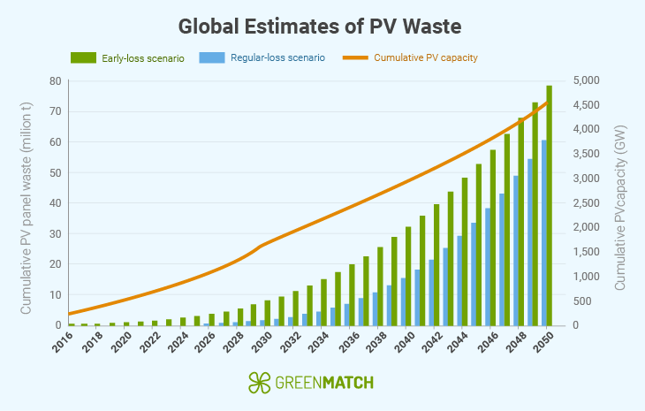
Background
Rapid expansion of solar PV systems across Africa.
Growth in utility-scale, commercial, and off-grid solar installations.
Global PV installations projected to exceed 4500 GW by 2050.
Future PV waste estimated at 60–78 million tonnes.

Slide 4
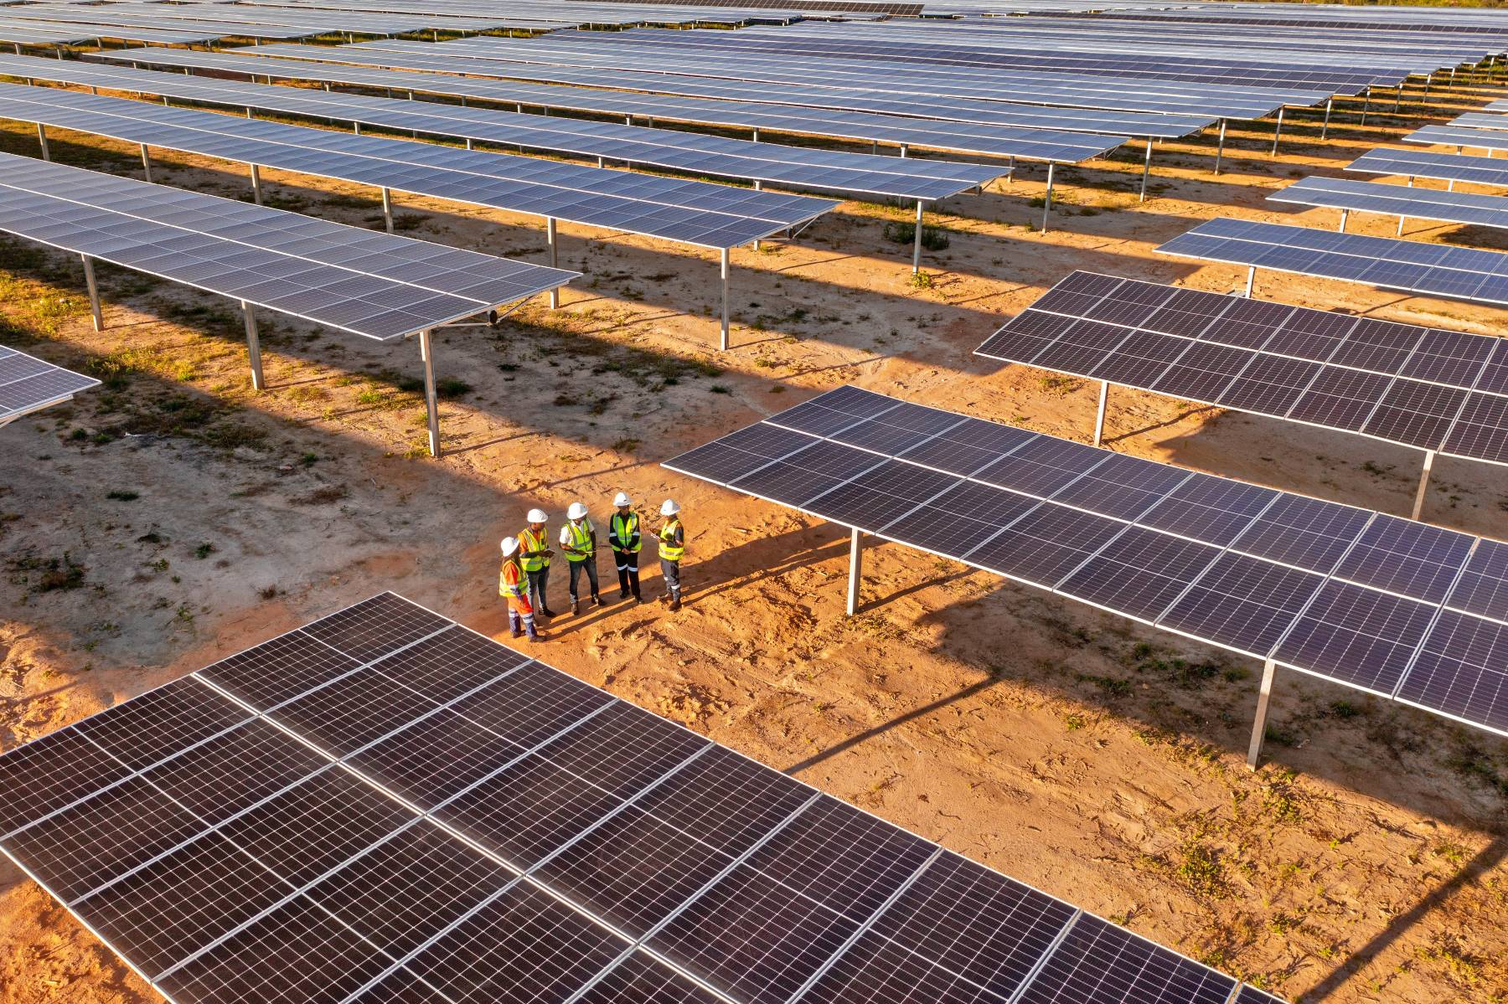
Solar PV Growth in Zambia
Rural electrification programmes.
Commercial and industrial solar adoption.
Private sector investment in solar projects.
Donor-supported renewable energy initiatives such as GET FiT Zambia.

Slide 5
Problem Statement
Solar systems generate complex waste streams.
Including PV modules, batteries, inverters and electronics.
Zambia lacks PV-specific dismantling infrastructure.
Limited traceability and extended producer responsibility systems.

Slide 6
Research Objectives
Assess Zambia’s solar PV end-of-life waste landscape.
Evaluate regulatory and engineering readiness.
Benchmark regional practices in COMESA countries.
Develop a long-term roadmap for solar waste management.

Slide 7
Research Approach
Engineering analysis of PV material flows.
Policy and regulatory assessment.
Comparative benchmarking with COMESA countries.
Review of recycling and recovery technologies.

Slide 8
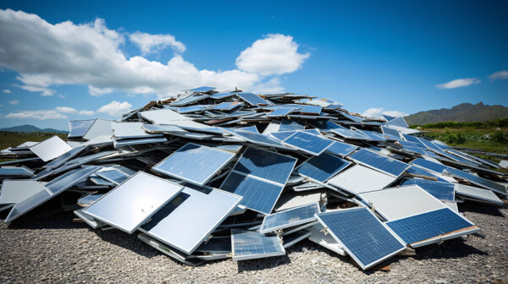
Solar Waste Components
PV modules
Inverters
Charge controllers
Batteries
Mounting structures and electrical components

Slide 9
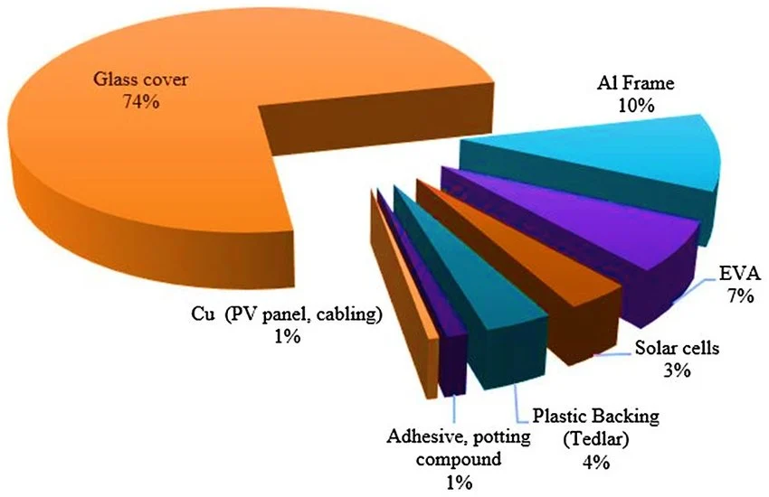
Material Composition of PV Modules
Glass (approximately 70–75%).
Aluminium frames.
Silicon solar cells.
Encapsulants such as EVA.
Metals including copper and silver.

Slide 10
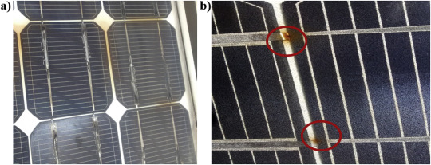
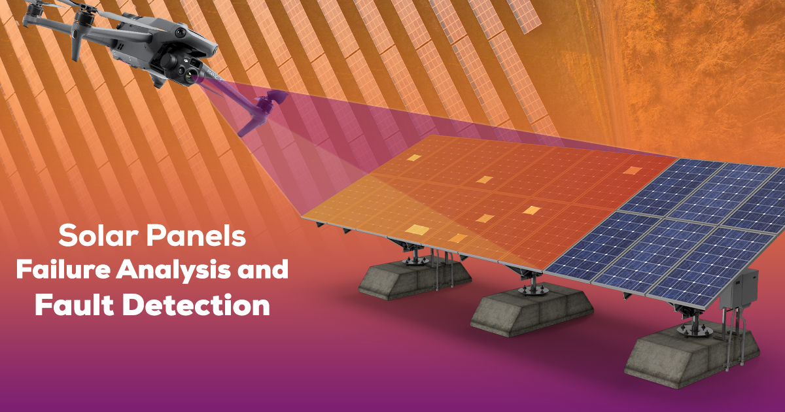
Failure Modes of Solar Systems
Module degradation and micro-cracks.
Inverter failures.
Battery degradation.
Technological obsolescence.
Physical damage to modules.

Slide 11
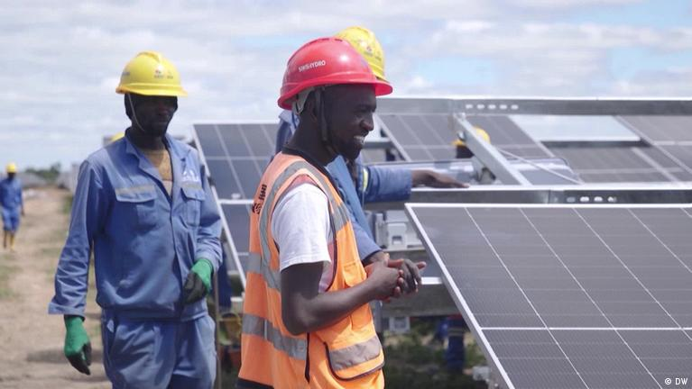
Solar Waste Timing in Zambia
Major solar plants installed between 2015 and 2019.
Module waste expected to emerge after 2035.
Batteries and inverters likely to fail earlier.
Evidence of early failures in some solar installations.

Slide 12
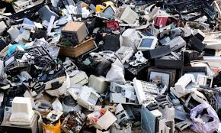
Current Status of E-Waste in Zambia
Approximately 23,000 tonnes of e-waste was generated in 2022.
Environmental Management Act governs hazardous waste.
E-Waste Management Regulations introduced in 2024.
Recycling capacity remains limited.

Slide 13

Regulatory Framework
Environmental Management Act No. 12 of 2011.
Extended Producer Responsibility regulations.
Licensing requirements for hazardous waste handlers.
Need to include PV components under EPR.

Slide 14
Regional Benchmarking
Kenya – PV waste integrated under EPR regulations.
Rwanda – Public-private e-waste recycling facility.
Uganda – Hazardous waste transport permit system.
Ethiopia – Circular economy supply-chain initiatives.

Slide 15

Technical Options for Solar Waste
Repair and refurbishment of modules.
Second-life solar deployment.
Mechanical separation recycling.
Thermal and chemical recovery processes.

Slide 16




Institutional Roles
ZEMA – Environmental regulation and licensing
ERB – Regulation of solar power systems
ZABS – Standards for equipment and dismantling
Local authorities – Waste infrastructure management
Financing Models
Extended Producer Responsibility fees.
Producer Responsibility Organisations.
PPP recycling facilities.
Climate finance mechanisms.

Slide 17
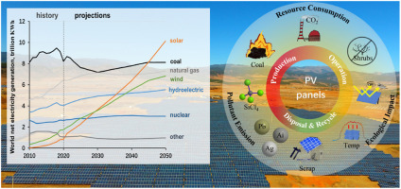
Environmental and Health Risks
Heavy metal contamination
Battery fires and thermal runaway
Toxic fumes from burning plastics
Occupational safety risks

Slide 18
Roadmap for Zambia (2025–2035)
Introduce PV-specific EPR regulations.
Develop national PV asset registry.
Establish regional waste collection centres.
Promote circular economy recycling infrastructure.

Slide 19
Expected Outcomes
Environmental protection.
Recovery of valuable materials.
Green job creation.
Regional leadership in solar waste management.
Conclusion
Zambia must prepare for future solar waste streams.
Engineering and regulatory reforms are necessary.
Circular economy strategies can transform waste into resources.

Slide 20

Questions and Discussion

