Slide 1

2026 ENGINEERING INSTITUTION OF ZAMBIA SYMPOSIUM
Waste-to-Value Engineering: Addressing Load Shedding in Zambia
PRESENTER : Patrick Mwamba Mubanga
DATE : Friday 17th April 2026
Avani Victoria Falls Resort, Livingstone, Zambia

Slide 2
PRESENTATION OUTLINE
Energy Vulnerability in Zambia: The Potential of WtE Technologies
Typical Composition of Municipal Solid Waste in Lusaka
Waste-to-Energy Technologies
Using WtE to addressing Load Shedding
Challenges /Recommendations
Conclusion

Slide 3
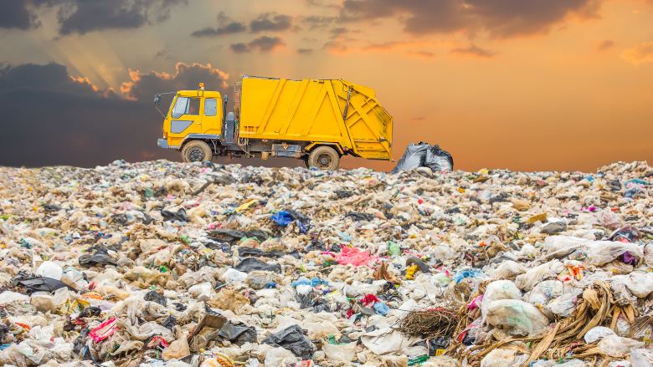
PRESENTATION OBJECTIVES
To assess the volume and composition of Zambian waste streams to evaluate their energy generation potential.
To evaluate Waste-to-Energy technologies for converting refuse into various usable energy forms.
To discuss the technical challenges to WtE implementation and propose recommendations.
03
01
02

Slide 4
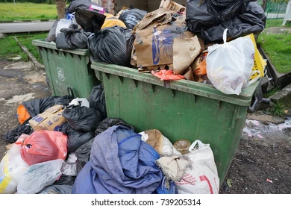
1.0 INTRODUCTION: ENERGY VULNERABILITY IN ZAMBIA
c.)
WtE provides a dual solutions: electricity generation and recycling the waste (IRENA, 2023).
Zambia’s heavy dependence on hydropower (84%–85%) leaves the national grid vulnerable to climate-induced droughts (ERB , 2024).
Potential: Integrating Waste-to-Energy (WtE) technologies into the country’s energy mix.

Slide 5
2.0 TYPICAL COMPOSITION OF MUNICIPAL SOLID WASTE IN LSK (ESTIMATED 2,500 TONNES/DAY)
Waste Type | (%) | Estimated Ton/Day | WtE Relevance
a. Organic Waste (food, market waste, yard waste) | 50–60% | 1,250–1,500 | Ideal for anaerobic digestion → biogas & biofertilizer
b. Plastics | 15–20% | 375–500 | Suitable for pyrolysis/gasification → syngas & bio‑oil
c. Paper & Cardboard | 10–12% | 250–300 | Incineration → heat & electricity
d. Metals | 5–8% | 125–200 | Recyclable → supports material loops
Sources: World Bank (2022)

Slide 6
3.1 Anaerobic Digestion (AD)
03
WASTE-to-ENERGY TECHNOLOGIES
3.1.1 Technical Requirements and Potential
Successful AD hinges on maintaining controlled conditions specifically temperature, pH, moisture, and nutrient balance
A 5 MW Kigali biogas plant, which processes 30,000 ton of organic waste annually (IRENA, 2026).
AD utilizes microorganisms to break down organic waste in oxygen-free environments, generating biogas for renewable energy and nutrient-rich digestate.

Slide 7
3.2 Incineration with
Energy Recovery
3.2.1Key Benefits of Incineration
It shrinks the physical footprint of waste by 70–80%, drastically extending the lifespan of existing landfills (World Bank,2023).
Unlike intermittent renewables, it provides a consistent baseload energy source for the power grid.
By processing waste in a controlled environment, it prevents the uncontrolled greenhouse gas emissions
Incineration uses controlled combustion to turn waste into high-temperature heat for electricity to minimize pollution.

Slide 8
04
USING WtE TO ADDRESS LOAD SHEDDING
4.1 Urban and Industrial
Deployment
4.1.1Practical Impact Example
A 10 MW WtE facility serving a local district can mitigate 2-3 hours of daily load shedding during peak times, enhancing overall grid stability (IEA,2023).
Locating Waste-to-Energy plants in urban and industrial hubs improves grid reliability, cuts energy waste, and ensures a steady power supply

Slide 9
5.3 Climate Change Mitigation
05
BENEFITS:ECONOMIC AND ENVIRONMENTAL
5.1 Job Creation and Industrial Growth
WtE systems generate employment in value chains i.e. waste management, facility operations and logistics (Kaza et al. 2018; Pan et al. 2015).
5.2 Resource Efficiency Enhancement
WtE systems integrate by-products back into industrial and agricultural value chains
Diverting organic waste and utilizing its energy reduces methane and carbon dioxide emissions (IPCC 2023; Kaza et al. 2018).

Slide 10
6.0 CHALLENGES
Feedstock & Technical Constraints:
High Moisture Content: High-moisture organic Zambian waste has low caloric value and requires extensive drying.
Inadequate Segregation
Infrastructure Gaps: Current grids lack the "smart" infrastructure to integrate decentralized WtE plants.
Economic & Financial Barriers
Significantly higher initial investment per megawatt compared to traditional energy sources
Inefficient waste collection systems and high transport costs can make the "cost-per-kWh" uncompetitive
Investment Risk: Lack of feed-in tariffs for WtE plants makes securing private sector difficult.

Slide 11
6.0 CHALLENGES CONT’D
3. Regulatory & Environmental
Emission Control: Managing toxic byproducts (dioxins/furans) in thermal plants adds immense complexity and cost to engineering designs.
Policy Ambiguity: Current frameworks often treat waste as "refuse" rather than a "resource".
4. Socio-Economic Dynamics
Informal Sector Displacement: Large-scale industrialization of waste may displace informal waste pickers.
Public Perception: Concerns over odor, health risks and site locations

Slide 12
7.0 RECOMMENDATIONS
7.1 Technical & Infrastructure Optimization
Separate Recyclables : Implement tiered processing to separate recyclables and treat high-moisture organic waste via Anaerobic Digestion (AD) rather than pure incineration.
Modular Gasification: Deploy decentralized, small-scale units near high-waste zones (e.g., markets/industrial hubs) to minimize logistics costs and provide localized grid support.
Grid Modernization: Invest in "Smart Grid" substations and automated load management to seamlessly integrate decentralized waste-power into the national utility.

Slide 13
7.0 RECOMMENDATIONS CONT’D
7.2. Financial & Economic Sustainability
Waste-Specific Feed-in Tariffs: Establish premium tariffs that account for WtE .
Public-Private Partnerships (PPP): Utilize "Build-Operate-Transfer" models to leverage private capital and technical expertise while the State/Council provides waste-supply guarantees.
Extended Producer Responsibility : Mandate that manufacturers fund end-of-life material recovery, creating a steady revenue stream for value chains.
7.3. Policy & Social Integration
Waste-as-Resource Legislation: Reclassify waste as a Strategic Energy Resource .
Source Segregation :Implement household and commercial waste-sorting policies to ensure high-quality, dry feedstock for thermal processes.
Inclusive Formalization: Integrate informal waste pickers into the value chain

Slide 14
CONCLUSION AND FUTURE OUTLOOK
08
8.1 Integrated Energy Strategy
8.2 Coordinated Action Needed
Waste-to-energy technologies represent a viable pathway to enhance Zambia's energy security while promoting sustainable waste management and circular economy principles.
Integrating WtE with other renewables and decentralized generation models can diversify the energy mix and mitigate load shedding.
Successful implementation requires coordinated policies, financing mechanisms, technical capacity building
Community engagement to help foster sustainable industrial and urban development in Zambia.

Slide 15
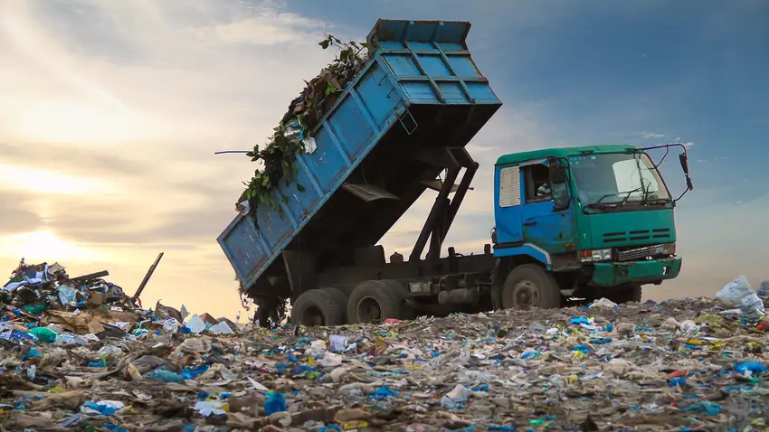
THANK FOR YOUR ATTENTION
" To solve load shedding, we need an engineering shift that utilizes urban waste as a valuable energy resource for the national grid rather than a disposal burden”.
(Saha & Naidoo, 2024)

