Slide 1

2026 ENGINEERING INSTITUTION OF ZAMBIA SYMPOSIUM
SUSTAINABLE ROAD BASE STABILISATION USING CEMENT–FLY ASH BLENDS: A WASTE-TO-VALUE APPROACH FOR KAFUE GORGE LOWER ROADS
PRESENTER : Musampeni Lungu & Asaph Banda
DATE :Friday 4th April 2025
Avani Victoria Falls Resort, Livingstone, Zambia

Slide 2
TABLE OF CONTENTS
Introduction and Background
Problem Statement and Objectives
Materials and Testing Methodology
Fly Ash Characteristics and Context
Experimental Results
Technical Findings and Repeatability
Economic Analysis
Conclusions and Recommendations

Slide 3
KAFUE GORGE LOWER POWER DEVELOPMENT CORPORATION
Study at Kafue Gorge Lower (750+12 MW) to identify low-carbon alternative engineering materials meeting required technical performance and reduced cost.
Project constructed by Sinohydro, operated and managed by KGLPDC (ZESCO subsidiary).
Aligned with corporate sustainability priorities: GHG management, carbon market development, biodiversity protection, sustainable waste management, community initiatives, and R&D supporting continuous improvement across all operations.

Slide 4
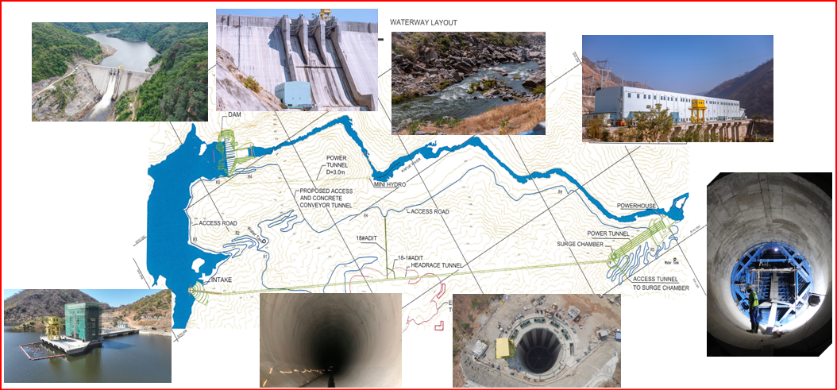
BACKGROUND

Slide 5
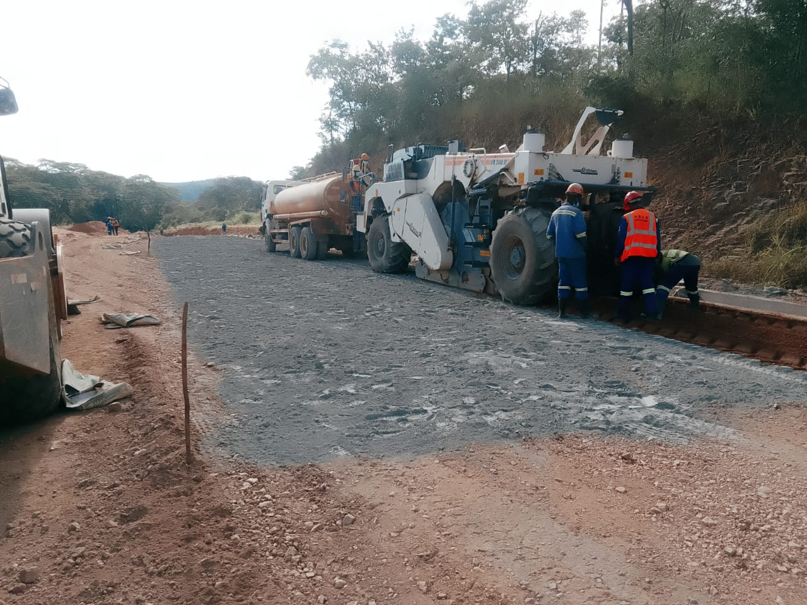
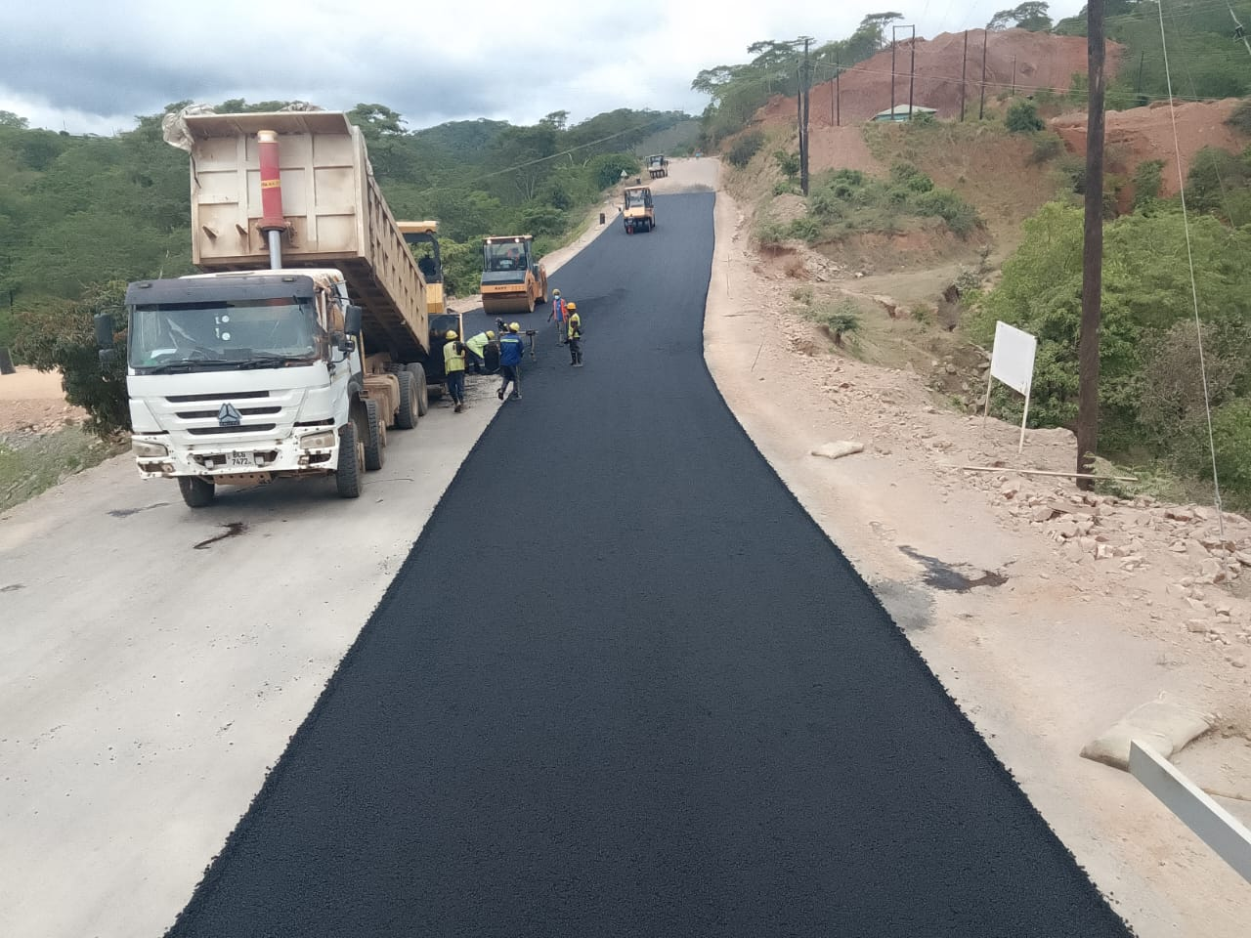
BACKGROUND
Aligned with KGL sustainability objectives, the study assessed cement–fly ash blends for their potential to reduce embodied carbon, enable beneficial reuse of industrial waste, improve resource efficiency, and maintain required engineering quality and performance.
Notes:
In line with KGL’s commitment to sustainability, this study addresses two key environmental priorities: reduction of embodied carbon and beneficial utilisation of industrial waste. The research evaluates cement–fly ash blends as a material optimisation strategy that reduces dependence on carbon-intensive cement while promoting productive reuse of fly ash generated from thermal power generation. This approach supports circular economy principles, improves resource efficiency, and contributes to enhanced environmental performance of infrastructure works.

Slide 6
PROBLEM STATEMENT
Deliver more roads without increasing project costs while still meeting all required engineering standards.
To overcome the identified problem several solutions were explored such as:
Reducing road widths for non-critical access roads
Optimizing pavement layer thicknesses
Investigating alternative materials

Slide 7
Experimental Study
The materials used in the study were:
32.5 grade cement from Chilanga Cement
Class F fly ash from Maamba
Magazine Junction Soil
KM11 soil
All materials were sourced from the actual project, ensuring real-world relevance.
The fly ash used was classified as Class F, meaning it is pozzolanic and not self-cementing. It requires the presence of cement to activate its reaction.
This justified investigating partial replacement of cement, rather than full replacement.

Slide 8
FLY ASH – GENERATION AND CLASSIFICATION
Fly ash is primarily generated during coal combustion in power plant boilers for electricity production.
Fly ash is categorized into two main types: Class F and Class C. Class F fly ash is derived from the combustion of anthracite or bituminous coal and is characterized by a low calcium oxide content.
In contrast, Class C fly ash is produced from the combustion of sub-bituminous or lignite coal and contains a higher proportion of calcium oxide. The type of fly ash significantly influences its properties and potential applications

Slide 9
FLY ASH – COMPOSITION
Fly ash consists of fine, spherical particles that are carried by flue gases during combustion. Its composition depends on the type of coal burned, combustion conditions, and the type of power plant. Common components of fly ash include silicon dioxide (SiO₂), aluminum oxide (Al₂O₃), iron oxide (Fe₂O₃), calcium oxide (CaO), and unburnt carbon.
A study by Chilikwazi on fly Ash Class F from Maamba collieries had composition of heavy metals presence in their descending order Fe>PB>Zn>Cu>Ni>Cd.

Slide 10
FLY ASH – ZAMBIAN CONTEXT
Main supply of Fly ash (predominantly Class F) is Maamba Energy Ltd, as a by-product of thermal grade coal combustion for electricity generation ( current capacity 300MW, expansion underway to 600MW.
According to mining cadaster, there are four exploration active licenses for coal mining, and five active mining licenses (large and small scale) for coal mining, Maamba inclusive.
This signifies an increase in accumulation of waste fly Ash, presenting significant environmental impact

Slide 11
FLY-ASH ENVIRONMENTAL IMPACT
  Heavy metal leaching and contamination - ash contains trace elements as earlier outlined, therefore, rainwater infiltration can dissolve soluble compounds, generating leachate that may migrate into soil and groundwater systems.
  Air quality and dust - fly ash is very fine particulate material, typically consisting of silt-sized or smaller particles that can easily become airborne when dry.
  Build up of ash deposits reducing land availability. - coal combustion produces large volumes of Ash typically 15-30% of the original coal mass. Long term accumulation can create land availability constraints.

Slide 12
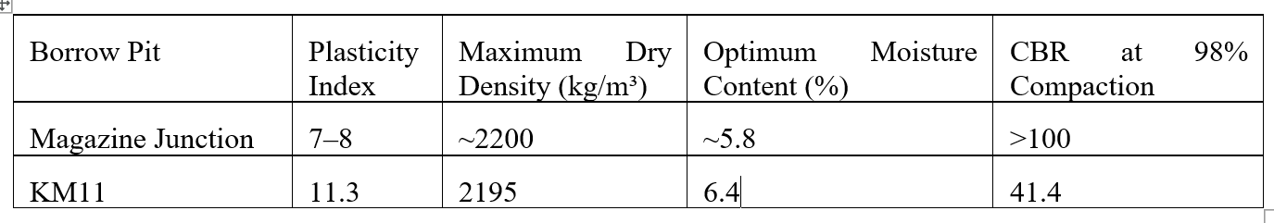
TESTING APPROACH
The study initially focused on Magazine Junction borrow pit to establish baseline behaviour.
Different cement–fly ash ratios were tested to observe strength development.
Once promising mixes were identified, they were evaluated across additional borrow pits to assess consistency.

Slide 13
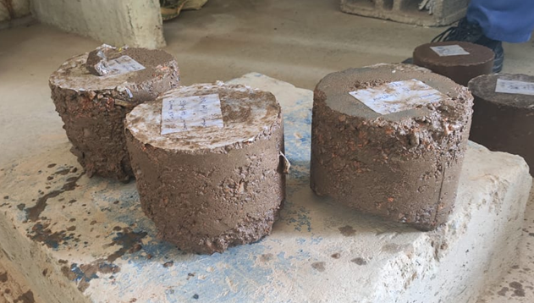
Fly Ash Only Test
A trial using 6% fly ash only was conducted to test whether it could stabilise soil independently.
The sample failed during curing and could not withstand the soaking stage required before UCS testing.
This confirmed that fly ash alone cannot stabilise soil and must be used in combination with cement.

Slide 14
MIX PROGRAMME
The following mix combinations were tested:
Control:
3% cement only
1% Cement Series:
1:2, 1:3, 1:4, 1:5
2% Cement Series:
2:1, 2:2, 2:3
This approach allowed gradual reduction of cement while monitoring performance.

Slide 15
TEST PROCEDURE
Maximum Dry Density (MDD) and Optimum Moisture Content (OMC) were determined for untreated soil
Samples were compacted into 152 mm moulds
Specimens were cured for 7 days
UCS testing was conducted using TMH1 Method A14
Sample weights were recorded for analysis

Slide 16
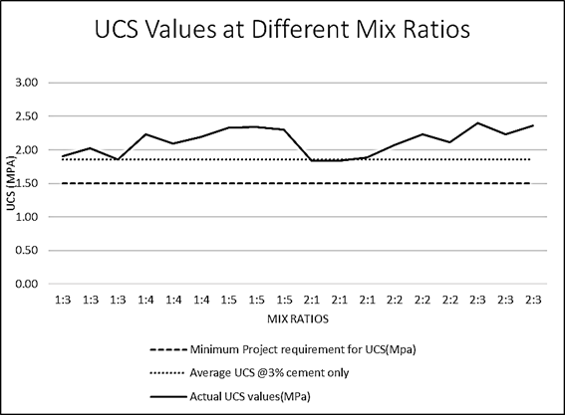
MAGAZINE JUNCTION RESULTS
All mixes exceeded the minimum requirement of 1.5 MPa.
Mix UCS (MPa)
1:2 1.86
1:3 1.93
1:4 2.17
1:5 2.32
2:1 1.86
2:2 2.14
2:3 2.33
Control 1.86

Slide 17
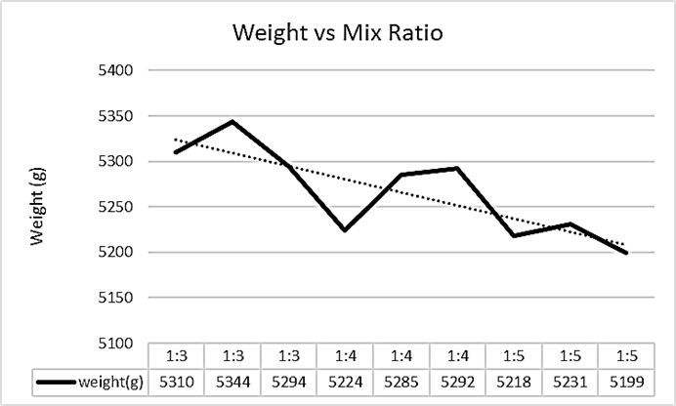
KEY TECHNICAL FINDINGS
The results showed that:
Fly ash did not reduce strength
Several mixes produced higher strength than cement-only control
Strength increased even as sample weight decreased. This indicates that the strength gain is due to chemical reactions, not density.

Slide 18
REPEATABILITY RESULTS
Repeat tests were conducted on selected mixes:]
the initial UCS values were 1.93 MPa and 1.85 MPa respectively, while the repeat tests gave 1.73 MPa and 1.91 MPa,
1:3 → remained stable and acceptable
2:1 → remained stable and close to control
This confirmed that 1:3 and 2:1 were the reliable mixes.

Slide 19
BORROW PIT BEHAVIOUR
The selected mixes were evaluated across different borrow pits:
KM11 borrowpit : Failed. All results were below the required 1.5mpa
This demonstrated that fly ash stabilisation is material-specific.

Slide 20
Economic Analysis
Fly ash was estimated to cost three times less than cement (Sinohydro bureau 5)
Mix Ratio (Cement: Fly Ash)
Cost Index Mix Ratio (Cement: Fly Ash) Cost Index
3:0 (Control) 9 2:1 7
1:3 6 2:2 8
1:4 7 2:3 9
1:5 8
mixes significantly reduced cost while maintaining strength close to the control and above.

Slide 21
Conclusion & Recommendations
The study concludes that:
Fly ash can partially replace cement in road stabilisation
1:3 and 2:1 provide the best balance of cost and performance
2:1 is preferred for site application due to easier handling
Application must be borrow pit specific
This approach offers a cost-effective and sustainable solution for road construction
More research and data is required for possible implementation outside the study area.

Slide 22
The End
THANK YOU FOR YOUR ATTENTION.

