Slide 1
2026 ENGINEERING INSTITUTION OF ZAMBIA SYMPOSIUM
EFFECT OF PARTIAL REPLACEMENT OF COARSE AGGREGATE WITH RECYCLED DEMOLITION AGGREGATE ON NOMINAL CONCRETE STRENGTH
PRESENTER : Eng. Prosper Ng’andu
DATE : Friday 17th April 2026
Avani Victoria Falls Resort, Livingstone, Zambia

Slide 2
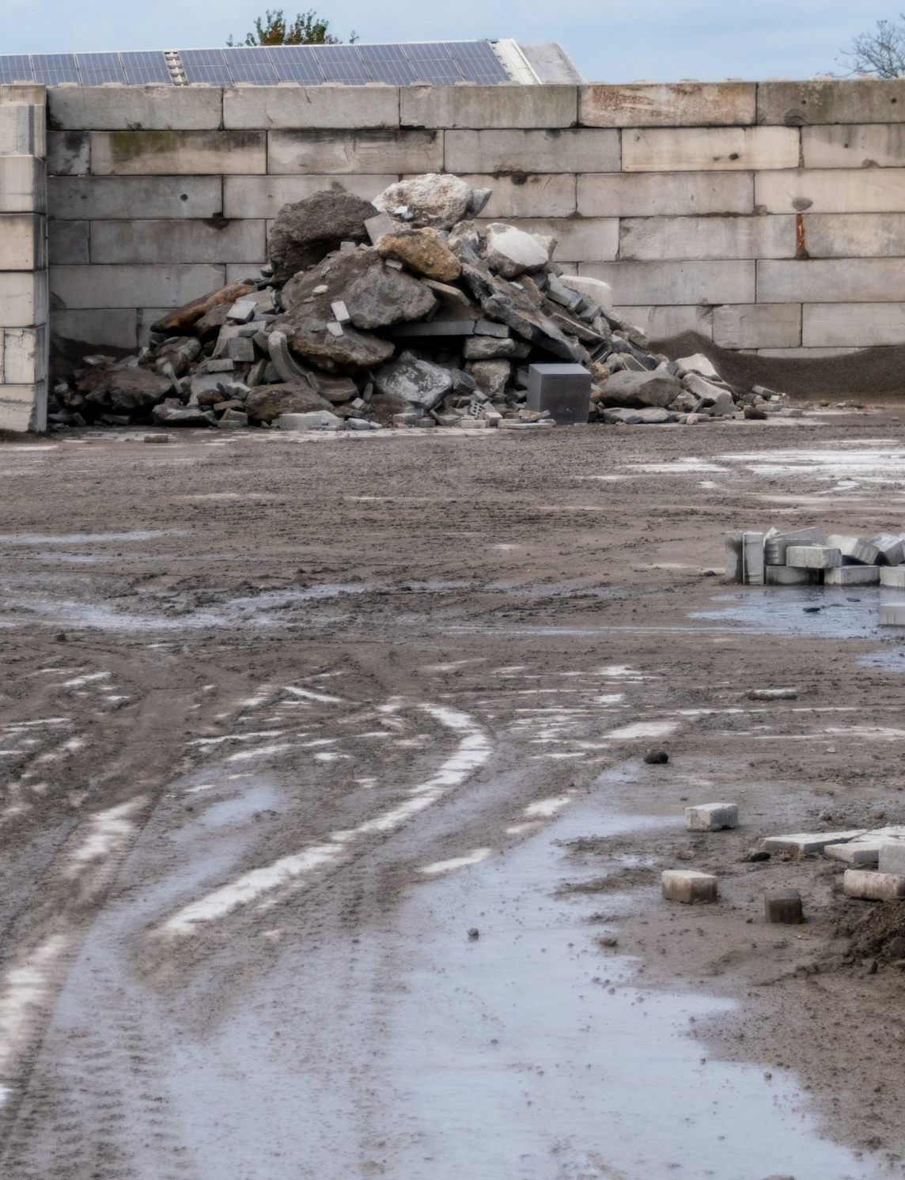

TABLE OF CONTENT
Introduction
Aim & Objectives
Methodology
Material preparation
Results and Discussion
Significance of Study
Conclusion

Slide 3
INTRODUCTION
1
Concrete production depends heavily on natural coarse aggregates. Excessive extraction of aggregates causes environmental degradation. Recycled Demolition Aggregate (RDA) offers a sustainable alternative. RDA helps reduce construction waste and conserve natural resources. In Zambia, research on RDA use in concrete is still limited.
This study examines partial replacement of coarse aggregate with RDA in M25 concrete.
Replacement levels tested: 0%, 10%, 20%, and 30%.
Key properties assessed: WORKABILITY and COMPRESSIVE STRENGTH.

Slide 4
AIM & OBJECTIVES
2
AIM
To investigate the effect of partially replacing natural coarse aggregate with recycled demolition aggregate on concrete strength.
• Evaluate the effect of RDA on workability
• Determine the effect of RDA on compressive strength
• Identify the optimum replacement level
OBJECTIVES

Slide 5
METHODOLOGY
3
START
Mix Design
Material used
Fresh state concrete properties
Cube Design
Material used
Material used
End

Slide 6
EXPERIMENTAL DESIGN
AIM & OBJECTIVES
4
1
2
3
4
5
Cement, sand, natural coarse aggregate and RDA sourced and prepared
0%, 10%, 20% and 30% RDA replacement levels at nominal M25 proportion
Slump test used to compare workability across mixes
Compression tests performed at 7, 14 and 28 days
Strength retention and practical suitability interpreted

Slide 7
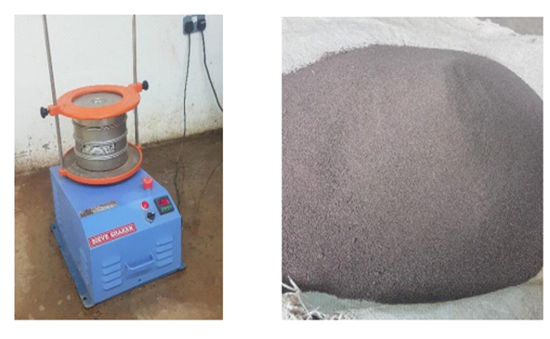
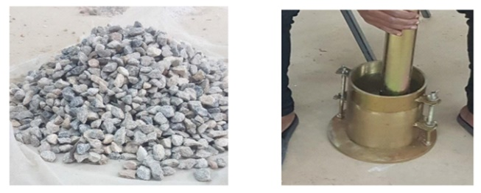
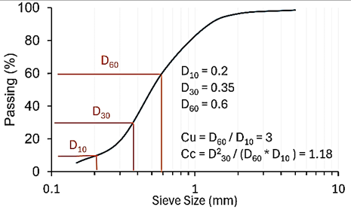
MATERIAL PREPARATION
AIM & OBJECTIVES
5
Sieving of fine aggregate
Fig 3.2 NCA according to ASTM C33 with a maximum size of 19 mm
Sample | Weight of Sample Before Crushing (g) | Weight of Sample After Crushing | Average Crushing Value (%)
Natural Coarse Aggregate | 3000 | 450 | 15%
Recycled demolition aggregate | 3000 | 1050 | 35%

Slide 8
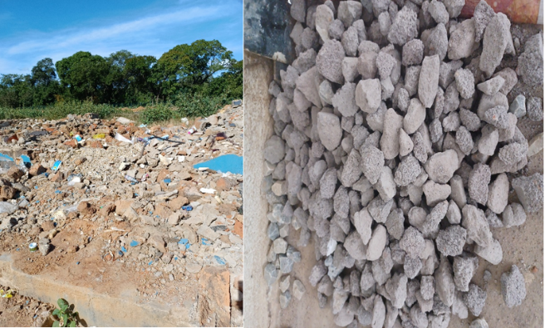
EXPERIMENTAL DESIGN
AIM & OBJECTIVES
6
Recycled demolition aggregate was obtained from demolished concrete structures at Mulungushi University. The debris was crushed, washed, and sieved to 19 mm. RDA was considered as a sustainable alternative to natural aggregates.

Slide 9
RESULTS
AIM & OBJECTIVES
7
Sieve No. | Sieve Opening (mm) | Mass Of Soil Retained (g) | % Retained | Cumulative % Retained | % Passing
1 | 25.0 | 0 | 0.0 | 0.0 | 100
2 | 19.0 | 350 | 7.0 | 7.0 | 93.0
3 | 12.5 | 1250 | 25.0 | 32.0 | 68.0
4 | 9.5 | 1800 | 36.0 | 68.0 | 32.0
5 | 4.75 | 1200 | 24.0 | 92.0 | 8.0
6 | 2.36 | 250 | 5.0 | 97.0 | 3.0
7 | PAN | 150 | 3.0 | 99.0 | 1.0
TOTAL |  | 5000 | 100% | 298
The recycled demolition aggregate Crushing Value was 35%, significantly higher than natural aggregate. The lower crushing resistance suggests that recycled aggregates are more brittle due to adhered mortar or pre-existing microcracks from demolition.

Slide 10
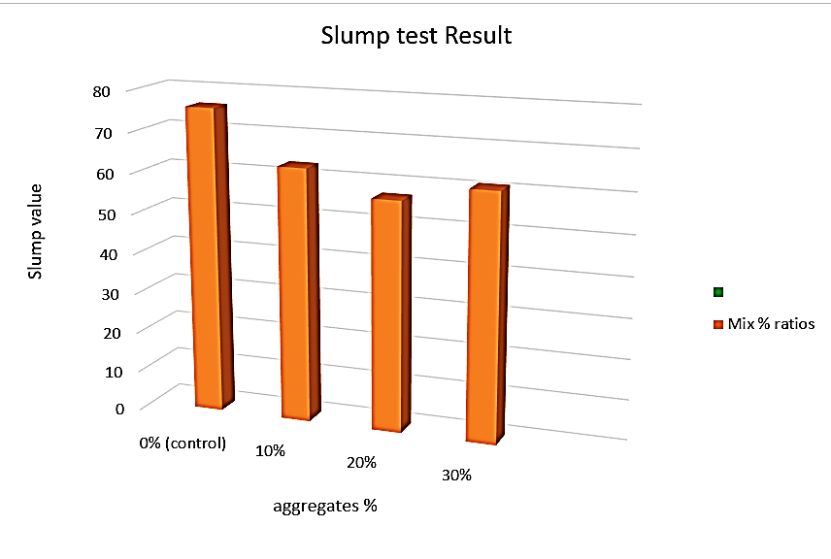
RESULTS
7
The reduced workability is attributed to the angular shape and higher porosity of recycled aggregates, which increase water absorption and friction. The slight rebound at 30% may reflect inconsistent moisture content or particle distribution.

Slide 11
RESULTS
8
the lower early strength is linked to the weaker recycled aggregates (higher Aggregate Crushing Value) and potential delays in hydration due to water absorption by adhered mortar.

Slide 12
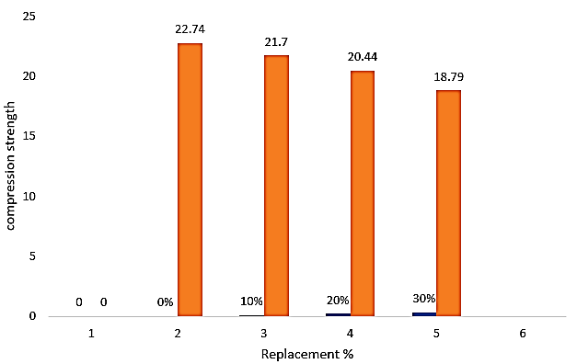
RESULTS
9
The strength gap narrows slightly compared to 7 days, suggesting partial recovery from slower hydration. However, the 30% mix lags significantly, highlighting its limitations for structural applications.

Slide 13
RESULTS
10
The 28-day compressive strength of concrete with greater or equal to 20% Recycled Demolition Aggregate replacement (24.82–25.15 MPa) closely matched the control mix (25.85 MPa), demonstrating feasibility for structural use. However

Slide 14
CONCLUSIONS
11
partial use of RDA presents a viable and sustainable option for reducing construction waste and natural resource consumption.
Concrete strength decreased as RDA content increased. Up to 20% replacement produced strength close to conventional concrete. 30% replacement caused significant strength loss. RDA can support sustainable concrete production in Zambia.
Recommended Threshold: 20% RDA

Slide 15


The End
THANK YOU FOR YOUR ATTENTION.

