Slide 1

2026 ENGINEERING INSTITUTION OF ZAMBIA SYMPOSIUM
ROSMA APP
Road Safety Mobile Application
PRESENTER: Ernest Musonda
DATE:Friday 4th April 2026
Avani Victoria Falls Resort, Livingstone, Zambia

Slide 2

ErnKate Limited
ROSMA APP – Road Safety Mobile Application

Slide 3
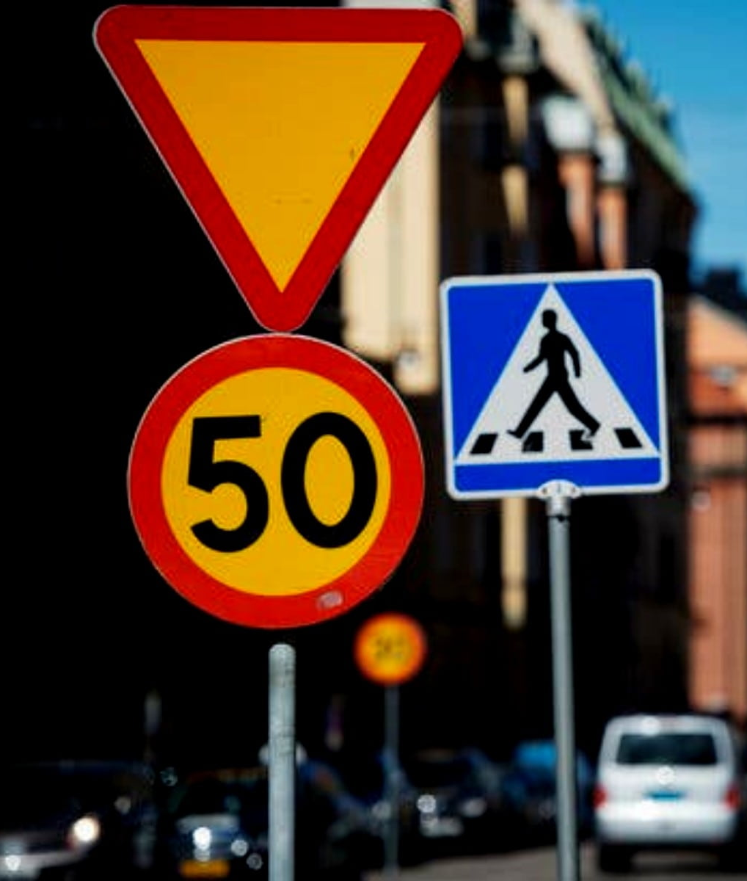
ROSMA app
The major causes of road traffic accidents are human error, vandalized road signage, over speeding, overtaking in blind spots, crashing into breakdown vehicles and fatigue.

Slide 4
Monthly Subscription ZMW25

Slide 5
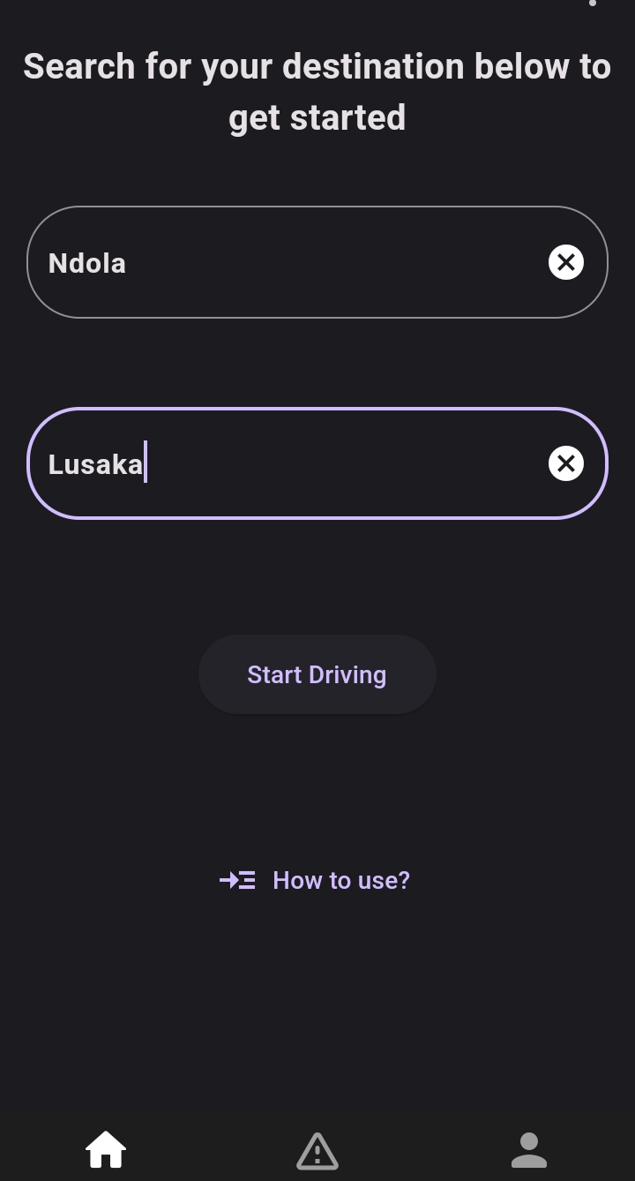
User App
Start and destination towns

Slide 6
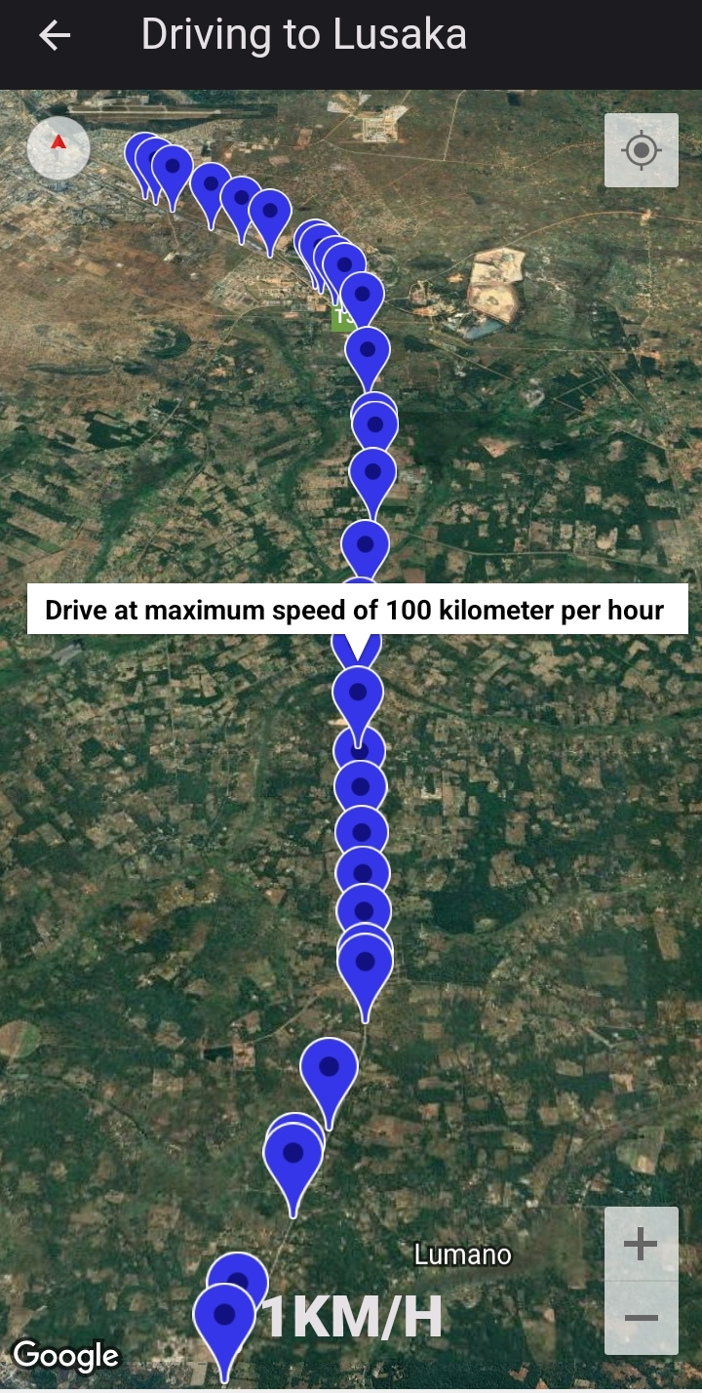
User App
The App gives audible voice alerts of the posted traffic signs
The App shows the digitally marked points on the map
The App shows the speed at which the driver is moving at
Audible alerts of road signs are given within 40m radius away from the road sign
*NB: The driver does not need to look at the phone screen to use the App
Driver's speed

Slide 7
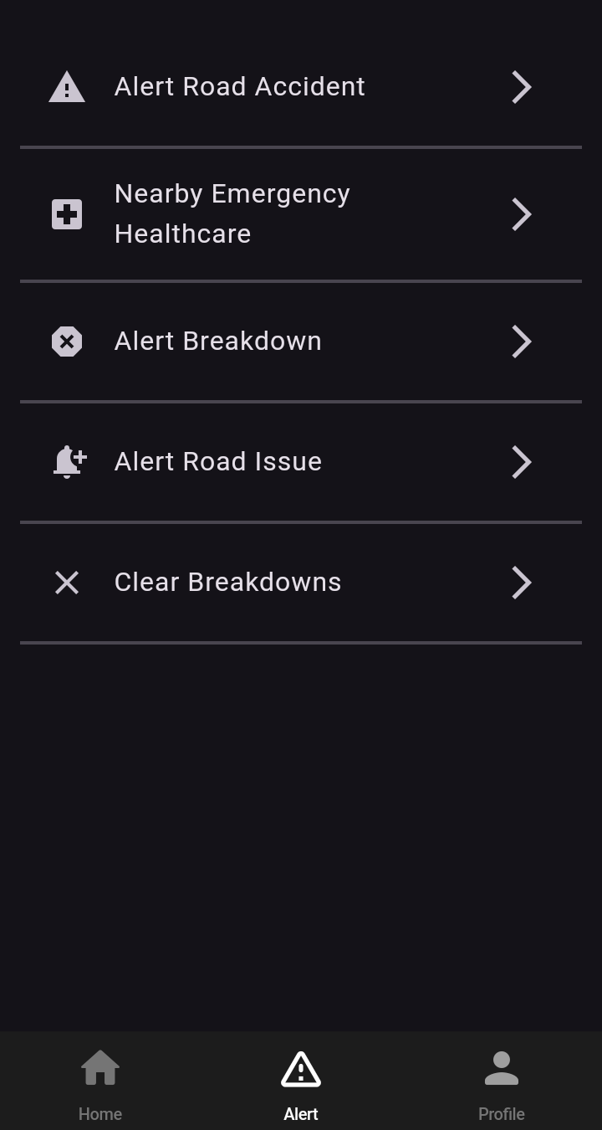
User App
User Broadcast Alert system
Each of these features are further expanded in the next slides

Slide 8
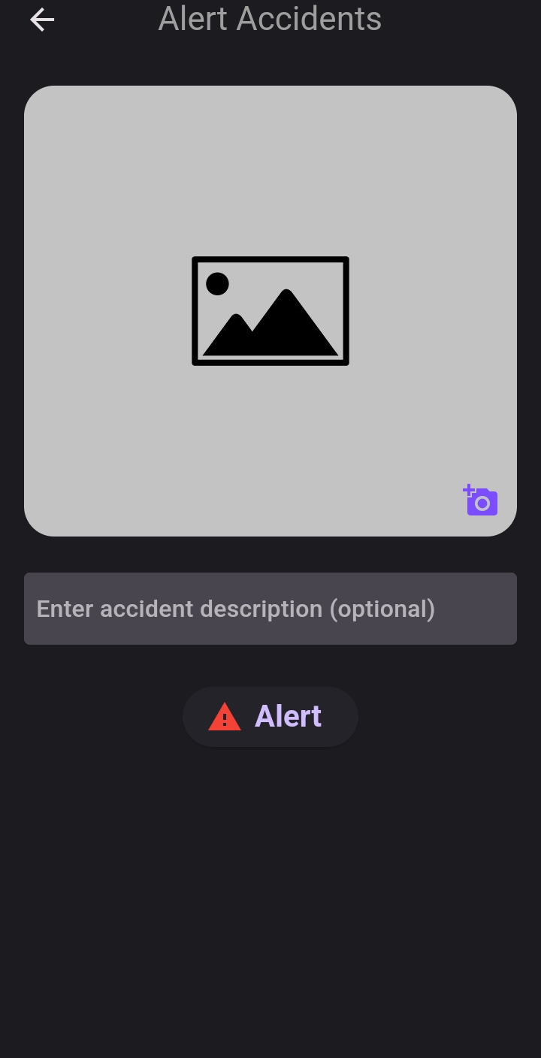
Broadcasting Road Accidents
Users can capture live accident pictures within the app and upload with a description
The uploaded picture will be accompanied with a date, location and the user’s phone number
The accident alert will be broadcasted 500m away from the accident scene

Slide 9
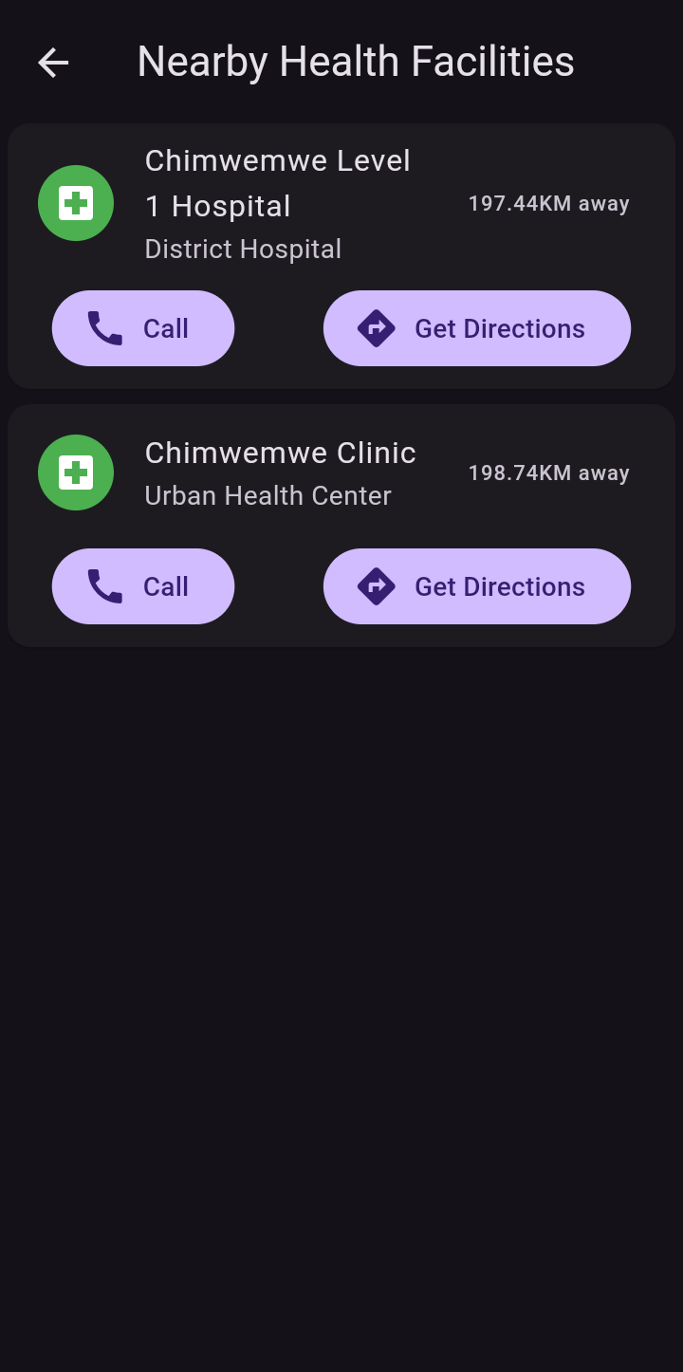
Health Facility Feature
Users can find nearest hospital/clinic when need be
Get directions to the desired health facility
Call the hospital/clinic
See health facilities on the map

Slide 10
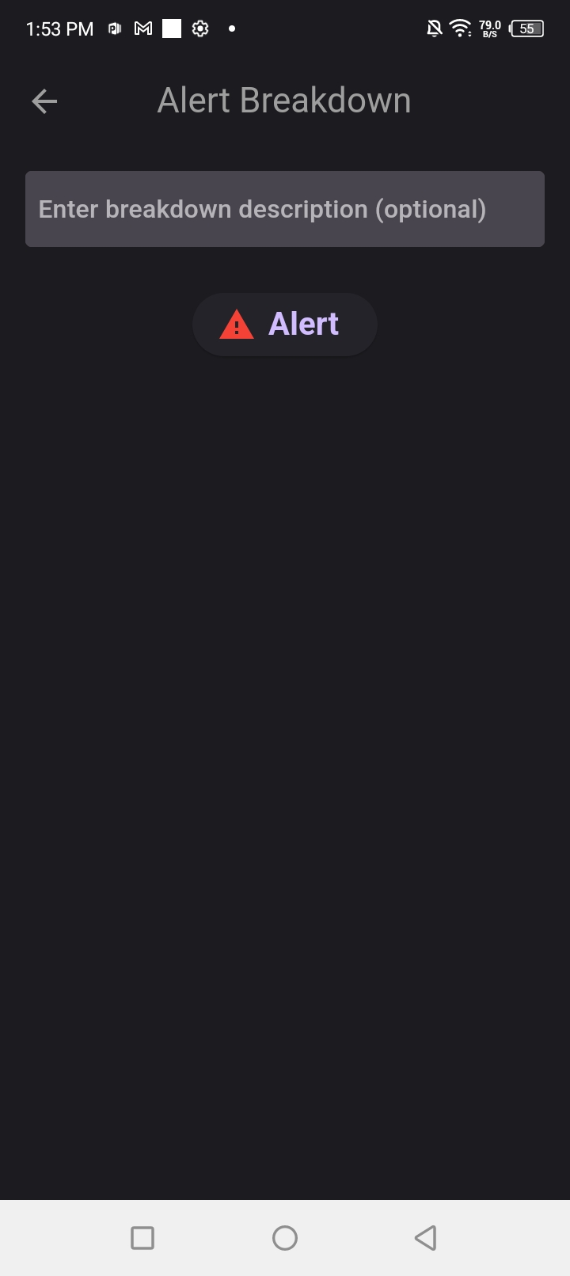
Broadcasting Breakdowns
Driver can turn on the Breakdown alerting for other road users who have the App to be informed.
Breakdown alerts cover a radius of 500m away from the breakdown scene
The Driver can turn off the breakdown alert once his/her vehicle has been fixed or moved off the road.

Slide 11
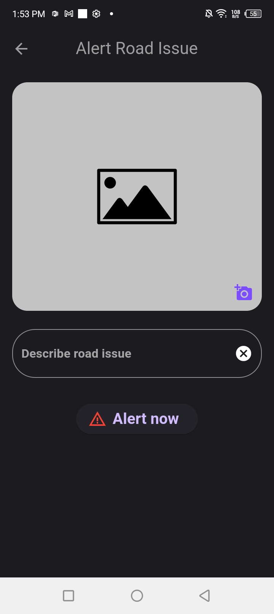
Broadcasting Road Issues
Users can capture pictures of road issues such as washed away bridges, large potholes and others in the app and upload with a description
The relevant authorities such as the Road maintenance team will attend to road issues
The road issue alerts will be broadcasted 500m away from the affected area

Slide 12
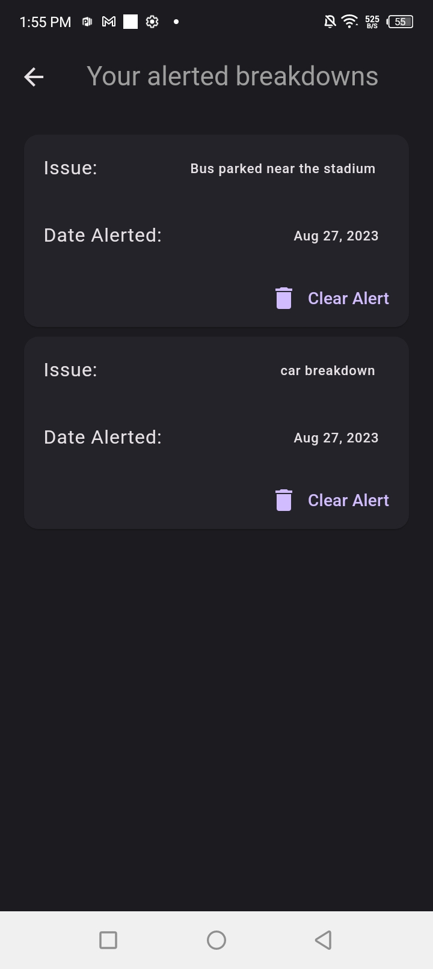
Clearing Breakdowns
The Driver can clear the breakdown alert once his/her vehicle has been fixed or moved off the road.

Slide 13
Ten Basic Driving Rules
10 Basic driving rules reminders every 30 minutes.
An audible reminder every 2 hours of continuous driving, prompting a 15-minute break

Slide 14
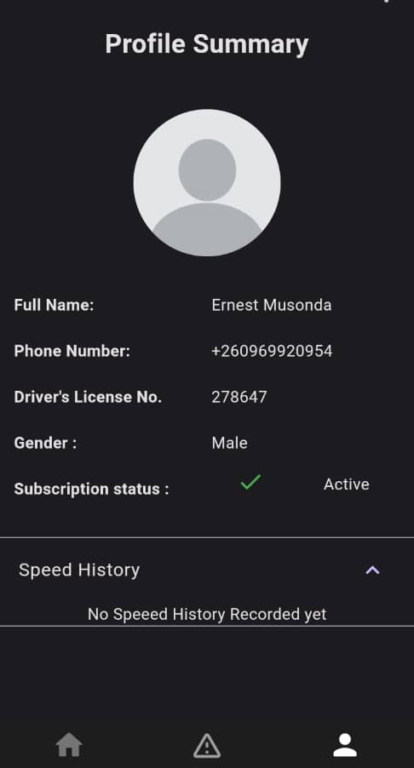
Over speeding Alerts & Speed history
The App alerts the user if the speed has been exceeded with an audible voice
The App has 5km/h tolerance above the specified speed limit.
The App keeps a record of the speed, updating it every 10 seconds

Slide 15
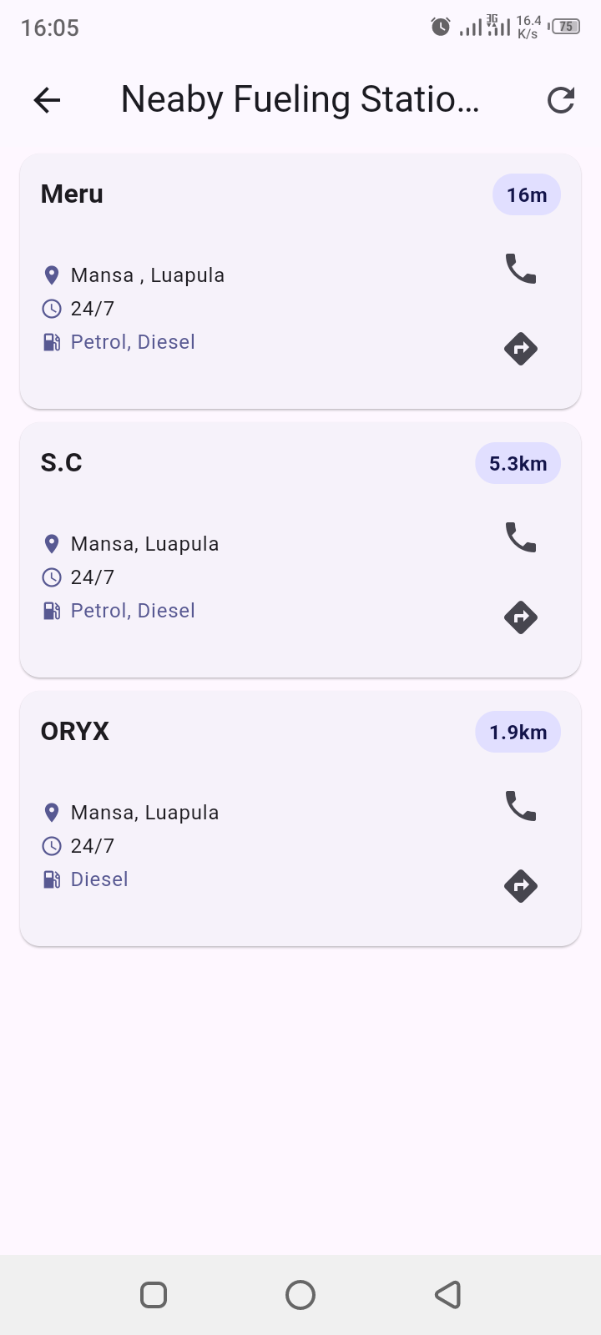
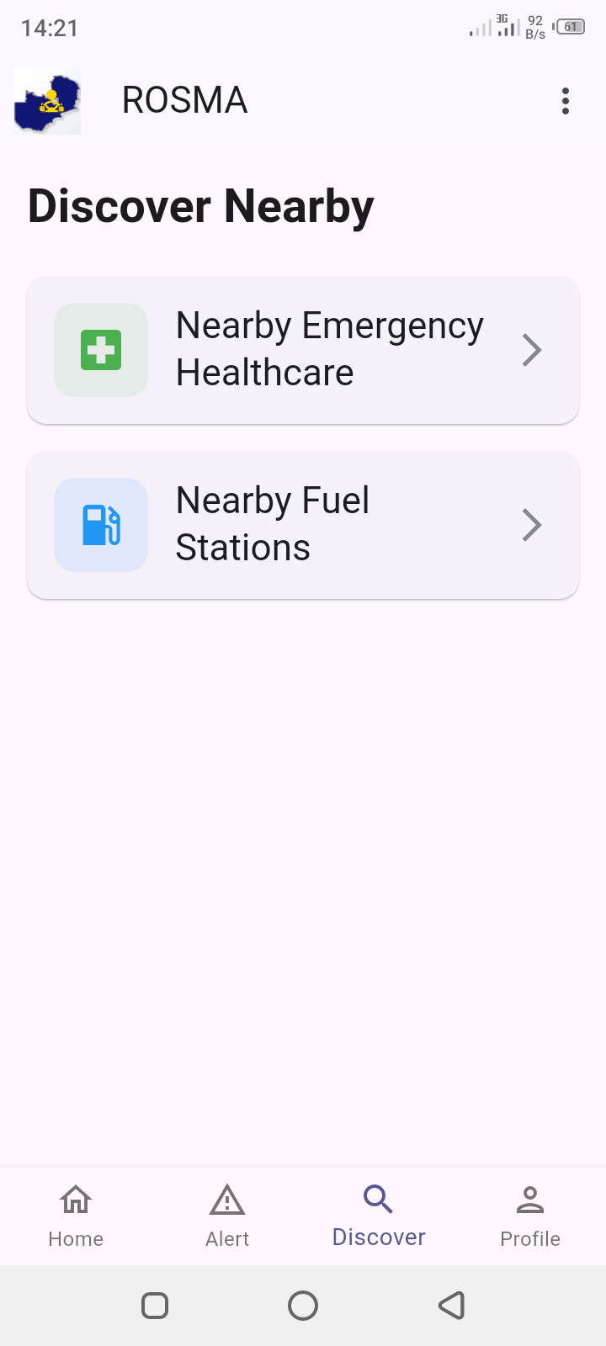
Fuel Filling Station
The Driver can search for nearby fuel filling stations.

Slide 16
ROSMA Pro
Under development 90% done. These are additional features from ROSMA;
This one sends evidence of over-speeding for enforcement to the admins(Speed limit, over speed done, Time, Location & contact details)

Slide 17
Challenges
The major challenge is initial data collection costs, which requires physical movement for the mapping exercise.
Additionally, backup funds are needed to cover unexpected bills that may arise from the increase in new registered downloads following extensive marketing efforts.

Slide 18
Thank you
ROSMA is a pioneering road safety platform that has already been validated through successful pilot tests along key routes, demonstrating its effectiveness in reducing human error and improving emergency response times. With over 5,000 registered users and partnerships with national authorities, ROSMA is positioned to transform road safety across Zambia and beyond—saving lives and fostering a culture of safety on our roads.

