Slide 1

2026 ENGINEERING INSTITUTION OF ZAMBIA SYMPOSIUM
COMBINING UAV PHOTOGRAMMETRY AND SLAM LIDAR
FOR MULTI‑SCALE 3D URBAN MODELLING IN ZAMBIA
Case study: University of Zambia (UNZA), Great East Road Campus — Lusaka
PRESENTER : Eng. Musoka Nyongolo
CO-PRESENTER: Eng. Dr. Penjani Hopkins Nyimbili
DATE : Thursday, 16th April 2026
Avani Victoria Falls Resort, Livingstone, Zambia

Slide 2
PRESENTATION OUTLINE
1. Introduction
Background on Lusaka urbanisation and spatial data gaps
2. Methodology
Study site, instruments, data acquisition and processing workflow
3. Results & Analysis
UAV photogrammetry 3D model outputs and accuracy
SLAM LiDAR point cloud outputs and alignment RMSE
4. Discussion
Complementary roles of UAV and SLAM for multi-scale modelling, limitations
5. Conclusion & Recommendations
2

Slide 3
INTRODUCTION
Technology Opportunity
UAV photogrammetry: rapid aerial imagery → detailed 3D models via Structure-from-Motion (SfM)
SLAM LiDAR: ground-level, high-precision scanning in GPS-denied environments
Combined → macro + micro scale context for infrastructure planning
Context
Lusaka's population surpassed 3.3 million (2022) — rapid urban expansion underserved by outdated 2D spatial data
Traditional mapping fails to capture the vertical complexity needed for utility networks, drainage and building compliance
Research Aim
Demonstrate complementary use of UAV + SLAM LiDAR to generate multi-scale 3D urban models for infrastructure planning
Case study: University of Zambia, Great East Road Campus, Lusaka
3

Slide 4
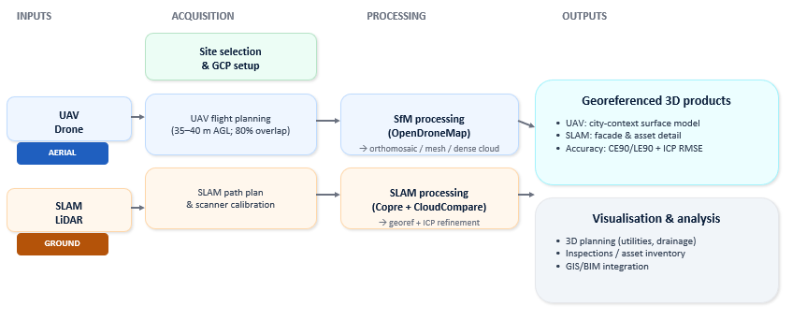
METHODOLOGY
Fig. 1: Summarized data workflow chart
4

Slide 5
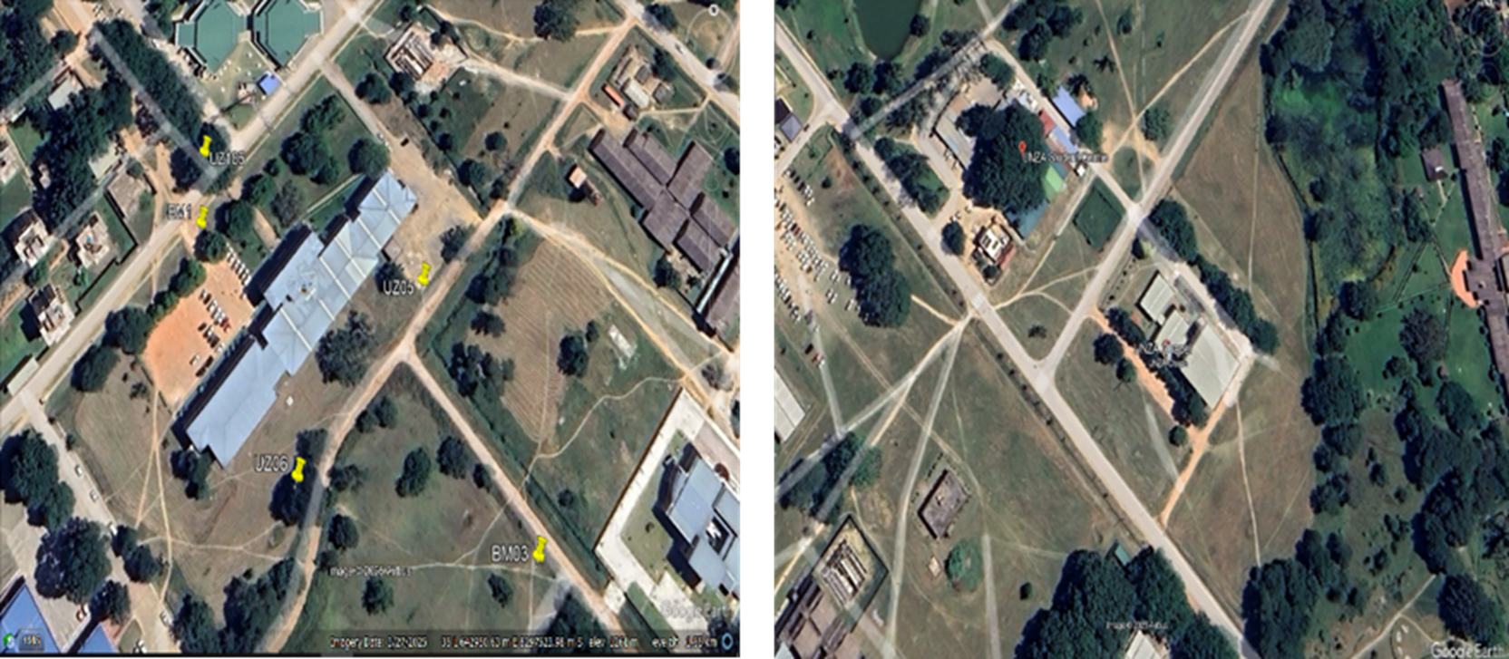
METHODOLOGY | Study Site
UNZA Site was selected for its architectural diversity and representative urban complexity, as shown in Figure 2.
Fig. 2: Satellite images of the Study Sites for the (a) SLAM LIDAR and (b) UAV. (Source: Google Earth)
4

Slide 6
METHODOLOGY (Cont’d)
UAV Photogrammetry System
DJI Matrice 400 (M400) with DJI Zenmuse P1 | RTK-enabled | 24 mm focal length | 1-inch CMOS
Flight: 35–40 m AGL | GSD ~1.2–1.5 cm/px | Double-grid, 80% forward & side overlap
Processing: OpenDroneMap v3.5.5 | SfM pipeline → 391 images, 55 M+ point cloud
SLAM LiDAR System
RS10 SLAM Scanner | Dual-laser LiDAR + panoramic camera | 6D SLAM (x, y, z, roll, pitch, yaw)
Processed in Copre software; georeferenced in CloudCompare via point-pair alignment + ICP refinement
Accuracy Assessment
UAV: CE90 / LE90 per ASPRS 2015 | SLAM: ICP alignment RMSE
8

Slide 7
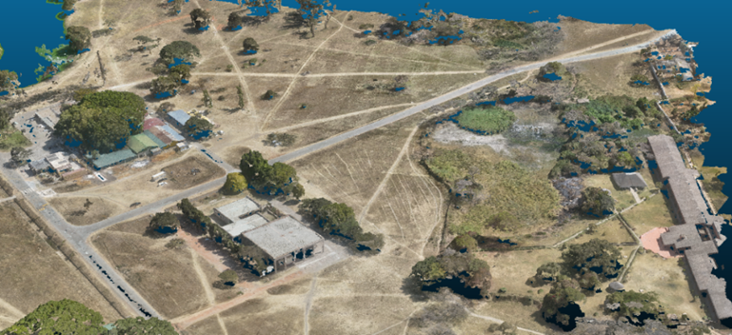
RESULTS - UAV PHOTOGRAMMETRY
Key takeaways
High‑detail surface context (roofs, terrain, access routes)
Scales efficiently across blocks/ campuses
Strong for GIS integration & city‑wide planning
55M+ pts
Dense cloud size
Fig. 3: UAV georeferenced 3D model
6

Slide 8
RESULTS: SLAM LiDAR | What it Captures
Point Cloud Outputs
Dense, geometrically precise point cloud capturing ground-up view: window frames, walkway textures, facades
Resolved complex vertical geometries occluded in aerial imagery
Works well in GPS-denied / Urban canyon conditions
Alignment Accuracy
0.229 m ICP alignment RMSE after georeferencing
Complementary Roles (UAV vs SLAM)
UAV macro-scale spatial context ("the WHERE"): zoning, land-use, master plans, GIS integration
SLAM micro-scale precision ("the WHAT"): facades, BIM, engineering inspections, asset documentation
Combined: full architectural visualisation + multi-scale urban analysis
8

Slide 9
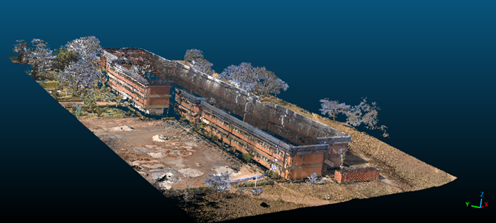
RESULTS: SLAM LiDAR | Point cloud example
Use Cases
Facade condition mapping
BIM/asset documentation
Engineering inspections (accessibility, defects)
0.229 m
Alignment RMSE
Fig. 4: SLAM-based point cloud
6

Slide 10
DISCUSSION | Why combine UAV + SLAM?
Planning & drainage
Smart city & inspection
Complementary technologies
Not competing — different spatial scales
Aerial + terrestrial fill occlusions
Better coverage of vertical complexity
Roof geometry & ground terrain supports drainage corridors
Improves near‑building flow interpretation
Supports site‑specific design
Facades support inspections & audits
Efficient processing suits resource-constrained settings e.g. municipalities
Integrates into GIS/BIM workflows
7

Slide 11
DISCUSSION | Integrated roles in 3D urban modelling
Table 1: Integrated Roles of UAV Photogrammetry and SLAM LiDAR in 3D Urban Modelling.
UAV vs SLAM vs Combined (practical lens)
Aspect
UAV photogrammetry
SLAM LiDAR
Combined
Best for
Macro context
Micro detail
Decision‑ready view
Captures
Roofs / terrain
Facades / assets
Full building envelope
Strength
Fast coverage
High detail
Occlusion reduction
Typical outputs
Mesh / DSM
Dense point cloud
Multi‑scale 3D model
Use examples
Zoning / GIS
BIM / inspections
Drainage, utilities, smart-city & digital twin
7

Slide 12
DISCUSSION | Limitations
SLAM dataset required manual georeferencing due to GNSS limitations during scanning
Datasets were not merged — complementary value is demonstrated, not fully integrated
7

Slide 13
CONCLUSION & RECOMMENDATIONS
Key Findings
UAV photogrammetry + SLAM LiDAR successfully addresses Lusaka City's critical spatial data gaps
Achieved high-accuracy 3D models: UAV RMS 0.125 m; SLAM ICP RMSE 0.229 m
Multi-scale approach bridges strategic city planning and detailed engineering design
Recommendations
Zambian planning authorities: adopt UAV photogrammetry as primary tool for routine city-wide mapping
Deploy SLAM LiDAR strategically for complex engineering projects requiring ground-level precision
Integrate outputs into GIS/BIM platforms to support Smart-City planning of Lusaka - aligned with SDG 9
8

Slide 14

REFERENCES
Al-Saeed, Y., Al-Naser, M. and Al-Adwan, A. (2023). "A Review on the Integration of GIS and BIM for Smart City." IOP Conference Series: Earth and Environmental Science, 1159(1).
Ali, F. (2020) "Unmanned Aerial Vehicles (UAVs) in urban land regularisation process. Opportunities and challenges." African Journal on Land Policy and Geospatial Sciences, 3(1), pp. 1–10.
Droeschel, D. and Behnke, S. (2018) "Efficient Continuous-time SLAM for 3D Lidar-based Online Mapping." Proceedings of the International Conference on Robotics and Automation (ICRA), pp. 1-8.
Hu, D. and Minner, J. (2023) "UAVs and 3D City Modelling to Aid Urban Planning and Historic Preservation: A Systematic Review." Remote Sensing, 15(23), p. 5507.
Nüchter, A., Lingemann, K. and Hertzberg, J. (2007) "6D SLAM - 3D Mapping Outdoor Environments." Journal of Field Robotics, 24(8–9), pp. 699–722.
Nyimbili, P. H., Demirel, H., Şeker, D. Z. and Erden, T. (2016) "Structure From Motion (SfM) – Approaches & Applications." International Scientific Conference on Applied Sciences, Antalya, Turkey.

Slide 15
The End
THANK YOU FOR YOUR ATTENTION.
Questions

