Slide 1

2025 ENGINEERING INSTITUTION OF ZAMBIA SYMPOSIUM
Integrating Circular Economy, Digital Platforms, and Engineering Design; A National Mechanization-as-a-Service (MaaS) Model for
PRESENTER : Joseph Mwape Chileshe
DATE : Friday 15th April 2026
Avani Victoria Falls Resort, Livingstone, Zambia
Notes:
Zambia This presentation is designed for a technical audience, focusing on the systemic restructuring of agricultural mechanization in Zambia from an asset-based model to a performance-engineered service.

Slide 2
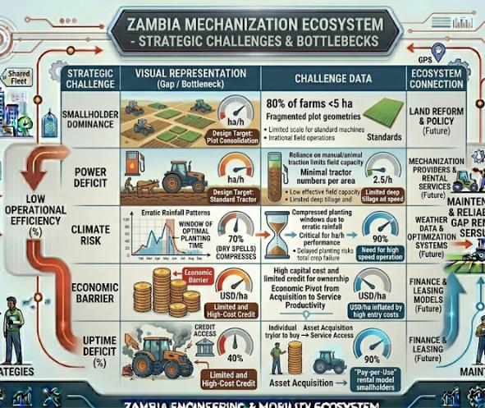

Problem Context (System Overview)
Smallholder Dominance: 80% of farms <5 ha; fragmented plot geometries.
Power Deficit: Reliance on manual/animal traction limits field capacity.
Climate Risk: Compressed planting windows due to erratic rainfall.
Economic Barrier: High capital cost and limited credit for ownership.
Notes:
Speaker Notes: We are seeing a critical mismatch between available farm power and the narrowing windows for land preparation caused by climate variability.

Slide 3
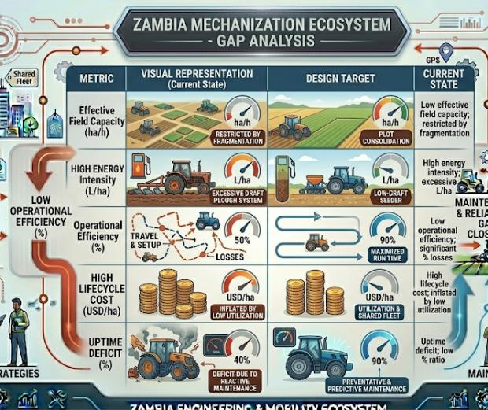
Engineering Problem Definition (Quantified Gaps)
Low Effective Field Capacity: Measured in ha/h; restricted by fragmentation.
High Energy Intensity: Excessive L/ha in high-draft plough systems.
Low Operational Efficiency: Significant % losses in travel and setup.
High Lifecycle Cost: USD/ha inflated by low utilization.
Uptime Deficit: Low % ratio due to reactive maintenance.
Notes:
To solve this, we must treat mechanization as a systems engineering challenge where every variable—from fuel to uptime—is measurable and improvable.

Slide 4
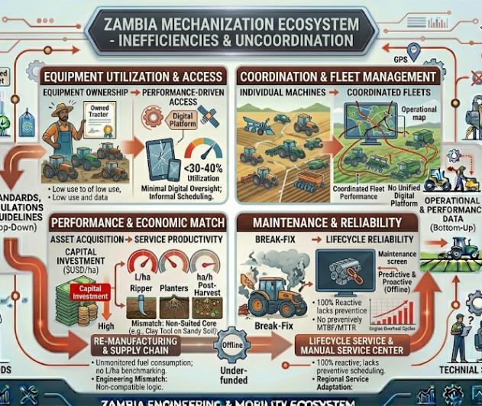
Mechanization System Failure (Current Baseline)
Utilization: <30–40% annual machine capacity.
Performance: Unmonitored fuel consumption; no L/ha benchmarking.
Maintenance: 100% reactive; lacks preventive scheduling.
Engineering Mismatch: Imported equipment ill-suited for local soil/geometries.
Coordination: Minimal digital oversight; informal scheduling.

Slide 5
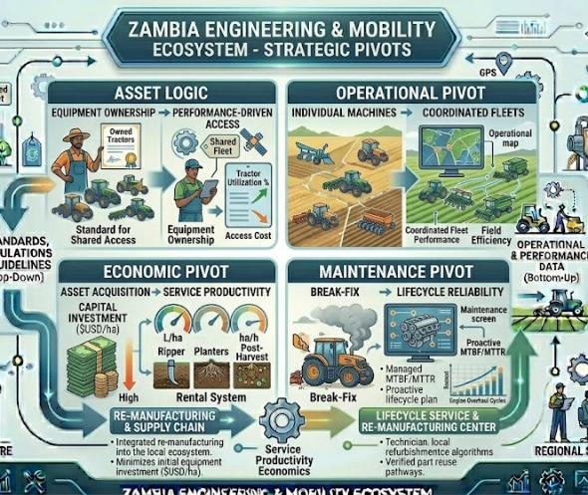
Conceptual Shift: From Ownership to Service System
Asset Logic: From "Equipment Ownership" to "Performance-Driven Access".
Operational Pivot: From "Individual Machines" to "Coordinated Fleets".
Economic Pivot: From "Asset Acquisition" to "Service Productivity".
Maintenance Pivot: From "Break-Fix" to "Lifecycle Reliability".
Notes:
Speaker Notes: We are moving away from the subsidy-driven model of giving tractors to individuals, which leads to idle iron and high costs.

Slide 6
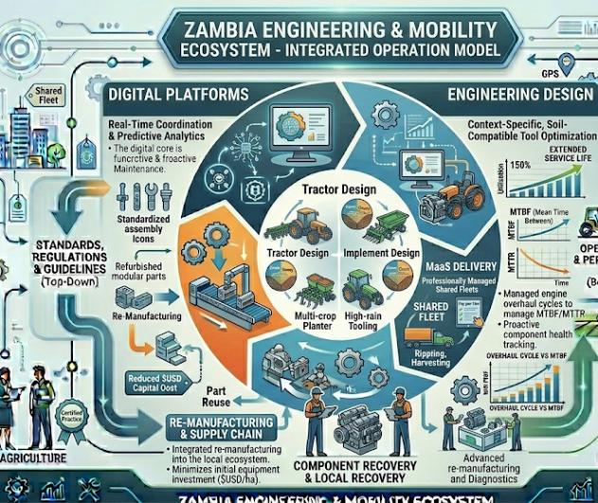
Framework Overview (The CE–Digital–Engineering–MaaS Model)
Circular Economy: Lifecycle recovery and modular remanufacturing.
Digital Platforms: Real-time coordination and predictive analytics.
Engineering Design: Context-specific, soil-compatible tool optimization.
MaaS Delivery: Professionally managed fleets on a pay-per-use basis.
Notes:
These four pillars act as interdependent subsystems. If one fails, the efficiency of the entire national system drops.

Slide 7
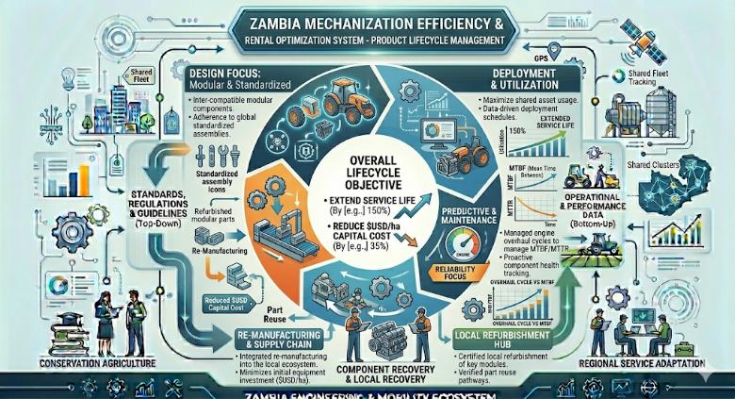
Pillar 1: Circular Economy Engineering
Objective: Extend service life and reduce $USD/ha$ capital cost.
Design Focus: Modular components and standardized assemblies.
Recovery: Local refurbishment and part reuse pathways.
Reliability: Engine overhaul cycles to manage MTBF/MTTR.

Slide 8
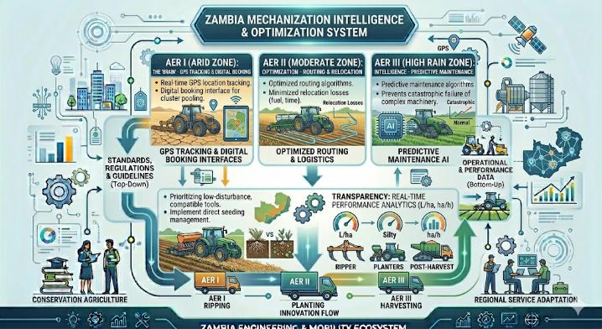
Pillar 2: Digital Coordination System
The "Brain": GPS tracking and digital booking interfaces.
Optimization: Minimized relocation losses and optimized routing.
Intelligence: Predictive maintenance algorithms to prevent catastrophic failure.
Transparency: Real-time performance analytics (L/ha, ha/h).

Slide 9
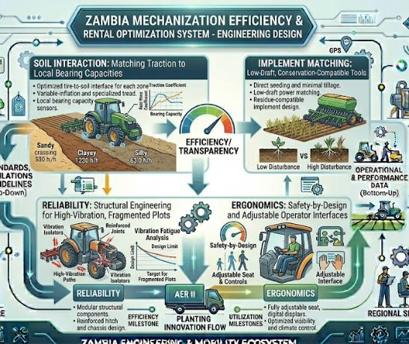
Pillar 3: Engineering Design Optimization
Soil Interaction: Matching traction to local soil bearing capacities.
Implement Matching: Focus on low-draft, conservation-compatible tools.
Reliability: Structural engineering for fragmented, high-vibration environments.
Ergonomics: Safety-by-design and adjustable operator interfaces.

Slide 10
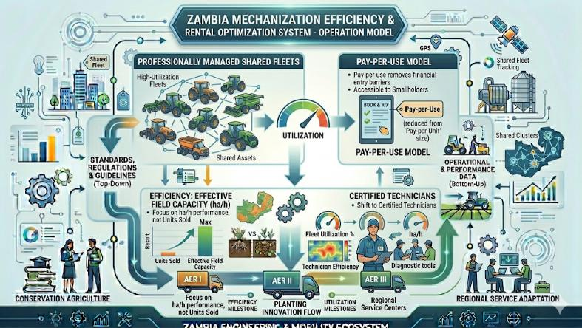
Pillar 4: MaaS Service Model
Delivery: Professionally managed, high-utilization shared fleets.
Pricing: Pay-per-use model reduces financial entry barriers.
Efficiency: Focus on "Effective Field Capacity" over "Units Sold".
Labor: Shift from farm-owner operators to certified technicians.

Slide 11
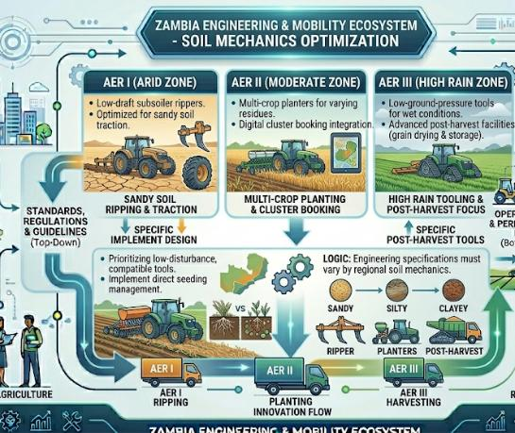
Agro-Ecological Engineering Strategy
AER I (Arid): Low-draft rippers; optimized for sandy soil traction.
AER II (Moderate): Multi-crop planters; digital cluster booking.
AER III (High Rain): Low-ground-pressure tools; post-harvest focus.
Logic: Engineering specifications must vary by regional soil mechanics.

Slide 12
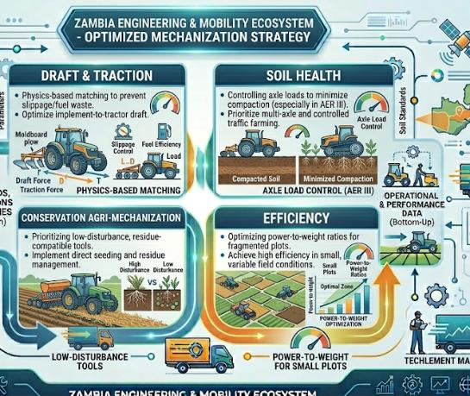
Soil–Machine Interaction & Power Matching
Draft & Traction: Physics-based matching to prevent slippage/fuel waste.
Soil Health: Controlling axle loads to minimize compaction (especially in AER III).
Conservation: Prioritizing low-disturbance, residue-compatible tools.
Efficiency: Optimizing power-to-weight ratios for fragmented plots.

Slide 13
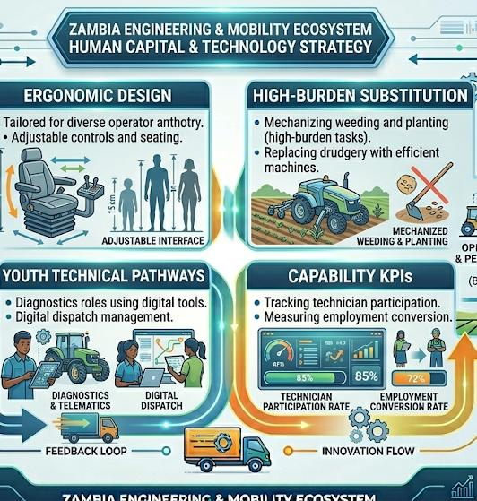
Inclusion as an Engineering Variable
Design Requirement: Ergonomics tailored for diverse operator anthropometry.
Drudgery Substitution: Mechanizing weeding/planting (high-burden tasks).
Youth Roles: Technical pathways in diagnostics and digital dispatch.
KPIs: Tracking technician participation and employment conversion rates.

Slide 14
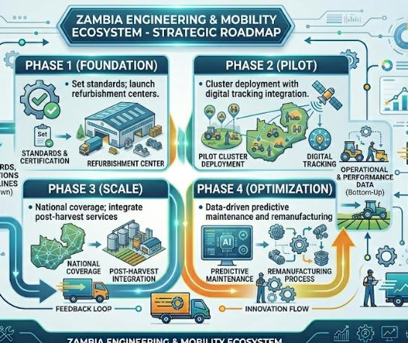
Implementation Roadmap (4 Phases)
Phase 1 (Foundation): Set standards; launch refurbishment centers.
Phase 2 (Pilot): Cluster deployment with digital tracking integration.
Phase 3 (Scale): National coverage; integrate post-harvest services.
Phase 4 (Optimization): Data-driven predictive maintenance and remanufacturing.

Slide 15
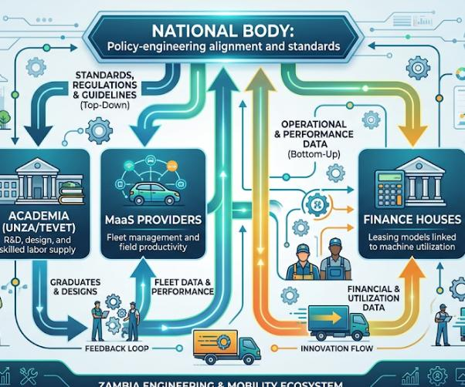
Governance & Institutional Architecture
National Body: Policy-engineering alignment and standards.
Academia (UNZA/TEVET): R&D, design, and skilled labor supply.
MaaS Providers: Fleet management and field productivity.
Finance Houses: Leasing models linked to machine utilization.

Slide 16
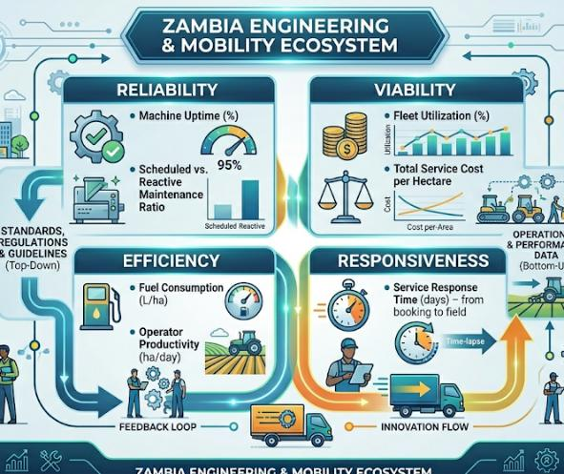
Engineering KPIs & Performance Metrics
Reliability
• Machine Uptime (%)
• Scheduled vs. Reactive Maintenance Ratio
Efficiency
• Fuel Consumption (L/ha)
• Operator Productivity (ha/day)
Viability
• Fleet Utilization (%)
• Total Service Cost per Hectare
Responsiveness
• Service Response Time (days) – from booking to field

Slide 17
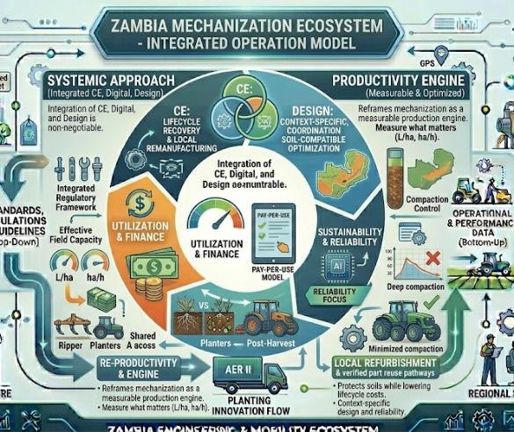
Conclusion (Engineering Synthesis)
Systemic Approach: Integration of CE, Digital, and Design is non-negotiable.
Productivity: Reframes mechanization as a measurable production engine.
Sustainability: Protects soils while lowering lifecycle costs.
Final Word: Success depends on linking finance to actual machine utilization.

Slide 18
The End
THANK YOU FOR YOUR ATTENTION.

