Slide 1

2026 ENGINEERING INSTITUTION OF ZAMBIA SYMPOSIUM
HYBRID RENEWABLE ENERGY-POWERED AUTOCLAVE SYSTEM: DESIGN, INTEGRATION, AND PROTOTYPE DEVELOPMENT FOR SUSTAINABLE BIOMEDICAL STERILISATION
PRESENTER : Eng. Ernest Mwaba
DATE : Thursday 16th April, 2026
Avani Victoria Falls Resort, Livingstone, Zambia

Slide 2
CONTENTS
ERNEST MWABA – BIOGRAPHY
ABSTRACT
BACKGROUND
MATERIALS AND SYSTEM ARCHITECTURE
COMPONENT SPECIFICATION AND INTEGRATION - AUTOCLAVE MODULE
PERFORMANCE EVALUATION PROTOCOL
ENERGY SYSTEM RESILIENCE AND COST-BENEFIT ANALYSIS
DISCUSSION
CONCLUSION AND FUTURE WORK

Slide 3

ERNEST MWABA – BIOGRAPHY
Professional Profile: Seasoned Mechanical Engineer and Biomedical Technologist; Registered Member of the Engineering Institute of Zambia (EIZ); Accredited Technical Trainer & Examiner with TEVETA
Academic Credentials: Master’s Degree in Mechanical Engineering, Bachelor of Science in Mechanical Engineering, & Diplomas in Mechanical Engineering, Biomedical Engineering and Monitoring & Evaluation
Industry & Academic Experience: Over 20 years across mining, automotive, biomedical engineering, spinning technology, and academia; worked with Mopani Copper Mines, SWARP Spinning, Northern Technical College, Eden University, and Evelyn Hone College. CEO and Co-founder of AGAMWE Consulting Limited & Psalm Salem General Dealers.

Slide 4
ABSTRACT
An autoclave sterilizes medical equipment using high-temperature, high-pressure steam (typically 121–134 °C at 4–6 bar).
Problem: Conventional autoclaves depend on grid electricity, or fossil fuels leading to high operational costs and unreliability due to load shedding.
Solution: A hybrid system integrating solar photovoltaic (PV), solar-thermal collectors, and biomass-assisted backup heating.
Performance: The system successfully reached and maintained sterilization temperatures of 121–134°C at 5 bar
Duration: Full sterilization cycles were completed in 18–25 minutes using stored solar energy, without reliance on grid power.
Impact: Findings demonstrate the viability of sustainable autoclave systems for rural healthcare, biomedical laboratories, and low-resource environments

Slide 5
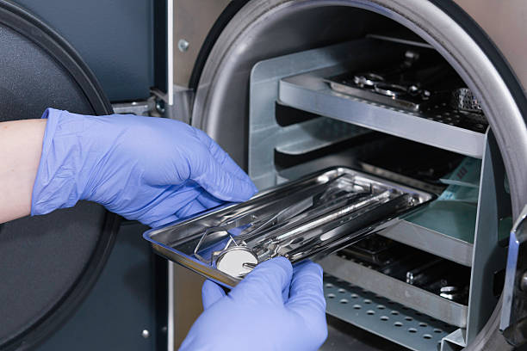
BACKGROUND
Steam autoclaves (Chamberland, 1879) remain the gold standard for sterilising medical devices.
Reliable sterilisation requires 121–134°C steam at 4–6 bar, demanding 3–5 kW of consistent power.
Evacuated tube and parabolic collectors can reach required temperatures but face variability, tracking needs, and soiling issues.
Solar preheating with combustion burners reduces fuel use but adds logistical and maintenance complexity.
Over one billion people rely on off‑grid clinics where diesel generators pose cost, supply, and pollution challenges (WHO, 2020)

Slide 6
MATERIALS AND SYSTEM ARCHITECTURE
Materials used were fiberglass insulation, stainless-steel V-23 casing, and silicone rubber seals used for thermal efficiency, structural integrity, and high-temperature resistance.
Sterilization Core was a Modified autoclave vessel with integrated sensors and PLC control, tested to a maximum working pressure of approximately 5 bar.
Solar-Thermal Subsystem comprised a Concave solar thermal collector designed to provide direct thermal energy for heating.
Solar PV array coupled with LiFePO₄ battery bank and pure sine wave inverter for reliable power supply.
Power Management Unit was an Intelligent PLC-based controller dynamically allocating energy from all subsystems

Slide 7
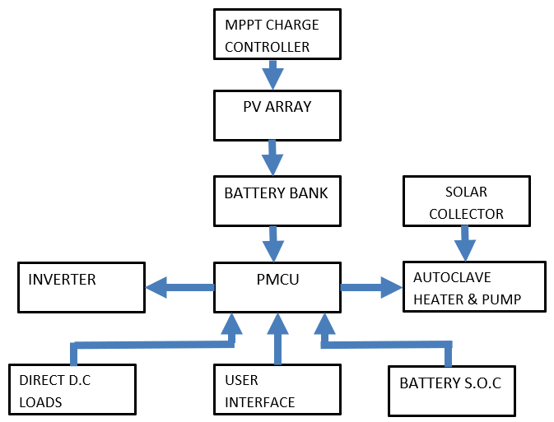
System Overview Diagram
PV ARRAY
MPPT CHARGE CONTROLLER

Slide 8
COMPONENT SPECIFICATION AND INTEGRATION - AUTOCLAVE MODULE
Component Specification and Integration
Modified Autoclave: A 10-litre vacuum-assisted benchtop autoclave was modified with a concave parabolic solar collector (1.5 m² aperture, 20:1 concentration ratio, 45–55% thermal efficiency).
Solar Thermal Integration: Dynamic tilt adjustments enabled solar tracking during peak irradiance hours (10:00–15:00) at approximately 700 W/m² for optimal thermal input.
Biomass Backup: A low-smoke rocket stove was incorporated as a biomass-assisted backup to supplement thermal load during periods of low irradiance or cloud cover.
Control System Upgrades: Early overheating issues led to integration of a thermocouple-based temperature monitor, enhanced heat-resistant control enclosure, and a Siemens S7-1200 PLC managing the system.

Slide 9
RENEWABLE ENERGY SYSTEM SPECIFICATIONS
PV Array: Six 300W monocrystalline silicon panels (total 1.8 kWp) sized to meet daily energy demand of 2.8 kWh per cycle with 4–6 hour recharge time under typical Lusaka solar conditions.
Charge Controller: An 80A MPPT charge controller (Victron SmartSolar 150/70) manages PV input to optimize battery charging efficiency.
Battery Bank: Four 12V, 100Ah LiFePO₄ batteries connected in series (48V nominal, 4.8 kWh usable capacity), providing at least two full sterilization cycles on stored energy.
Battery Chemistry: LiFePO₄ selected for high cycle life, safety profile, and superior performance under partial state-of-charge conditions.
Inverter: A 3 kW pure sine wave inverter (Victron MultiPlus-II) converts 48V DC to 240V AC, ensuring compatibility with the system.

Slide 10
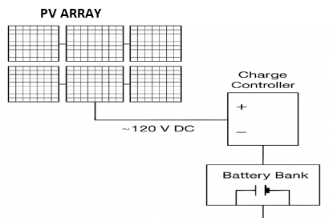
Renewable System Flow Chart

Slide 11
Power Management and Control Unit (PMCU)
Central Intelligence: An Arduino Mega 2560 serves as the system’s central controller, managing energy arbitration, cycle modulation, and data logging functions.
Energy Arbitration: Prioritizes DC power for low-load components (PLC, sensors, valves) and enables the high-load AC inverter only when battery State of Charge exceeds 55%.
Cycle Modulation: In low SoC conditions, the PMCU signals the autoclave PLC to pause heating and maintain a pre-heat state until sufficient solar energy is harvested.
Real-Time Monitoring: Continuously monitors PV parameters, battery SoC, and autoclave process variables (temperature and pressure) for optimized system performance.
User Interface & Logging: A 7-inch touchscreen HMI provides intuitive user control, while an SD card enables comprehensive data logging for analysis.

Slide 12
PERFORMANCE EVALUATION PROTOCOL
Prototype Build: Modular wheeled aluminium frame (1.5 m × 1 m), outdoor‑rated cabling, emergency stops, and fuse protection.
PV Mounting: Separate tilt‑adjustable solar frame for optimisation.
Testing Period: 14‑day evaluation in Lusaka climate.
Sterilisation Trials: Five full cycles with 5 kg instrument load + biological indicators (G. stearothermophilus, 10⁶ spores).
Test Regimes: Optimal sun (>700 W/m²),
simulated intermittency (60% PV drop),
Battery‑only post‑sunset cycles.

Slide 13
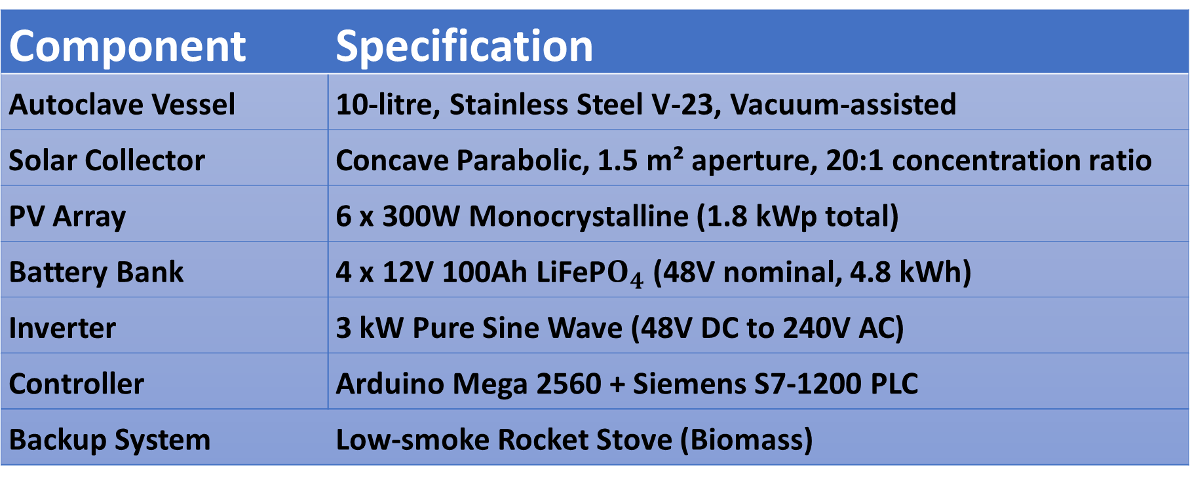
System Component Specifications
Table 1 provides a detailed overview of the key components used in the hybrid renewable energy-powered autoclave system, including their specifications.
Component | Specification
Autoclave Vessel | 10-litre, Stainless Steel V-23, Vacuum-assisted
Solar Collector | Concave Parabolic, 1.5 m² aperture, 20:1 concentration ratio
PV Array | 6 x 300W Monocrystalline (1.8 kWp total)
Battery Bank | 4 x 12V 100Ah LiFeP$O_{4}$ (48V nominal, 4.8 kWh)
Inverter | 3 kW Pure Sine Wave (48V DC to 240V AC)
Controller | Arduino Mega 2560 + Siemens S7-1200 PLC
Backup System | Low-smoke Rocket Stove (Biomass)

Slide 14
System Operational Performance And Thermal Profile
Metric | Regime 1 (Optimal) | Regime 2 (Intermittent) | Regime 3 (Battery-Only)
Mean Heat-up Time (min) | 22 ± 2 | 39 ± 5 | 25 ± 3
Total Cycle Time (min) | 75 ± 3 | 92 ± 7 | 78 ± 4
Energy Consumed (kWh) | 2.8 ± 0.1 | 3.1 ± 0.2 | 2.9 ± 0.1
Final Battery SoC (%) | 88 ± 2 | 72 ± 4 | 52 ± 3

Slide 15
System Operational Performance And Thermal Profile - Continued
Optimal Sun: Reached 121 °C sterilization temperature within 22 minutes
Simulated Intermittency: Dynamic load management extended cycle time to 92 minutes while preserving battery safety
Battery-Priority: All cycles completed successfully using only 4.8 kWh stored energy
Consistent Performance: Holding temperature maintained at ≥121 °C across all regimes

Slide 16
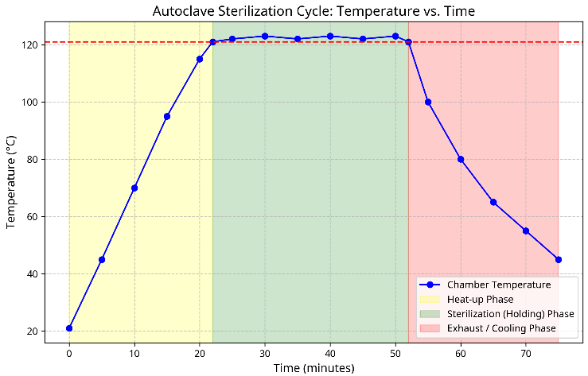

Slide 17
ENERGY SYSTEM RESILIENCE AND COST-BENEFIT ANALYSIS
Sterilization Efficacy: 100% success rate (50/50 biological indicators) with no growth after 7-day incubation
Process verification: Met ISO 17665-1 Class B vacuum cycle requirements; chamber cold spots remained ≥120°C during 30‑minute dwell
System Resilience: Battery state of health maintained; lowest recorded charge was 45% after consecutive night‑time cycles
Cost-Benefit Comparison: Hybrid solar system has higher upfront capital (K85,500) vs. diesel generator (K22,800), a K62,700 incremental investment
Projected Operating Costs: Lower annual operating costs for the solar hybrid system (detailed in Table 3)

Slide 18
Projected preliminary Annual Cost Comparison
Item | Solar Hybrid System (ZMW) | Diesel Generator System (ZMW)
Initial Capital Cost | 85,500 | 22,800
Annual Fuel Cost | 0 | 34,200
Annual Maintenance | 2,260 | 8,550
Annual Biomass material costs | 8,000 | 0
Total Annual OpEx | 10,260 | 42,750
OpEX Cost Reduction | ~76% | Baseline

Slide 19
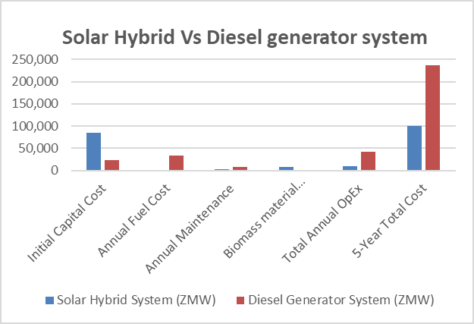

Slide 20
DISCUSSION
Technical Viability: Hybrid renewable energy autoclave prototype is feasible for off-grid healthcare settings
Key Design Factors: Dynamic solar concentrator tracking outperformed fixed-angle operation; biomass backup ensured readiness during low sunlight or high demand
Sterilization Success: System consistently met sterilization standards, verifying core functionality
Effectiveness Limitation: Extended cycle times under intermittent conditions may limit clinical effectiveness during prolonged poor weather
Future Improvements: Adding thermal storage or PV-optimized DC pre-heating could reduce heat-up time by 10–15 minutes and improve overall efficiency

Slide 21
CONCLUSION AND FUTURE WORK
Demonstrated Potential: Successfully translated renewable energy concepts into a functional prototype that delivers standards-compliant sterilization for resource-constrained settings
Future Work – Durability: 12-month field trial at a partner rural clinic in sub-Saharan Africa to assess real-world reliability and user interaction
Future Work – Cost-Benefit: Detailed lifecycle cost comparison against diesel-powered sterilization, including maintenance, fuel, and carbon emissions
Future Work – Commercialization: Refine design for manufacturability, pursue regulatory approval (ZABS, CE/FDA) for the PMCU, and establish local assembly partnerships

Slide 22
REFERENCES
Al-Hrari, M., Al-Salaymeh, A. & Al-Afif, R. (2022) ‘Feasibility analysis of a solar-powered autoclave for rural healthcare centres: a case study in Jordan’, International Journal of Sustainable Energy, 41(3), pp. 234-251.
Alba R., Ilaria G. (2017), Solar-Thermal and Hybrid Photovoltaic-Thermal Systems for enewable Heating
Bhakta, S. & Mukherjee, V. (2017) ‘Potential and economics of hybrid PV-wind-diesel energy system for far-flung area of Rajasthan, India’, International Transactions on Electrical Energy Systems, 27(12), e2429.
Fraise, A.P. (2021) Sterilisation of Medical Devices. 4th edn. Boca Raton: CRC Press.
International Organization for Standardization (2006) *ISO 17665-1:2006 Sterilization of health care products — Moist heat — Part 1: Requirements for the development, validation and routine control of a sterilization process for medical devices*. Geneva: ISO.

Slide 23
REFERENCES (CONTINUED)
International Organization for Standardization (2017) *ISO 11138-1:2017 Sterilization of health care products — Biological indicators — Part 1: General requirements*. Geneva: ISO.
Ituna Yudonago, J. F. (2021) “Review of solar-thermal collectors powered autoclave for the sterilization of medical equipment.” doi: 10.1016/J.AEJ.2021.04.007.
Mustansiriyah University (2017). “Design Build and Test a Device Working by Solar Energy to Desalination and Sterilization and Heating Water” doi: 10.13140/RG.2.2.23601.86884.
World Health Organization (2020) Global report on health care waste management: status, impacts and recommendations. Geneva: WHO.
World Health Organization (2021) WHO guidance for climate-resilient and environmentally sustainable health care facilities. Geneva: WHO.
Zhu, J., Chen, Y., Zhang, L. & Wang, H. (2019) ‘Design and experimental study of a parabolic trough solar autoclave system’, Energy Procedia, 158, pp. 1767-1772.

Slide 24
The End
THANK YOU FOR YOUR ATTENTION.

