Slide 1

Autonomous Sorting and Transport Robot for African Warehouses and Mines
2026 ENGINEERING INSTITUTION OF ZAMBIA SYMPOSIUM
PRESENTER : Aaron Munyanya
DATE : Friday 17th April 2026
Avani Victoria Falls Resort, Livingstone, Zambia

Slide 2
INSTITUTION:
THE UNIVERSITY OF ZAMBIA
SCHOOL OF ENGINEERING
DEPARTMENT OF MECHANICAL ENGINEERING
TEAM MEMBERS:
Group members: Hope Rumbidzai Shabolyo, Kelvin Mushingo
SUPERVISORS:
Supervisors: Mr. Grain M. Munakaampe, Dr. Chizyuka G. Chizyuka

Slide 3
Outline of Presentation
Introduction
Problem Statement
Rationale
Research Aim and Objectives
Literature Review
Methodology
  Progress Made so far
  Proposed Solution
  Estimated Parameters
Work Plan and Timeline
Expected Impact
Conclusion
References
Questions and Discussions

Slide 4
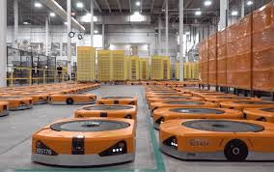
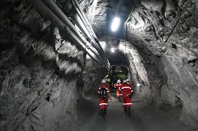
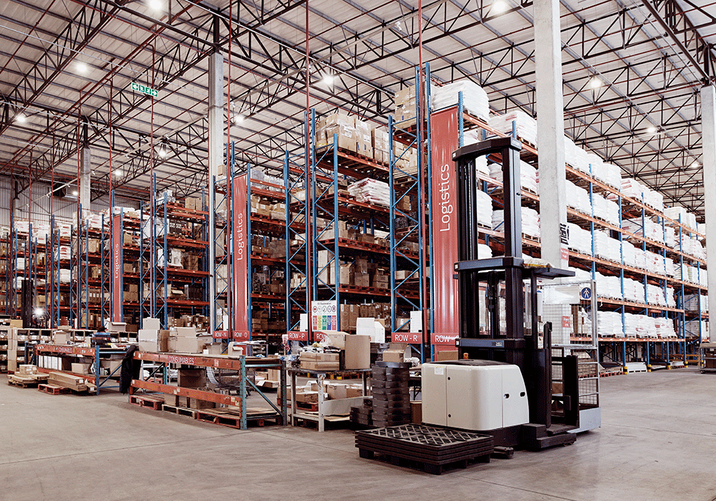
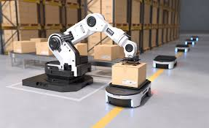
Introduction
Automation is globally reshaping industries for safety and efficiency.
The African Reality: Adoption remains low due to high costs and infrastructure limitation.
Amazon robotics
Robotic Arm packing items
Autonomous robots could be useful in underground operations
South African Warehouse – full integration of robotics is still limited in Africa

Slide 5
Problem Statement
African manufacturing, logistics, and mining sectors offer low global competitiveness due to limited automation
Existing robotic solutions are:
  Too expensive for SMEs
  Designed for advanced industrial environments
  Dependent on high-end infrastructure
Resulting challenges:
  Slow warehouse operations
  Frequent mining accidents
  High labor costs for repetitive and hazardous tasks

Slide 6
Rationale
There is a strong need for a cost-effective, adaptable robotic system that can improve safety while maintaining efficiency.
This project addresses that gap by proposing an affordable autonomous sorting and transport robot, designed specifically for African industrial environments.
The solution aims to enhance safety, enable continuous operation (24/7), and shift human labour to higher-value tasks.

Slide 7
Research Aim
AIM:
To develop a low-cost autonomous robot for sorting and transport in warehouses and mines to improve safety, efficiency, and reduce costs.
Objectives:
Design validated hardware layout for warehouse robot
Implement SLAM navigation and object detection for autonomous sorting and transport
Enable autonomous sorting and material transport using computer vision and machine learning
Build a fully functional warehouse robot integrating all components

Slide 8
Literature Review
Automation improves safety, efficiency, and productivity in warehouses and mining (Bogue, 2018)
Advanced systems rely on expensive sensors and controlled environments, limiting use in Africa (Eke, 2024)
Existing solutions assume ideal conditions, unlike local industrial settings (Adebayo et al., 2023)
Limitations
High costs restrict adoption in SMEs (Luo, et al., 2021)
Poor suitability for irregular layouts, dust, and low infrastructure (Adebayo et al., 2023)
Research Gap
Lack of affordable, adaptable robots for African industries (Mulenga & Kunda, 2021).
Need for systems combining low cost, rugged design, and autonomous operation (Adebayo et al., 2023).
Conclusion
Opportunity to develop a low-cost autonomous sorting and transport robot tailored to African conditions

Slide 9
Methodology
Approach:
1. Mechanical Modelling: SolidWorks CAD software.
2. Electronics: Circuit simulation with Multism.
3. Software: Navigation and Machine Learning algorithm development - Python, C++ and Matlab.

Slide 10
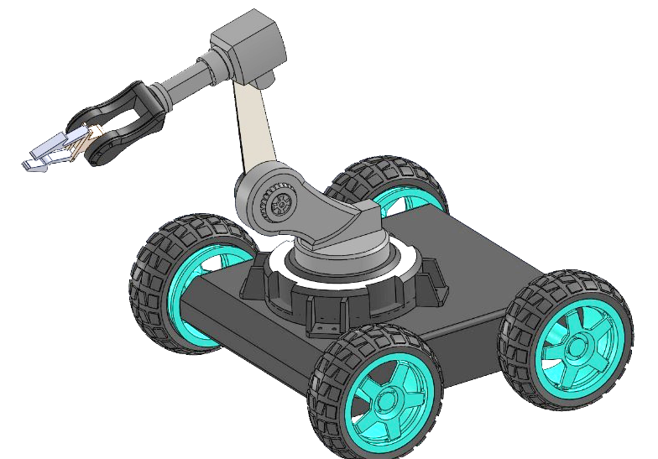
Proposed Solution (WareHouse)
System Overview:
Integration of low-cost sensors
LiDAR-assisted navigation
And Computer Vision
Key Features:
Rugged mobility for uneven terrain
Autonomous decision-making algorithms
Designed for ‘non-ideal’ environments

Slide 11
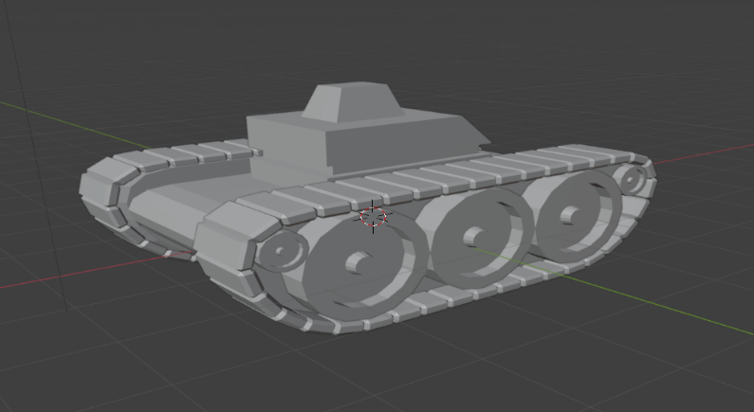
Proposed Locomotion System for Mines
For the rougher terrain of the mine, the robot uses tank tracks for locomotion

Slide 12
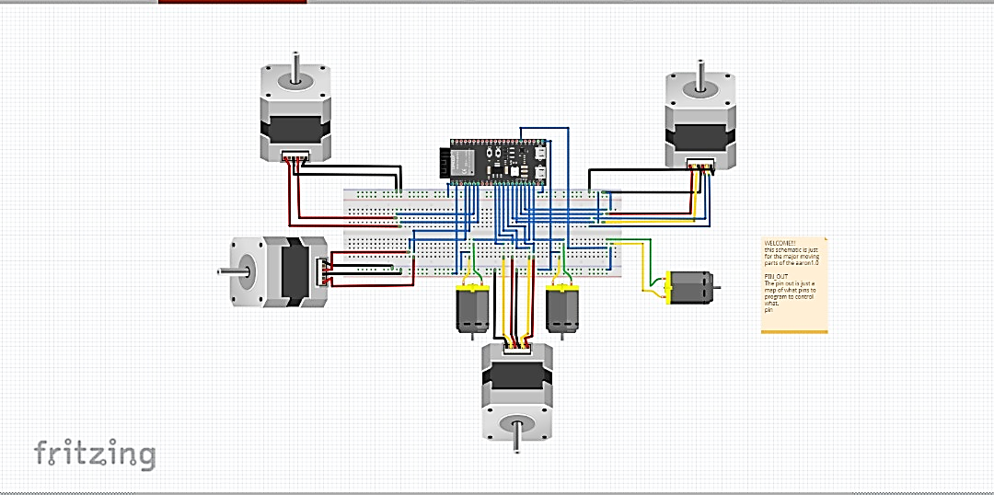
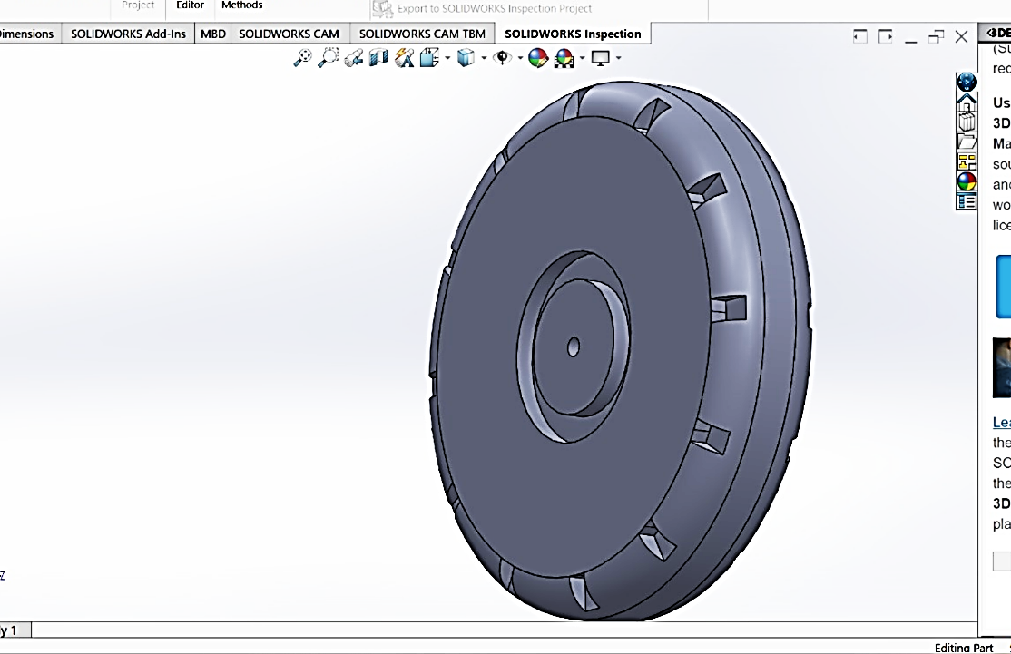
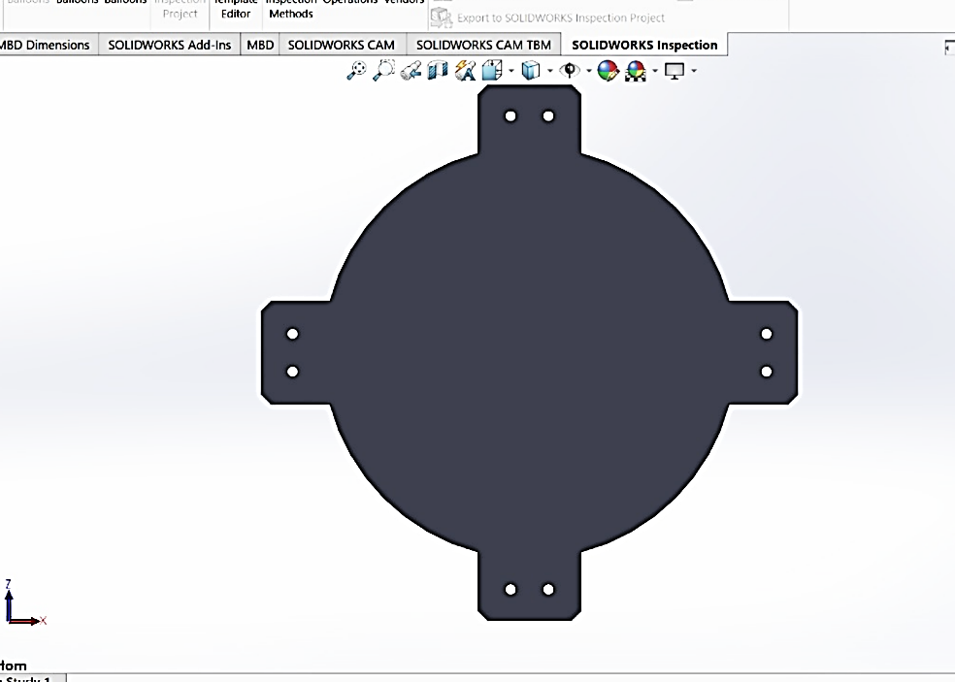
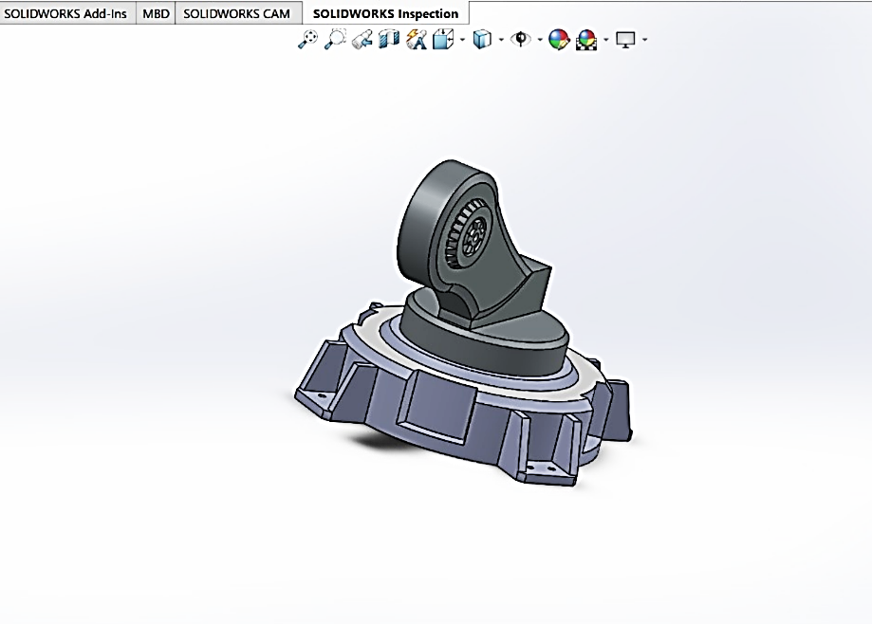
Mechanical Design (SolidWorks)
Robot wheel design in SolidWorks
Circuit layout with Fritzing software
Base of Robotic Arm
This project is currently in the design and simulation phase, focusing on mechanical modelling, electronic circuit simulation, and preliminary development of navigation and machine learning algorithms.
Part of the robotic arm, partially assembled

Slide 13
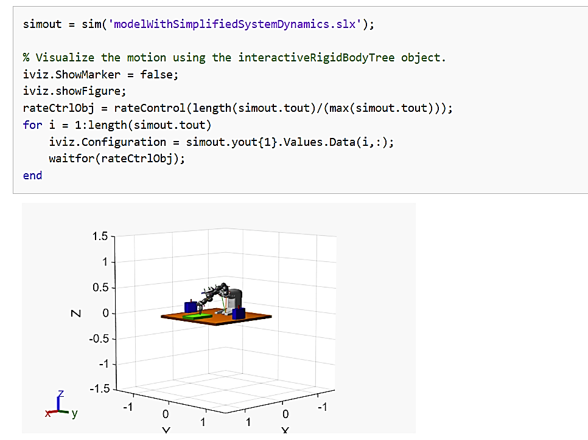
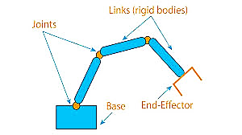
Matlab and Simscape Simulation
This is currently ongoing
The robot is modelled as an arm and a car separately
The goal of the simulations is to find the best angles to turn the motors in order to move in required directions either for navigation or for carrying objects
The robotic arm is thought of as a combination of blocks for simplicity in modelling

Slide 14
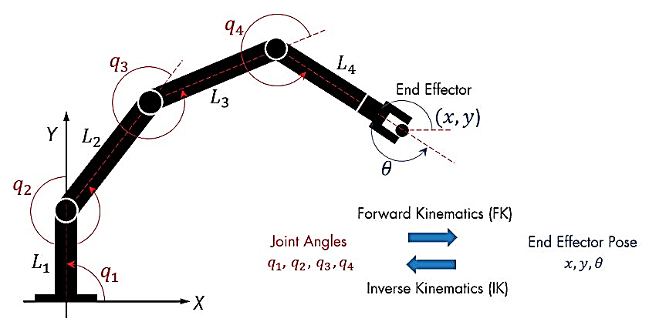
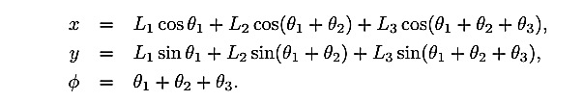
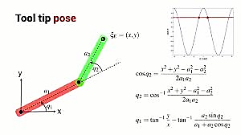
Interaction with Objects
Forward Kinematics equation showing the 2D planner coordinates of the end effector (x, y, phi) in order to move the robotic to a certain location
Inverse Kinematics Determines the angles in advance and then moves the arm by moving the motors to those angles
For Picking and placing things, the robot uses inverse and forward Kinematics to determined the angles the motors must be set to in order to pick up the object from it’s location to the body and then place it at a new location

Slide 15
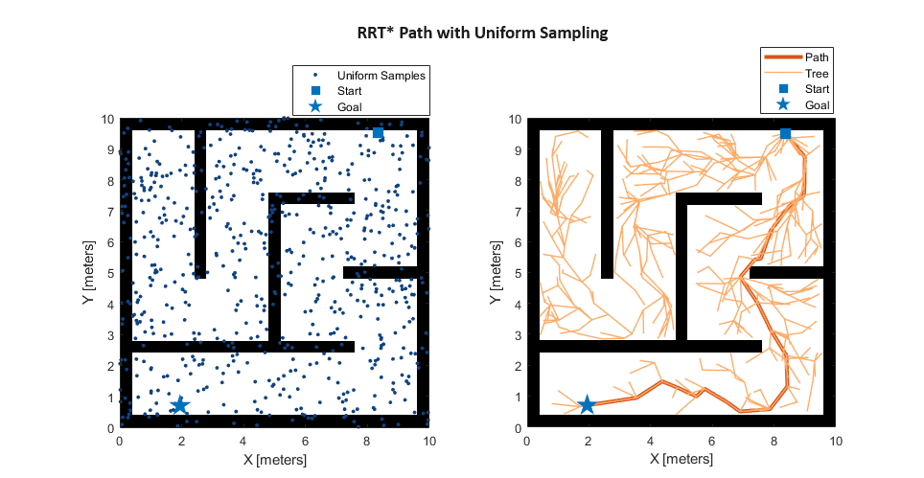
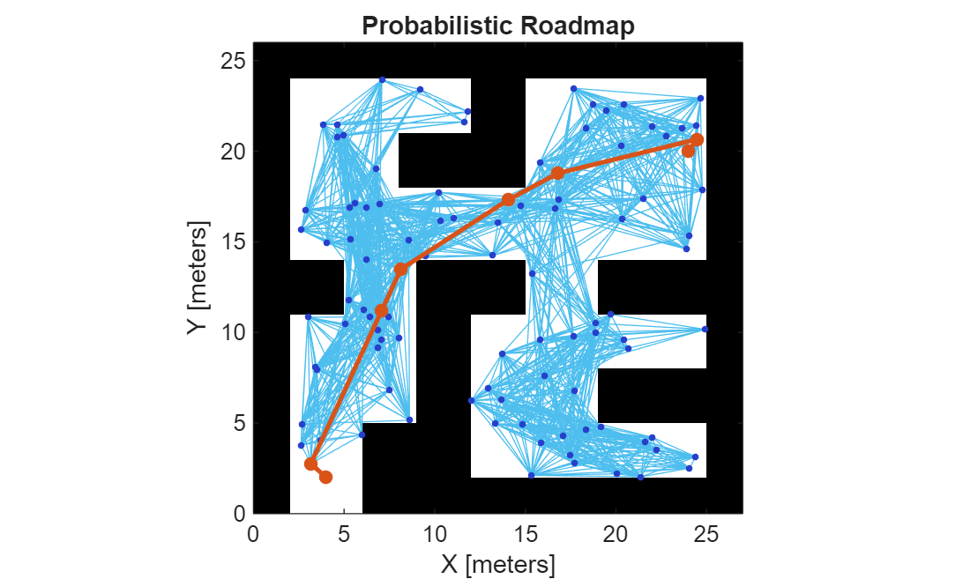
Path Planning
Probabilistic Roadmap - A path planning algorithm that creates a network of randomly sampled, collision-free points. The robot uses this roadmap to find a path from start to goal, making it effective in complex environments.
Random sampling - A technique where points are generated randomly within the environment to explore possible paths. It helps efficiently cover large or complex spaces without checking every possible location.

Slide 16
Approximated Performance Metrics for use in Simulation and Testing
Category | Parameter | Estimated Value | Basis of Estimation | Validation Status
Navigation | Maximum Linear Speed | 0.8 m/s | Motor RPM and wheel radius | To be validated in simulation
 | Navigation Accuracy | ±5 cm | SLAM grid resolution & sensor specs | To be validated
 | Path Deviation Error | < 7% | PID tracking estimation | To be validated
 | Obstacle Detection Range | 0.2 – 4 m | LiDAR manufacturer specification | Component-based estimate
Payload & Manipulation | Maximum Payload | 2.5 kg | Torque analysis with safety margin | Estimate
 | Arm Reach Radius | 25–35 cm | CAD design dimensions | Design-based estimate
Energy Performance | Average Power Consumption | 2.5 KW | Motor + electronics rating | Analytical estimate
 | Battery Runtime | 1.8–2.2 hrs | Energy balance calculation | To be validated
Control Performance | Settling Time | < 2.5 s | PID theoretical response | Simulation pending
 | Overshoot | < 10% | PID tuning projection | Simulation pending
 | Steady-State Error | 0 | Integral control property | Theoretical

Slide 17
Gantt Chart

Slide 18
Expected Impact
No. | Aspect | Impact
I | Safety | Removes humans from hazardous zones.
II | Economic | Reallocates labor to cognitive roles; reduces cost of automation.
III | Productivity | Enables continuous (24/7) operation.
IV | Local Relevance | A solution specifically tailored for African infrastructure constraints.

Slide 19
Conclusion
There is a critical need for context-aware automation in Africa.
Current high-end solutions are not feasible for local SMEs.
The proposed robot offers a viable, low-cost alternative for warehouses and mines.
Facilitates continuous 24/7 industrial operation by deploying autonomous robotic systems to execute repetitive, low-cognitive-load tasks, thereby enhancing productivity and optimizing human resource allocation.

Slide 20
References
Amazon Robotics (2020) How Amazon Robotics changed the landscape of fulfillment.
Bogue, R. (2024) ‘The role of robots in logistics’, Industrial Robot: the international journal of robotics research and application, 51(3), pp. 381–386.
Mur-Artal, R. and Tardós, J.D. (2017) ‘ORB-SLAM2: An Open-Source SLAM System for Monocular, Stereo, and RGB-D Cameras’, IEEE Transactions on Robotics, 33(5), pp. 1255–1262.
Redmon, J. and Farhadi, A. (2018) ‘YOLOv3: An Incremental Improvement’
Bogue, R. (2024) ‘The role of robots in logistics’, Industrial Robot, 51(3), pp. 381–386.
Luo, X., Zhang, H. and Wang, Z. (2021) ‘A literature review of smart warehouse operations management’, Frontiers of Engineering Management, 8(4), pp. 509–525.
Wang, J. et al. (2024) ‘A Low-Cost 3D SLAM System Integration of Autonomous Mobile Robots’, Remote Sensing, 16(11).
Zhen, L. and Li, H. (2021) ‘A literature review of smart warehouse operations management’, Frontiers of Engineering Management, 8(4), pp. 509–525
Kevin M. Lynch and Frank C. Park, Modern Robotics Mechanics, Planning, and Control, Cambridge University Press, May 2017
Nikolaus Correll et all, Introduction to Autonomous Robots: Mechanisms, Sensors, Actuators, and Algorithms, December, 2021
Eke, C. (2024) ‘Robotic Technology Empowerment: Mitigating Youth Migration for Nigerian Prosperity’, International Journal of Environmental and Maritime Technology (IJEMT), 10(3), pp. 83–93.
Adebayo, A., Olatunji, O. and Ogunleye, O. (2023) ‘Robotic Warehouse Management Systems: Adaptability in Developing

Slide 21
The End.
Questions & Discussion

