Slide 1
2026 ENGINEERING INSTITUTION OF ZAMBIA SYMPOSIUM
Application of Artificial Intelligence in Air Traffic Management Systems
PRESENTER: ENG. DANIEL MUSANTU
DATE : Friday 17th April 2026
Avani Victoria Falls Resort, Livingstone, Zambia

Slide 2
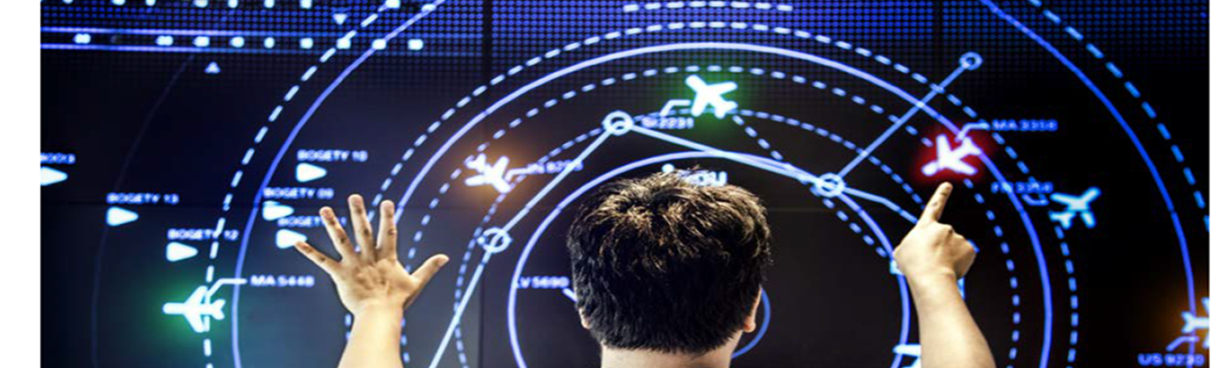

COVERAGE
Introduction
Aim & Objectives
Overview of ATM System
Benefits of AI
Challenges
Recommendation & Conclusion

Slide 3
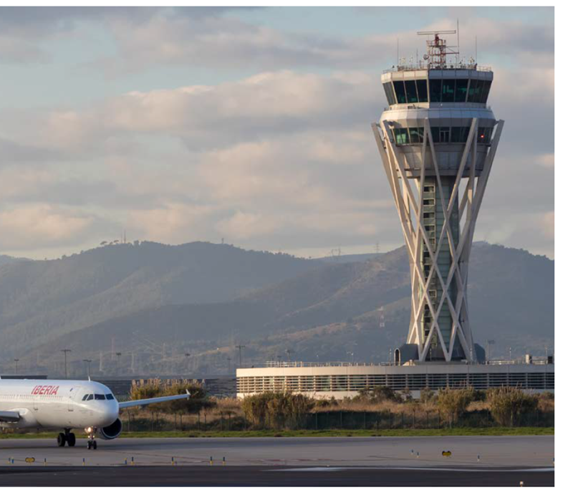
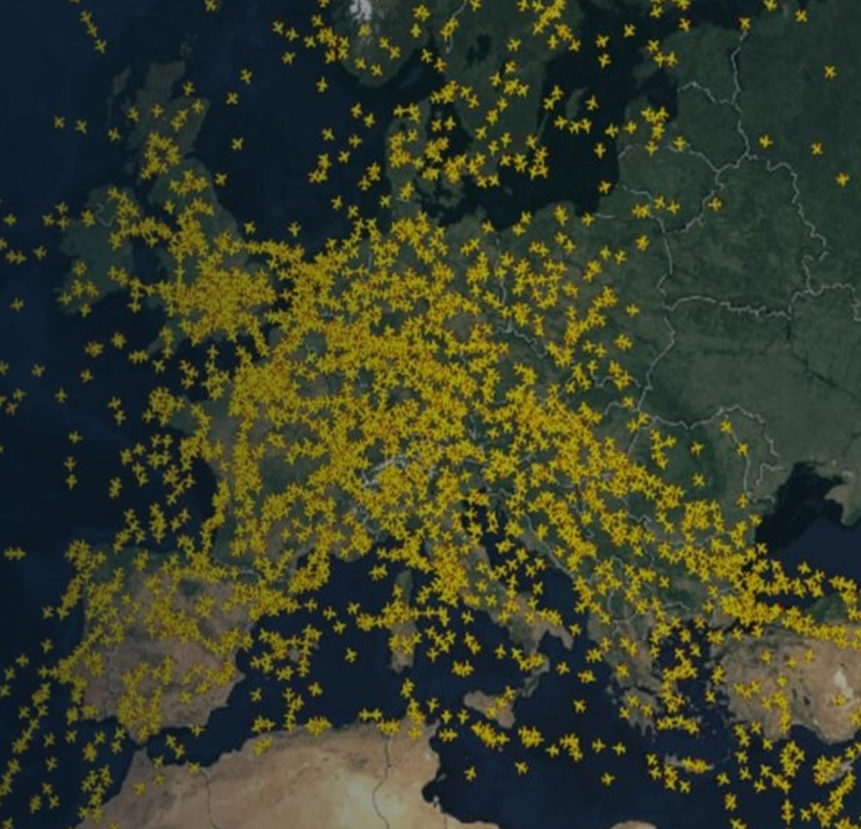
INTRODUCTION
Increasing traffic demand and complex airspace operations require advanced technologies and tools.
To improve operational efficiency and ensure safety

Slide 4
AIM & OBJECTIVES
OBJECTIVES
AIM
To analyze existing AI applications in operational ATC systems
1
To examine the application of Artificial Intelligence in Air Traffic Management systems, explore emerging AI technologies, and evaluate the challenges affecting AI adoption in operational ATM environments.
2
2
To assess the major challenges and constraints affecting AI implementation in ATC environments

Slide 5
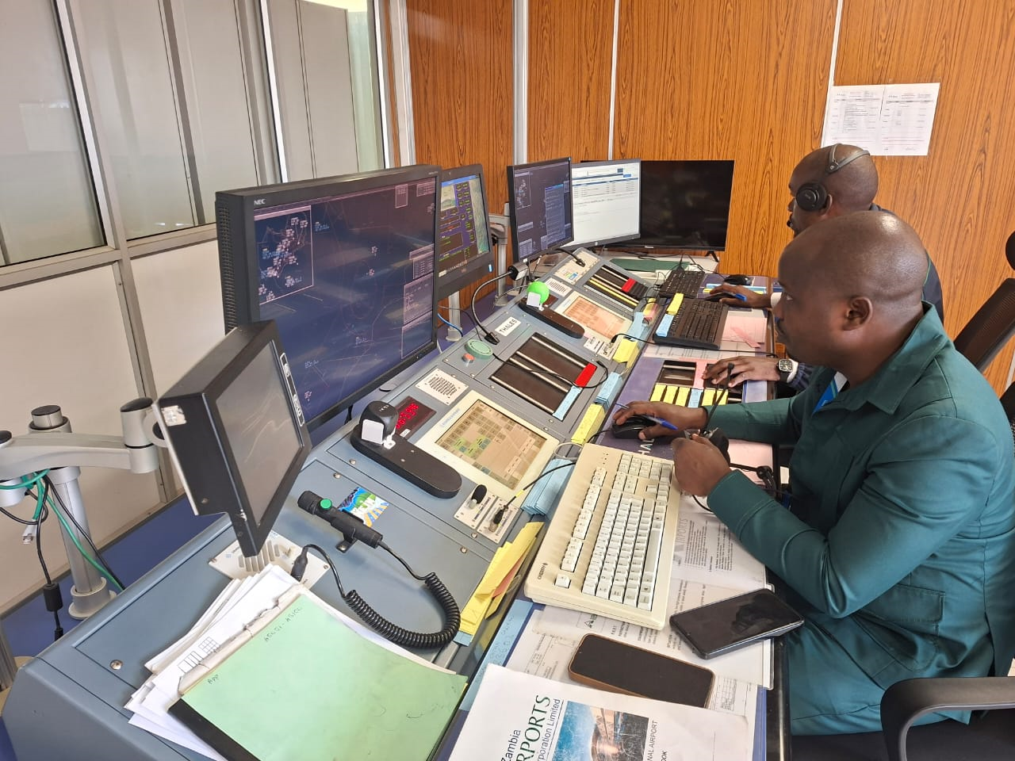
OVERVIEW OF ATM SYSTEM
ATM system is part of air traffic services, air traffic control (ATC) works to keep planes from crashing into one another or obstacles in the sky, and it also helps keep air traffic flow smoothly and safely.
.

Slide 6
OVERVIEW OF ATM SYSTEM cont.
Surveillance
PSR, SSR, MLAT, ADS-B
ATC automation
system
Controller
decisions
Communications
VHF / UHF voice + CPDLC
Fuses surveillance and flight data, builds system tracks, and presents information on radar or tower displays.
Maintain separation, sequence traffic, and manage flow safely.
Flight data & alerts
Plans, tracks, conflict alerts
Why AI helps: it can turn more data into earlier warnings and cleaner recommendations for the controller.

Slide 7
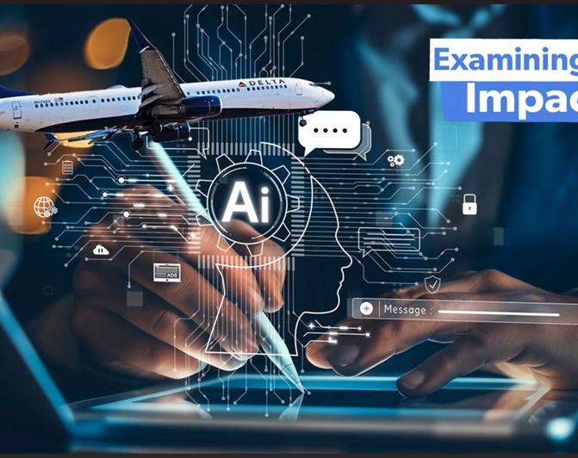

ARTIFICIAL INTELLIGENCE
AI is the subfield of computer science that studies how to make computers act and behave more like the brain.
Its primary function is to adequately resolve problems that conventional computational methods have failed to solve and explain.

Slide 8
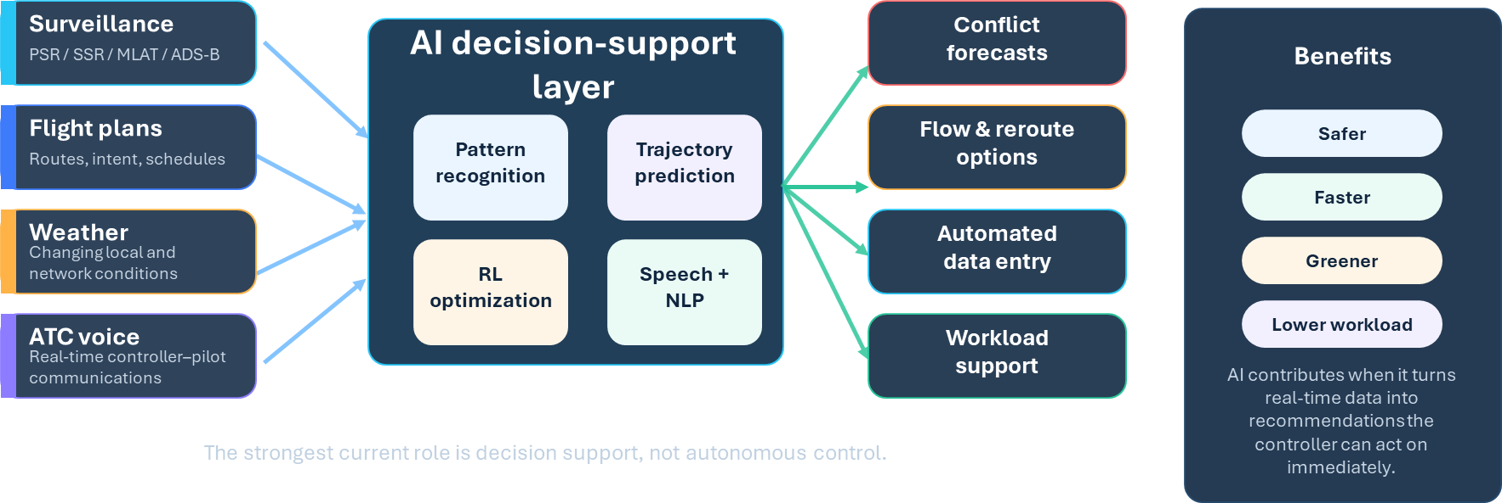
Integration and Benefits of AI in ATM Systems

Slide 9
What Benefits Are Already Visible
S
Safety
C
Capacity
Earlier conflict awareness and risk forecasting strengthen separation support.
Flow optimization helps absorb higher demand with less disruption.
AI as
controller
decision support
E
Efficiency
W
Workload
Smarter routing reduces delays, fuel burn, and emissions.
Speech recognition and automation remove repetitive manual tasks.
Operational value is clearest when AI augments controller judgment rather than trying to remove it.

Slide 10
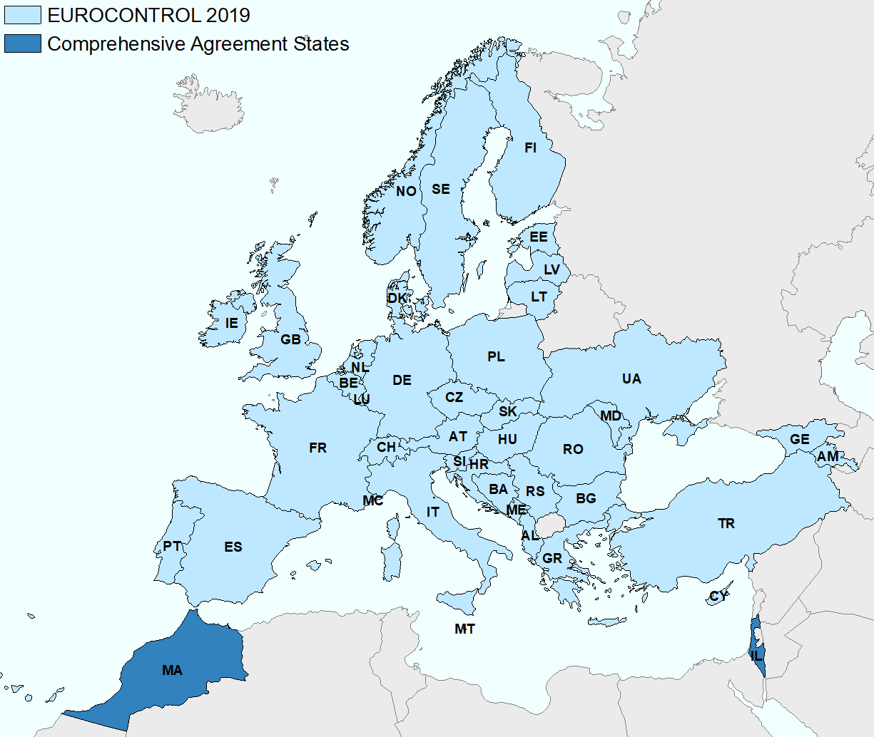
EUROCONTROL Network Manager.
AI-driven strategic flow management uses reinforcement learning to recommend ground delays, reroutes, and flow regulations across the European network.
EUROCONTROL network footprint
41
11.1M
1.57 min
ANSPs in network scope
Flights handled in 2019
Average delay per flight
En-route delays (million minutes)
2018
19.0
2019
17.5
The reported outcome: delay fell despite a higher-traffic network.
8% decline

Slide 11
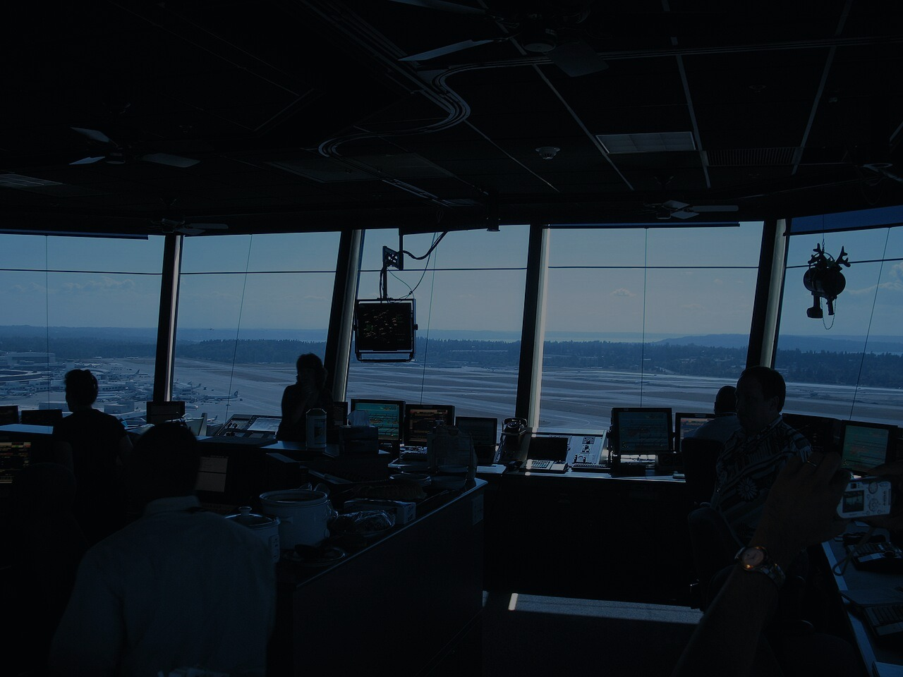
NATS Intelligent Assistant.
Operational AI for real-time ATC speech transcription and high-confidence data-entry support.
Speech-processing flow
Reported performance
50,000 h
< 5%
Domain-specific ATC speech used for training
Word-error rate in reported use
> 98%
99.97%
Confidence threshold before automated entry
Accuracy for validated transactions
ATC speech
Bi-LSTM
acoustic model
Transformer
NLP
Flight-data
update
Real-time radio audio
Recognizes ATC language
Extracts heading, altitude, squawk, frequency
Auto-entry only at high confidence
Operational effect: reduced manual data-entry workload and fewer readback-related errors.

Slide 12
What Slows Adoption?
Why AI in Air Traffic Management
These are deployment barriers and not evidence that AI has no value. They define the conditions under which it must be trusted.
1
Certification & deterministic behavior
2
Cybersecurity
In a safety critical environment, AI must support predictable, explainable, and certifiable behavior not just high average accuracy.
Expanded connectivity, adversarial inputs, and data poisoning risk widen the attack surface for ATM infrastructure.
3
Data quality & legacy integration
4
Human factors & trust
Interpretability, over reliance, situational awareness, and job concerns affect how quickly controllers accept AI tools.
Robust datasets and seamless interoperability with existing ATM systems remain difficult and expensive to achieve.

Slide 13
RECOMMENDATIONS
Why AI in Air Traffic Management
1
Review the certification process and training
2
Strengthen data governance and model monitoring-cybersecurity
3
Modernize legacy interfaces
4
Collaboration with ATC before implementation -trust

Slide 14
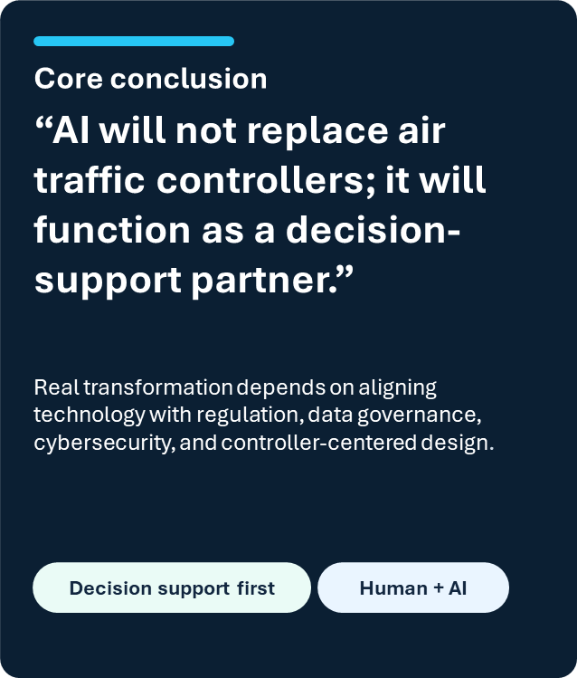
CONCLUSION
Why AI in Air Traffic Management
AI is becoming an important support tool in modern Air Traffic Management.
AI will:
Enhance operational efficiency
Improve safety
Support controllers in complex airspace

Slide 15
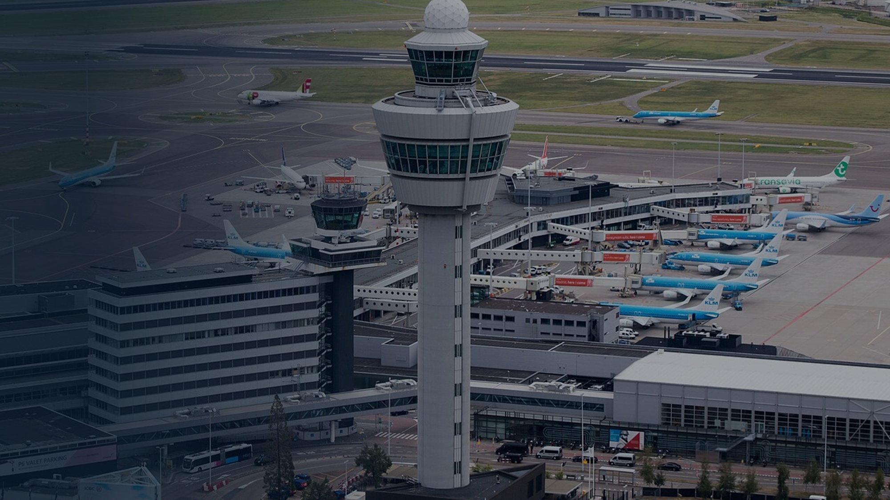
The End
THANK YOU FOR YOUR ATTENTION.

