Slide 1

2026 ENGINEERING INSTITUTION OF ZAMBIA SYMPOSIUM
MACHINE LEARNING ASSISTED CLASSIFICATION OF CFB OPERATING CONDITIONS
PRESENTER : Musango Lungu, D Eng
DATE : Thursday 16TH April 2026
Avani Victoria Falls Resort, Livingstone, Zambia

Slide 2
TABLE OF CONTENTS
Motivation and Background
Research Objective
CFB Experimental Set-up
Methodology
Results and Discussion
Conclusion

Slide 3
MOTIVATION AND BACKGROUND
Fluidization, central to chemical engineering and process industries, involves the study of multiphase flows where solid particles are suspended by a fluid.
Typical applications include Circulating Fluidized Bed Combustion technology (Thermal Power Plants) e.g. Maamba Energy Limited, Copper-Cobalt Sulphating Roasters (Extractive Metallurgy) and Fluid Catalytic Crackers (Petroleum Industry).
Fluidization involves complex multiphase dynamics necessitating the application of CFD and empirical models.
These approaches are however computationally intensive.
On the other hand, Machine learning (ML) enables fast, data-driven insights into fluidization phenomena including regime identification.

Slide 4
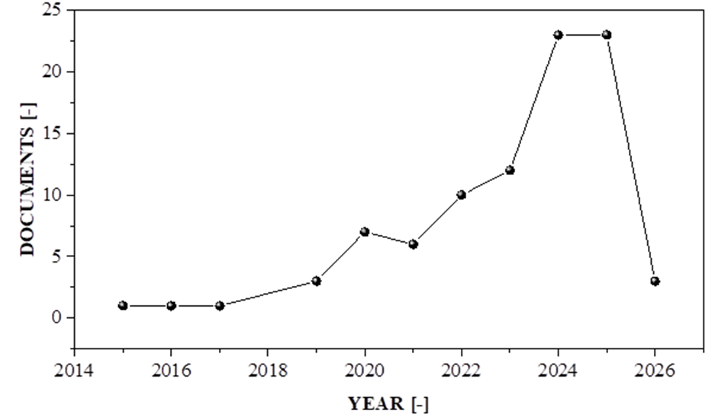
MOTIVATION AND BACKGROUND
It is important to differentiate flow regimes because hydrodynamics, mixing, heat and mass transfer behavior, and reactor performance all vary from regime to regime (Grace et al., 1986)
Fig. 1 shows Number of indexed articles appeared in the last 10 years related to machine learning and Fluidization.
Fig. 1: Publication trends in ML application to Fluidization (Scopus Database)]

Slide 5
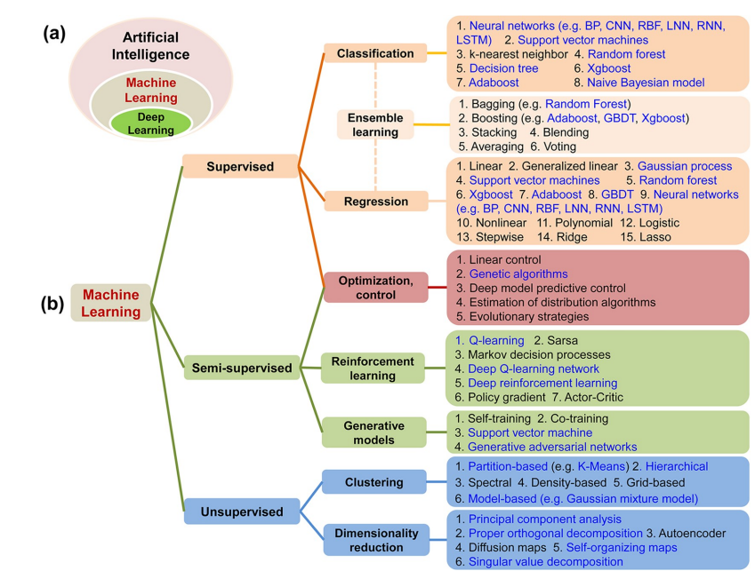
MOTIVATION AND BACKGROUND
There are various ML algorithms as depicted in Fig. 2.
They have been applied to gas–solid systems for predicting different fluidization phenomena.
The
Fig. 2: (a) The relationships among artificial intelligence (AI), machine learning (ML), and deep learning (DL); (b) categorization of ML algorithms (Zhu et al., 2022)

Slide 6
RESEARCH OBJECTIVE
Develop CNN LSTM and CNN-LSTM based classifiers for CFB operating regimes.
Compare Classification with raw pressure signals vs extracted time–frequency features.

Slide 7
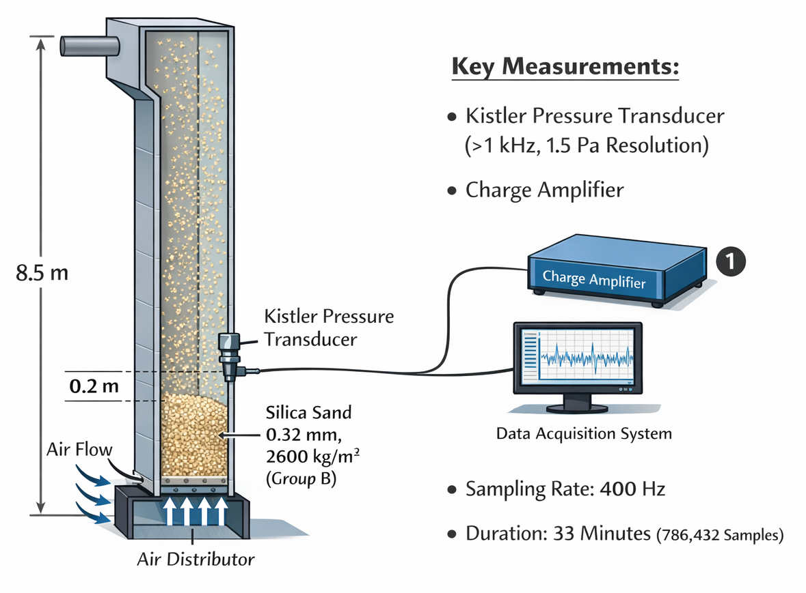
CFB EXPERIMENTAL SETUP
The experiments were conducted in a CFB unit with a riser cross-section of 0.12×0.7m and 8.5m height. The bed material was silica sand with 0.32mm average particle size and 2600kg/m³ density (Group B particles).
Pressure fluctuations were measured 0.2m above the air distributor using a high-precision system: Kistler transducer (>1kHz response, 1.5Pa resolution) connected to a charge amplifier . Data was sampled at 400Hz for 33 minutes (786,432 samples) with virtually no random noise.
17 data sets were obtained covering noncirculating, circulating and transport regimes.
Fig. 3: CFB Experimental set-up.

Slide 8
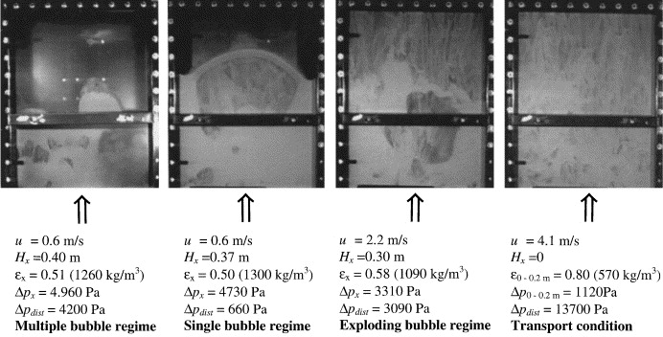
CFB EXPERIMENTAL SETUP
The riser was operated in the multiple, single, exploding and transport regimes as depicted in Fig 4.
The multiple and single bubble regimes are limited to non-circulating conditions (G_{s} ~ 0 kg ms⁻²s⁻¹ ), exploding bubble is classified as circulating
(G_{s} ~ 1 kg ms⁻²s⁻¹) and for transport condition (G_{s} = 25 kg ms⁻²s⁻¹).
Fig. 4: CFB operation under different fluidization regimes. (Johnsson et al., 2000).

Slide 9
METHODOLGY
Development of a machine learning classification model involves the following steps:
(i) Data preparation
Definition of the predictors (input features) and the response (categorical labels to be predicted).
Raw data and time-frequency based features were both used for training and validation of the M.L. models.
For the flow regime classifier , the 17-time series data sets are preprocessed by segmenting each set into smaller subsets of 8192 samples (~ 20 seconds) giving a total of 1632 data subsets.
Of the 17 sets , 9 are Noncirculating, 2 Circulating and 6 Transport.
Corresponding labels i.e. Noncirculating, Circulating and Transport abbreviated as N,C and T are defined.
Training/validation/testing split is 80/10/10.

Slide 10
METHODOLGY
(ii) Model Development and training
We adopted Convolution Neural Networks (CNN), Long Short-Term Memory (LSTM) networks and hybrid of the two i.e. CNN-LSTM
CNN Architecture
Input layer (time series) - 1D vector of pressure readings over a fixed time window.
Layer 1 (1D Conv + ReLu) - Multiple filters slide across the time axis to detect local patterns (e.g., pressure spikes or steady states).
Layer 2 (Max Pooling) - Reduces the sequence length to keep only the most prominent features and lower computational cost.
Layer 3 (1D Conv + ReLu) - Learns more complex, high-level temporal relationships.
Layer 4 (Global Average Pooling) - Condenses the feature maps into a single vector, providing a global summary of the signal.

Slide 11
METHODOLGY
Layer 5 (Fully Connected (Dense)) - Maps the extracted features to the three specific output categories.
Output (SoftMax (3 Nodes)) - Produces probabilities for: Noncirculating, Circulating, and Transport.
1D Convolutional Layers: Unlike standard 2D CNNs used for images, these filters move in only one direction—along the time axis.
Feature Extraction: The early layers automatically identify "short-term" signatures (like turbulence or static pressure), while deeper layers capture the "long-term" behavior of the entire cycle.
Classification Layer: The final Dense layer uses a Softmax activation to ensure the sum of all three category probabilities equals 1.0.

Slide 12
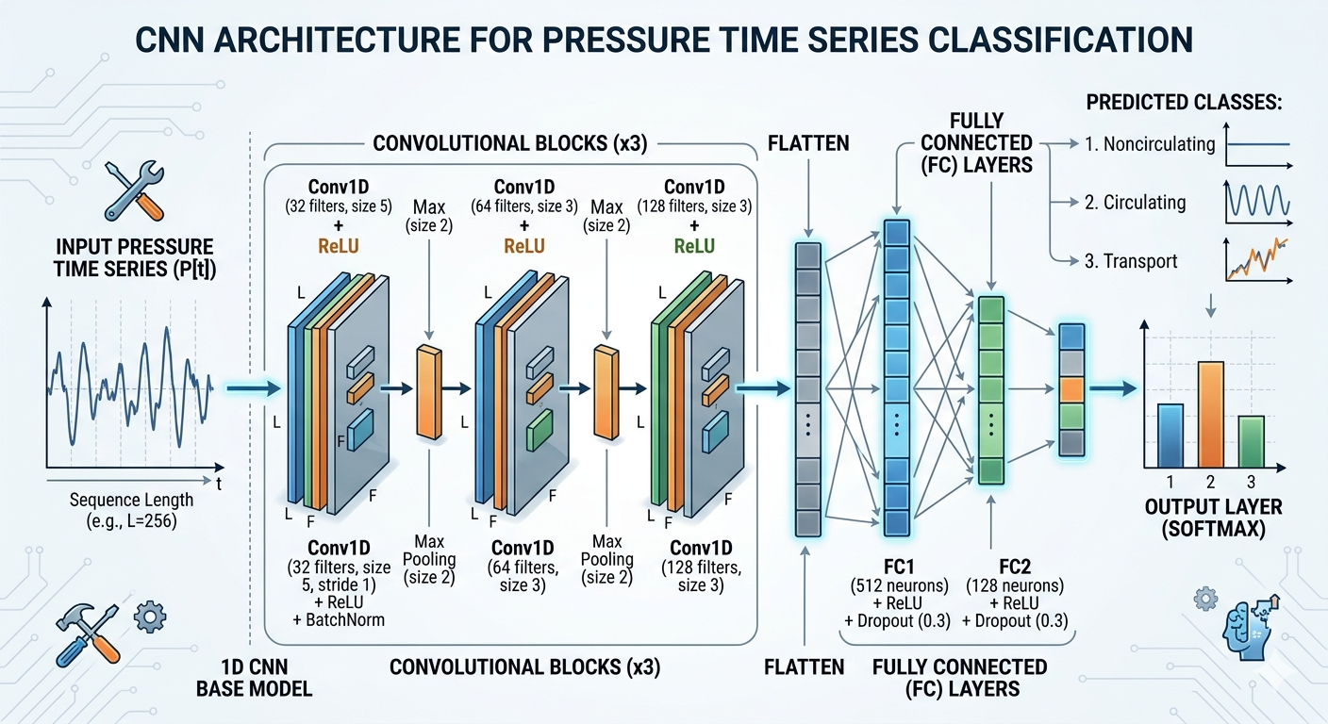
METHODOLOGY
Fig 5. CNN Classifier Architecture.

Slide 13
METHODOLGY
LSTM Architecture
Input layer – raw pressure time series data or feature engineered data.
LSTM layer 1 and layer 2 - these "stacked" layers contain multiple neurons that sequentially process the input vectors to find complex temporal patterns.
Each LSTM unit, has four components that control the cell state (c_{t}) and hidden state (h_{t}):
Forget Gate (f): Decides what information to discard from the cell state.
Input Gate (i): Controls which new information updates the cell state.
Cell Candidate (g): Adds new information to the cell state.
Output Gate (o): Determines the next hidden state based on the current cell state.
Dropout Layer - temporarily disables a set of random neurons during training to prevent overfitting (over-learning specific training data).

Slide 14
METHODOLGY
Features Extracted (Fully Connected Layer) - a dense layer that converts the outputs of the LSTM layers into a final vector of learned features, which are then passed to the classifier.
Classification Output Layer - The extracted feature vector is passed through a Softmax function, which converts the values into probability scores for each class. The final classification based on the highest probability.

Slide 15
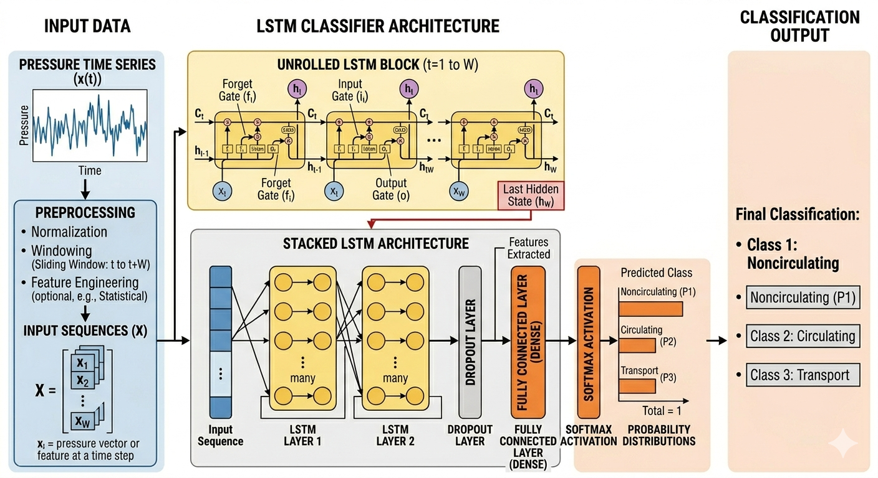
METHODOLGY
g
Fig 6: Typical LSTM Classifier Architecture.

Slide 16
METHODOLGY
Hybrid CNN-LSTM architecture
CNN Layers - Act as a feature extractor. They use convolutional and pooling layers to identify local patterns or spatial structures in the raw input.
Flattening/Reshaping: The multi-dimensional output from the CNN is flattened into a 1D vector to be compatible with the sequential requirements of the next stage.
LSTM Layers: Use memory cells and gating mechanisms (input, forget, and output gates) to process the extracted features over time, capturing long-term relationships and trends.
Dropout Layer - temporarily disables a set of random neurons during training to prevent overfitting (over-learning specific training data).
Dense Output Layer: Final fully connected layers translate the high-level features into a final classification result

Slide 17
METHODOLGY
Table 1:Model hyperparameter settings
Neural Network | Mode | Number of convolutional kernels | Convolutional kernel size | Number of neurons in LSTM layer
CNN | CNN-I | 32 | 5 | -
 | CNN -II | 32-64 |  | -
 | CNN - III | 32-64-128 |  | -
LSTM | LSTM-I | - |  | 32
 | LSTM-II | - |  | 64-32
CNN-LSTM | CNN-LSTM I | 32 | 5 | 32
 | CNN-LSTM II | 32 |  | 64-32
 | CNN- LSTM III | 32-64 |  | 32
 | CNN -LSTM IV | 32-64 |  | 64-32
 | CNN-LSTM V | 32-64-128 |  | 32
 | CNN-LSTM VI | 32-64-128 |  | 64-32

Slide 18
METHODOLGY
Table 2:Hyperparameter settings for neural networks
Neural Network | Learning rate | Padding | Stride | Epoch | Batch size | optimizer | Loss Function | Early Stopping
CNN | 0.001 | SAME | 1 | 150 | 256 | Adam | Cross- Entropy | False
LSTM | 0.001 | SAME | - | 50 | 256 | Adam | Cross-Entropy | False
CNN - LSTM | 0.001 | SAME | 1 | 150 | 256 | Adam | Cross-Entropy | False

Slide 19
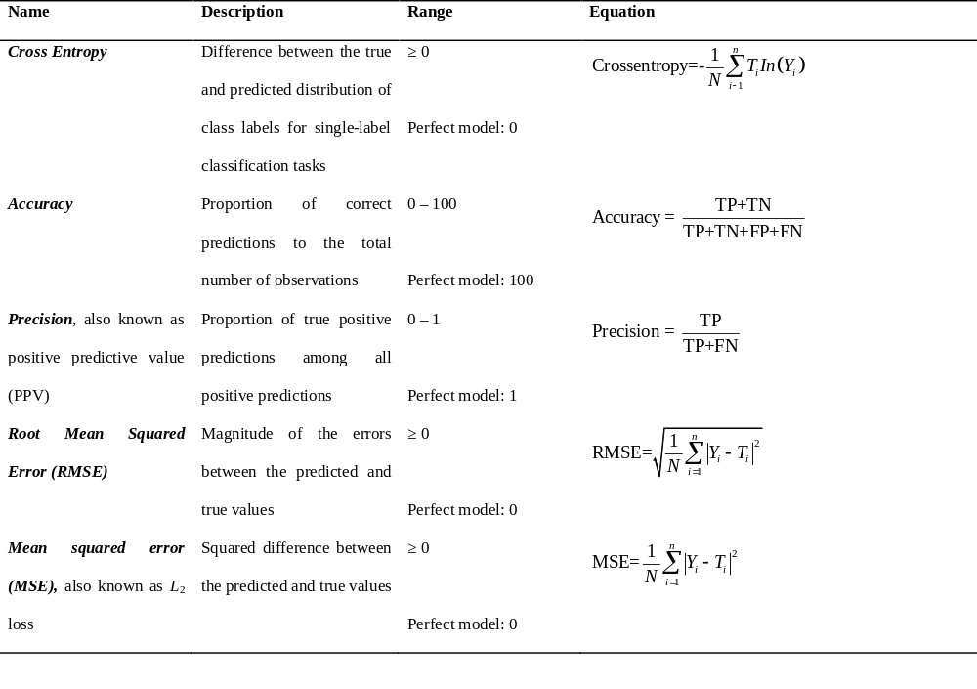
METHODOLGY
Table 3:Machine Learning Model Performance Metrics

Slide 20
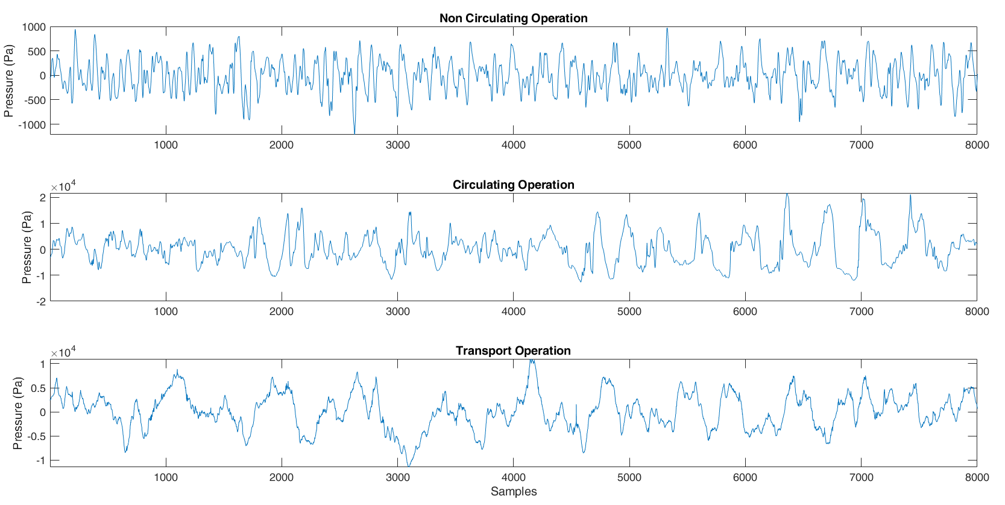
RESULTS AND DISCUSSION
Fig. 7 displays typical raw signals for the three operating conditions and a visual inspection shows qualitative differences vis-à-vis relevant time scales.
Fig. 7: Typical pressure fluctuation signals for noncirculating, circulating and transport operating conditions.

Slide 21
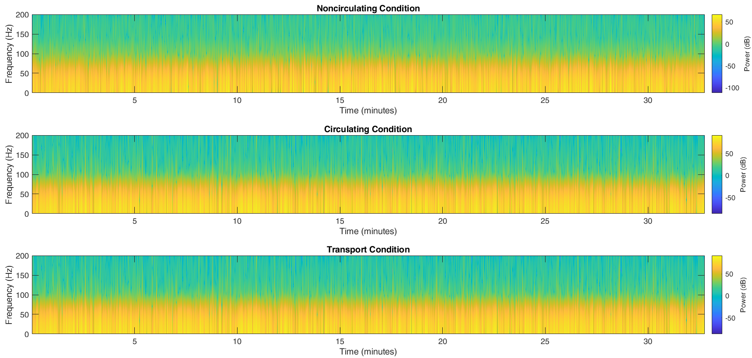
RESULTS AND DISCUSSION
Fig. 8 shows spectrogram derived from Short Time Fourier Transform (STFT).
Instantaneous Frequency and the Spectral Entropy are the two features extracted from the spectrogram used for second round training.
Fig. 8: Typical Spectrogram for the three CFB operating conditions.

Slide 22
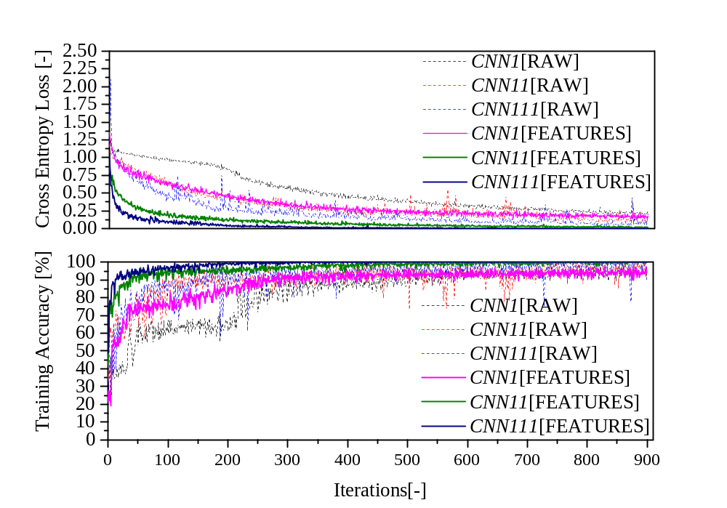
RESULTS AND DISCUSSION
Fig. 9 displays Cross Entropy Loss and Training accuracy for different CNN architectures with and without features.
Faster convergence and higher accuracy observed for training with features.

Slide 23
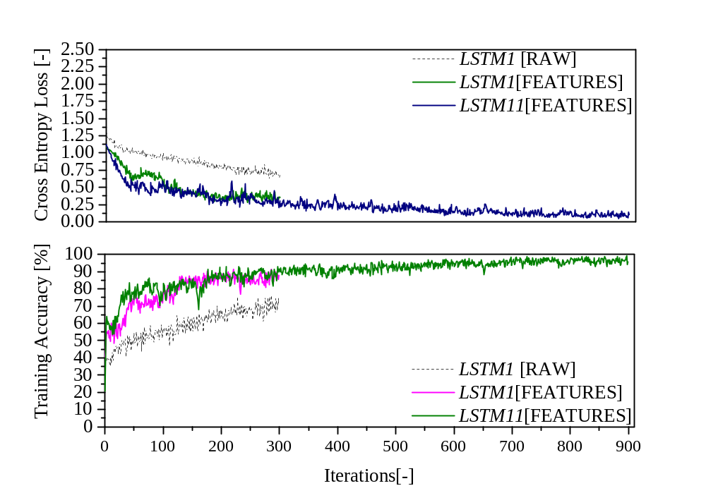
RESULTS AND DISCUSSION
Fig. 10 displays Cross Entropy Loss and Training accuracy for the two LSTM architectures with and without features.
Training of the LSTM11 model with raw data was unsuccessful due to out of memory error.
Faster convergence and higher accuracy observed for training with features is again seen.

Slide 24
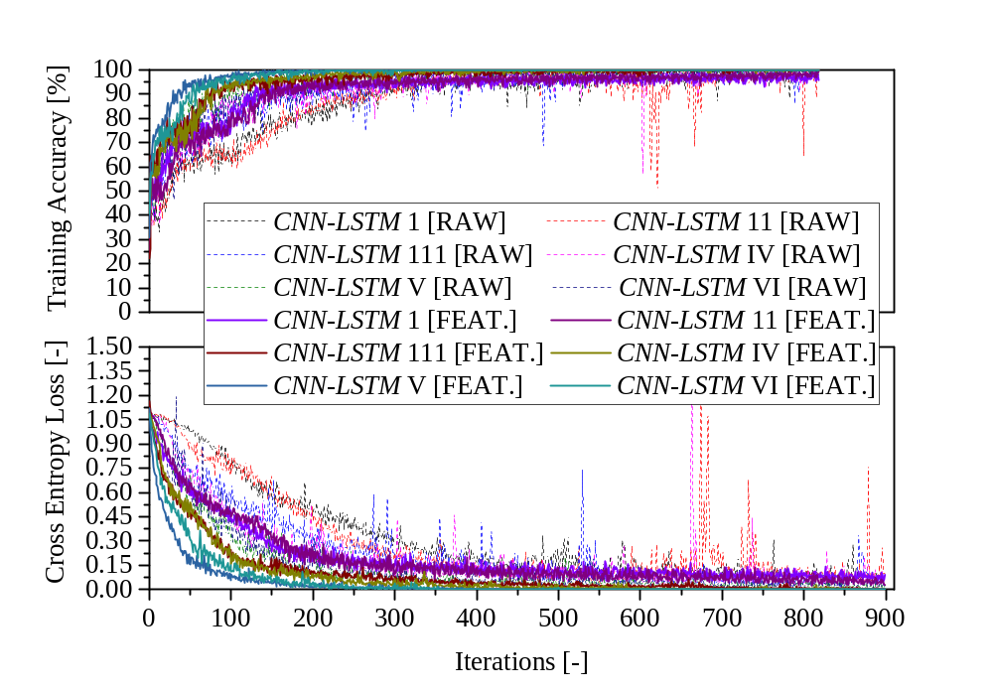
RESULTS AND DISCUSSION
Fig. 11 displays Cross Entropy Loss and Training accuracy for the two CNN-LSTM models.
Hybrid CNN-LSTMs generally outperform standalone CNNs or LSTMs.

Slide 25
RESULTS AND DISCUSSION
Table 4:Comparison of model performance for different modes with unstructured data
Neural Network | Mode | Training Accuracy | Testing Accuracy | Precision | RMSE | MSE
CNN | CNN-I | 95.19 | 98.77 | 0.7861 | 0.2962 | 0.0960
 | CNN-II | 97.40 | 98.77 | 0.9073 | 0.2264 | 0.0572
 | CNN-III | 99.77 | 99.39 | 0.9278 | 0.1894 | 0.0429
LSTM | LSTM-I | 74.77 | 76.69 | 0.5707 | 0.4154 | 0.1737
 | LSTM-II | - | - | - | - | -
CNN-LSTM | CNN-LSTM I | 99.15 | 99.39 | 0.8574 | 0.2202 | 0.0600
 | CNN-LSTM II | 98.36 | 98.77 | 0.8493 | 0.2133 | 0.0575
 | CNN-LSTM III | 98.76 | 98.77 | 0.9143 | 0.1781 | 0.0422
 | CNN-LSTM IV | 98.98 | 98.16 | 0.9131 | 0.1731 | 0.0388
 | CNN -LSTM V | 97.62 | 98.77 | 0.9508 | 0.1248 | 0.0241
 | CNN-LSTM VI | 97.00 | 98.77 | 0.9354 | 0.1372 | 0.0281

Slide 26
RESULTS AND DISCUSSION
Table 5:Comparison of model performance for different modes with structured data
Neural Network | Mode | Training Accuracy | Testing Accuracy | Precision | RMSE | MSE
CNN | CNN-I | 94.46 | 95.09 | 0.8772 | 0.2385 | 0.0617
 | CNN-II | 99.77 | 98.16 | 0.9706 | 0.1102 | 0.0161
 | CNN-III | 100.00 | 97.55 | 0.9882 | 0.0507 | 0.0063
LSTM | LSTM-I | 85.75 | 83.44 | 0.7721 | 0.3115 | 0.1007
 | LSTM-II | 97.62 | 94.48 | 0.2113 | 0.0496 | 0.8963
CNN-LSTM | CNN-LSTM I | 96.55 | 96.93 | 0.9077 | 0.1806 | 0.0383
 | CNN-LSTM II | 97.85 | 96.93 | 0.9086 | 0.1744 | 0.0379
 | CNN-LSTM III | 99.10 | 97.55 | 0.9593 | 0.1036 | 0.0188
 | CNN-LSTM IV | 99.55 | 97.55 | 0.9617 | 0.0858 | 0.0167
 | CNN -LSTM V | 100.00 | 98.77 | 0.9838 | 0.0433 | 0.0075
 | CNN-LSTM VI | 100 | 100 | 0.9768 | 0.0512 | 0.0105

Slide 27
RESULTS AND DISCUSSION
Table 6:Comparison of computational time for training
Neural Network | Mode | Training Duration
 |  | raw data | features
CNN | CNN-I | 42.85 min | 3.85 min
 | CNN-II | 4.21 h | 6.57 min
 | CNN-III | 13.73 h | 42.1 min
LSTM | LSTM-I | 15.08 h | 5.78 min
 | LSTM-II | - | 28.9 min
CNN-LSTM | CNN-LSTM I | 53.48 min | 2.1 min
 | CNN-LSTM II | 51.25 min | 4.88 min
 | CNN-LSTM III | 4.13 h | 16.77 min
 | CNN-LSTM IV | 3.93 h | 6.28 min
 | CNN -LSTM V | 14.71 h | 36.62 min
 | CNN-LSTM VI | 14.16 h | 39.47 min

Slide 28
RESULTS AND DISCUSSION
Following observations are made from the tabulated results:
For standalone NN, CNNs outperform LSTMs generally for structured and unstructured data for the case considered here and less demanding computationally.
This is expected as LSTMs are trained to learn long term dependencies requiring more computational effort as opposed to CNNs which capture local spatial features occurring at shorter time scales.
Synergetic effects of combined CNN and LSTM networks yields better trained models which are also computationally less demanding as opposed to individual neural networks.
This is consistent with other works i.e. (Dianyu et al., 2026) on predictive modelling of hydro cyclones, (Oh et al., 2018) on automated diagnosis of arrhythmia and (Kim and Cho, 2019) on residential energy consumption.

Slide 29
CONCLUSIONS
Deep learning CNN , LSTM and hybrid CNN-LSTM models were developed and successfully applied for classification of CFB operating conditions.
Comparison of the three models shows that hybrid CNN-LSTM perform better than stand alone CNN or LSTM in terms of performance and computational efficiency.
It was also demonstrated that training machine learning models using structured data ( features) significantly reduced the training time whilst giving reasonably good accuracy as compared to using unstructured ( raw data).
This is due to the reduced data dimensionality with structured data.
Machine Learning assisted classification is promising for real-time industrial CFB monitoring.
Future works will consider integration with online sensors in industrial setups.

Slide 30
REFERENCES
E, D., Zhang, Y., Hu, H., Xu, G., Liu, L., Cui, J., Tan, C., Zou, R., Kuang, S., 2026. CFD data-driven CNN-LSTM for fast prediction of instantaneous flow characteristics in hydro cyclones. Minerals Engineering 235, 109814
Grace, J.R., 1986. Contacting modes and behavior classification of gas—solid and other two‐phase suspensions. Can J Chem Eng 64, 353–363.
Johnsson, F., Zijerveld, R.C., Schouten, J.C., Leckner, B., 2000. Characterization of Fluidization regimes by time-series analysis of pressure Fluctuations. International Journal of Multiphase Flow 26, 663–715.
Kim, T.-Y., Cho, S.-B., 2019. Predicting residential energy consumption using CNN-LSTM neural networks. Energy 182, 72–81.
Oh, S.L., Ng, E.Y.K., Tan, R.S., Acharya, U.R., 2018. Automated diagnosis of arrhythmia using combination of CNN and LSTM techniques with variable length heart beats. Computers in Biology and Medicine 102, 278–287.
Zhu, L.-T., Chen, X.-Z., Ouyang, B., Yan, W.-C., Lei, H., Chen, Z., Luo, Z.-H., 2022. Review of Machine Learning for Hydrodynamics, Transport, and Reactions in Multiphase Flows and Reactors. Ind. Eng. Chem. Res. 61, 9901–9949.

Slide 31
The End
THANK YOU FOR YOUR ATTENTION.

